Slide 1
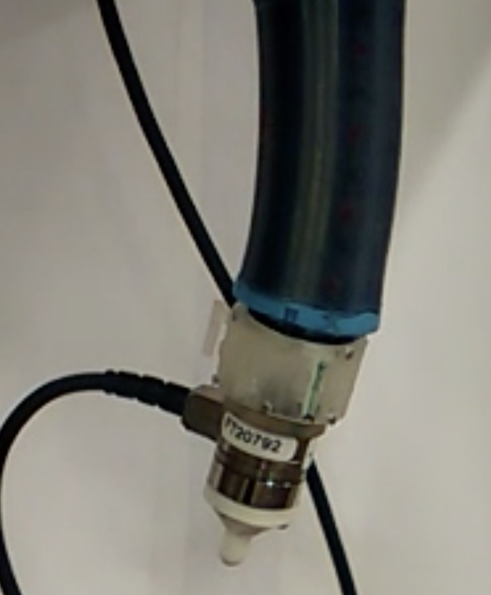
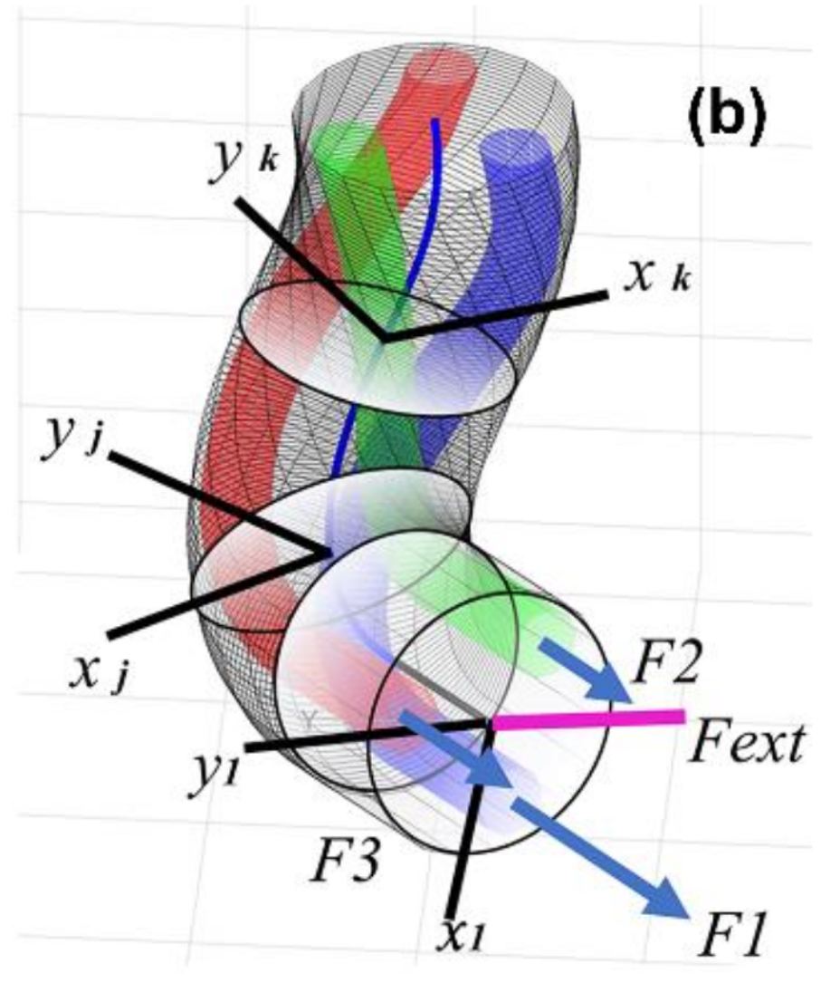
Sadati, S. H., Shiva, A., Herzig, N., Rucker, C. D., Hauser, H., Walker, I. D., ... & Nanayakkara, T. (2020). Stiffness Imaging With a Continuum Appendage: Real-Time Shape and Tip Force Estimation From Base Load Readings. IEEE Robotics and Automation Letters, 5(2), 2824-2831.

