Slide 1
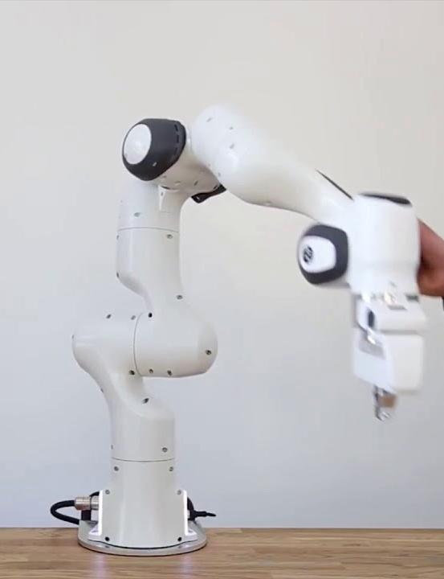



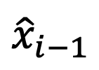


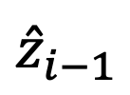

$${\hat{x}}_{i−1}$$
$$θ_{i}$$
$$d_{i}$$
$$α_{i}$$
$${\hat{z}}_{i}$$
$$a_{i}$$
$${\hat{x}}_{i}$$
$${\hat{z}}_{i−1}$$

