Slide 1
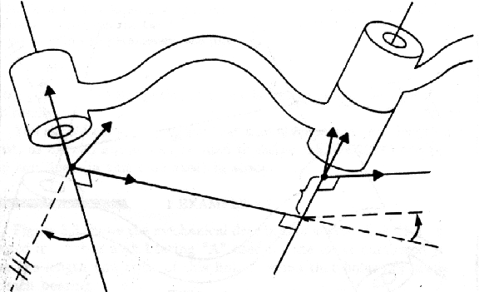










Axis i-1
Axis i
Link i-1
Link i
$${\hat{z}}_{i−1}$$
$${\hat{y}}_{i}$$
$${\hat{y}}_{i−1}$$
$${\hat{z}}_{i}$$
$${\hat{x}}_{i}$$
$$a_{i−1}$$
$$d_{i}$$
$${\hat{x}}_{i−1}$$
$$θ_{i}$$
$$α_{i−1}$$

