Slide 1
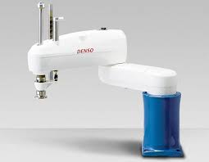
Industrial Scara robot
Top view

