Slide 1
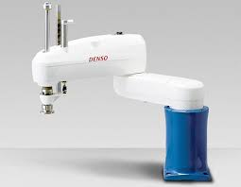













Industrial Scara robot
$$z_{2}$$
$$z_{3}$$
$$θ_{2}$$
$$z_{0},z_{1}$$
$$l_{2}$$
$$d_{2}$$
$$x_{1}$$
$$x_{2}$$
$$l_{1}$$
$$x_{3}$$
$$o$$
$$θ_{1}$$
$$x_{0}$$

