Slide 1
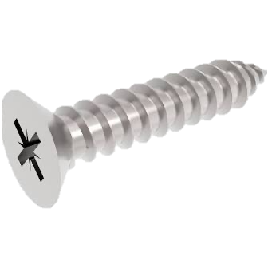
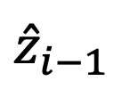



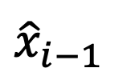


$${\hat{x}}_{i−1}$$
$$O_{int}$$
$$α_{i}$$
$${\hat{z}}_{i}$$
$$a_{i}$$
$${\hat{z}}_{i−1}$$
$$O_{i−1}$$

