Slide 1
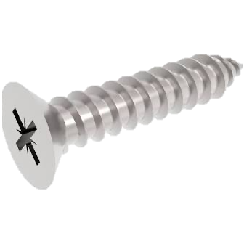





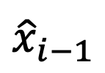

$${\hat{x}}_{i−1}$$
$$O_{int}$$
$$d_{i}$$
Rotation
$$θ_{i}$$
$$O_{i}$$
$${\hat{z}}_{i}$$
Displacement
$${\hat{x}}_{i}$$

