Slide 1
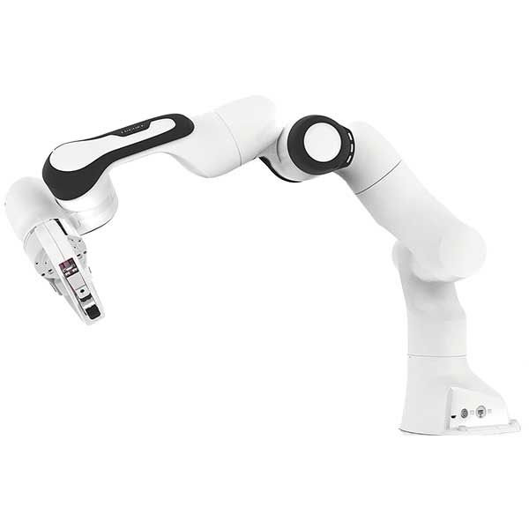














$$v=\left[\begin{matrix}J_{1} & J_{2} & J_{3}\end{matrix} ⋯ \begin{matrix}J_{n−1} & J_{n}\end{matrix}\right]\left[\begin{aligned}\begin{matrix}{\dot{θ}}_{1} \\ {\dot{θ}}_{2} \\ {\dot{θ}}_{3}\end{matrix} \\ ⋮ \\ {\dot{θ}}_{n−1} \\ {\dot{θ}}_{n}\end{aligned}\right]$$
$$v=J \dot{θ}$$
$$J_{3} {\dot{θ}}_{3}$$
$$J_{2} {\dot{θ}}_{2}$$
$$J_{1} {\dot{θ}}_{1}$$
$$J_{n−1} {\dot{θ}}_{n−1}$$
$$J_{n−1} {\dot{θ}}_{n−1}$$
$$J_{n} {\dot{θ}}_{n}$$
$$v$$
$$J_{3} {\dot{θ}}_{3}$$
$$J_{n} {\dot{θ}}_{n}$$
$$J_{1} {\dot{θ}}_{1}$$
$$v$$
$$J_{2} {\dot{θ}}_{2}$$

