Slide 1

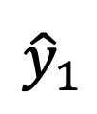





$$θ$$
$${\hat{z}}_{t}$$
$${\hat{z}}_{1}$$
$${\hat{x}}_{1}$$
$${\hat{y}}_{t}$$
$${\hat{y}}_{1}$$
$${\hat{x}}_{t}$$

