Slide 1



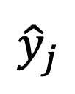


$${\hat{z}}_{i}$$
$${\hat{z}}_{j}$$
$${\hat{y}}_{j}$$
$$γ$$
$$γ$$
$${\hat{y}}_{i}$$

