Slide 1

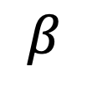



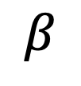
$${\hat{x}}_{i}$$
$${\hat{x}}_{j}$$
$${\hat{z}}_{j}$$
$$β$$
$$β$$
$${\hat{z}}_{i}$$

