Slide 1
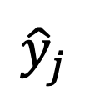





$${\hat{y}}_{i}$$
$${\hat{y}}_{j}$$
$${\hat{x}}_{j}$$
$$α$$
$$α$$
$${\hat{x}}_{i}$$

