Slide 1
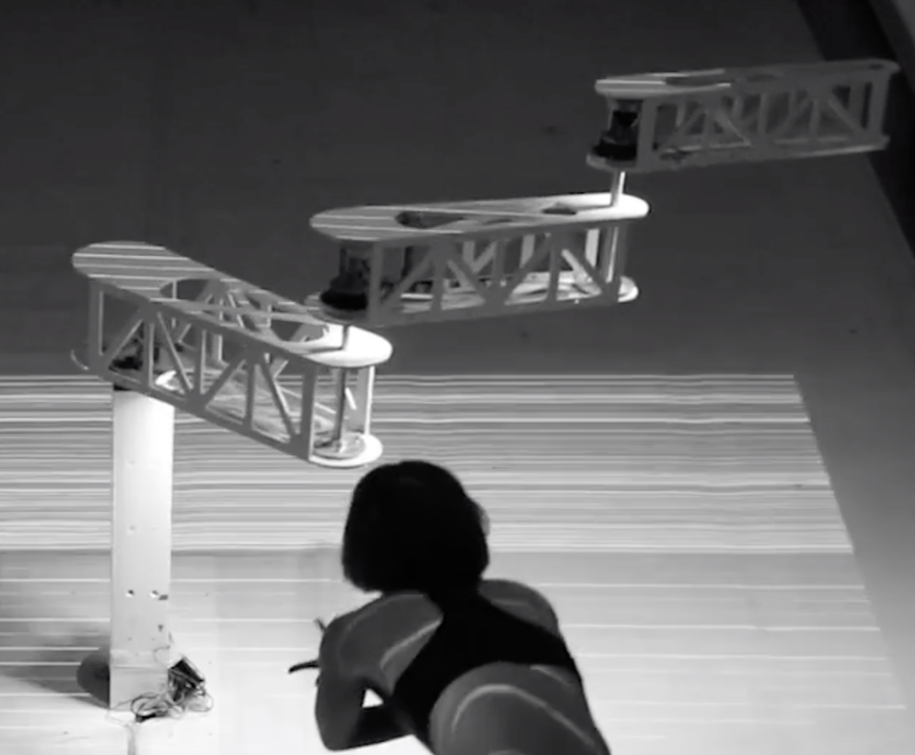

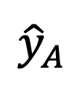
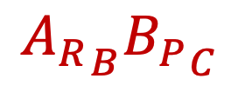

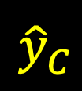
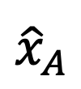



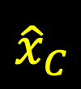



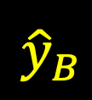
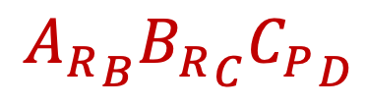
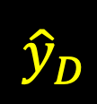
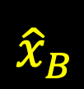

$${\hat{z}}_{D}$$
$${\hat{y}}_{D}$$
$${\hat{x}}_{D}$$
$${C_{P}}_{D}$$
$${\hat{z}}_{C}$$
$${\hat{y}}_{C}$$
$${\hat{z}}_{B}$$
$${B_{P}}_{C}$$
$${\hat{y}}_{B}$$
$${\hat{x}}_{C}$$
$${\hat{x}}_{B}$$
${A_{P}}_{B}$+ ${A_{R}}_{B}{B_{P}}_{C}+{A_{R}}_{B}{B_{R}}_{C}{C_{P}}_{D}$
$${A_{P}}_{B}$$
$${A_{R}}_{B}{B_{R}}_{C}{C_{P}}_{D}$$
$${\hat{z}}_{A}$$
$${\hat{y}}_{A}$$
$${A_{R}}_{B}{B_{P}}_{C}$$
$${\hat{x}}_{A}$$

