Slide 1
ProjectPulse
Project planning and compact analytics
Python project presentation
01
Notes:
ProjectPulse is a local academic project planning application. Introduce the project as a way to turn task lists into a dependency-aware schedule and a compact progress summary. Sources: README.md and docs/architecture.md.

Slide 2
The planning problem
Task lists hide sequencing
Some tasks must wait for other work to start or finish.
Calendar dates need working-time rules
Weekends and nonworking hours affect the plan.
Progress needs a consistent definition
ProjectPulse counts completed tasks and shows duration statistics.
02
Notes:
Explain that a task list alone does not show dependency order, working-time constraints, or the effect of changing duration. These are the design motivations, not findings from a user study. Source: README.md, plan.md.

Slide 3
Project structure and access
Organization / Workspace / Project
Owner and admin
Manage organizational access and planning work.
Editor
Create and update projects, tasks, dependencies, and calendars.
Viewer
Read tasks and schedules, inspect insights, and export dates.
03
Notes:
Organizations own workspaces, which contain projects. Membership in the organization defines access. Owner and admin can manage workspaces and members subject to owner restrictions. Editors manage planning data. Viewers read project information and export ICS. Source: docs/api-conventions.md.

Slide 4
Technology and architecture
Layer | Technology | Responsibility
Interface | React, TypeScript, CSS | Tasks, Timeline, Settings
API and services | Python, Flask | Access control and scheduling
Storage | SQLite, SQLAlchemy, Alembic | Planning data and migrations
Analytics | pandas and NumPy | Status counts and statistics
The browser requests data from the API. Services calculate results from stored inputs.
04
Notes:
React and TypeScript call the Flask JSON API under /api/v1. SQLAlchemy persists inputs in SQLite and Alembic manages schema history. The service layer computes schedules and summaries on demand. There is no background worker or analytics cache. Sources: docs/architecture.md, requirements.txt, frontend/package.json.

Slide 5
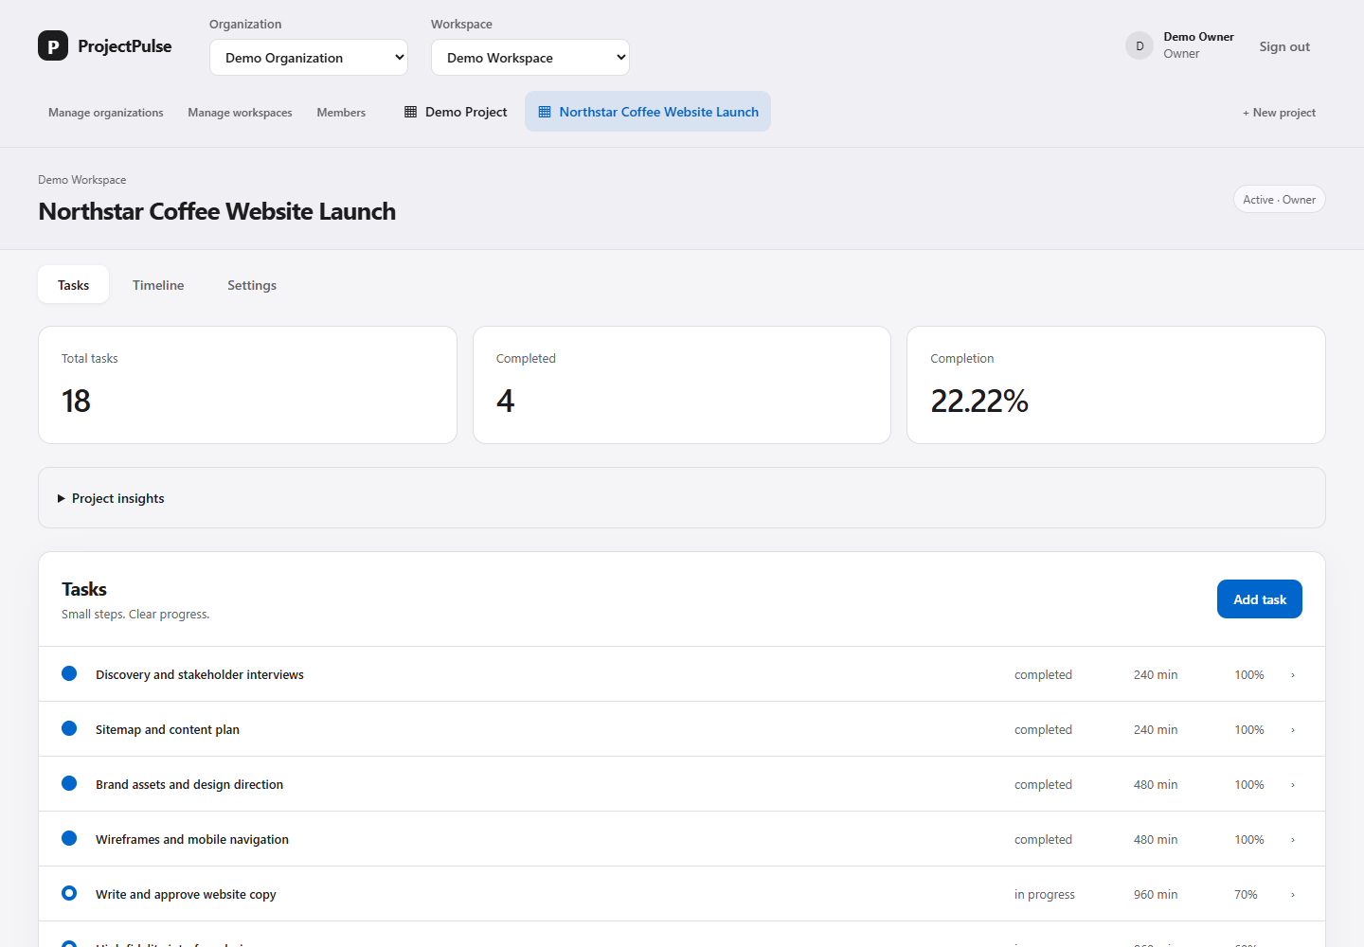
A focused planning workspace
Top navigation
One project context across all three views.
Task summary
Completion stays visible above the list.
05
Notes:
Actual screenshot of the local sample project captured 27 October 2026. Top navigation selects the organization, workspace, and project. Tasks is the default view. Timeline shows scheduling. Settings holds project metadata and working hours. Source: frontend/src/pages/WorkspacePage.tsx.

Slide 6
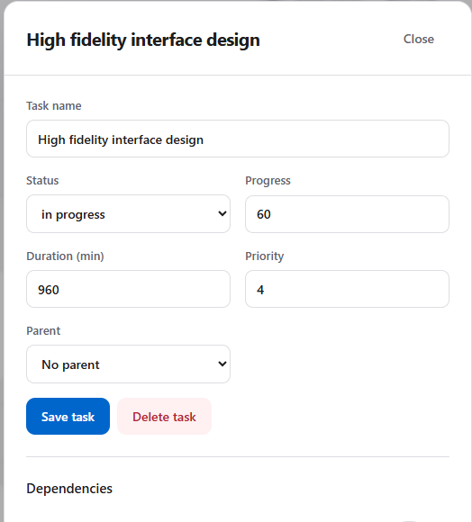
Task editing and progress
Select a task
Edit its name, duration, priority, status, and progress.
Add dependencies
Connect predecessor and successor tasks in the same dialog.
Save the changes
The task list and project summary refresh.
06
Notes:
Select a task row to open its details. Status and progress are separate inputs. Only completed status contributes to project completion. Zero duration represents a milestone. Viewers receive read-only details. Failed saves preserve the draft. Screenshot: current application. Source: frontend/src/components/PlanningForms.tsx and WorkspacePage.tsx.

Slide 7
Dependencies and working time
Relation | Constraint
FS: Finish to start | Successor start follows predecessor finish
SS: Start to start | Successor start follows predecessor start
FF: Finish to finish | Successor finish follows predecessor finish
SF: Start to finish | Successor finish follows predecessor start
Lag adds or subtracts working minutes. A zero-duration task marks a milestone.
07
Notes:
FS means the successor starts after the predecessor finishes, plus lag. SS constrains starts, FF constrains finishes, and SF constrains successor finish relative to predecessor start. Lag uses working minutes and can be negative. Validation rejects cycles and invalid links. Source: docs/scheduling-assumptions.md.

Slide 8
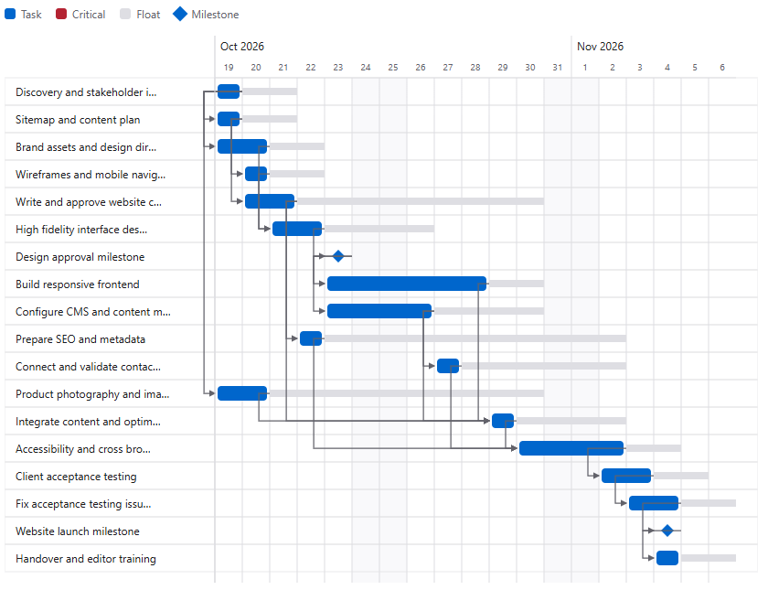
The Gantt chart
Bars and diamonds
Bars show scheduled work. Diamonds mark milestones.
Dependencies and float
Links show sequence. Gray extensions show scheduling flexibility.
Recalculate and export
Refresh the schedule or download an ICS calendar.
08
Notes:
Actual Gantt screenshot from the Northstar Coffee sample. It calculates a finish of 4 November 2026 against a target of 6 November. The target allows positive float in this example, so the screenshot need not contain red critical bars. Red identifies zero-float tasks when present. The chart is read-only. Change inputs in Tasks or Settings, then use Recalculate. Sources: app screenshot, docs/scheduling-assumptions.md.

Slide 9
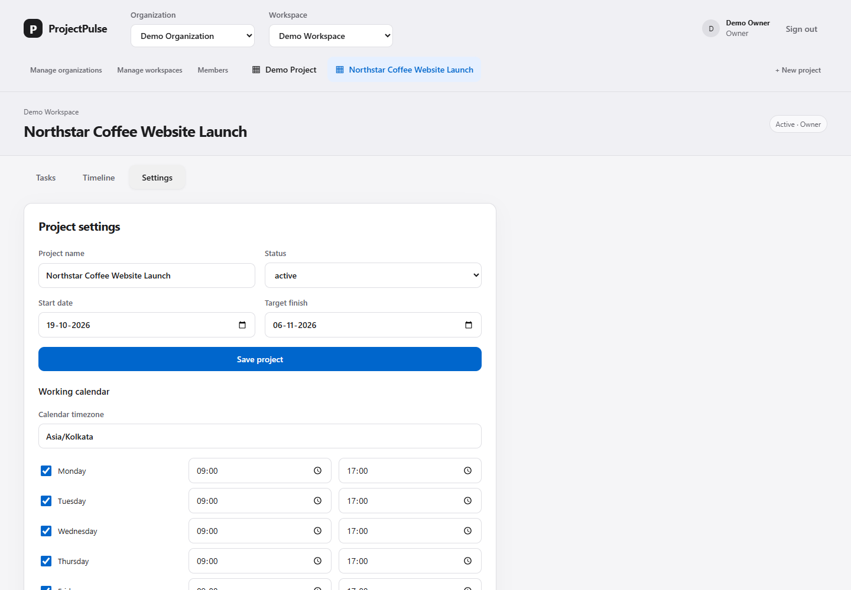
Project settings and calendars
Project dates
Set a start date and optional target finish.
Working hours
Choose the timezone and active weekday intervals.
09
Notes:
Project settings include project name, status, start date, target finish, and working calendar. The sample uses Asia/Kolkata, Monday to Friday, 09:00 to 17:00. Calendar time excludes nonworking hours. The UI edits one interval per day and preserves existing exceptions. Screenshot: current application. Source: docs/scheduling-assumptions.md.

Slide 10
Compact analytics with pandas and NumPy
22.22% complete
4 completed tasks out of 18
Positive-duration tasks
Mean: 615 min
Median: 480 min
90th percentile: 960 min
Milestones count as tasks. Duration statistics exclude zero-duration milestones.
10
Notes:
Sample data snapshot from the local database on 27 October 2026. pandas constructs a task DataFrame and aggregates every supported status. NumPy excludes the two zero-duration milestones and computes mean 615, median 480, and 90th percentile 960 working minutes over 16 positive-duration tasks. Completion is 4/18*100 = 22.22%. These duration statistics describe individual tasks, not project elapsed time. Source: backend/app/services/summary.py and current sample records.

Slide 11
Sample project walkthrough
Northstar Coffee Website Launch
18 tasks 23 dependencies 2 milestones
1. Tasks
Review completed discovery work and the blocked photography task.
2. Timeline
Inspect the sequence from design approval to launch and handover.
3. Settings
Review the working calendar and the 6 November target finish.
11
Notes:
This is fictional demonstration data, not an actual client engagement. Northstar Coffee Website Launch has 18 tasks, 23 FS dependencies, 2 milestones, 4 completed, 2 in progress, 1 blocked, and 11 not started. Open the sample, inspect tasks, open High fidelity interface design, then Timeline and Settings. Start 19 October 2026, calculated finish 4 November, target 6 November. Sources: current local sample records and application screenshots.

Slide 12
Access control and data protection
Authorization on the server
Organization membership and role checks guard project access.
Protected edits
CSRF checks and project/calendar versions help reject invalid writes.
Database compatibility
Retired features keep their legacy storage and migration history.
12
Notes:
All project reads and changes enforce organization membership and roles on the server. Session mutations require CSRF. Project and calendar edits use version checks to reject stale saves. Feature cleanup retains migrations, legacy tables and minimal ORM mappings for existing records. Explicit user deletion still follows normal cascade semantics. Source: docs/architecture.md and docs/api-conventions.md.

Slide 13
Verification and current limits
101
61
backend tests passed
frontend tests passed
Production build and migration checks passed.
Current limits: local SQLite, read-only Gantt, no live co-editing.
No human user study or production deployment validation yet.
13
Notes:
Recorded verification on 27 October 2026: 101 backend tests and 61 frontend tests passed, along with the production build and disposable-database migration checks. Browser checks covered responsive layouts, light/dark appearance, dialogs, errors and summary refresh. These are engineering checks, not a human user study or production certification. Source: docs/evaluation.md.

Slide 14
ProjectPulse in use
A task plan with
visible progress
The next step is a live walkthrough of the sample project.
Questions
14
Notes:
Close by returning to the running application for a demonstration. The project combines working-calendar scheduling and compact analytics in a simpler interface. Show how one task change updates the task summary and schedule. Possible future improvements should be treated as proposals, not implemented features. Sources: README.md, docs/architecture.md.

