Slide 1
jSCAPE – Java Self-assessment Center of Adaptive Programming Exercises
Alexis Chantreau

Slide 2
Introduction
Programming can be a useful skill to have in today's society.
University CompSci courses and MOOCs enrolment → Definite interest in programming.
Programming can be difficult to learn. (different programming paradigms and specific skills needed)
Students are limited by the number of exercises.
Teachers receive a limited amount of feedback.
Creating exercises can be time consuming and inefficient.

Slide 3
Motivation
More practice for students. (self-assessment)
Better feedback for teachers.
Easier way for teachers to supply exercises.

Slide 4
jSCAPE System
Provide programming exercises for practice.
Display statistics on student progress/performance.
Adapt the difficulty of exercises to the student's ability.
Automatically generate exercises.

Slide 5
Exercises
Exercises to test understanding of programming concepts (in Java).
Currently jSCAPE supports multiple choice questions only.
Format is exercise data on the left + question and choices on the right.
Exercises divided into different exercise categories.
Simple feedback after exercise, i.e. show correct/incorrect + solution.
Difficulty of exercises is adapted to the student's ability.

Slide 6
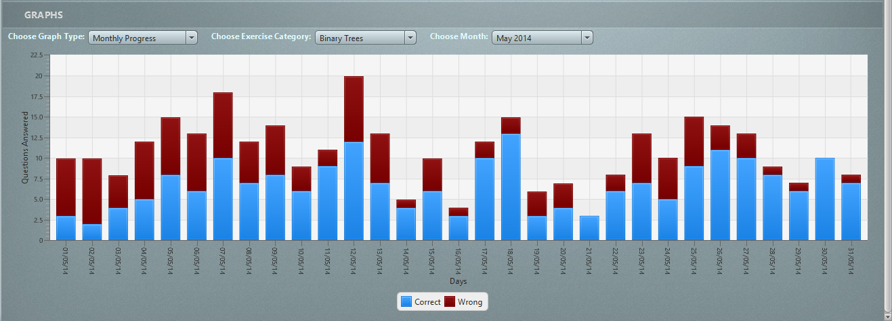
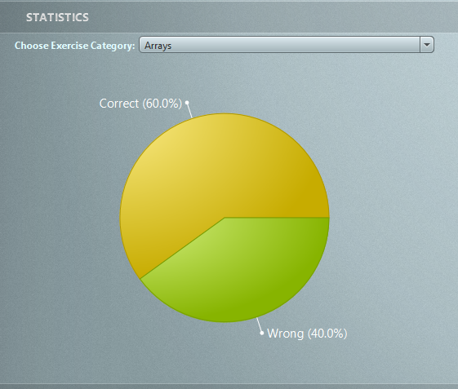
Statistical data
jSCAPE collects various statistical data, e.g. correct/incorrect, progress over time, ...
Students can view statistics on their own performance/progress.
Teachers can view statistics for individual students or a class as a whole.

Slide 7
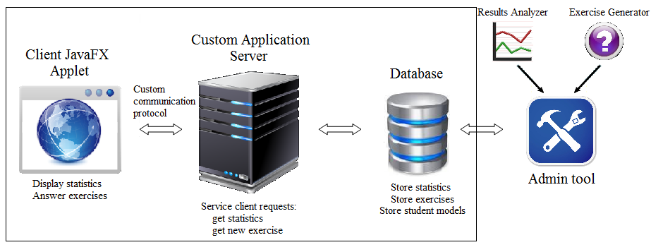
Implementation - jSCAPE
Three tier architecture: web client, server and database.
Web client is a JavaFX applet.
Custom written Java server and communication protocol.

Slide 8
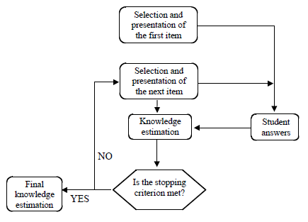
Adaptive Difficulty - CAT
Based on computerized adaptive testing (CAT).
Calibrated item pool.
Starting point.
Item selection algorithm.
Scoring algorithm.
Termination criterion.

Slide 9
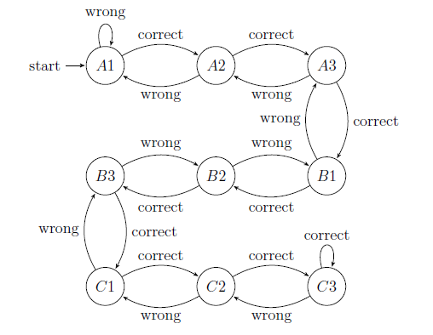
Adaptive Difficulty – Simple Algorithm
Simple algorithm inspired from Programming Adaptive Testing (PAT) software.
Exercises split into 3 difficulty categories: A (easy), B (intermediate), C (difficult).

Slide 10
Adaptive Difficulty – More Complex Algorithm
More sophisticated algorithm based on Item Response Theory (IRT).
IRT is a psychometric model, an improvement over Classical Test Theory.
IRT assumes that one can model the probability of a correct answer to an item, given item parameters and examinee ability level.
Several IRT models exist to address the different types of tests, e.g. multiple choice, agreement questionnaires (Likert scale), etc...

Slide 11
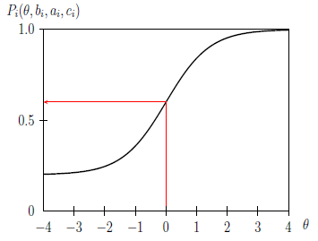
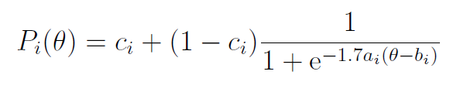
Adaptive Difficulty – Item Response Theory
Item response theory 3PL model used in jSCAPE.
Theta (θ)= trait being measured, e.g. student ability/knowledge.
a = discrimination; b = difficulty; c = pseudo-chance/guessing.
P_i(θ)=probability of correct answer for item i at ability θ.
In the graph: a = 1.4; b = 0; c = 0.2

Slide 12
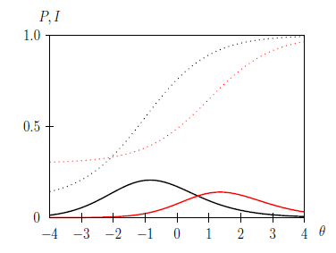
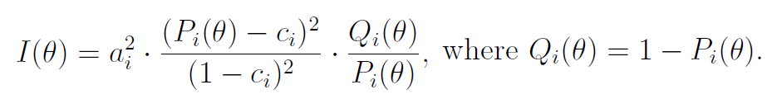
Adaptive Difficulty – Item Information
Precision in the ability estimate that the item provides,
at all ability levels.
Indication of quality of item in terms of how well it
discriminates between respondents.
Concept used in item selection algorithm
e.g. maximum information method.

Slide 13
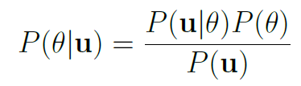
Adaptive Difficulty – Knowledge Estimation
Knowledge estimation techniques → jSCAPE uses Bayesian estimation.
CAT maintains a knowledge distribution P(θ), the probability that the student's ability is θ.
Initial knowledge distribution is uniform distribution.
Knowledge distribution updated according to Bayes' rule and Bayesian inference.
u is the student's response vector.
The mode (highest value) of the knowledge distribution is the new ability estimate.

Slide 14
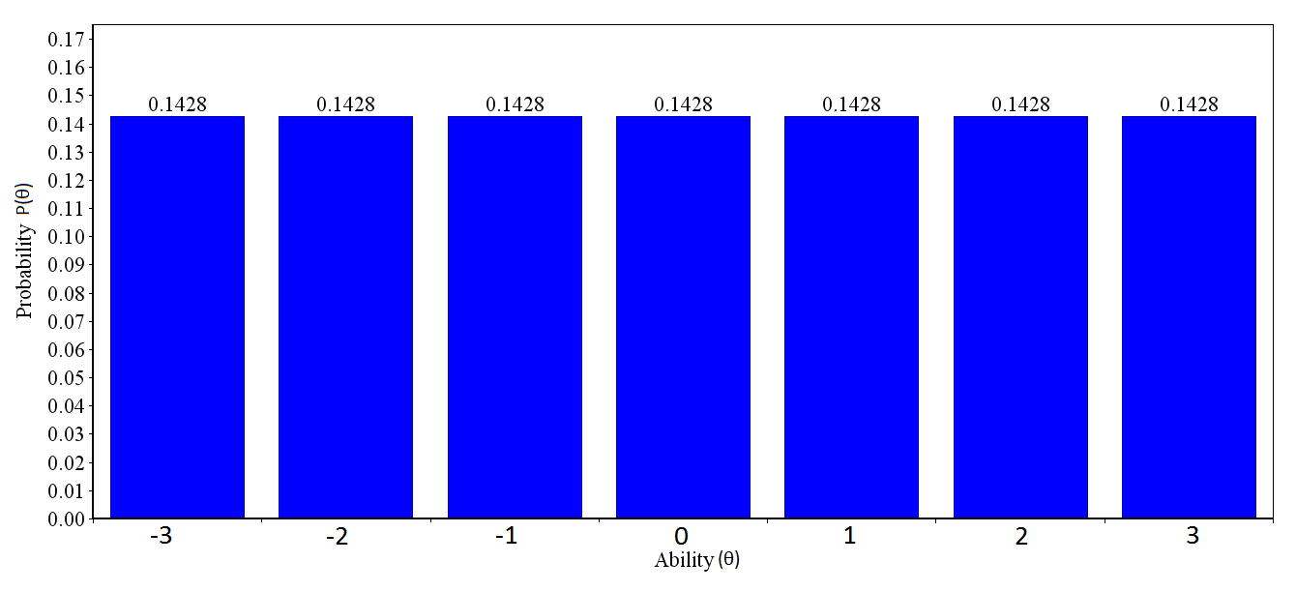
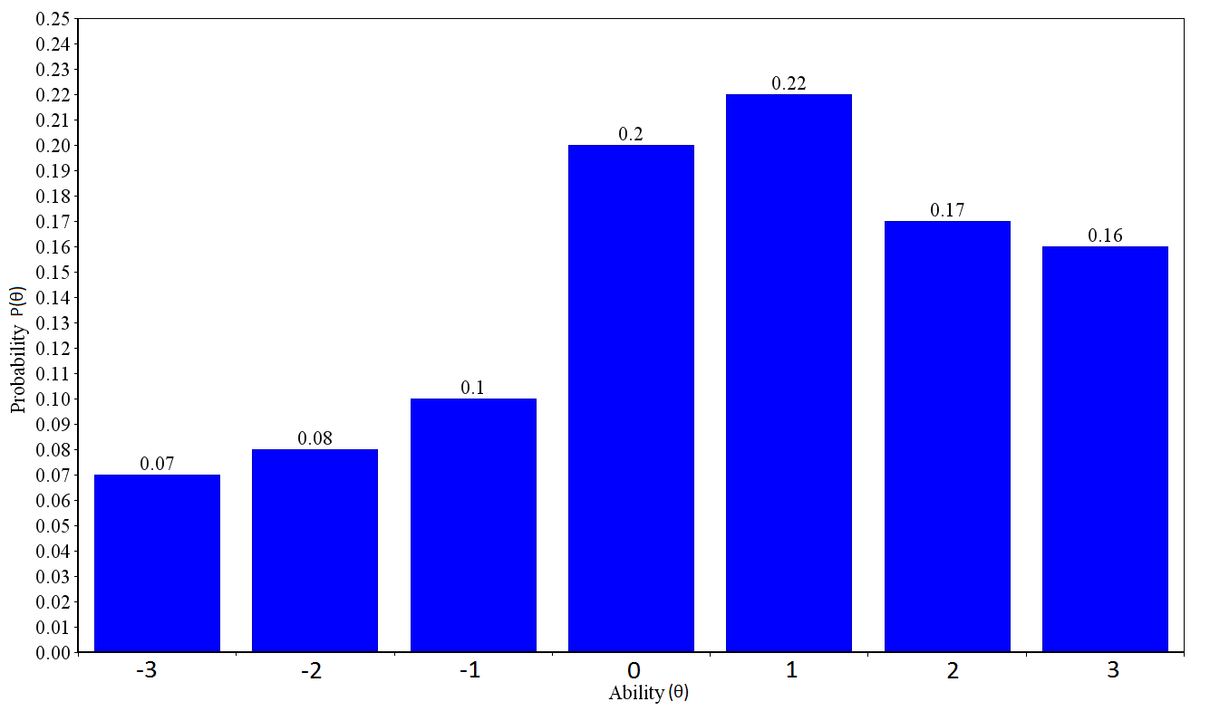
Adaptive Difficulty – Knowledge Dist. Update
Knowledge distribution update after student answers correctly a medium difficulty exercise.

Slide 15
Adaptive Difficulty in jSCAPE
Implementation details based on SIETTE.
θ = 0 to 10, 11 discrete knowledge levels.
Calibrated item pool, parameters assigned manually, 0.5 < a < 1.5 and 0 <= b <= 10, c=0.25
Starting point: assume student is of average ability, i.e. θ = 5
Exercise selection algorithm: maximum information method.
Scoring algorithm: Bayesian estimation method.
Termination criterion: exiting jSCAPE and changing exercise category.

Slide 16
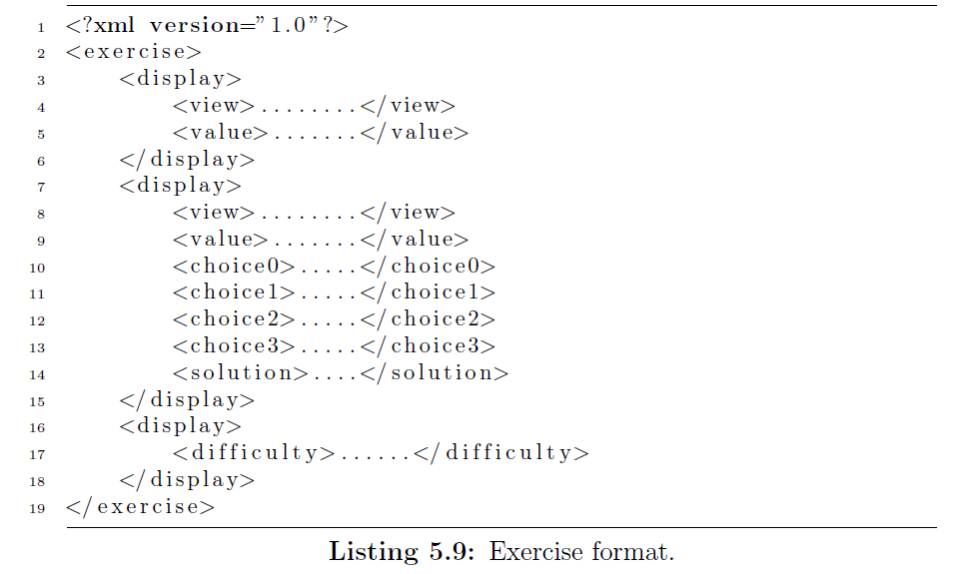
Exercises and Exercise Generation

Slide 17
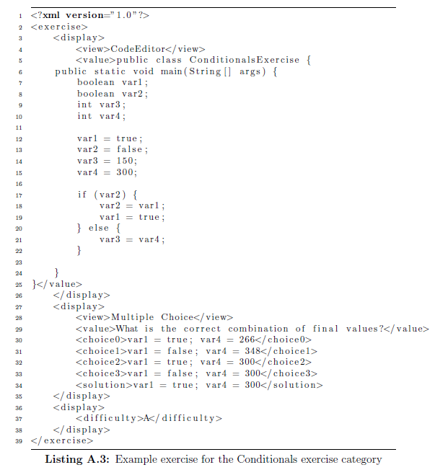

Slide 18
Conclusion
Result of this project is jSCAPE, a complete system with core features.
Exercises and statistics implemented successfully.
However, more work needs to be done on the adaptive difficulty and exercise generation components!

Slide 19
Future work
Other programming languages, e.g. cSCAPE, hSCAPE.
More exercise types, e.g. fill-in-blank, multiple response, interactive exercises, etc...
More feedback after a student answers an exercise.
Improve adaptive difficulty component of jSCAPE.
More scalable code generator.
Different approach to automated exercise generation.

Slide 20
Questions ?

