Slide 1
Star Collector
A 30-Second WebGL Storytelling Animation
HUANG Boxuan, Liu Limeng, Mo Fengyuan

Slide 2
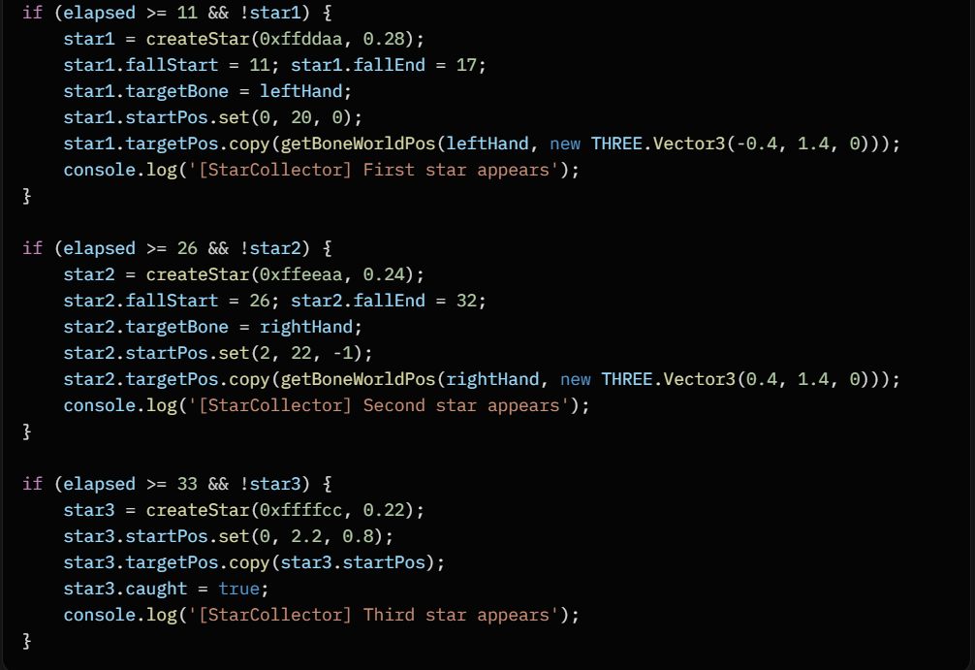
Story & Narrative (30-second timeline)
"Star Collector" tells a story about a fox collecting stars.
• A little fox stands on a hill at dusk, gazing at the stars
• Three falling stars are gently collected
• Finally, countless star particles are released into the night sky
Key Moments:
  0s → Night falls, fox breathing calmly
11–17s → 1st star → flash & disappear → fox tilted its head
26–32s → 2nd star → fox’s tail curls
33s → Camera pulls back, particles emitted upward

Slide 3
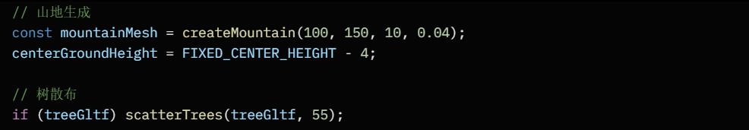
Scene Design
• Central hill with a large tree
• Fox positioned under the tree
• Procedural rolling mountains (Perlin noise)
• Sparse trees scattered on distant hills
• Dynamic sky: sunset → deep night with visible stars

Slide 4
3D Models – Fox & Tree-Hill
Fox Model
• Source: GLTF (downloaded)
• Triangles: 11.1k
• Full skeletal rigging
Tree-Hill Model
• Source: GLTF
• Triangles: 746
• Used as central platform

Slide 5
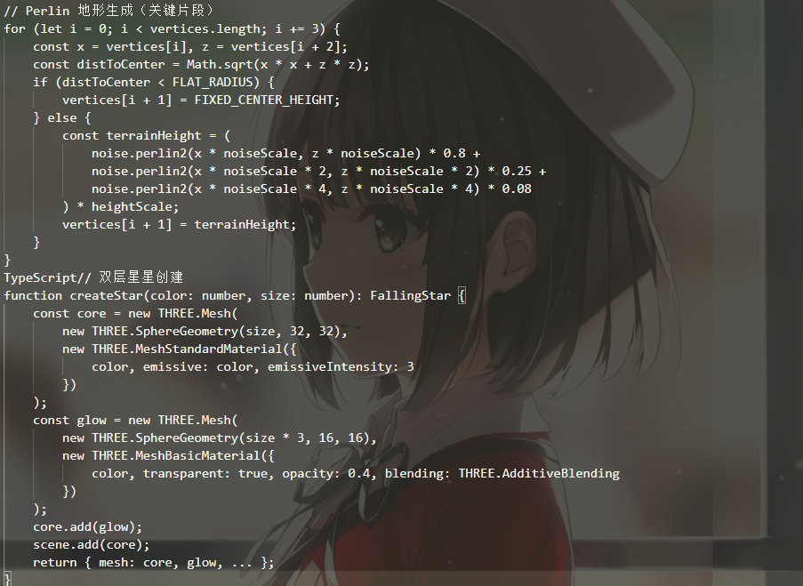
Terrain & Stars
Procedural Terrain
• Multi-octave Perlin noise
• Flattened center for the fox
Star Objects
• Double-layer glowing sphere
• Core + additive glow shell
Star Particles
• Pool of 50 emissive spheres
• Dynamic opacity & scale

Slide 6
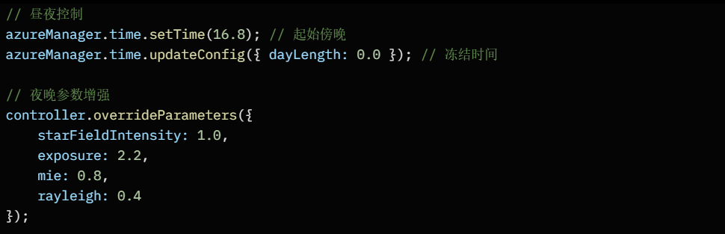
Lighting & Environment
• Dynamic directional light (sun → moon)
• Real-time day-night cycle (frozen at deep night)
• Star self-illumination with additive glow
• Shadow casting on fox and trees

Slide 7
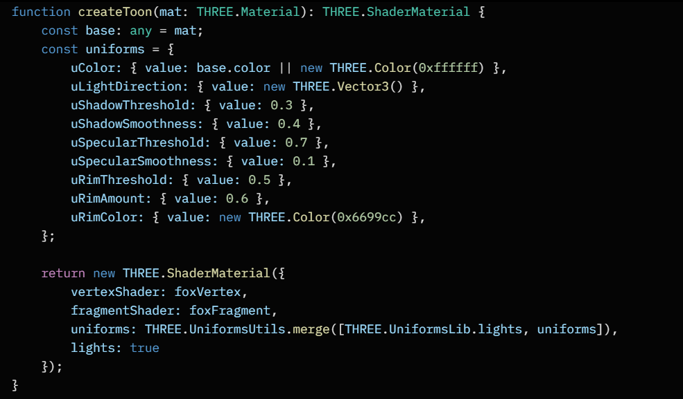
Custom Toon Shader (Fox)
Features:
• Step-wise diffuse (3 levels)
• Hard specular highlights
• Blue-white rim lighting
• Shadow bands
• Ambient term

Slide 8
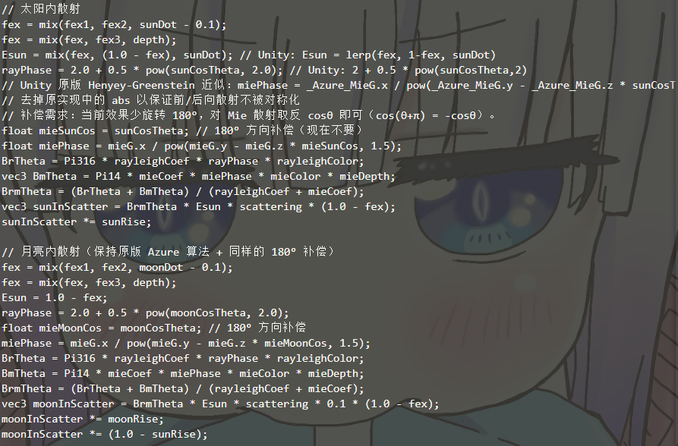
Atmospheric Scattering & Fog
• Real-time Rayleigh + Mie scattering
• Depth-based exponential fog
• Greatly enhances depth and night mood

Slide 9
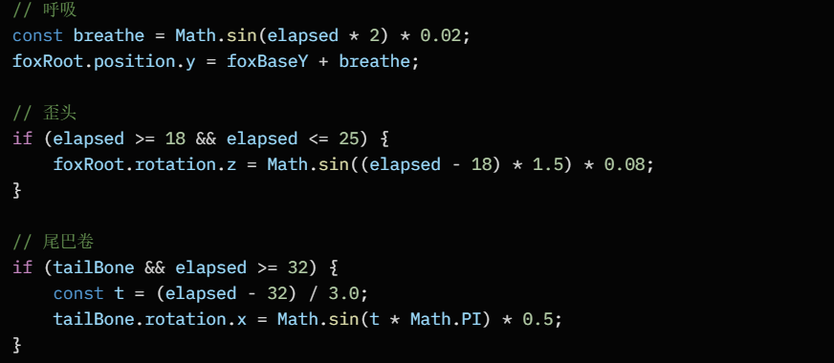
Fox Animation
• Breathing → sinusoidal position offset
• Head tilt (18–25s)
• Tail curl after second star
• All driven by global timer

Slide 10
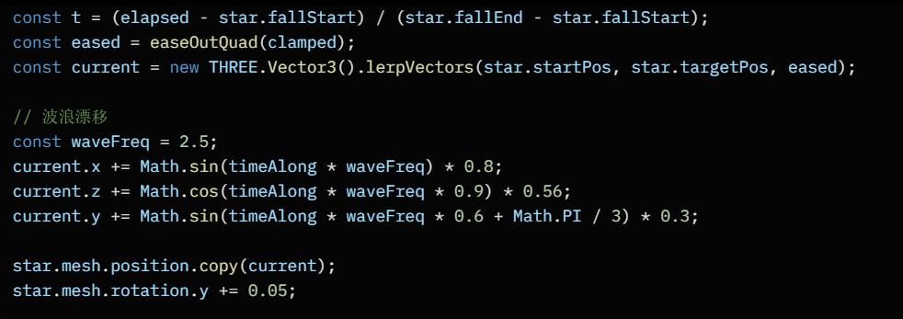
Star Falling & Collection
• Easing (easeOutQuad)
• Wavy drift + rotation
• Flash → rapid fade & shrink on collection

Slide 11
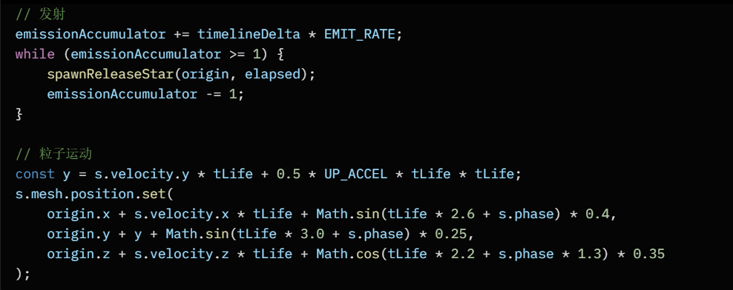
Particle System – Final Release
• Triggered at 33s
• 6 particles/sec, pool of 50
• Upward acceleration + wavy drift
• Fade-in → pulse → fade-out

Slide 12
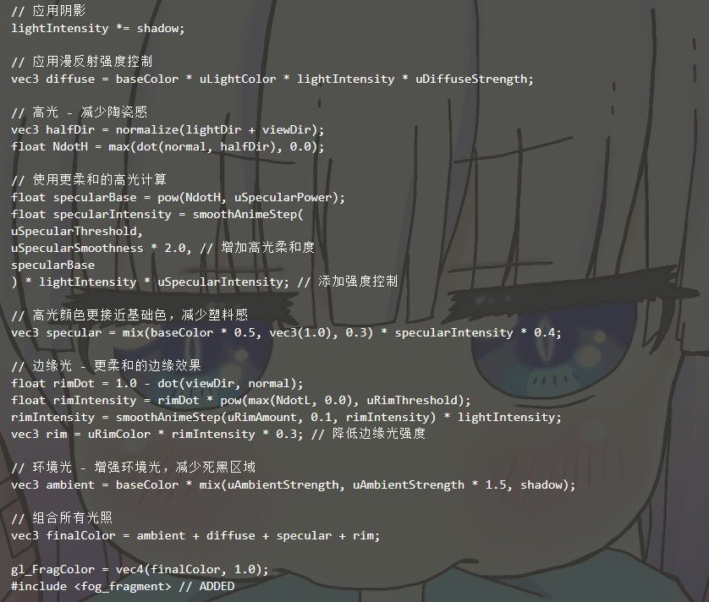
Technical Discussion – Toon Shader
• Diffuse: floor(dot(N,L))
• Specular: smoothstep threshold
• Rim: pow(1 - dot(N,V), 2)
• Shadow: biased shadowMap + step

Slide 13
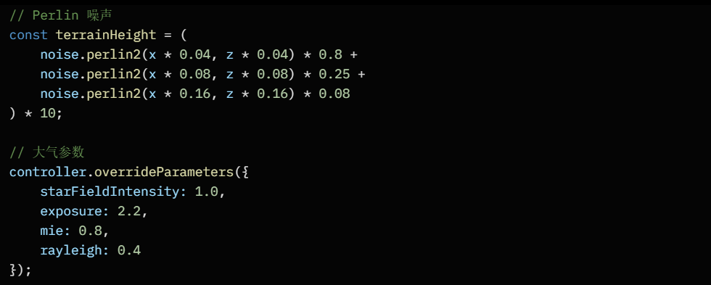
Technical Discussion – Atmosphere & Terrain
• Preetham atmospheric scattering
• 4-octave Perlin noise terrain
• Distance-based flattening

Slide 14
Conclusion & Highlights
Achievements
• Complete 30s story-driven WebGL animation
• Custom toon + atmospheric shaders
• Sophisticated particle & animation system
• Precise timeline synchronization
Live Demo: morphex-mo.github.io/COMP4422-Computer-Graphics-Proj/?scene=starCollectorScene
Source Code:github.com/Morphex-Mo/COMP4422-Computer-Graphics-Proj

Slide 15
Team Contribution
Member SID Main Responsibilities
───────────────────────────────────────────────────
HUANG Boxuan 23100165d Atmosphere, fox
Liu Limeng 20101524d Mountain, Report
Mo Fengyuan 25011254x Stars, PPT

Slide 16
Thank You!

