Slide 1
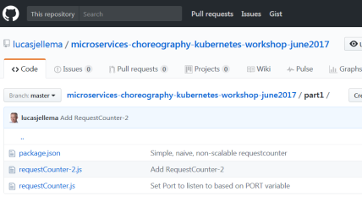

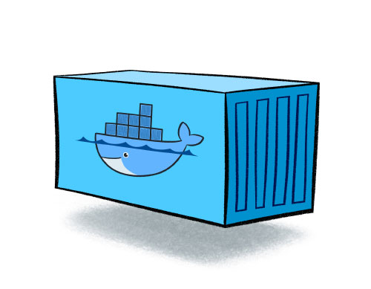

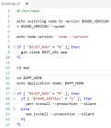
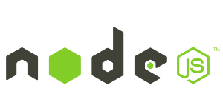
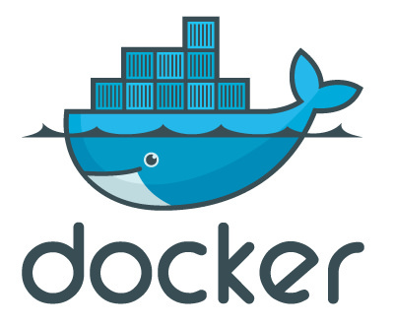
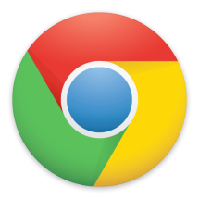
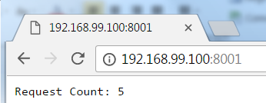
Run a Node.JS application from Github using generic container image
2. docker run:
port mapping
volume
3. clone from GitHub
run container
1. pull from Docker Hub registry
4. npm install
Specify:
GITHUB_URL
APP_HOME
APP_STARTUP
APP_PORT
NODE_VERSION
5. npm start or node app.js
6. access application

