Slide 1
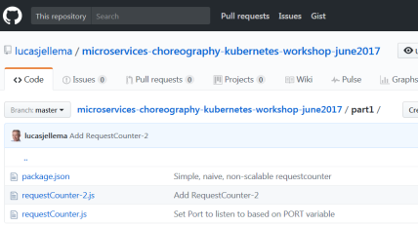
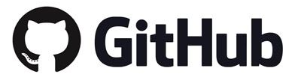
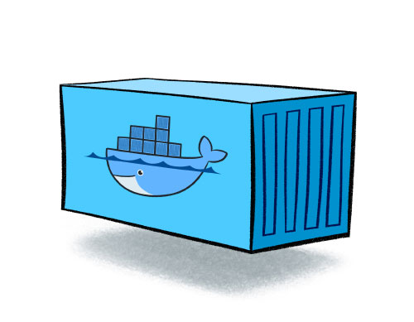

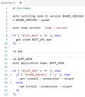
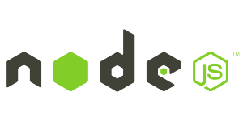
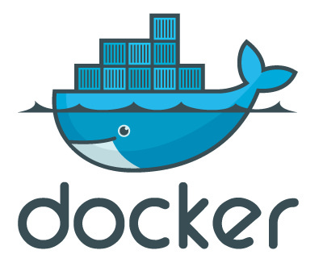
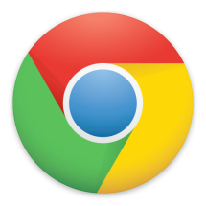
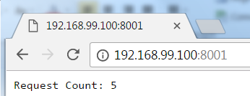
Run a Node.JS application from Github using generic container image
Node 8
npm
git client
nodemon
node reload app
3. clone app from GitHub
8. pull app from GitHub
2. docker run:
port mapping
volume
run container
1. pull image from Docker Hub registry
4. npm install // install application dependencies
Specify:
- GITHUB_URL
- Other environment variables
5. Nodemon //to run and monitor Node app
6. access application
9. restart Node application
7. curl /reload //refresh app from GitHub
10. access upgraded application

Slide 2
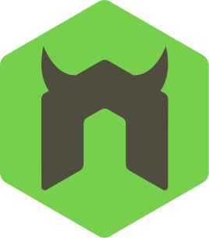
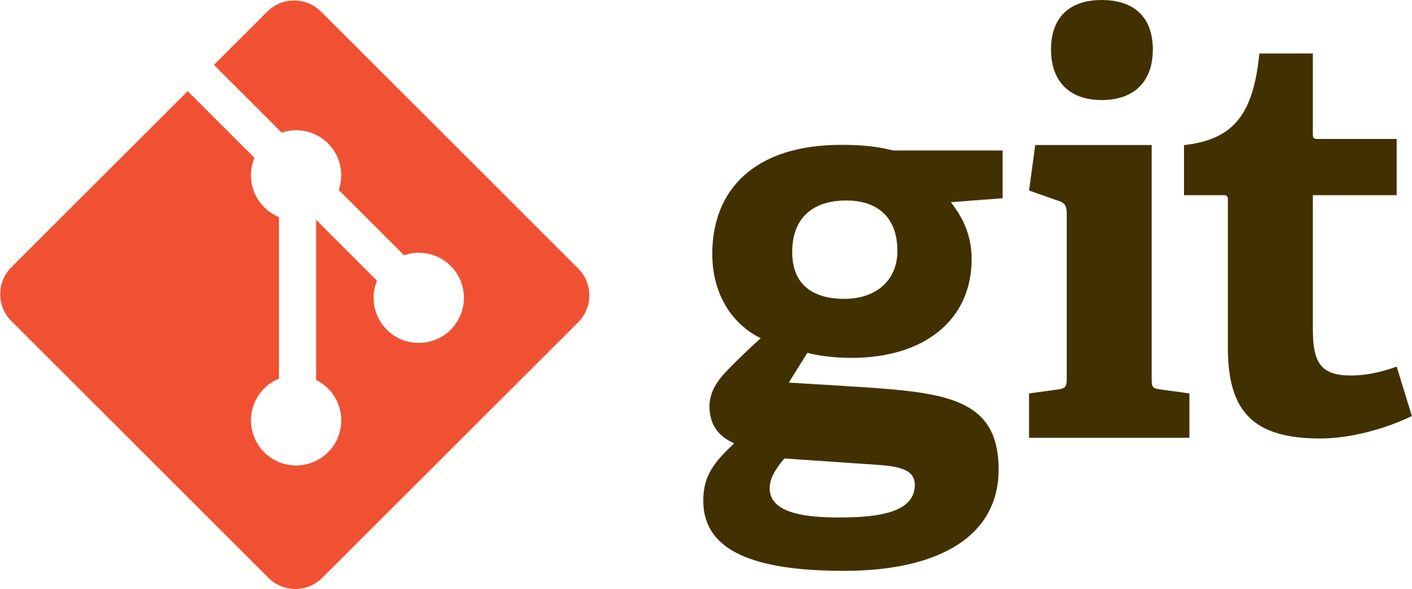
Run a Node.JS application from Github using generic container image
Node 8
npm
git client
nodemon
node reload app
Reload trigger
GitHubReload Node application
Node application

