Slide 1

Chapter 10: Working with Sequence Data

Slide 2
Learning objectives
Understand FASTA & FASTQ
Basic intro to nucleotides and quality scores
Trimming and graphing sequence data
Indexing sequences
FASTA / FASTQ
1

Slide 3


FASTA
The FASTA file format was created by William Pearson and David Lipman as a means to store sequence data not requiring per-base quality scores.
FASTA is a powerful and flexible tool which can be easily be modified for your projects specific needs. FASTA’s inherit ad-hoc nature can also create compatibility problems.
William Pearson
David Lipman
FASTA / FASTQ
2

Slide 4
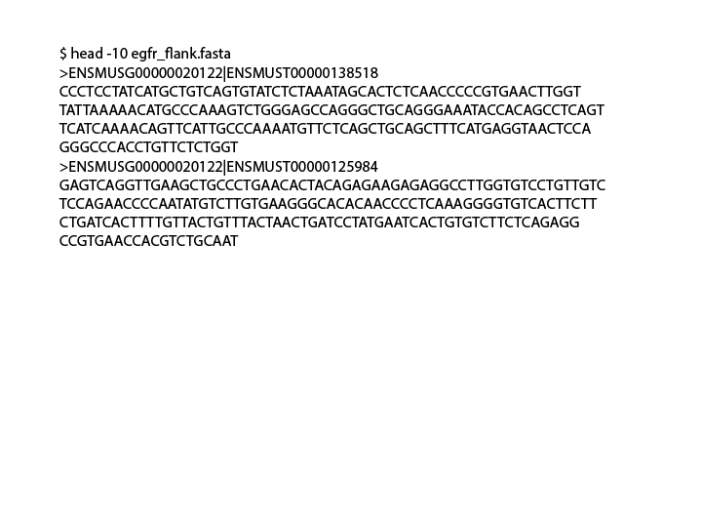
FASTA file composition
FASTA files are composed of descriptions and the sequence data.
FASTA / FASTQ
3

Slide 5
FASTA file composition
The description (>) contains the sequence identifier and any optional descriptive information.
FASTA / FASTQ
4

Slide 6
FASTA file composition
The actual sequence data starts after the description line. This contains raw sequence data with no quality data.
FASTA / FASTQ
5

Slide 7
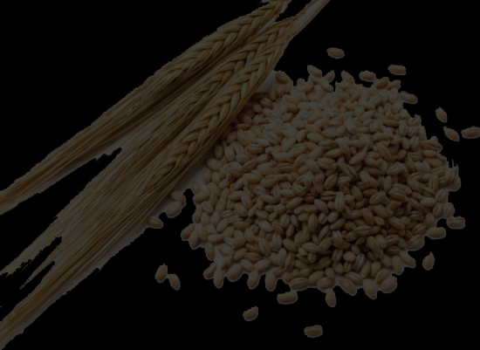
FASTA pitfalls
The open source nature of FASTA is a doubled edge sword. It can give a team extreme amounts of flexibility, allowing them to adapt your project to the needs of your data. This is no universal registry of identifiers and each FASTA file is unique. Which can be a huge problem if you’re receiving someone else's data, sharing your own, inheriting code or trying to trouble shoot. Mis-matched identifiers can lead to inaccurate results, since you don’t know what the identifiers effect.
FASTA / FASTQ
6

Slide 8

FASTA solutions
There are two simple solutions to help resolve these problems:
Utilize public repositories of FASTA file formats - this is the closet thing to standardization. Once obtained you can make a copies of the original file and observe and optimize the FASTA file for your purpose.
Create an internal designation system of FASTA classification. A common format contains: an identifier, comments and unique id - for other groups or future staff members.
FASTA / FASTQ
7

Slide 9
FASTQ
FASTQ is an extension of FASTA, which displays the quality scores of each base pair in a sequence. The quality score shows the confidence of each base pair – this value is represented by an ascii character – which translates to a numerical value.
@AZ1:233:B390NACCC:2:1203:7689:2153
GTTGTTCTTGATGAGCCATGAGGAAGGCATGCCAAATTAAAATACTGGTGCGAATTTAAT
+
CCFFFFHHHHHJJJJJEIFJIJIJJJIJIJJJJCDGHIIIGIGIJIJIIIIJIJJIJIIH
FASTA / FASTQ
8

Slide 10
FASTQ format
This is a description line (@), which contains an identifier and comment.
FASTA / FASTQ
9

Slide 11
FASTQ format
Much like FASTA the sequence data starts below the description line.
(+) this line indicates the end of a sequence.
FASTA / FASTQ
10

Slide 12
FASTQ format
This is the quality line that contain ascii characters and should be the same length as the sequence line. This is the bread and butter of FASTQ, and the main difference between FASTA and FASTAQ. Each character is linked to a numerical value on the ascii table. Be careful the (@) symbol is also an allowed quality character.
FASTA / FASTQ
11

Slide 13
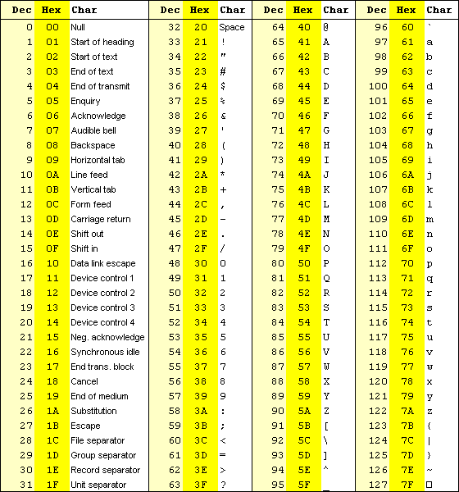
ASCII table
There are 3 prominent ASCII quality control schemes: Sanger, Solexa and Illumina. The Bioinformatics field settled on Sanger as the quality decoding standard.
Sanger uses the PHRED quality score type which recognizes ASCII characters between 33 to 126 and has a quality value range between: 0-93. None characters are omitted from the list (space bar, sounds, etc).
FASTA / FASTQ
12

Slide 14
FASTQ base qualities
Within Python you can use the ord() command to translate and refine your quality values into numerical values.
>>> phred = [ord(b)-33 for b in qual]
>>> phred
[41, 41, 41, 41, 41, 41, 41, 41, 41, 41, 41, 41, 38, 41, 41, 41, 41, 41, 40,
40, 41, 41, 41, 41, 41, 40, 38, 41, 41, 41, 41, 41, 40, 41, 41, 41, 41, 41,
41, 41, 40, 41, 40, 41, 41, 41, 41, 39, 39, 39, 39, 39, 37, 37, 37, 35, 37,
34, 34, 34]
You can now use the PHRED (P) formula (P = 10-Q/10) to translate those values into probability estimates for the bases.
>>> [10**(-q/10) for q in phred]
[1e-05, 1e-05, 1e-05, 1e-05, 1e-05, 1e-05, 1e-05, 1e-05, 1e-05, 1e-05, 1e-05,
1e-05, 0.0001, 1e-05, 1e-05, 1e-05, 1e-05, 1e-05, 0.0001, 0.0001, 1e-05,
1e-05, 1e-05, 1e-05, 1e-05, 0.0001, 0.0001, 1e-05, 1e-05, 1e-05, 1e-05,
1e-05, 0.0001, 1e-05, 1e-05, 1e-05, 1e-05, 1e-05, 1e-05, 1e-05, 0.0001,
1e-05, 0.0001, 1e-05, 1e-05, 1e-05, 1e-05, 0.0001, 0.0001, 0.0001, 0.0001,
0.0001, 0.0001, 0.0001, 0.0001, 0.0001, 0.0001, 0.0001, 0.0001, 0.0001]
FASTA / FASTQ
13

Slide 15

FASTQ/FASTA nucleotide codes
Sequences and quality scores are fine and dandy, but what do they represent? They represent nucleotide data - the core nucleotides being A,T,G,C , which are referred as unambiguous. During the sequencing what if there is difficulty reading the sequence segment, or large quantities of base pairs repeating? These are referred to as ambiguous nucleotides and there are two ways these are handle in FASTQ files:
Difficult to interpret bases of 2 or more are labeled: Degenerate or ambiguous, there are bases that could be in one of two possible states – they are marked as none ATGC characters.
Repeating base pairs are referred to as soft mask or low complexity sequences. These can cause excessive noise when trying to find unique base pairs. These repeats can be represent by none ATGC characters or the variables N and/or X.
The standard for nucleotides ratings are set by The International Union of Pure and Applied Chemistry (IUPAC).
FASTA / FASTQ
14

Slide 16
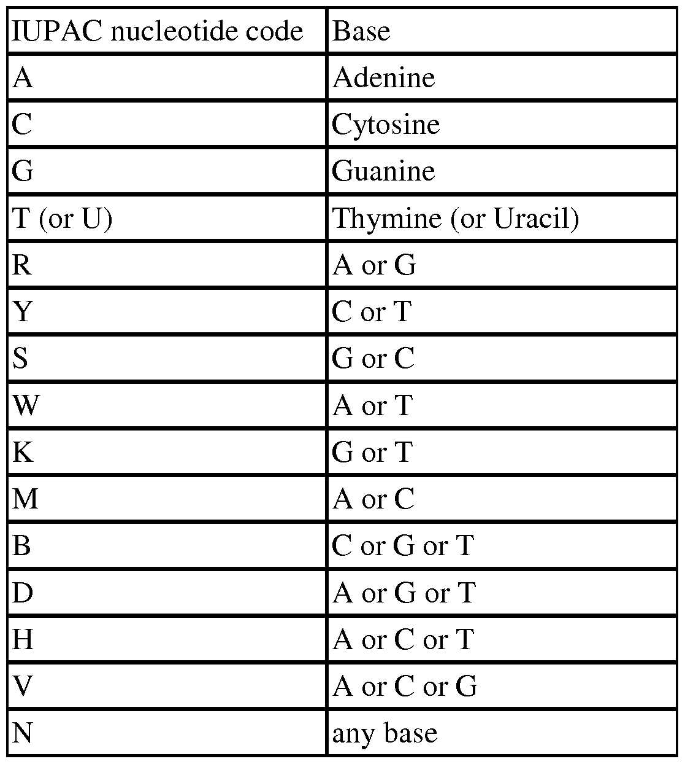
IUPAC nucleotide table
Value table for nucleotides for FASTQ files.
FASTA / FASTQ
15

Slide 17
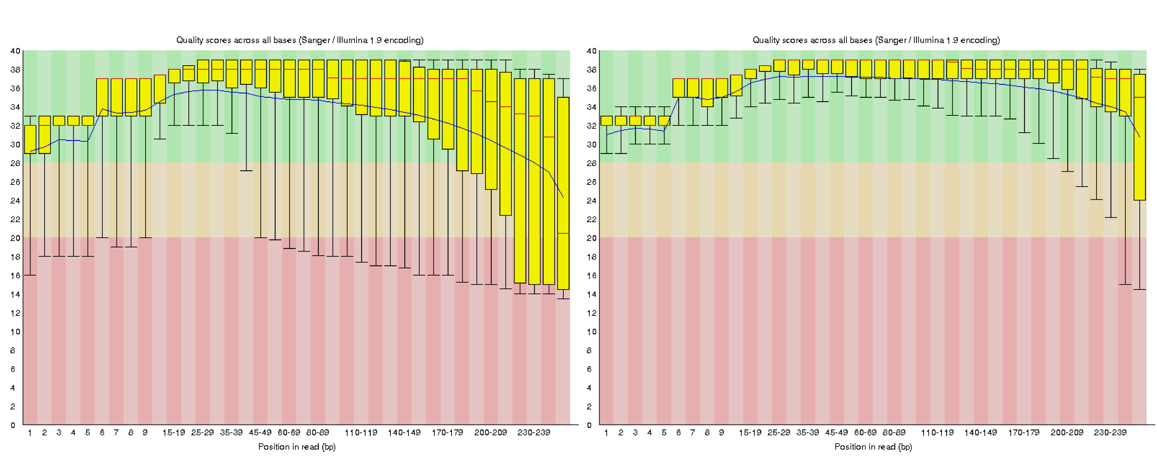
FASTQ trimming data
FASTQ files with low probability scores are trimmed off the overall data. The most common software being FASTQC, Seqtk and Sickle. FASTQC only displays and graphs information, Seqtk and Sickle trim the outlaying probability scores from your FASTQ file. This will give you workable data, filled with nucleotides that are concrete and workable.
Paul and Skylar from the Morrell lab have developed an automated sequence handling system that simplifies this process by rolling the entire process into one Github file. If you would like to try this process for yourself you can head to the Morrell Lab Githib page and search for: sequence handling.
FASTA / FASTQ
16

Slide 18
FASTA / FASTQ indexing
To prevent excessive use of memory, it’s important to index your files using Samtools. This allows you to jump straight to the point of interest instead of having to run though and scan each file in acceding order.
samtools faidx <region> <search>
You can also search for multiple items as well:
samtools faidx <region> <search> \ <search>
FASTA / FASTQ
17

Slide 19
Questions or concerns

