Slide 1
sequence_handling
M. Fernanda Rodriguez
Dec 5th 2016

Slide 2
sequence_handling
“A series of scripts that automates sequence analysis workflows”
Developed by Paul Hoffman and Skylar Wyant

Slide 3
sequence_handling
For today’s exercise: (commands in green)
Log in MSI
echo export MODULEPATH=/panfs/roc/groups/9/morrellp/public/Modules:'$MODULEPATH' >> ~/.bash_profile
2. Log out MSI
3. Log in MSI using ssh –Y user@login.msi.umn.edu (for MAC users only, otherwise log in regular way)
4. Clone “sequence_handling” and SH_Exampe_Data” directories:
git clone /panfs/roc/groups/9/morrellp/public/sequence_handling
git clone /panfs/roc/groups/9/morrellp/public/SH_Example_Data

Slide 4
sequence_handling Presentation
https://github.com/MorrellLAB/DoesNaughtCompute/blob/master/Sequence_Handling/DoesNaughtCompute_SeqHandling_Dec052016.pptx

Slide 5
sequence_handling handlers
Quality Assessment - FastQC
Read depths - Zip/Unzip/Grep
Adapter trimming - Scythe
Quality trimming - Sickle/ Seqqs
Read mapping - BWA-MEM
SAM processing - Picard/ SAMtools
Coverage mapping - BEDtools
Indel realignment - GATK

Slide 6
sequence_handling handlers
Quality Assessment - FastQC (Oct 06th – Paul Hoffman)
Read depths - Zip/Unzip/Grep
Adapter trimming - Scythe (Oct 13th – Chaochih Liu)
Quality trimming - Sickle/ Seqqs (Oct 13th - Chaochih Liu)
Read mapping - BWA-MEM (Oct 20th/ 27th – P. Morrell/ Y. Zhang)
SAM processing - Picard/ SAMtools (Nov 10th /17th - L. Lei/ C. Pierce)
Coverage mapping - BEDtools
Indel realignment - GATK

Slide 7
sequence_handling handlers
Quality Assessment - FastQC

Slide 8
sequence_handling handlers
Quality Assessment - FastQC
The Quality_Assessment handler runs FastQC on a list of FastQ, SAM, or BAM samples.
Produce a HTML document for each sample containing metrics on the sequence quality, sequence length distribution, sequence duplication levels, adapter content, and other base statistics.

Slide 9
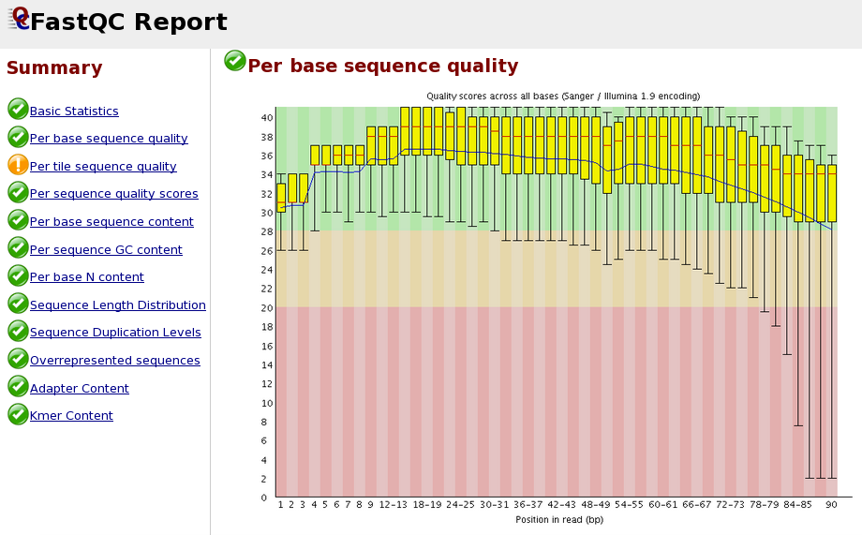
Sequence Handling
Quality control – FastQC
The Quality_Assessment handler runs FastQC on a list of FastQ, SAM, or BAM samples.
Produce a HTML document for each sample containing metrics on the sequence quality, sequence length distribution, sequence duplication levels, adapter content, and other base statistics.

Slide 10
sequence_handling handlers
Quality Assessment - FastQC
Read depths - Zip/Unzip/Grep
Calculates the read depth for each sample, using information from the FastQC files generated by the Quality_Assessment handler
(# of reads x read length) / target size

Slide 11
sequence_handling handlers
Quality Assessment - FastQC
Read depths - Zip/Unzip/Grep
Calculates the read depth for each sample, using information from the FastQC files generated by the Quality_Assessment handler
(# of reads x read length) / target size

Slide 12
sequence_handling handlers
Quality Assessment - FastQC
Read depths - Zip/Unzip/Grep
Adapter trimming - Scythe

Slide 13
sequence_handling handlers
Quality Assessment - FastQC
Read depths - Zip/Unzip/Grep
Adapter trimming - Scythe
Removes adapter sequences off of sample reads

Slide 14
sequence_handling handlers
Quality Assessment - FastQC
Read depths - Zip/Unzip/Grep
Adapter trimming - Scythe
Quality trimming - Sickle/ Seqqs

Slide 15
sequence_handling handlers
Quality Assessment - FastQC
Read depths - Zip/Unzip/Grep
Adapter trimming - Scythe
Quality trimming - Sickle/ Seqqs
Trims samples based on quality scores to remove low-quality regions.
Sickle performs the trimming and Seqqs generates trimming statistics
Works on single and paired-end data

Slide 16
sequence_handling handlers
Quality Assessment - FastQC
Read depths - Zip/Unzip/Grep
Adapter trimming - Scythe
Quality trimming - Sickle/ Seqqs
Read mapping - BWA-MEM

Slide 17
sequence_handling handlers
Quality Assessment - FastQC
Read depths - Zip/Unzip/Grep
Adapter trimming - Scythe
Quality trimming - Sickle/ Seqqs
Read mapping - BWA-MEM
Maps to reference genome

Slide 18
sequence_handling handlers
Quality Assessment - FastQC
Read depths - Zip/Unzip/Grep
Adapter trimming - Scythe
Quality trimming - Sickle/ Seqqs
Read mapping - BWA-MEM
SAM processing - Picard/ SAMtools

Slide 19
sequence_handling handlers
Quality Assessment - FastQC
Read depths - Zip/Unzip/Grep
Adapter trimming - Scythe
Quality trimming - Sickle/ Seqqs
Read mapping - BWA-MEM
SAM processing - Picard/ SAMtools
Sorts, de-duplicates, and adds read groups to the SAM files produced from Read Mapping into finished BAM files.
Creates before and after statistics using the flagstat function of SAMtools

Slide 20
sequence_handling handlers
Quality Assessment - FastQC
Read depths - Zip/Unzip/Grep
Adapter trimming - Scythe
Quality trimming - Sickle/ Seqqs
Read mapping - BWA-MEM
SAM processing - Picard/ SAMtools
Coverage mapping - BEDtools

Slide 21
sequence_handling handlers
Quality Assessment - FastQC
Read depths - Zip/Unzip/Grep
Adapter trimming - Scythe
Quality trimming - Sickle/ Seqqs
Read mapping - BWA-MEM
SAM processing - Picard/ SAMtools
Coverage mapping - BEDtools
Generates a coverage map for each BAM file

Slide 22
sequence_handling handlers
Quality Assessment - FastQC
Read depths - Zip/Unzip/Grep
Adapter trimming - Scythe
Quality trimming - Sickle/ Seqqs
Read mapping - BWA-MEM
SAM processing - Picard/ SAMtools
Coverage mapping - BEDtools
Indel realignment - GATK

Slide 23
sequence_handling handlers
Quality Assessment - FastQC
Read depths - Zip/Unzip/Grep
Adapter trimming - Scythe
Quality trimming - Sickle/ Seqqs
Read mapping - BWA-MEM
SAM processing - Picard/ SAMtools
Coverage mapping - BEDtools
Indel realignment – GATK
SNP calling

Slide 24
sequence_handling
What does it do?
It’s a workflow and it’s designed so each step can happen simultaneously for each sample - List-based Batch Submission
Notes:
List-based batch submission allows the workflow to run on multiple samples at once

Slide 25
sequence_handling
What does it do?
It’s a workflow and it’s designed so each step can happen simultaneously for each sample - List-based Batch Submission
Notes:
List-based batch submission allows the workflow to run on multiple samples at once

Slide 26
sequence_handling
What does it do?
It’s a workflow and it’s designed so each step can happen simultaneously for each sample - List-based Batch Submission
All of the handlers in sequence_handling rely on the information stored in the config file
Notes:
All of the handlers in sequence handling rely on the information stored in the config file. To edit the config file, open it in your favorite text editor such as vim or Sublime Text.
Follow the instructions in the config file to insert all the relevant information. Ideally, one shouldn't have to modify the config file between handlers. Each handler is self-contained.

Slide 27
sequence_handling
What does it do?
It’s a workflow and it’s designed so each step can happen simultaneously for each sample - List-based Batch Submission
All of the handlers in sequence_handling rely on the information stored in the config file
What does it does not do?
Runs all handlers automatically in the workflow (runs one handler at the time)
Notes:
List-based batch submission allows the workflow to run on multiple samples at once
All of the handlers in sequence handling rely on the information stored in the config file. To edit the config file, open it in your favorite text editor such as vim or Sublime Text.
Follow the instructions in the config file to insert all the relevant information. Ideally, one shouldn't have to modify the config file between handlers. Each handler is self-contained.

Slide 28
sequence_handling
git clone /panfs/roc/groups/9/morrellp/public/sequence_handling
git clone /panfs/roc/groups/9/morrellp/public/SH_Example_Data
Sequence Handling can be obtained from P. Morrell’s lab Github repository https://github.com/MorrellLAB/sequence_handling
README and documentation
For today’s exercise, in MSI:

Slide 29
Exercise
1. Create sample list
2. Edit Config file
3. Run analysis interactively

Slide 30
Exercise
1. Create sample list
2. Edit Config file
3. Run analysis interactively
Shared variable (top)
Handler-specific variables
Dependencies (bottom)
Notes:
Config file is broken up into several sections. The first section, at the top of Config contains variables that are used by more than one handler – shared variables.
Each section below is headed by a block of hash (#) marks and contains variables for one specific handler only.

Slide 31
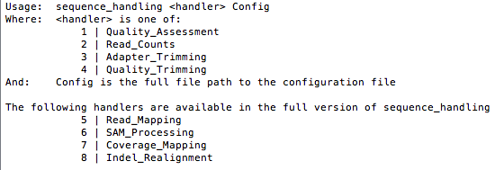
Exercise
In sequence-handling directory
ls
Config ErrorFiles Handlers HelperScripts README.md sequence_handling Sequence_Handling_Workflow.png
./sequence_handling
Notes:
Config file is broken up into several sections. The first section, at the top of Config contains variables that are used by more than one handler – shared variables. Each section below is headed by a block of hash (#) marks and contains variables for one specific handler only.

Slide 32
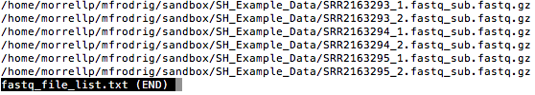
Exercise – Sample list
1. Create sample list (in SH_Example_data directory)
ls -d -1 $PWD/*.gz >fastq_file_list.txt
Check file
less fastq_file_list.txt

Slide 33
Exercise – Config shared variables
2. Edit Config file (located in sequence_handling directory)
RAW_SAMPLES=path_to_sample_fastq_list
OUT_DIR=path_to_output
PROJECT=project_name
EMAIL=user@example.com
PLATFORM=sanger
obs. this is the quality encoding, not the sequencing platform
Run fastqc on one sample to obtain encoding info
TIPS
No space in variable definition
pwd –P (for obtain path)
Final dir ${OUT_DIR}/Name_of_Handler

Slide 34
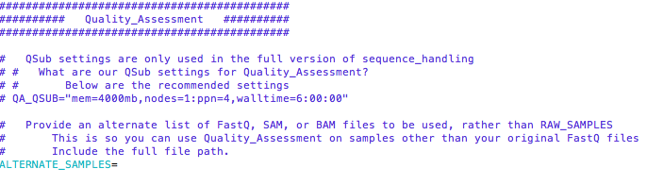
Exercise – Config handler-specific variables
2. Edit Config file cont. – for our exercise nothing needs to be added here

Slide 35
Exercise – Config dependencies
2. Edit Config file
############################################
########## Dependencies ##########
############################################
# This section defines installations to
# various dependencies for sequence_handling
…
# Do we have GNU parallel installed
#module load parallel
#PARALLEL=
#export PATH=${PARALLEL}:${PATH}
# Do we have FastQC installed?
#module load fastqc
#FASTQC=
#export PATH=${FASTQC}:${PATH}
In HPC - do module load
Delete # in front of module load for parallel and FASTQC

Slide 36
Exercise – Config Quality Assessment
3. Run analysis interactively
(in sequence_handling directory, in one of the high performance systems – lab, Itasca, Mesabi)
./sequence_handling 1 ~/sequence_handling/Config
(path to Config file)

Slide 37
Exercise – Config Quality Assessment results
Mac users:
firefox <fastqc.html>
PC users:
Instructions in email sent by Paul Hoffman today

Slide 38
Exercise Read-counts
1. Create sample list - DONE
2. Edit Config file
3. Run analysis
./sequence_handling 2 ~/sequence_handling/Config
Shared variable (top) - DONE
Handler-specific variables ** soybean 1.2Gb (use bp)
Dependencies (bottom) - DONE

Slide 39
Exercise Adapter trimming
1. Create sample list - DONE
2. Edit Config file
3. Run analysis
./sequence_handling 3 ~/sequence_handling/Config
Shared variable (top) - DONE
Handler-specific variables ** adapt file is in SH_Example_Data
Dependencies (bottom) ** remove # scyth

Slide 40
Exercise Quality trimming
1. Create sample list - DONE
2. Edit Config file
3. Run analysis
./sequence_handling 4 ~/sequence_handling/Config
Shared variable (top) - DONE
Handler-specific variables ** QT_THRESHOLD=20
Dependencies (bottom) ** remove # seqqs, sickle, R

