Slide 1
Sequence_handling
A series of scripts to automate sequence workflows
https://github.com/MorrellLAB/sequence_handling

Slide 2
Introduction
What is sequence_handling?
A modular workflow designed to automate the process of converting a dataset of FASTQ files into a singular VCF file
Why use sequence_handling?
Reproducible
Decreased computational and troubleshooting time
Visualization and quality assessment tools

Slide 3
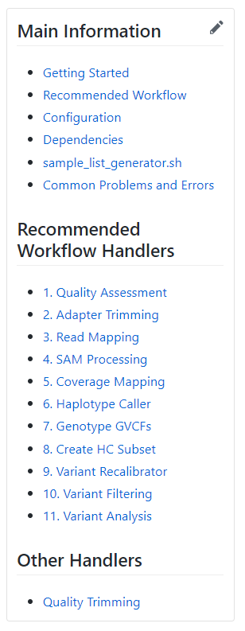
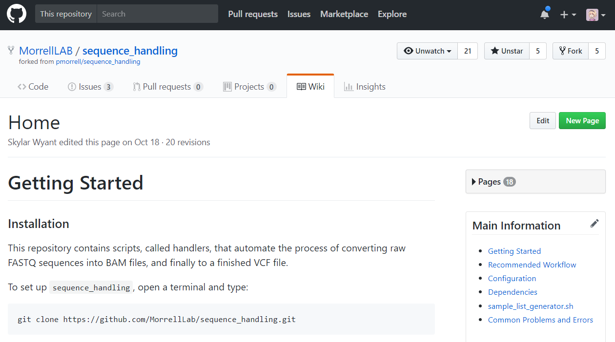
The Wiki

Slide 4
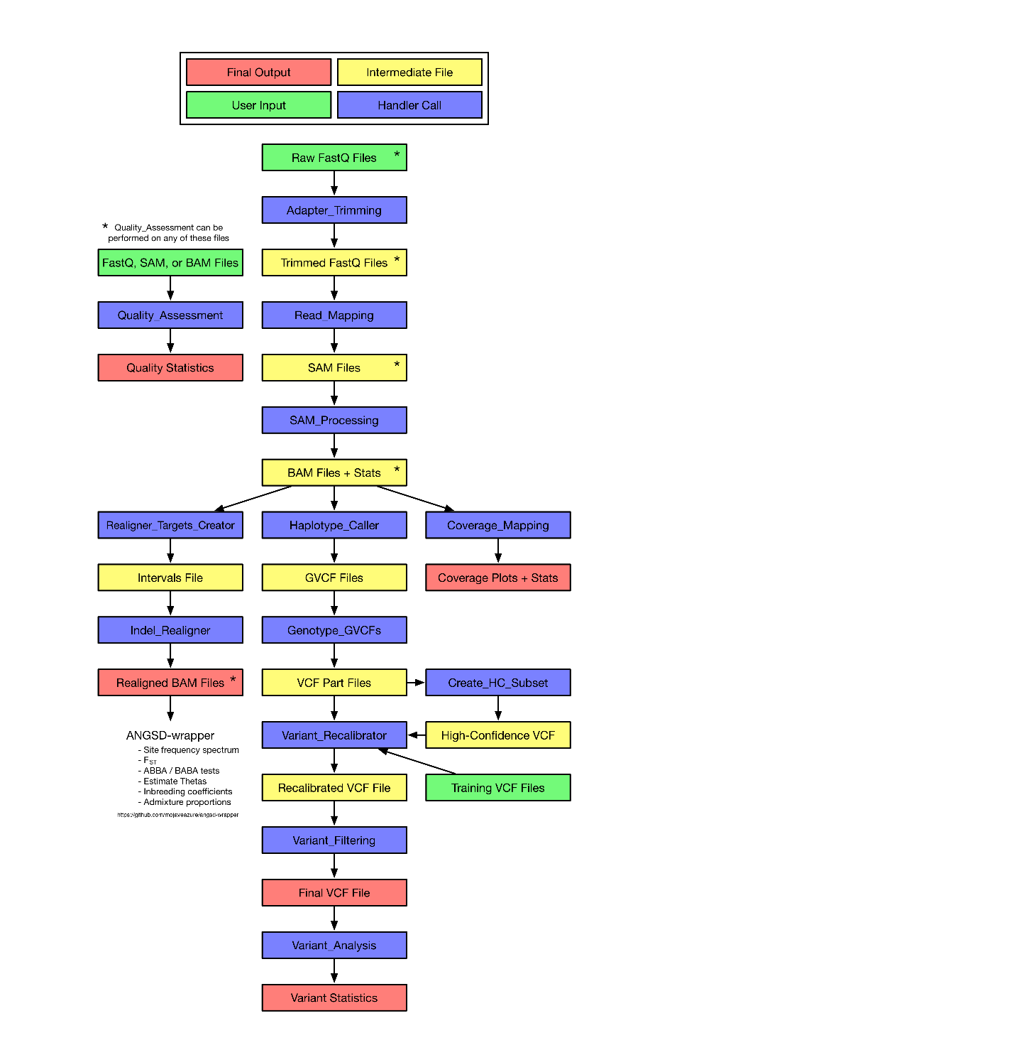
Recommended Workflow
https://github.com/MorrellLAB/sequence_handling/wiki/Recommended_Workflow

Slide 5
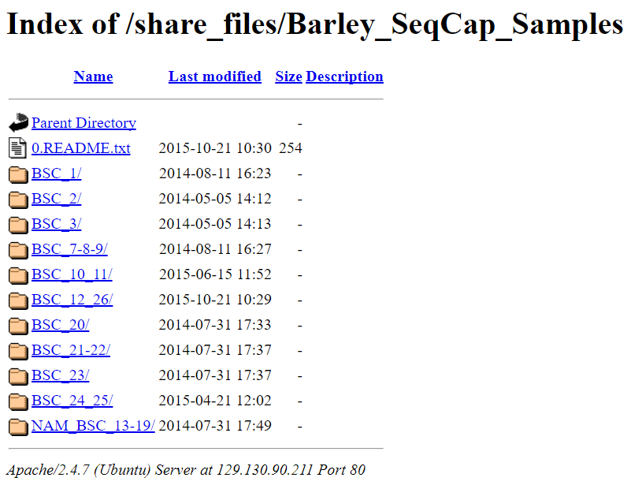
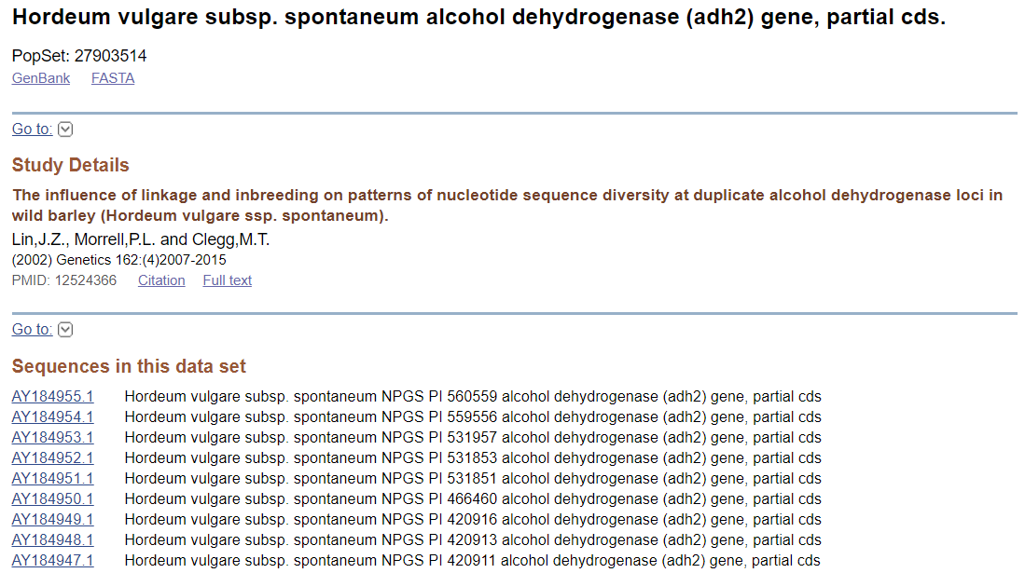
Step 0: Obtaining your raw sequence data
Downloaded directly from the sequencing center or self-produced
Downloaded from the Short Read Archive (SRA)
Lab utilities such as SRA_Fetch.sh by Tom Kono exist to automate the download process

Slide 6
Types of sequencing data
Whole genome sequencing
Exome capture
Genotype by sequencing (GBS)
The entire genome is sequenced
Usually paired-end
Very expensive for large genomes like barley
Only the regions that contain genes are sequenced
Usually paired-end
Less expensive
Only regions near restriction enzyme cut sites are sequenced
Always single-end
Cheapest option, but gives the least information
Sequence_handling can process all of these

Slide 7
What does raw sequencing data look like?
One or two files per sample
Each file contains millions of reads
A read is a short length of sequenced DNA, usually 100 – 150 base pairs in length
Each read also has quality information about each base pair
Follows the FASTQ format
How do you check the quality of your reads when each file has millions of them?

Slide 8
A single tab-delimited text file with summary information about each input file
A list of full file paths to each sample file in your dataset
Can accept FASTQ, SAM, or BAM files
Can accept gzipped and bzipped files
Step 1: Quality_Assessment
Depends on FastQC and GNU Parallel
Takes 30 minutes – 3 hours
Individual HTML files for each FASTQ file with quality plots and graphs for visualization
The expected size of the region that was covered by sequencing
Whole genome sequencing: the genome size
Exome capture: the size of the capture region
GBS: put “NA”
ZIP files not intended for human viewing

Slide 9
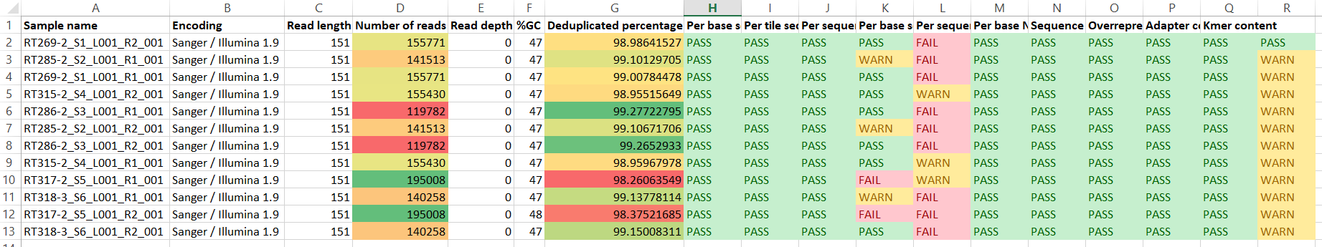
Quality_Assessment output
A single tab-delimited text file with summary information about each input file
Can be imported into Microsoft Excel and have conditional formatting applied to easily visualize data

Slide 10
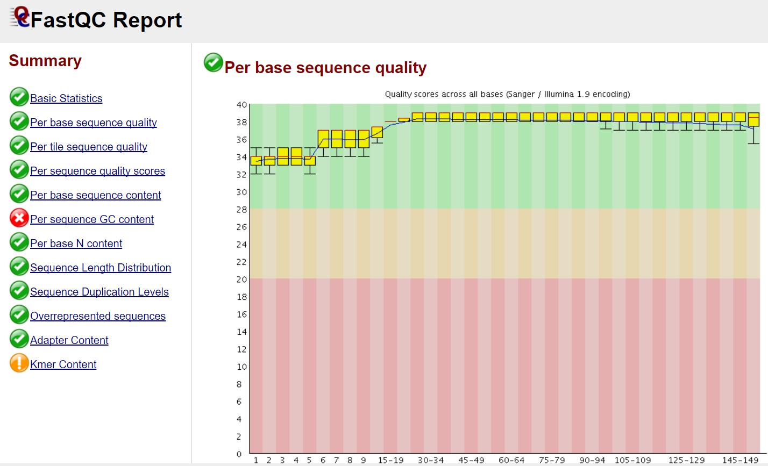

Slide 11
A list of full file paths to each raw FASTQ file in your dataset
Trimmed, gzipped, renamed FASTQ files
Shared suffixes that indicate if a FASTQ file contains forward, reverse, or single reads
Step 2: Adapter_Trimming
Depends on Scythe and GNU Parallel
Takes 30 minutes – 3 hours
A list of full file paths to all output FASTQ files
A FASTA file with adapter sequences
A prior contamination estimate, to be used in Scythe’s Bayesian approach
Default is 0.05

Slide 12
Shared suffixes explained
Sample01_R1.fastq
Sample01_R2.fastq
Sample02_A_R1.fastq
Sample02_B_R2.fastq
Test_03_R1.fastq
Test_03_R2.fastq
2017-12-06_R1.fastq
2017-12-06_R2.fastq
Shared forward suffix in blue
Shared reverse suffix in green
Quality_Assessment can be performed on the trimmed files to assure that adapters were removed properly

Slide 13
A list of full file paths to each trimmed FASTQ file
A reference sequence
Step 3: Read_Mapping
Depends on BWA-MEM and GNU Parallel
Each job takes 12 – 36 hours, but six can run simultaneously
Uses a task array, submitting one PBS job per sample
Shared suffixes that indicate if a FASTQ file contains forward, reverse, or single reads
One SAM file per sample
Forward and reverse reads are merged into one SAM file
BWA-MEM mapping parameters
Default parameters in Config are set for 100 base pair barley reads

Slide 14
A list of full file paths to each SAM file
One BAM file and index BAI file per sample
The sequencing platform that was used
Step 4: SAM_Processing
Can use either SAMtools or Picard, but Picard is recommended
Takes 6 – 18 hours per job
Uses a task array
A reference sequence
Deduplication and mapping quality statistics generated by SAMtools flagstat
A directory to hold temporary files generated by Picard

Slide 15
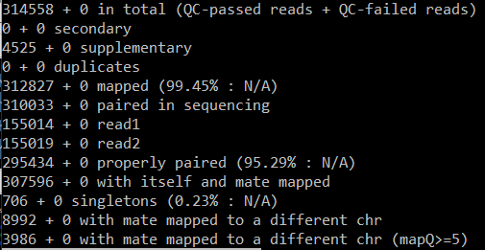
SAM_Processing statistics
A text file containing mapping and duplication statistics is generated for each raw sample and each deduplicated sample

Slide 16
A single tab-delimited text file with coverage information about each input BAM file
A list of full file paths to each BAM file
Step 5: Coverage_Mapping
Depends on BEDtools and R
Takes 30 minutes – 3 hours
Exome capture: A BED file containing the capture targets
For whole genome sequencing, leave this variable blank
For GBS data, do not use Coverage_Mapping
Text files with histograms generated by BEDtools
Future feature: histogram coverage plots for each sample generated by R

Slide 17
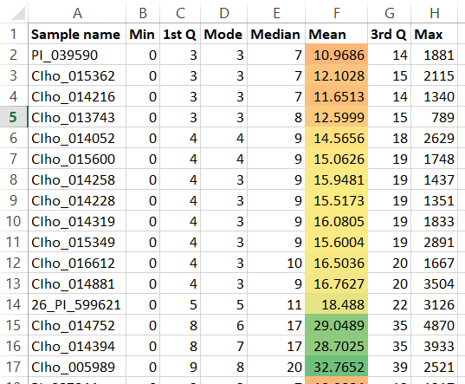
Coverage_Mapping output example

Slide 18
A list of full file paths to each BAM file
Step 6: Haplotype_Caller
Depends on the Genome Analysis Toolkit (GATK)
Takes 3 – 18 hours per job
Uses a task array
Memory intensive
A reference sequence
A genomic VCF file (GVCF) and an index file for each sample
The nucleotide diversity per base pair, Watterson's theta
Barley: 0.008
Soybean: 0.001

Slide 19
A list of full file paths to each GVCF file
The nucleotide diversity per base pair, Watterson's theta
Barley: 0.008
Soybean: 0.001
Step 7: Genotype_GVCFs
Depends on the Genome Analysis Toolkit (GATK)
Takes 3 - 12 hours per job
Uses a task array
Must be run on the entire dataset at once
A VCF file and an index file for each chromosome or chromosome part that contains information on all samples in the dataset
A reference sequence and reference dictionary
The number of chromosomes or chromosome parts
The sample ploidy. Highly inbred samples will have a ploidy of 1

Slide 20
A list of full file paths to each chromosome part VCF file
A singular VCF file containing only high-confidence variants
Step 8: Create_HC_Subset
Dependendencies:
VCFtools
vcflib
R
Python3
GNU Parallel
Takes 2 - 8 hours
Exome capture: A BED file containing the capture targets
If not exome capture, put “NA”
Should be the same BED file used in Coverage_Mapping
Before and after filtering tables showing the percentiles for depth per sample and genotyping quality
Filtering parameters
(more detail on next slide)

Slide 21
Create_HC_Subset: Filtering explained
Filters out sites outside of the exome capture region, if applicable
Filters out insertions, deletions, and sites with more than two alleles
If the quality score is missing or the site quality score is too low, filters out the site
If too many samples are heterozygous, filters out the site
If too many samples are "bad" (missing, low quality, or low depth), filters out the site
Blue = user defined threshold

Slide 22

Percentile tables
Easily compare before and after depth and genotyping quality
Allows for a guess-and-check strategy for finding the right filtering criteria
Unfiltered and filtered VCF files can be put through Variant_Analysis for more detail

Slide 23
A list of full file paths to each chromosome part VCF file
A reference sequence
For barley, this will be the full pseudomolecular reference, not the parts reference
Step 9: Variant_Recalibrator
Depends on the Genome Analysis Toolkit (GATK)
Also uses VCFtools and Python3
Takes 1 - 6 hours
Memory intensive
Requires at least 30 samples
A VCF file with the FILTER field annotated and an index file
The high-confidence VCF file and its prior
At least one reference VCF file and its prior

Slide 24
The full file path to the recalibrated VCF file
A reference sequence
For barley, this will be the full pseudomolecular reference, not the parts reference
A final, finished VCF file containing only variants that passed the filtering
Step 10: Variant_Filtering
Dependendencies:
VCFtools
vcflib
R
Python3
Takes 2 - 8 hours
Exome capture: A BED file containing the capture targets
If not exome capture, put “NA”
If barley, use the full pseudomolecular BED file, not the parts BED file
Before and after filtering tables showing the percentiles for depth per sample and genotyping quality
Filtering parameters
(more detail on next slide)

Slide 25
Variant_Filtering: Filtering explained
Filters out sites that have been tagged as false positives by Variant_Recalibrator
Filters out sites outside of the exome capture region, if applicable
Filters out insertions, deletions, and sites with more than two alleles
Genotypes that are under the minimum number of reads cutoff or over the maximum number of reads cutoff are set to missing
Samples with a unbalanced heterozygote call are set to missing
Genotypes below the GQ or DP thresholds are set to missing
If the quality score is missing or the site quality score is too low, filters out the site
If too many samples are heterozygous, filters out the site
If too many samples are "bad" (missing, low quality, or low depth), filters out the site
Monomorphic sites caused by filtering are removed
Blue = user defined threshold

Slide 26
A minor allele frequency histogram plotted with R
Heterozygosity summaries, missing-ness summaries, the Ts/Tv ratio, and the raw count of SNPs
Step 11: Variant_Analysis
Depends on VCFtools, vcflib,
molpopgen, Python3, GNU Parallel, BCFtools, R, TeX Live, and the Enthought Python Distribution
Takes 1 - 6 hours
The full file path to the VCF file to be analyzed
If barley, population genetics statistics are also generated for 18 loci to facilitate comparison with Sanger alignments in Morrell et al. 2006

Slide 27
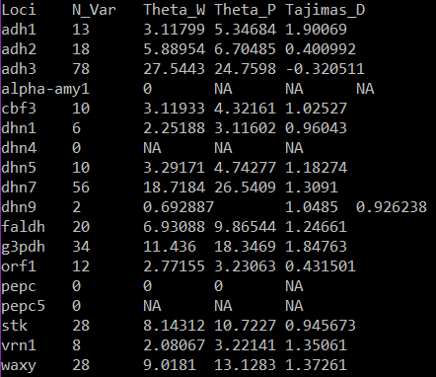
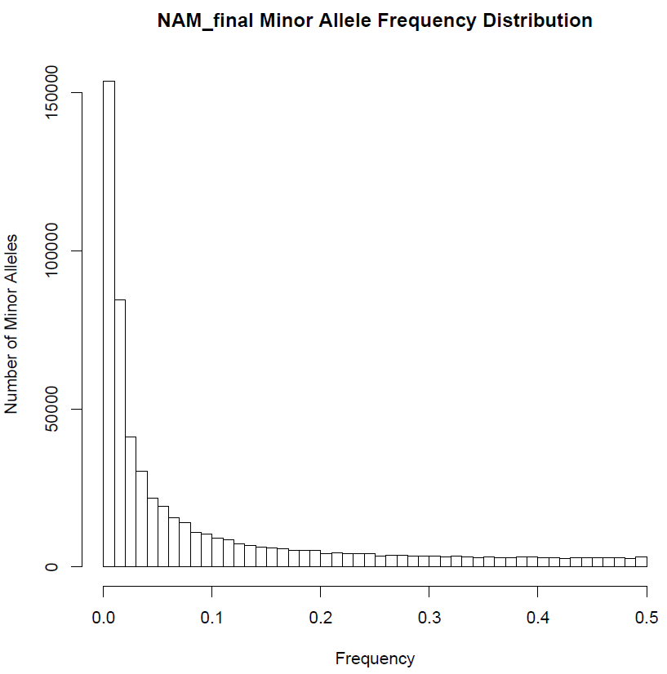
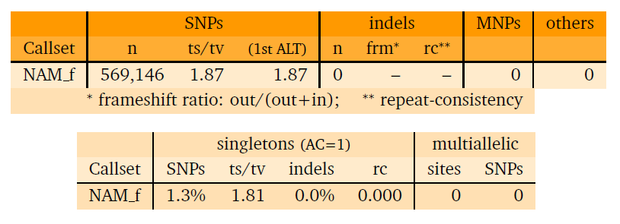
Variant_Analysis output

Slide 28
Future features
Coverage_Mapping histogram plots for each sample using R
Realigner_Targets_Creator and Indel_Realigner to realign BAM files to be used in ANGSD-wrapper
GBS_Demultiplex
10x genomics support, developed by Chaochih Liu

Slide 29
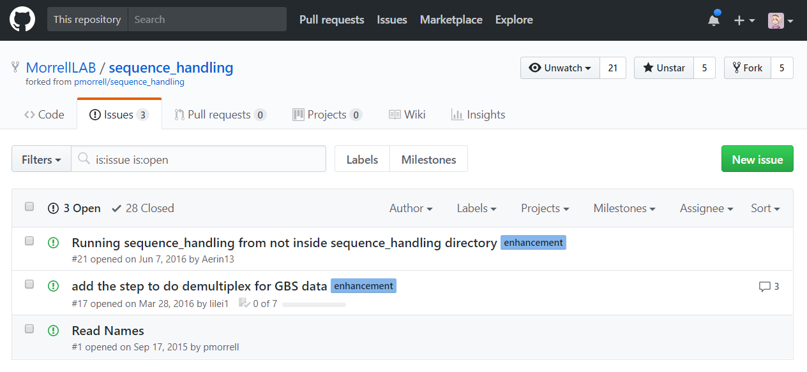
Want to request a new feature? Find a bug?

