Slide 1
Introduction to Statistics
Chaochih Liu and Skylar Wyant

Slide 2
Chapter 5: Basic Statistics

Slide 3
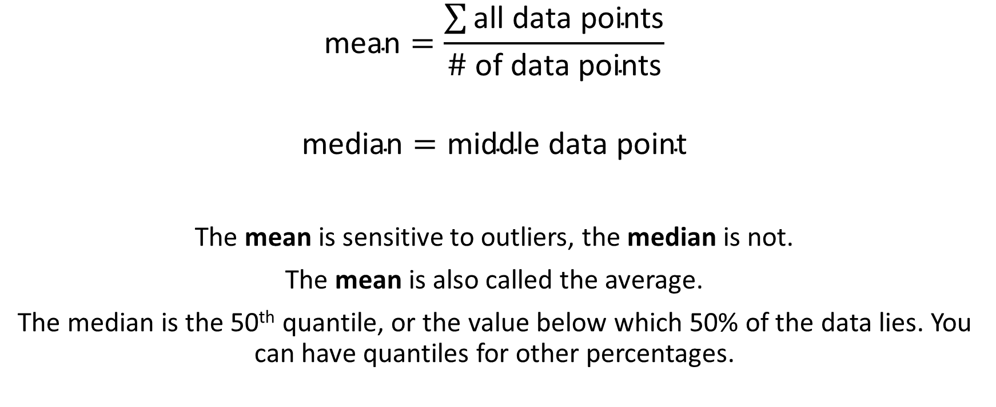
Describing Data Centrality
$$\text{mean}=\frac{\sum{\text{all} \text{data} \text{points}}}{\# \text{of} \text{data} \text{points}}$$
$$\text{median}=\text{middle} \text{data} \text{point}$$
The mean is sensitive to outliers, the median is not.
The mean is also called the average.
The median is the 50th quantile, or the value below which 50% of the data lies. You can have quantiles for other percentages.

Slide 4
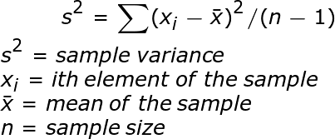

Describing Data Dispersion
$$\text{range}=\text{largest} \text{value}−\text{smallest} \text{value}$$
The standard deviation is the square root of the variance.
Range, variance, and standard deviation are all sensitive to outliers.
Interquantile range, or the difference between two quantiles, is more robust to outliers.

Slide 5
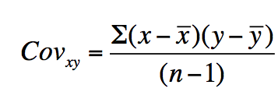
Covariance
Covariance measures how much two different variables vary together.
A “large” positive covariance means x is large when y is large. A “large” negative covariance means x is large when y is small. A covariance near zero means there is little relationship between the two.
Problems:
Units are products of both datasets
Very difficult to quantify what is a “large” versus a “small” covariance.

Slide 6
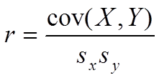
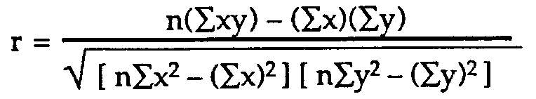
Correlation
Correlation is just the covariance divided by the standard deviations of each data set.
Correlation is unitless and lies between 1 (perfect correlation) and -1 (perfect anti-correlation).

Slide 7
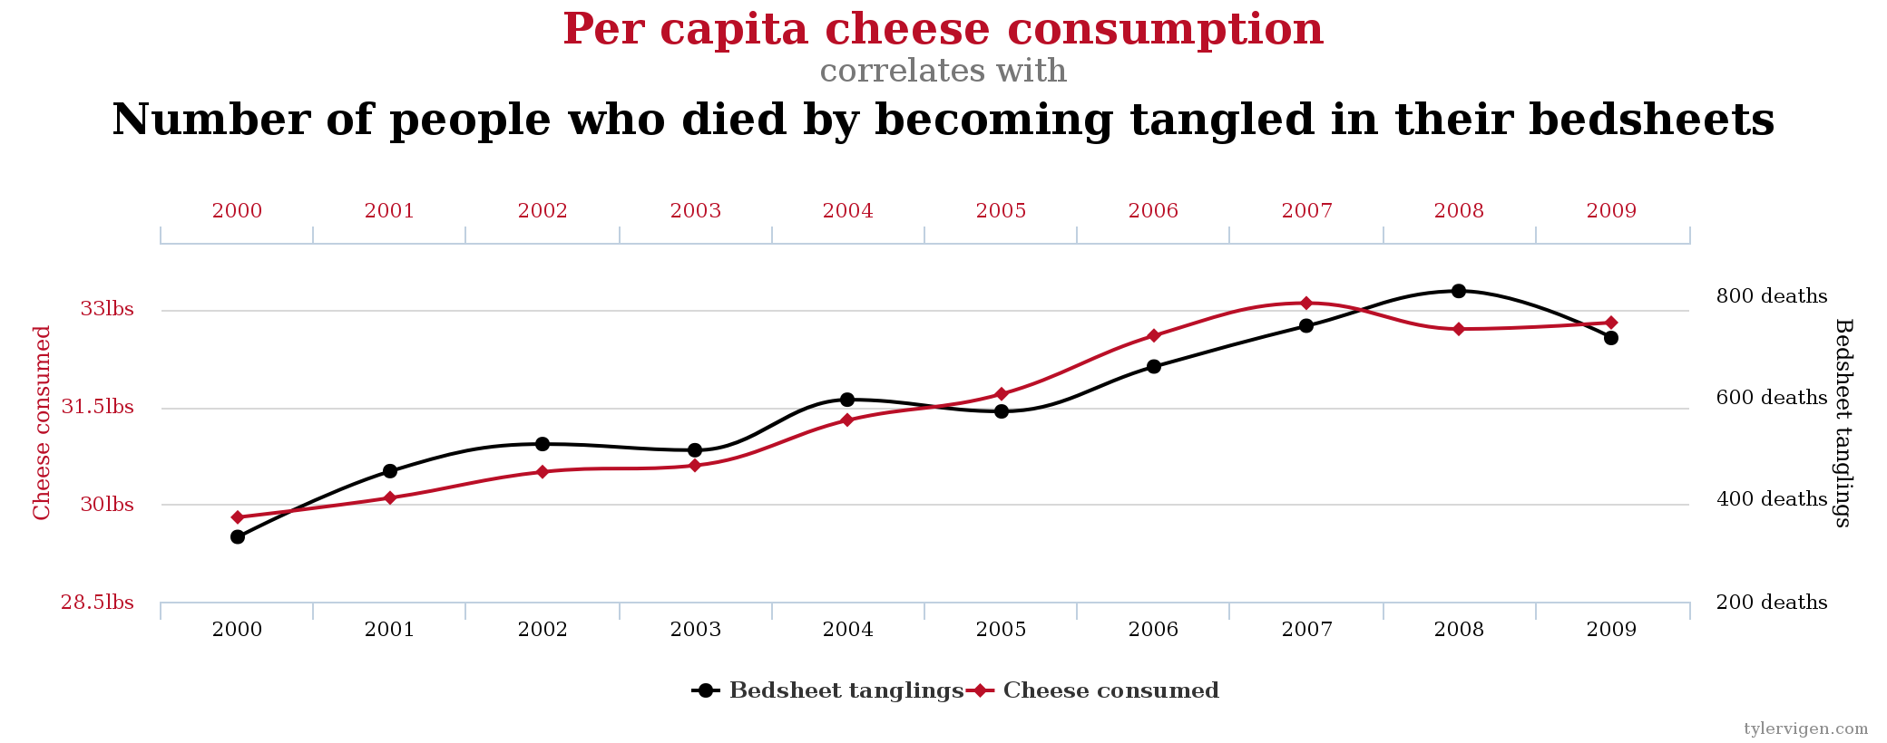
Correlation is not Causation!
Source: http://www.tylervigen.com/spurious-correlations

Slide 8
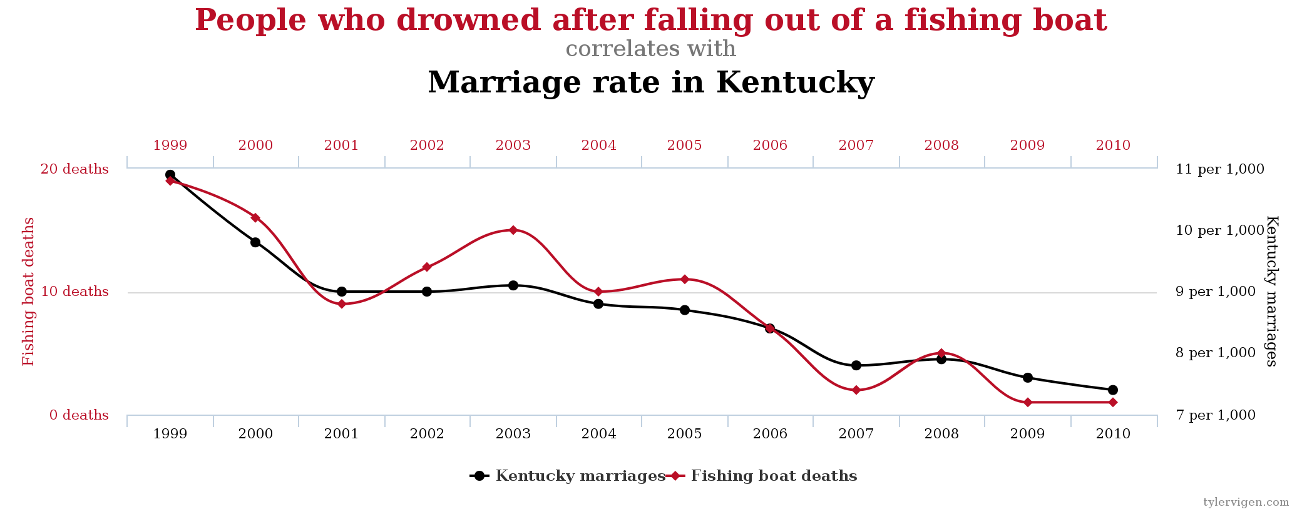
Source: http://www.tylervigen.com/spurious-correlations

Slide 9
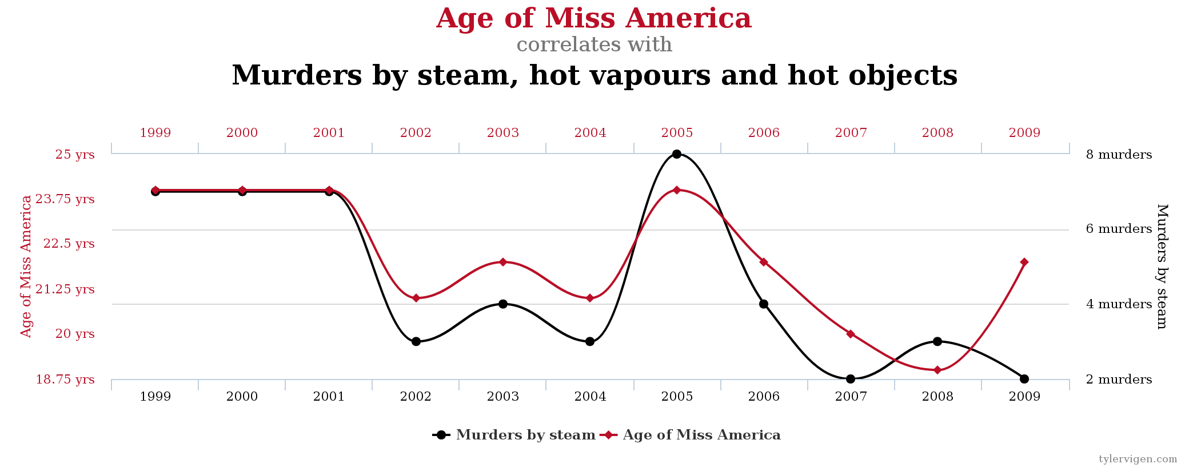
Source: http://www.tylervigen.com/spurious-correlations

Slide 10
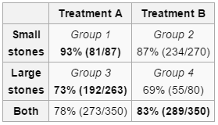
Simpson’s Paradox
Consider two different treatments for kidney stones. An experiment was performed and the results are shown below.
If you ignore the size of the stone, it looks like treatment B is the better treatment (83% versus 78%).
However, treatment A is better at treating both small stones (93% versus 87%) AND large stones (73% versus 69%).
Source: https://en.wikipedia.org/wiki/Simpson%27s_paradox

Slide 11
Chapter 6: Probability

Slide 12
Given a shuffled deck of 52 cards…

Slide 13
What is the probability that the top card is the Ace of Spades?

Slide 14
Independence and Dependence
Independence:
Given two events
Occurrence of Event A does not inform us about the probability that Event B will occur
Example:
Rolling same fair die twice
Pr[first roll is 2] = 1/6
Pr[second roll is 2] = 1/6
Dependence:
Given two events
Occurrence of Event A provides some info about results of Event B
Example:
Drawing a King then a Queen from a deck of 52 cards without replacing the cards
Pr[first draw is a King] = 4/52
Pr[second draw is a Queen] = 4/51

Slide 15
Conditional Probability
Conditional Probability: the probability of an event occurring given that a condition is met.
The notation is Pr[event | condition] or Pr[A | B].

Slide 16
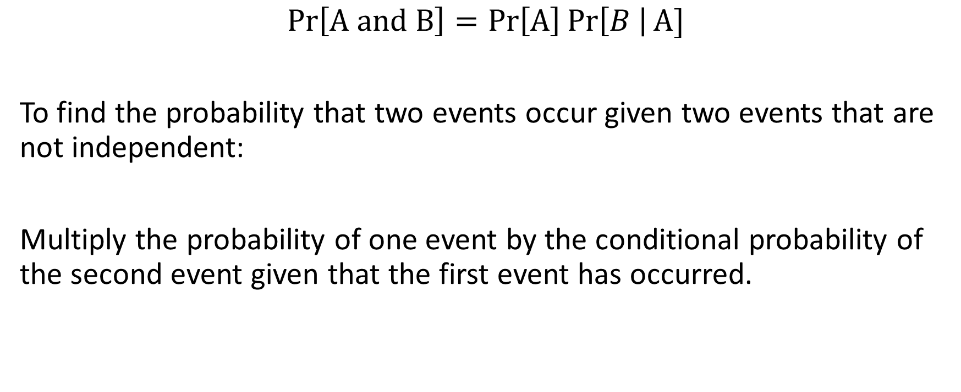
The General Multiplication Rule
$$Pr\left[A and B\right]=\operatorname{Pr}\left[A\right]\operatorname{Pr}\left[B \right|A]$$
To find the probability that two events occur given two events that are not independent:
Multiply the probability of one event by the conditional probability of the second event given that the first event has occurred.

Slide 17
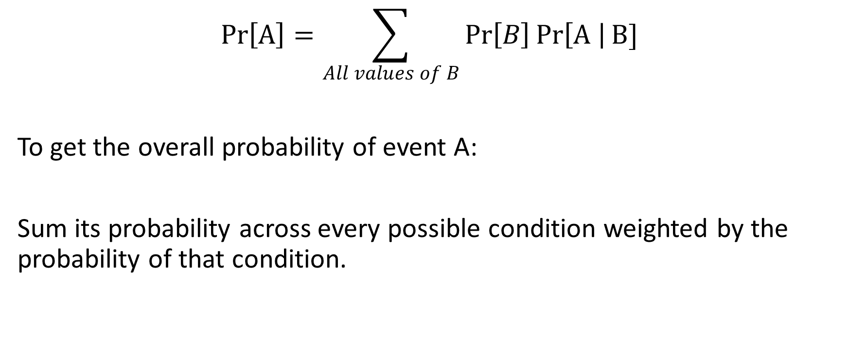
The Law of Total Probability
$$Pr\left[A\right]=\sum_{All values of B}{\operatorname{Pr}\left[B\right]\operatorname{Pr}\left[A \right|B]}$$
To get the overall probability of event A:
Sum its probability across every possible condition weighted by the probability of that condition.

Slide 18
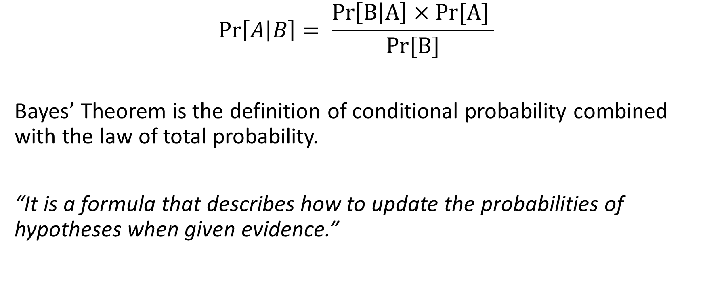
Bayes’ Theorem
$$Pr\left[A | B\right]= \frac{\operatorname{Pr}\left[B | A\right]×Pr[A] }{Pr[B]}$$
Bayes’ Theorem is the definition of conditional probability combined with the law of total probability.
“It is a formula that describes how to update the probabilities of hypotheses when given evidence.”

Slide 19
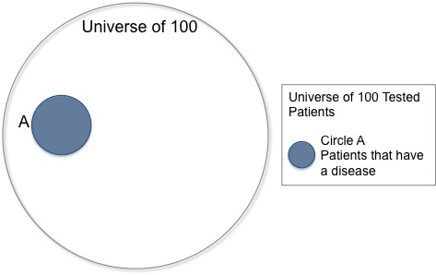
Bayes’ Theorem Example
A disease is present in 5 out of 100 people, and a test that is 90% accurate is administered to 100 people. If one person in the group tests positive, what is the probability that this one person has the disease?
Total population is 100.
5 people have the disease.
Notes:
https://brilliant.org/wiki/bayes-theorem/#visualizing-bayes-theorem

Slide 20
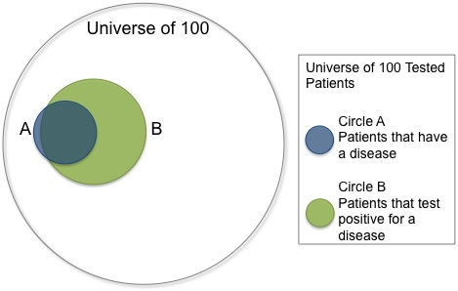
Bayes’ Theorem Example
Total population is 100.
5 people have the disease.
90% of those with the disease will get positive result.
10% of the population who doesn’t have the disease will get a positive result.
Notes:
https://brilliant.org/wiki/bayes-theorem/#visualizing-bayes-theorem

Slide 21
Bayesian Statistics
A way to use probability to represent uncertainty about the unknown.

Slide 22
Bayesian Inference
Method that uses Bayes’ Theorem to update the probability of a hypothesis as more evidence becomes available.

Slide 23
Types of Data
Numerical
Continuous | Any real-number value within some range Ex: core body temp, height, weight, cigarette consumption rate, etc.
Discrete | Indivisible units Ex: number of children, number of cigarettes consumed per day, etc.
Categorical
Ordinal | Having an order Ex: Life stage, stage of cancer, etc.
Nominal | No inherent order Ex: Sex (male/female), blood group (A, B, AB, O), predominant language spoken, etc.
Numerical variable:
Describes quantitative measurements with magnitude on a numerical scale
Quantitative characteristics that are expressed as numbers
Categorical variable:
Describes membership in a category or group
Qualitative characteristics that don’t correspond to a degree of difference on a numerical scale

Slide 24
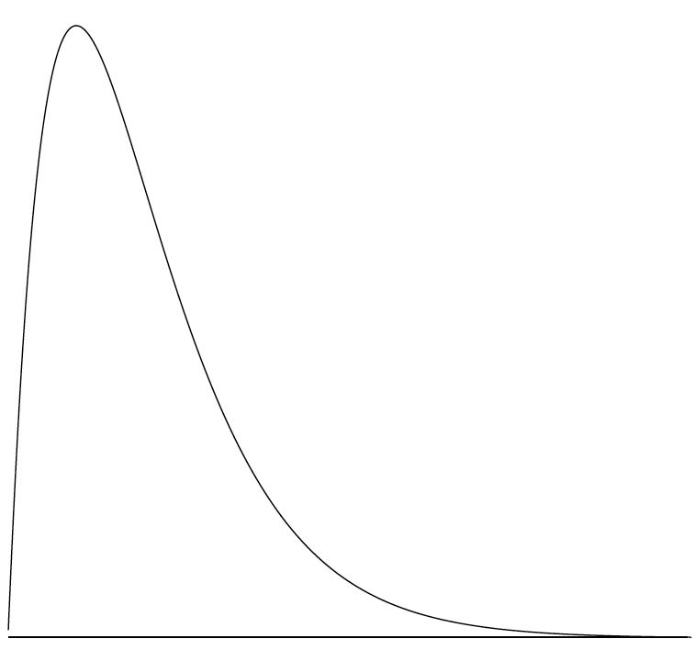
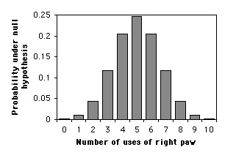
Distributions
Continuous Distributions
Discrete Distributions
Notes:
Image Sources: http://onlinestatbook.com/2/introduction/graphics/pos_skew.jpg and http://www.biostathandbook.com/pix/exactbingraph.gif

Slide 25
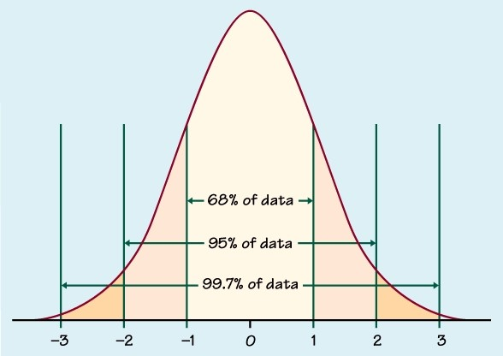
The Normal Distribution
Characteristics:
A continuous probability distribution describing a bell-shaped curve
Probability measured by the area under the curve (not the height of the curve)
Symmetrical around its mean
Has a single mode
Probability density is highest exactly at the mean
We use it because it is a good approximation to the frequency distributions of many biological systems

Slide 26
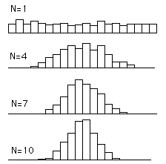
The Central Limit Theorem
The sum or mean of a large number of measurements randomly sampled from a non-normal population is approximately normally distributed.
Fit gets better as sample size increases.
Many powerful statistical methods available for analyzing biological data assume the distribution of sample means follows a normal distribution.
Notes:
Image: http://davidmlane.com/hyperstat/pictures/sampling_dist3.GIF

Slide 27
Expected Values
Current Powerball jackpot (08/03/16): $40,000,000
Odds of winning jackpot: 1/292,201,338
Cost of Powerball ticket: $2
To compute the expected value:
($40,000,000 * 1/292,201,338) + ($0 * 292,201,337/292,201,338) = $0.14
But you payed $2 for the ticket, so on average you will lose $1.86 per ticket you buy!
Note that this analysis isn’t entirely accurate since you can win smaller prizes that aren’t the jackpot by having a partial number match.

Slide 28
Chapter 7: Hypothesis Testing

Slide 29
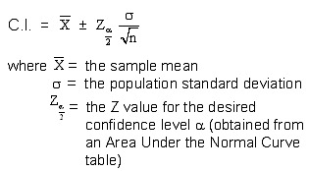
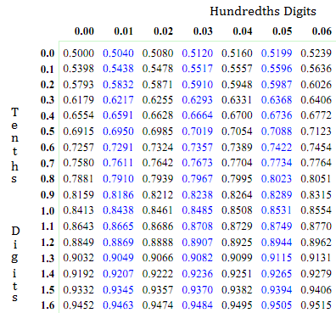
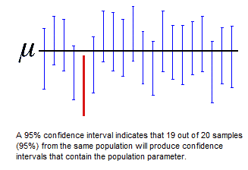
Confidence Intervals

Slide 30
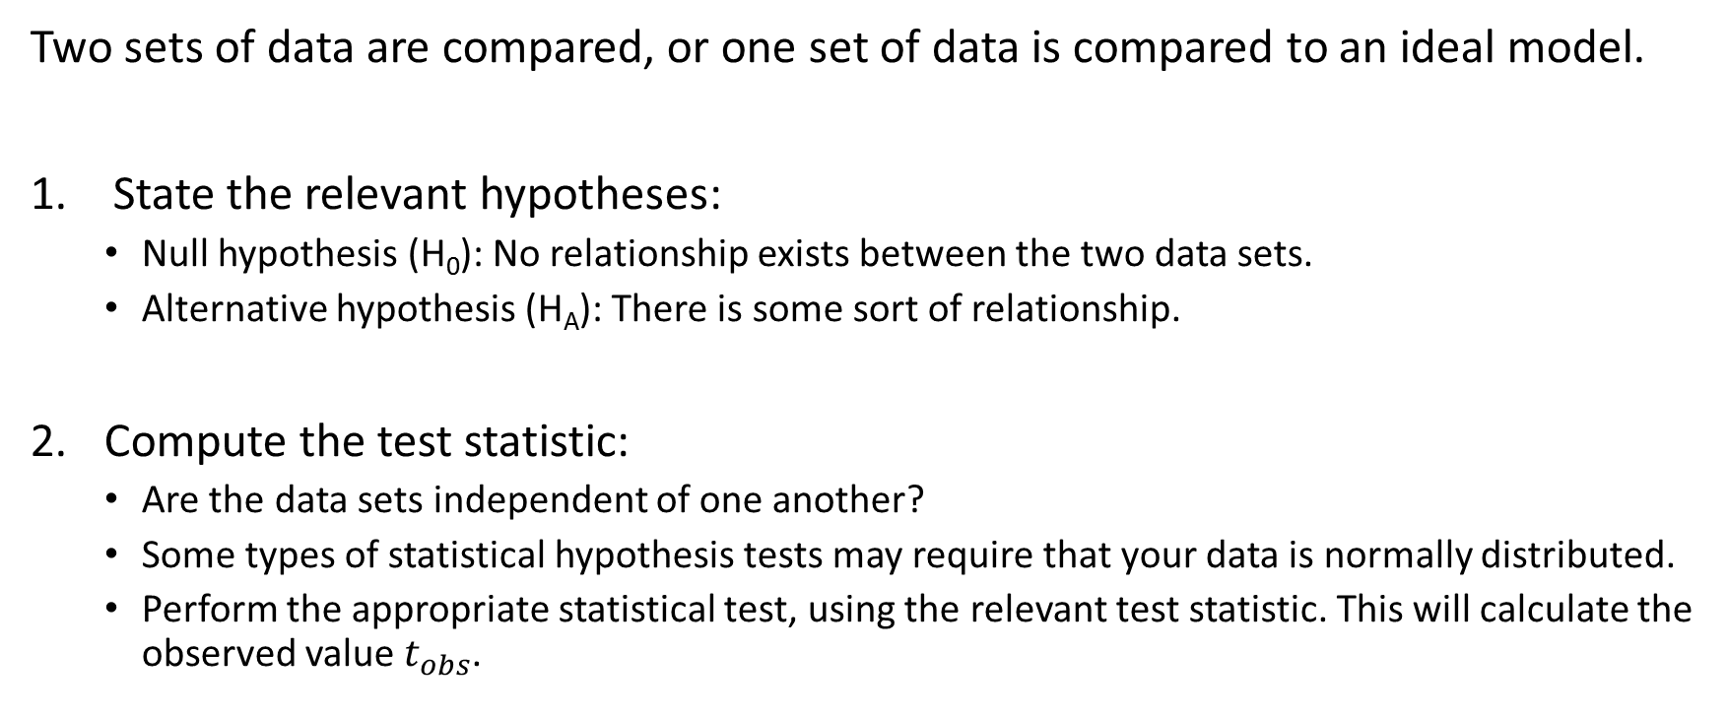
The Hypothesis Testing Process
Two sets of data are compared, or one set of data is compared to an ideal model.
State the relevant hypotheses:
Null hypothesis (H₀): No relationship exists between the two data sets.
Alternative hypothesis (H_{A}): There is some sort of relationship.
Compute the test statistic:
Are the data sets independent of one another?
Some types of statistical hypothesis tests may require that your data is normally distributed.
Perform the appropriate statistical test, using the relevant test statistic. This will calculate the observed value$t_{obs}$.

Slide 31
The Hypothesis Testing Process
Determine the p-value.
Select a significance level
Most commonly this is set to α = 0.05.
Draw the appropriate conclusions.
Compare your p-value and your significance level α. If p < α, then reject the null hypothesis. If p > α, then you cannot reject the null hypothesis.
Note: if you reject the null hypothesis, it does not mean that the alternative hypothesis is true. If you fail to reject the null hypothesis, it does not mean the null hypothesis is true.

Slide 32
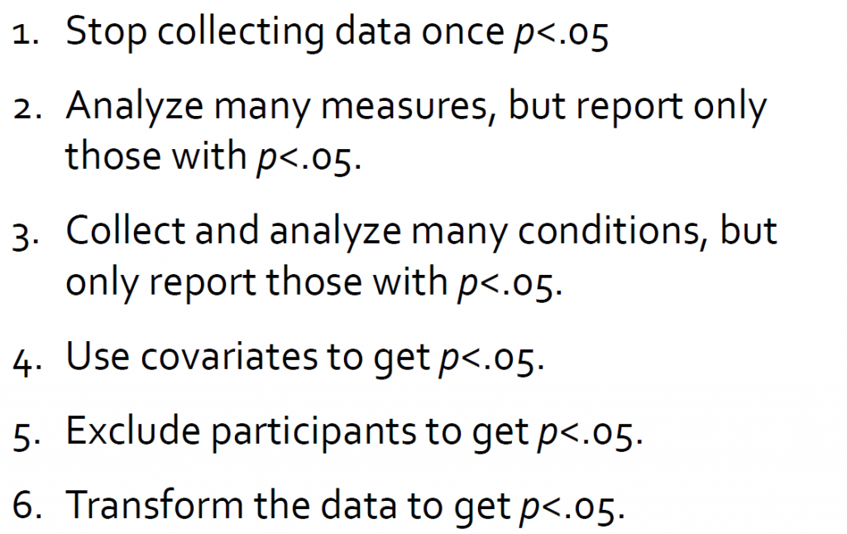
P-hacking
P-hacking example
Notes:
http://fivethirtyeight.com/features/science-isnt-broken/#part2

Slide 33
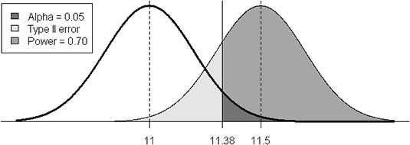
Type 1 and Type 2 Errors
Conclusion | H­₀ True | H­₀ False
Reject H­₀ | Type I error | Correct
Do not reject H­₀ | Correct | Type II error

Slide 34
Type 1 and Type 2 Errors
Reduce Type I error rate: use smaller significance level (i.e. α = 0.01)
Makes H₀ more difficult to reject when true
Makes H₀ more difficult to reject when false
Side effect: increases chance of committing a Type II error

Slide 35
Power
Power: Probability of not making a type 2 error.
Study has high power if it has a low probability of Type II error.
More power makes a study better.
Notes:
Note: it is difficult to predict with confidence how much power a study really has

Slide 36
Type I or Type II Error?
Conclusion | H­₀ True | H­₀ False
Reject H­₀ | Type I error | Correct
Do not reject H­₀ | Correct | Type II error
Scenario:
We have a person in court on trial for murder. The penalty is a death sentence.
What are the costs associated with committing a Type I vs. Type II error?

Slide 37
Type I or Type II Error?
Conclusion | H­₀ True | H­₀ False
Reject H­₀ | Type I error | Correct
Do not reject H­₀ | Correct | Type II error
H₀ Hypothesis | Type I Error / False Positive | Type II Error / False Negative
Person is not guilty of the crime. | Person did not commit the crime but is judged as guilty (convicting innocent person) | Person did commit the crime but is judged not guilty (letting guilty person go free)
Cost Assessment | Costs of a death sentence for an innocent person. | Risks of letting a criminal roam the streets and commit future crimes.

