Slide 1
Data Science from Scratch
Chapter 11: Machine Learning
Does[0]Compute
Kevin Silverstein
19 August, 2016

Slide 2
Outline
Modeling
What is Machine Learning
Overfitting and Underfitting
Correctness
The Bias-Variance Trade-off
Feature Extraction and Selection

Slide 3
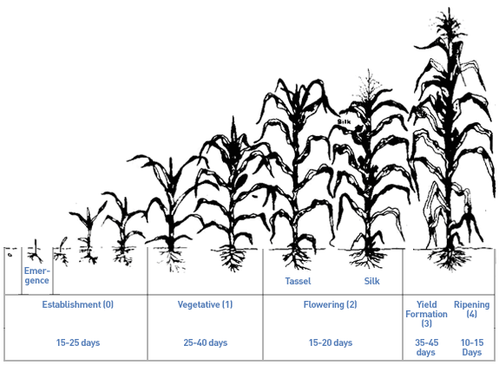
Modeling
A model is a specification of a mathematical (or probabilistic) relationship between different variables.

Slide 4
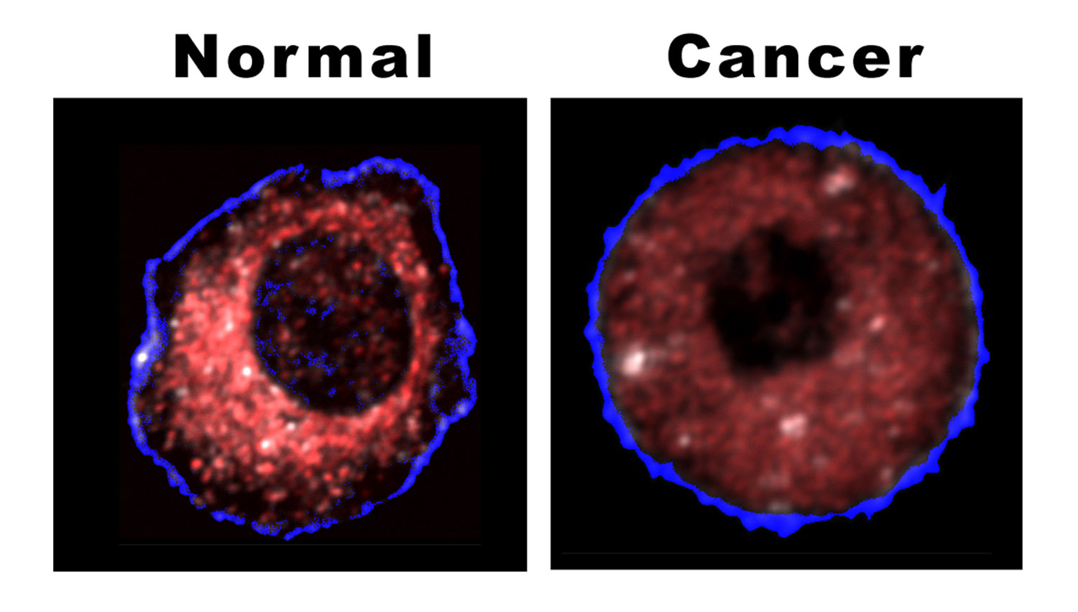
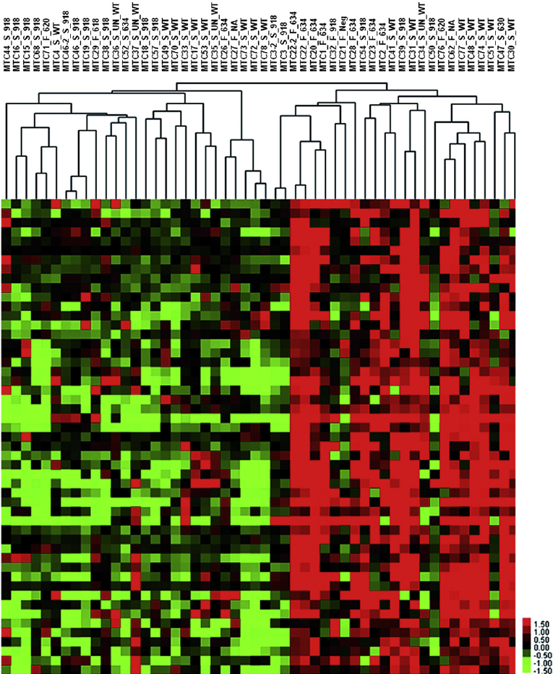
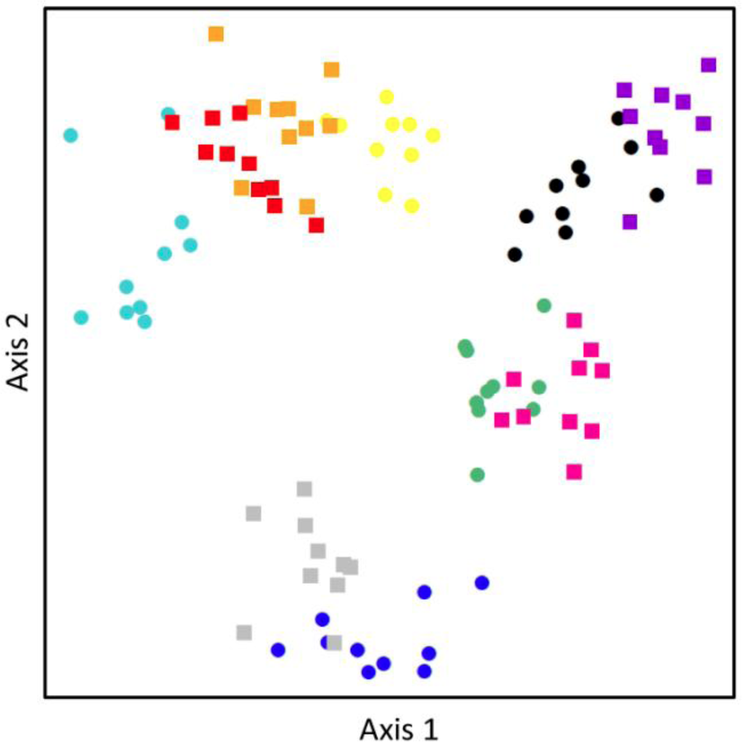
What is Machine Learning?
Creating and using models that are learned from data.

Slide 5
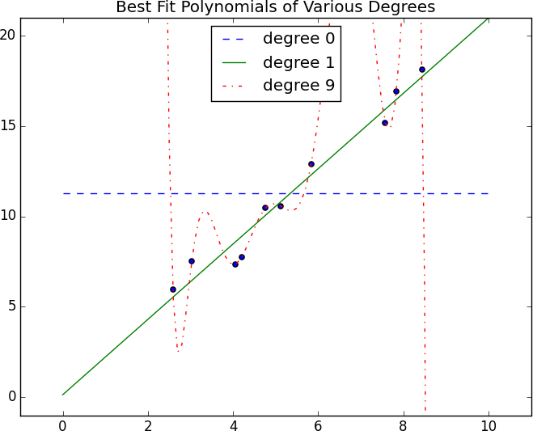
Overfitting and Underfitting (1/3)
Overfitting – producing a model that performs well on the data you train it on, but generalizes poorly to new data.
Underfitting – producing a model that doesn’t perform well even on the training data.

Slide 6
Overfitting and Underfitting (2/3)
import random
def split_data(data, prob):
"""split data into fractions [prob, 1 - prob]"""
results = [], []
for row in data:
results[0 if random.random() < prob else 1].append(row)
return results
>>> x = [1, 3, 5, 7, 9, 11, 13, 15, 17, 19]
>>> split_data(x, 0.33)
([1, 3, 7, 15], [5, 9, 11, 13, 17, 19])
>>> split_data(x, 0.33)
([1, 11, 15], [3, 5, 7, 9, 13, 17, 19])
>>> split_data(x, 0.33)
([11, 19], [1, 3, 5, 7, 9, 13, 15, 17])
>>> split_data(x, 0.33)
([3, 11, 17, 19], [1, 5, 7, 9, 13, 15])
Separating your data set into a training set and a test set is a good idea.

Slide 7
Overfitting and Underfitting (3/3)
def train_test_split(x, y, test_pct):
data = zip(x, y) # pair corresponding values
train, test = split_data(data, 1 - test_pct) # split the data set pairs
x_train, y_train = zip(*train) # magical un-zip trick
x_test, y_test = zip(*test)
return x_train, x_test, y_train, y_test
>>> y = [2, 4, 6, 8, 10, 12, 14, 16, 18, 20]
>>> train_test_split(x, y, 0.33)
((1, 3, 5, 7, 9, 11, 13, 15, 19), (17,), (2, 4, 6, 8, 10, 12, 14, 16, 20), (18,))
>>> train_test_split(x, y, 0.33)
((3, 7, 9, 11, 13, 17, 19), (1, 5, 15), (4, 8, 10, 12, 14, 18, 20), (2, 6, 16))
>>> train_test_split(x, y, 0.33)
((1, 5, 7, 11, 15, 19), (3, 9, 13, 17), (2, 6, 8, 12, 16, 20), (4, 10, 14, 18))
When you have paired vectors of input variables x and output variables y, you can use zip() to keep corresponding values from both vectors together.

Slide 8
How can the train/test split go wrong?
Common pattern in both test and training data won’t generalize to a larger data set
If you use the test/train split to choose among many models.
This meta-training picks out your best test set, not your best model
You should split data into three parts
Training set for building models
Validation set for choosing among trained models
Test set for judging the final model

Slide 9
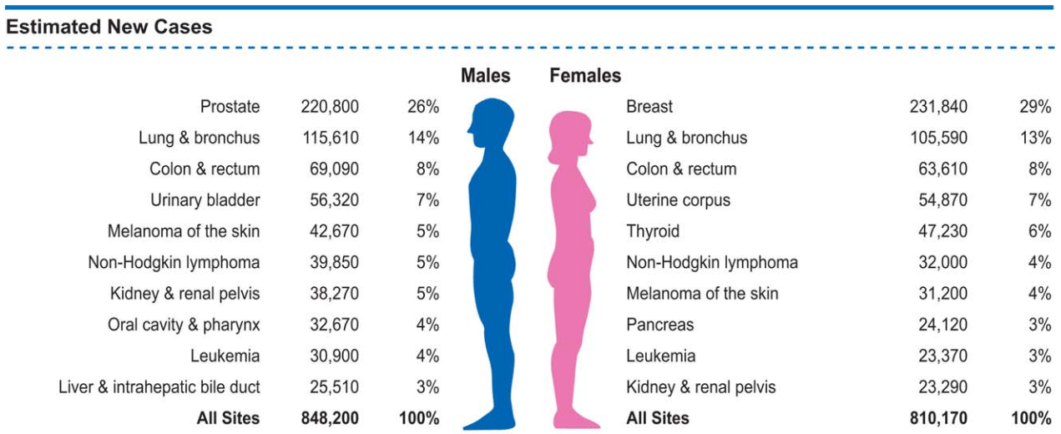
Correctness (1/4)
 | Cancer | Not Cancer
Predict “Cancer” | True Positive | False Positive
Predict “Not Cancer” | False Negative | True Negative
Siegel, Miller and Jemel, CA Cancer J. Clin 2015; 65:5-29.
To evaluate a model you need to consider all elements of the confusion matrix.

Slide 10
Correctness (2/4)
PSA screening and mammograms are blunt tools
70-80% of men with elevated PSA who have a biopsy don’t have cancer [false-positive rate]
About 20% of men who have cancer also have a normal PSA (less than 4 ng/ml) [false-negative rate]
Mammogram sensitivity (i.e., recall) = 84%
50-60% false-positive rate after 10 years of mammograms implies 7% false positive rate per test: 1-(1-fp)^10 = 0.5
http://www.harvardprostateknowledge.org/is-psa-reliable
https://ww5.komen.org/BreastCancer/AccuracyofMammograms.html

Slide 11
Correctness (3/4)
def accuracy(tp, fp, fn, tn):
correct = tp + tn
total = tp + fp + fn + tn
return correct / total
def precision(tp, fp, fn, tn):
"""Aka positive predictive value (PPV)"""
return tp / (tp + fp)
def recall(tp, fp, fn, tn):
"""Aka sensitivity"""
return tp / (tp + fn)
Exercise: compute accuracy, precision and recall for PSA screening and mammograms based on the statistics from the previous slides.
Then play with https://kennis-research.shinyapps.io/Bayes-App/

Slide 12
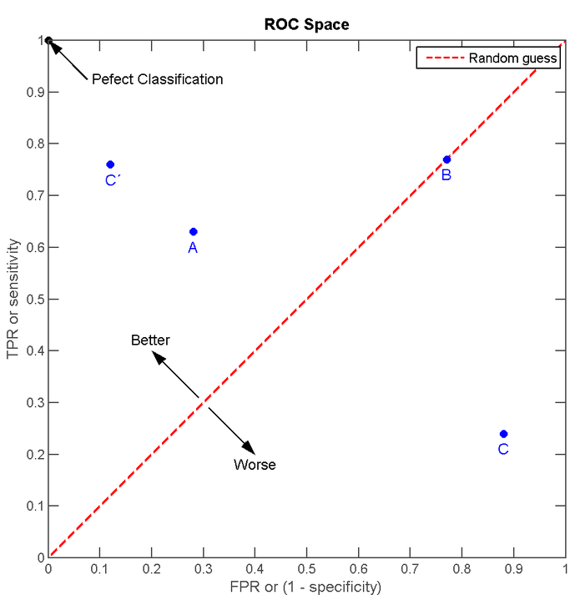
Correctness (4/4)
Receiver Operator Curve (ROC) can distinguish better models/predictors from worse ones.

Slide 13
The Bias-Variance Trade-off (1/2)
High bias & low variance (degree 0) – increase complexity of the model.
More data won’t help!

Slide 14
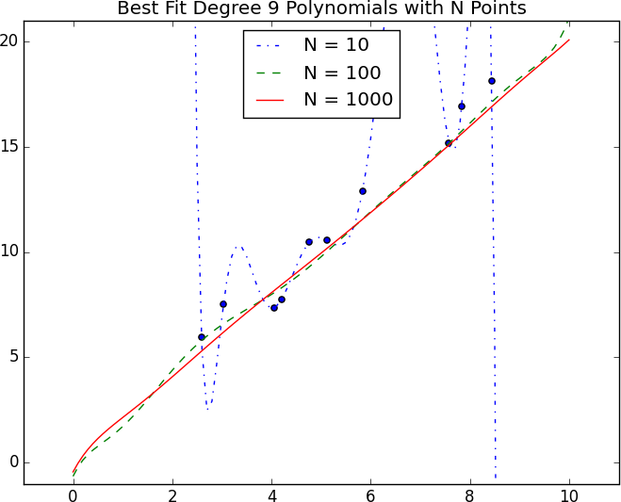
The Bias-Variance Trade-off (2/2)
low bias & high variance (degree 9) – increase data usually helps.

Slide 15
Feature Extraction and Selection
Variables that go into the model (e.g., GXE → yield)
Categorical
Genetic markers
Soil type
Boolean
Fertilizer applied (Y/N)
Numerical
Altitude
Longitude
Max & Min Temperature
Precipitation during cropping cycles
Not every variable is useful!
Choose using experience & domain expertise

