Slide 1
Intro to Data Science and Linear Algebra
Connor Depies and Felipe Reyes

Slide 2
Chapter 1: Welcome to DataSciencester!
As a data scientist you will:
Extract insights from messy data
Avoid making a mess of insightful data

Slide 3
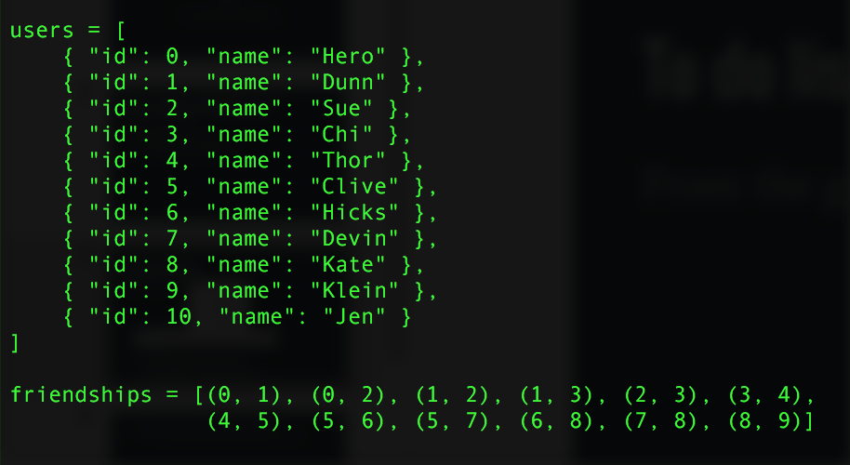
To do list for day one
From the given data:
Build connections
Create networks
Friends suggester

Slide 4
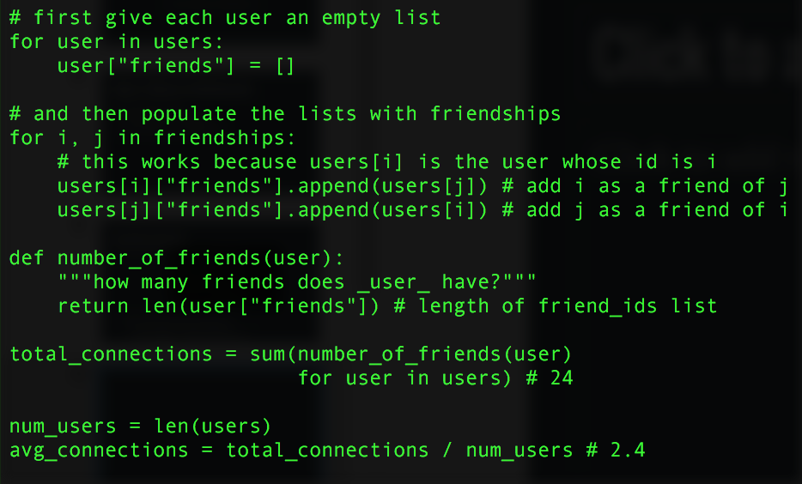
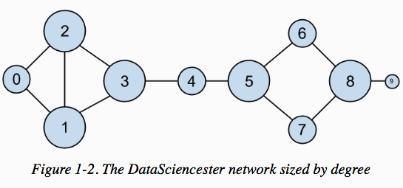
More on building networks and degree of centrality on Ch 21

Slide 5
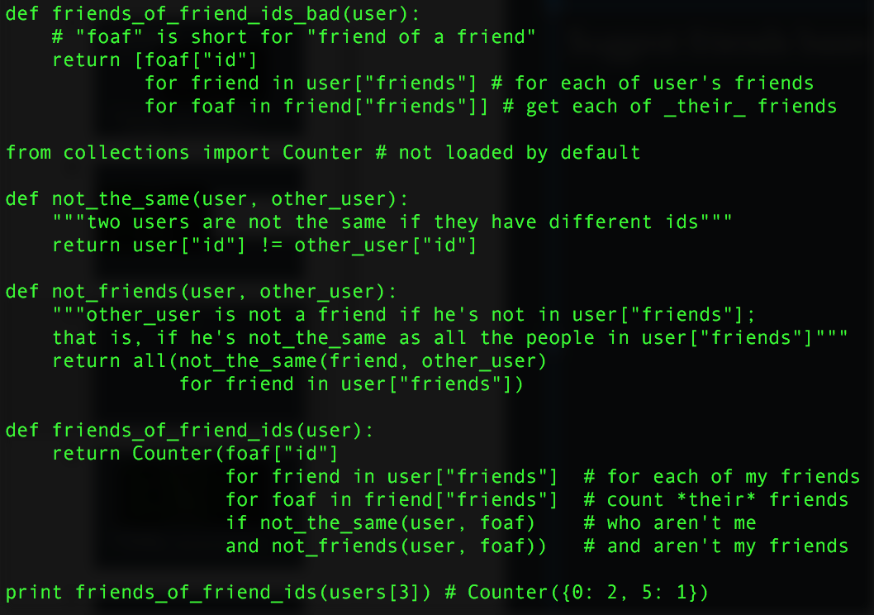
Suggest friends based on mutual friends

Slide 6
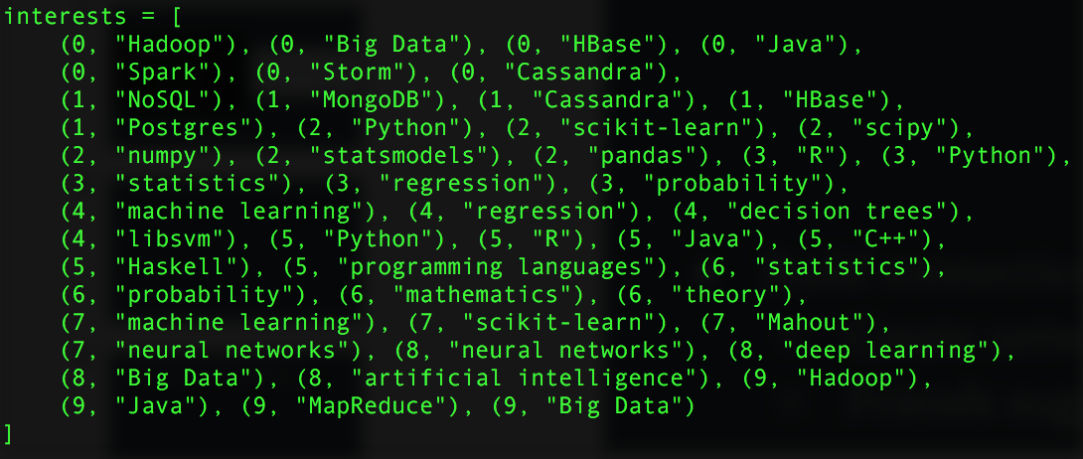
What if you know their interests

Slide 7
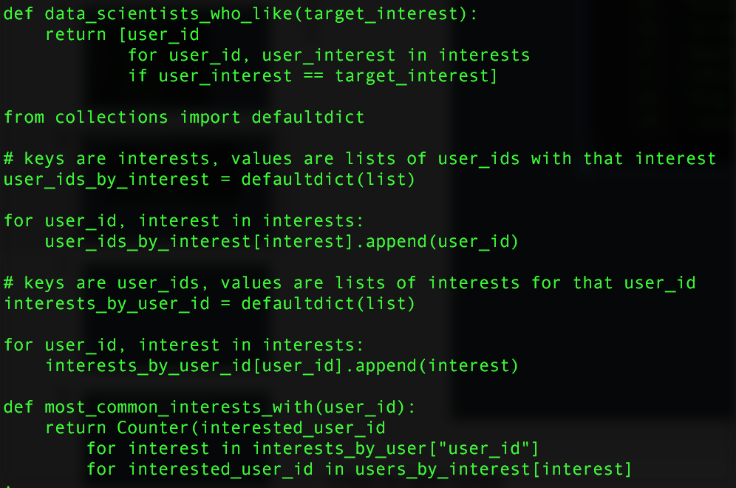
More on recommender systems on Ch 22
Notes:
-Iterate over the user’s interests
-For each interest, iterate over the other users with that interest
-Keep count of how many times we see each other user

Slide 8
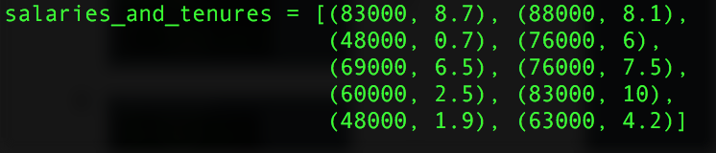
Anonymous data set:
Fun facts about the salary-experience relationship of DataSciencester employees.

Slide 9
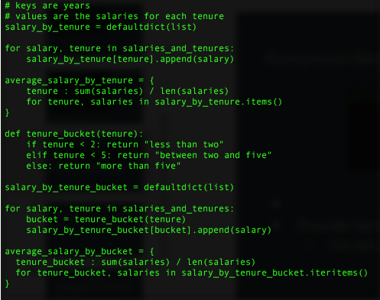

More on providing facts and making predictions on Ch 14

Slide 10
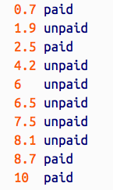
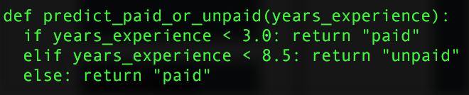
Create a model to predict which users will pay their accounts based on their years of experience
More on predicting the likelihood of events on Ch 16
l

Slide 11
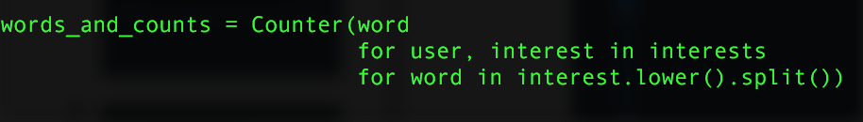

One last thing before you leave
Look for topics or trends most users are interested in (already have the dataset)

Slide 12
Vectors
A vector is a mathematical object with both magnitude and direction.
A vector is usually represented as a point in a space of some finite number of dimensions.
Vectors can be added, subtracted, multiplied by constants as well as other operations

Slide 13
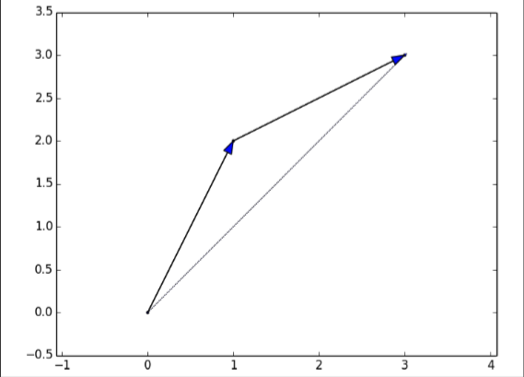
Vector Operations
Vectors are added and subtracted componentwise: [1,2,3]+[2,3,4]=[3,5,7], [4,5]-[1,0]=[3,5]
Vectors can be also be multiplied by constants componentwise: 2*[1,2,3]=[2,4,6]
There are two other major mathematical operations on Vectors, the Dot and Cross Products. You only have to worry about the Dot Product.

Slide 14
The Dot Product
The Dot product of two vectors is a scalar quantity which exists only when the two vectors have the same number of elements.
Let V=[a,b] and W=[c,d]. Then V.W=a*c+b*d.
The Dot product measures how far in the V direction the vector W extends, or equivalently, how far in the W direction V extends.
The Dot product is also useful in finding the magnitude of a vector.

Slide 15


Magnitude of A Vector
The magnitude of vector V=[a,b] is defined as the distance between the origin and the point (a,b).
If V=[a,b,c], then ||V||=
Similarly, the distance between V=[a,b,c] and W=[d,e,f] is equal to: ||V-W||=
Interesting fact: V.W=||V||||W||cos(Φ), with Φ the angle between V and W.

Slide 16
Python Vectors
Import NumPy for ready made vectors with all the functions you could ever need.
If you can’t or don’t want to use NumPy, you can use lists instead and write functions to manipulate these lists as if they were functions.
Just be careful that your lists only have arithmetic values. Vectors don’t take non-numerical values.
The next slide has an example of a function to compute the dot product of two vectors:

Slide 17
Example of Python Functions for Dot Product, addition
#Dot Product
Def dp(v_1, v_2):
Return sum([v_1i*v_2i for v_1i, v_2i in zip(v_1, v_2)])
#Vector Addition
def vadd(v_1, v_2):
return [v_1i+v_2i for v_1i,v_2i in zip(v_1,v_2)]

Slide 18

THE MATRIX

Slide 19
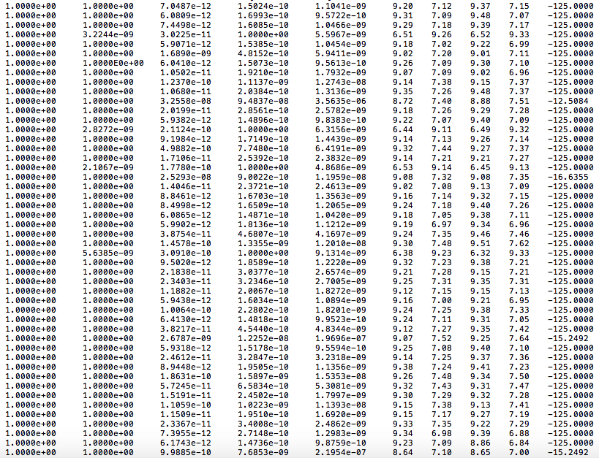

Slide 20
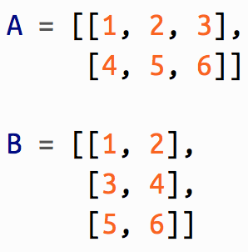

Matrices
A matrix is a two dimensional array of numbers, (or is it? Take the red pill!).
For our purpose, matrices will be represented as a lists of lists.
Matrices can be multiplied by constants, and by certain other matrices (as well as added and subtracted with matrices of the same size), and are used to represent linear transformation of vector spaces.

Slide 21
Python Matrices
Again NumPy provides you with an already set up system for manipulating matrices, but if you don’t want to use NumPy, you can use lists of lists of lists to represent matrices.
Word of Caution: If you do this, make sure that each list in your list of lists has the same length. Matrices cannot have a first column or row of one length and a second column or row of a different length
As with vectors, matrices cannot take non-numerical values.

Slide 22

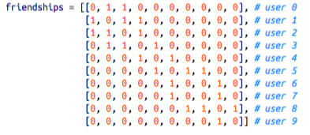
Use of matrices
Represent data sets as multiple vectors, where each vector is a row of the matrix.
Map k-dimensional vectors to n-dimensional vectors.
Depict binary relationships.

