Slide 1
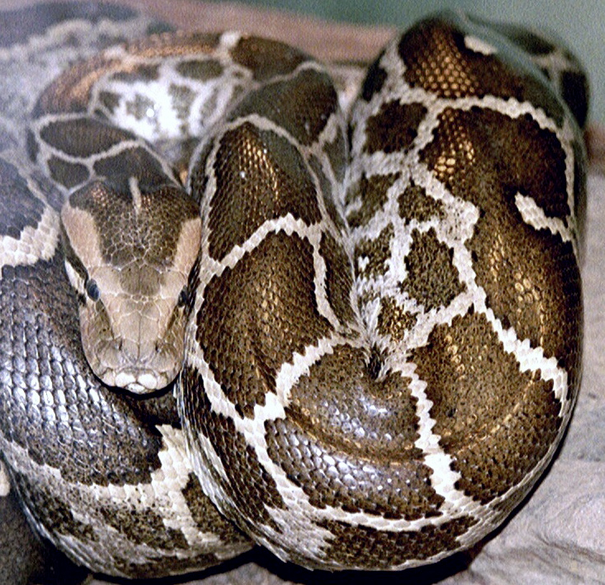
Modules and Testing
Presented by
Colin Pierce and Skylar Wyant

Slide 2
Modules Goals
Review modules
Learn how to use modules in a meaningful way to reuse code
Be able to write and use our own modules
Learn about namespaces and how they are useful
Discuss docstrings and their applications within modules

Slide 3
Modules Review & Introduction
What is a module? random module
os, random, argparse
How do we import a module?
import random
How can we use modules in a way that allows us to re-use code?

Slide 4

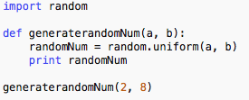
Module example
How could we re-use this piece of code, for example in another script?
randomNum.py

Slide 5


Module example contd...
randomNum.py

Slide 6
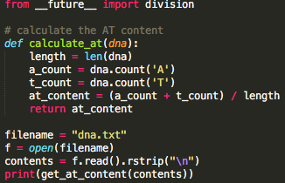
Example: reading a DNA sequence, printing AT content
at_calculator.py

Slide 7

Call on the at_calculator script as a module

Slide 8
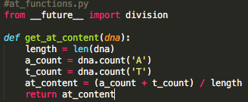
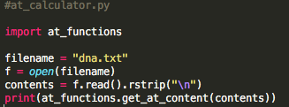
Option 1: Split at_calculator.py
Library!

Slide 9

Option 1: Split at_calculator.py

Slide 10
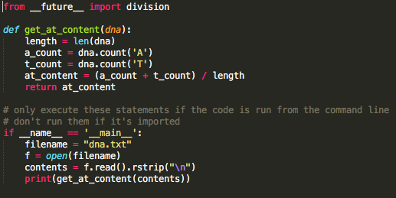
Option 2: Make top-level code conditional
When is this method useful?
Want code that can act as both a library AND a program
Want to include set of unit tests along with a library

Slide 11
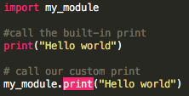



Names and namespaces
my_module has its own “namespace”
The print function defined in my-module belongs to the my_module namespace
DANGER!
‘print’ will now refer to function defined in my_module, NOT the built-in function
No way of knowing which functions might be overwritten
Poor readability (mm)

Slide 12

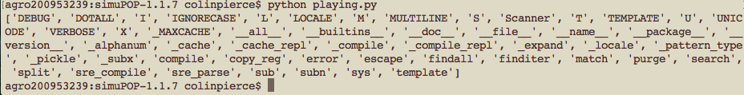
What’s in a module?

Slide 13
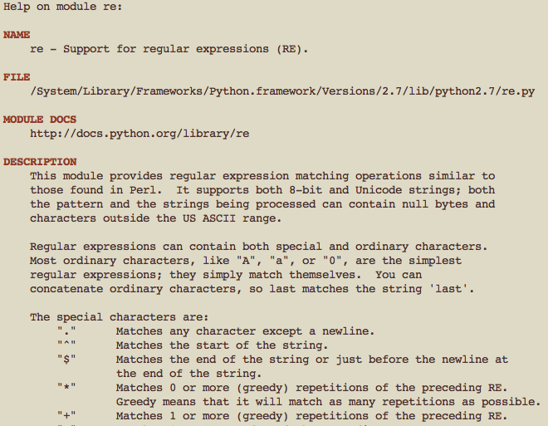
Accessing embedded documentation on a module

Slide 14
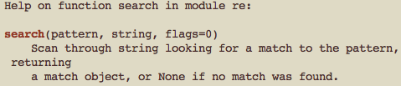
Accessing embedded documentation on a single function

Slide 15
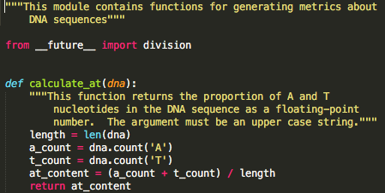
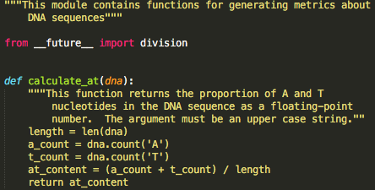
Docstrings: Adding our own documentation

Slide 16
Testing Goals
Think about test cases: What should your code do when provided with a specific input? What should happen if it doesn’t produce the expected result?
Ideally, a failed test should tell you exactly what went wrong and where.
Decide whether you want your test program to stop after the first failed test, or continue performing additional tests.
Test each small bit of code. Make it modular.

Slide 17
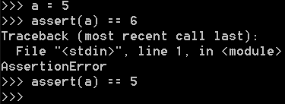
Assert statements
This is the simplest way to test that the code produces the output you expect it to.
If the specified condition isn’t true, the program will raise an AssertionError and fail out.
Multiple assertion statements get unwieldy quickly with complex bits of code. Additionally, the exception raised doesn’t tell us much about what went wrong. The unittest module provides a better testing structure for these reasons.

Slide 18
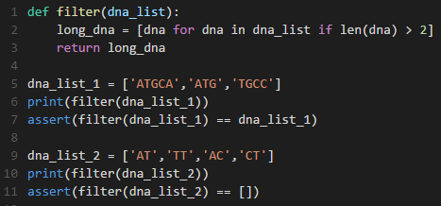

Example
Positive control: does the code produce the results we want when we feed it good data?
Negative control: does the code correctly fail to give us results when we feed it bad data?
No AssertionErrors were raised, so our code passed the tests successfully.

Slide 19
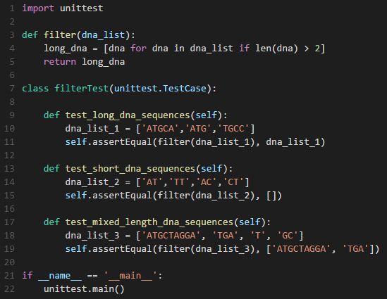
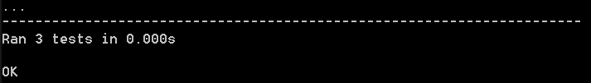
Writing a Test Class
imports unittest module
unittest.TestCase is a class inside the unittest module
assertEqual is a method of the unittest.TestCase class
the last if statement assures that the tests are only run if the script is run from the command line
each test MUST start with test
tests are run alphabetically

Slide 20

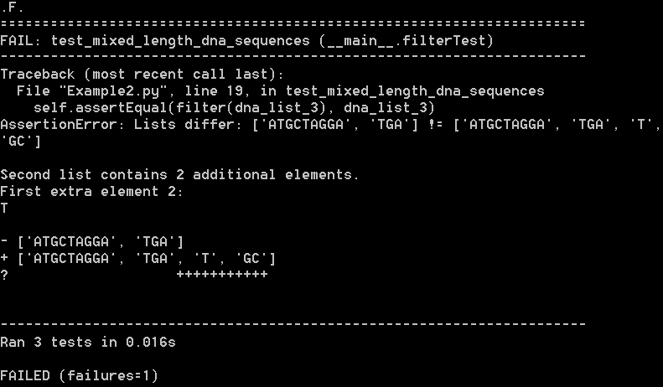

Slide 21
Problems with Multiple Test Interactions
What if I was using the same dna_list for all the tests? The first test would remove any dna sequences less than three base pairs, and then any following tests would have nothing more to remove. Essentially, I would gain no information at all from running any tests after the first one.
Fortunately, there’s a way to get around this.

Slide 22
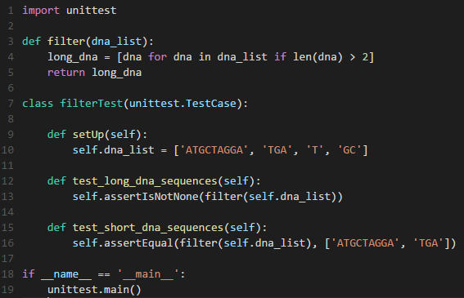
setUp and tearDown
The setUp method will regenerate the dna_list variable before each test.
There’s also a tearDown method to do a specified action after each test in case you want to delete temporary files or close network connections.

Slide 23
Coding Challenge!

Slide 24
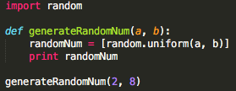
Coding Challenge - Modules
Write your own module that does something - anything!
Make sure it includes at least one function that can be called

Slide 25
Coding Challenge - Testing
Write a basic test for your new module.
Instead of defining your function at the top, import it as a module.
Example code is shown here.

