Slide 1
Object Oriented Programming
By Skylar Wyant and Felipe Reyes

Slide 2
What’s Object Oriented Programming
The practice of creating new type of things
Why use it?
Solve groups of related problems rather than a single, well-defined problem
Greater flexibility allows us to write more sophisticated programs

Slide 3
Objects vs Classes
Before Type: different kind of values in Python
Thing: bit of data (string or file)
Now Type of thing: Class
Individual Thing: Object
“A given object is an instance of a class”
Example: Vehicle
Example: Sedan
Example: A sedan is a kind of vehicle

Slide 4
Variables and Methods
Class Variables: shared amongst all the instances in a class
Instance Variables: specific to one instance of the class
Method: piece of code that calls an action on an object of a class
*Recall that an instance of a class is just an object
Example: kind, manufacturer, model, wheels
Example: sedan, Honda, Civic, four
Example: count the number of powered wheels

Slide 5
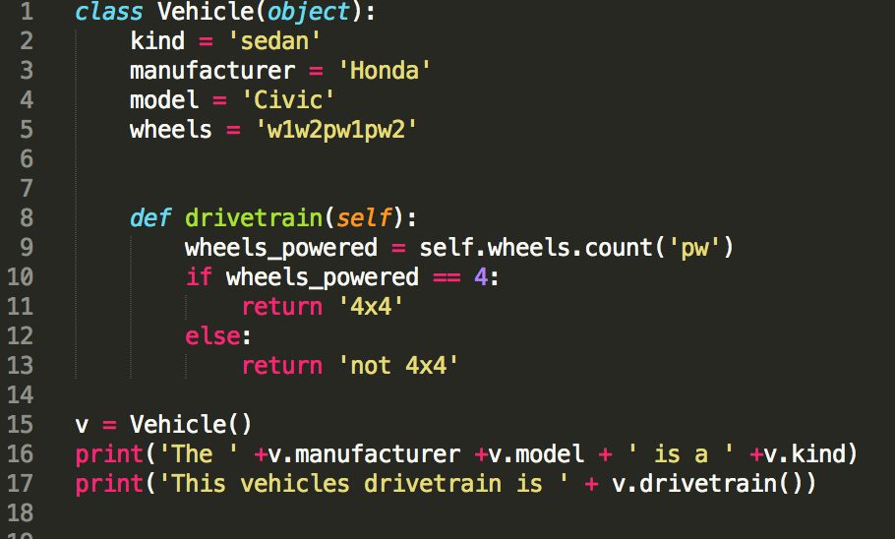

Classes, Objects, Variables, Methods
Result

Slide 6
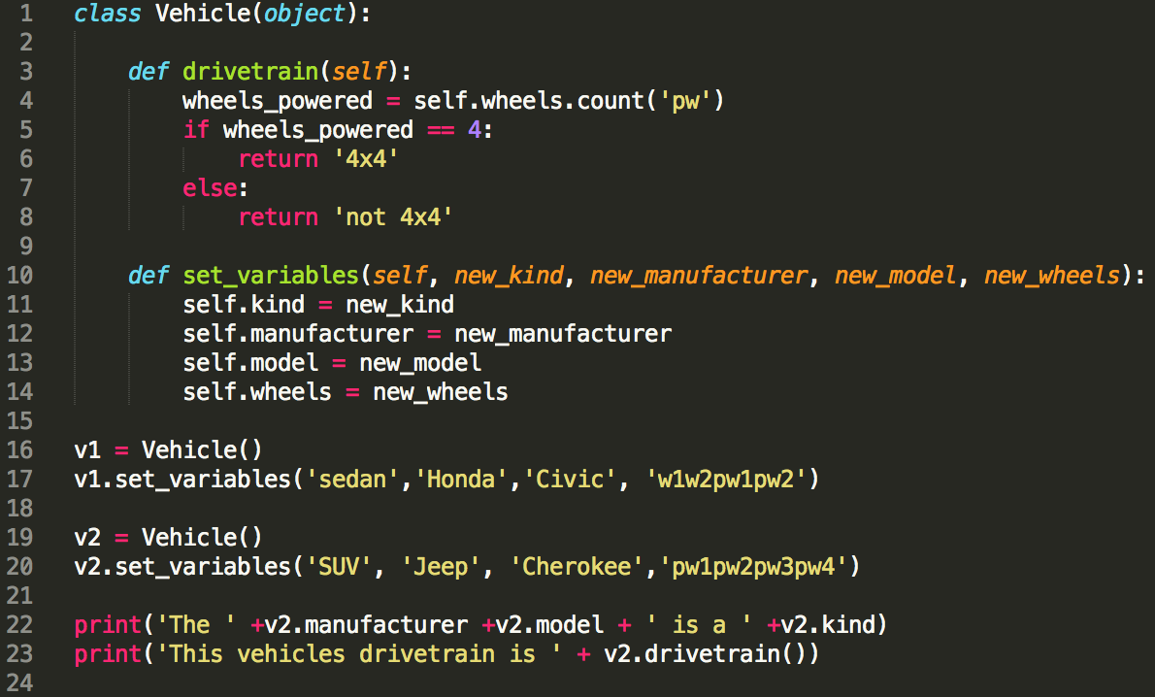

Classes, Objects, Variables, Methods
Result

Slide 7
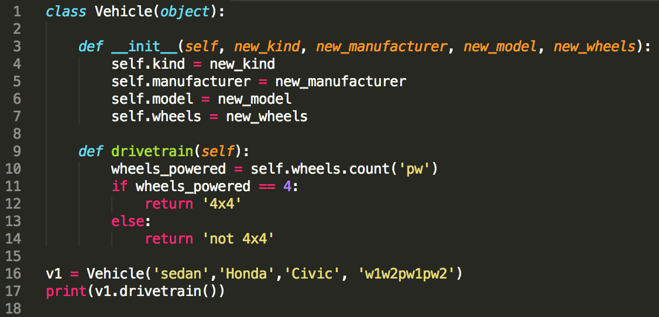
Constructor
__init__()
Ensures we define the variables of an instance when we create them
Prevents the use of “ghost” instances

Slide 8
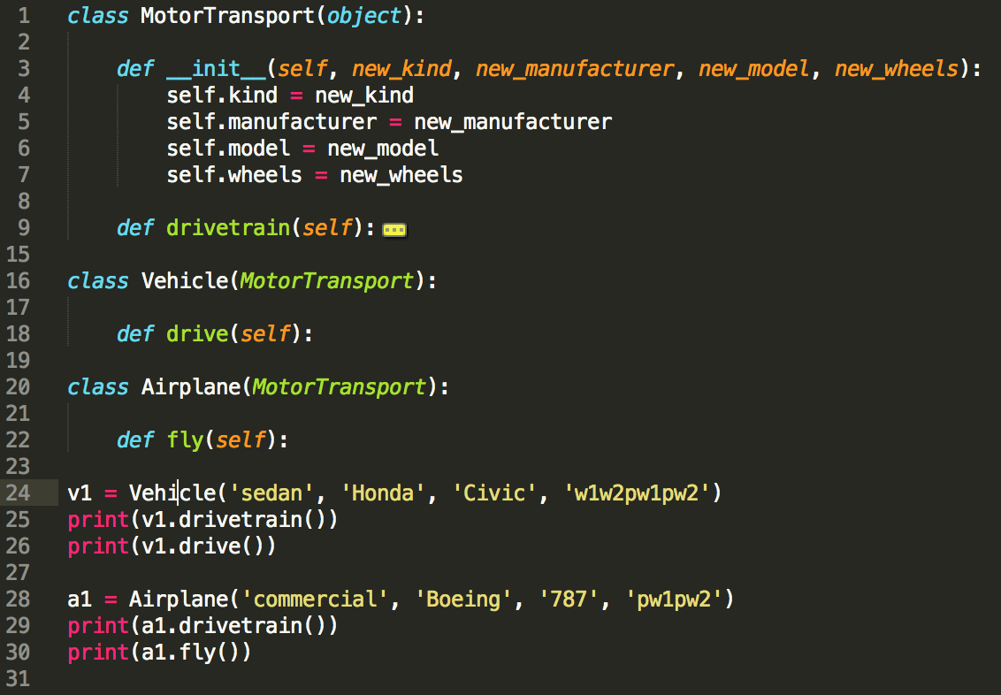
Inheritance
Two classes that share code (vehicles and airplanes)
Overriding

Slide 9
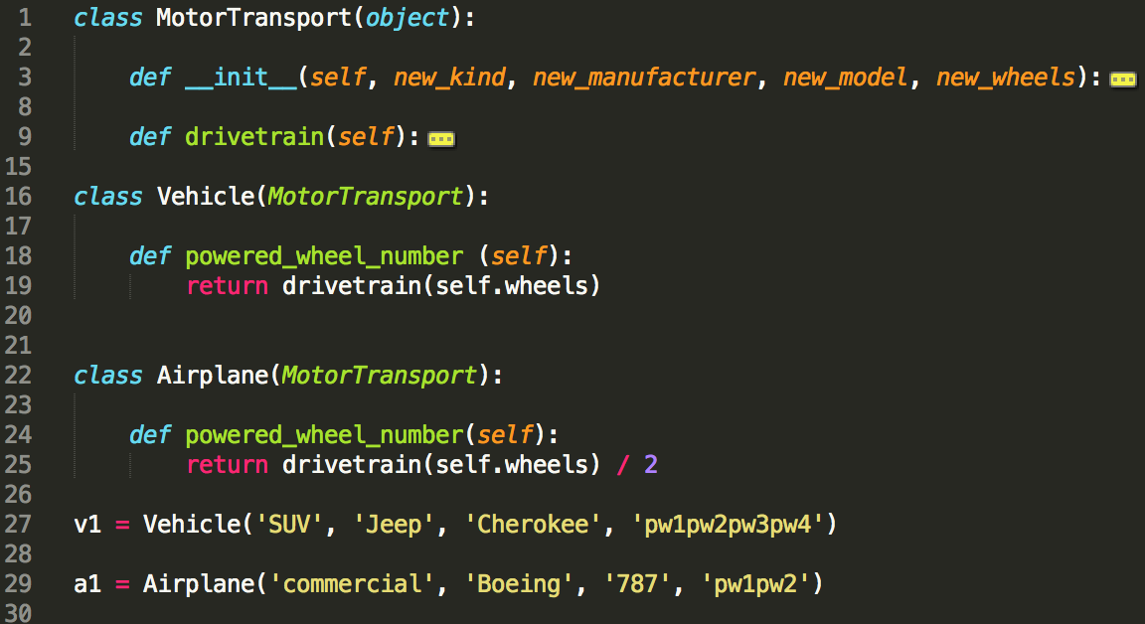
Polymorphisms

Slide 10
Exercise 1
Make your own vehicle.
Include: A constructor
At least 3 class variables
At least 2 methods
Vehicle examples: airplane, boat, piggy-back ride, etc.
Method examples: speed (distance/time), mpg (miles/gallon of fuel), cost of ownership (initial cost + upkeep), etc.

Slide 11
Exercise 2
Write a molecule class that takes atoms as inputs and can output the molecular weight of the molecule. (This means you’ll have to define an atom class too!)
Hints: molecular weight of an atom = # protons + # neutrons
molecular weight of a molecule = sum of molecular weights of the atoms
Useful info: Carbon has 6 protons and 6 neutrons.
Hydrogen has 1 proton and 0 neutrons.
Oxygen has 8 protons and 8 neutrons.
Example molecule: Ethanol = 2 carbon, 6 hydrogen, 1 oxygen
Bonus points: add a method to print the chemical formula of molecule (C2H6O1)

Slide 12
Why you shouldn’t use OOP.
Next time....
By Paul and Chaochih

