Slide 1

Securing Form Data
Inbound Filtering
Never trust your users

Slide 2
What is meant by “inbound” data?
“Inbound” refers to data which originates from outside your website.

Slide 3
What is meant by “filtering”?
“Filtering is the process of transforming data so that it is safe to store and display.

Slide 4
Why is inbound filtering important in developing a website?
Mandatory in order to maintain the safety and security of your website!
Failure to properly validate input data is the main reason for most vulnerabilities and exploits in PHP scripts.
Form fields can be exploited by hackers by adding scripts and malicious code.

Slide 5
What needs to be filtered?
ALL data that originates from outside your website needs to be filtered.
Never trust your users.

Slide 6
XSS Attacks
Cross-site Scripting (XSS)
A type of computer security vulnerability typically found in web applications.
XSS enables attackers to inject client-side scripts into web pages viewed by other users. (Wikipedia)

Slide 7
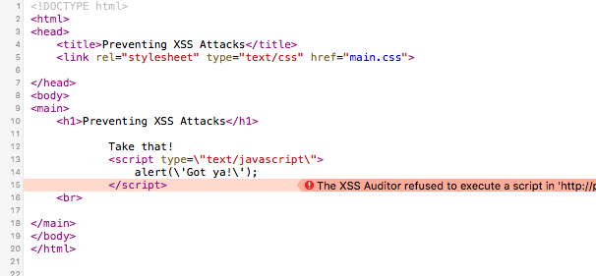
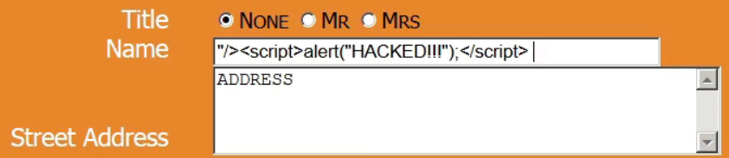
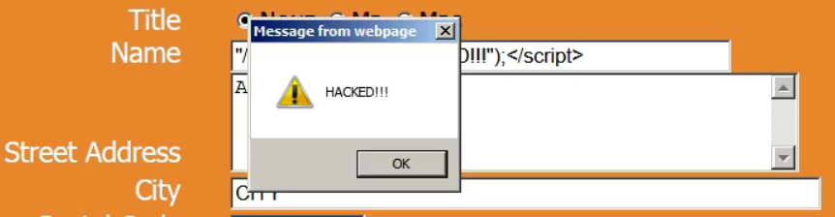
What does filtering do?
Filtering transforms data into a state where it can be safely used.

Slide 8
filter_input()
New in PHP 5.2
Use whenever you get values from superglobals like $_GET and $_POST
Checks to make sure the value has been set.
Prevents “undefined” variable errors.
Provides easy ways to do basic validation.

Slide 9
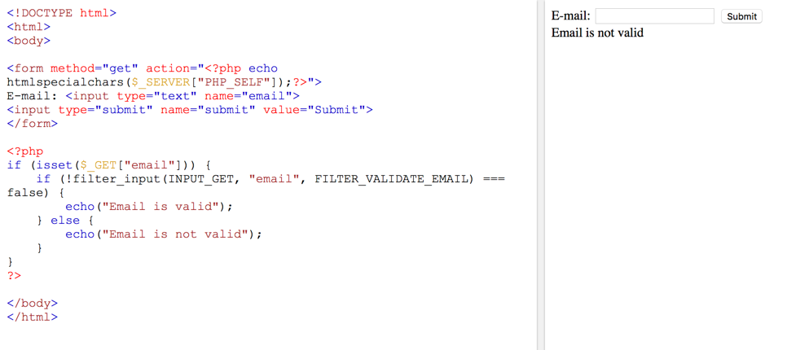
https://www.w3schools.com/php/func_filter_input.asp

Slide 10
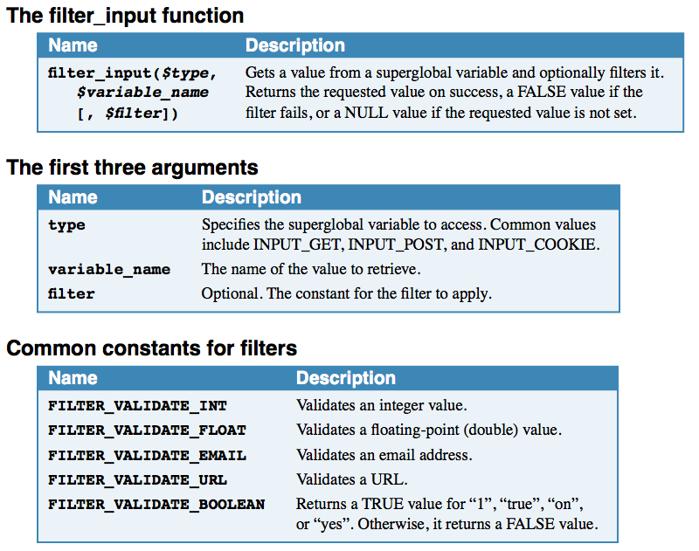

Slide 11
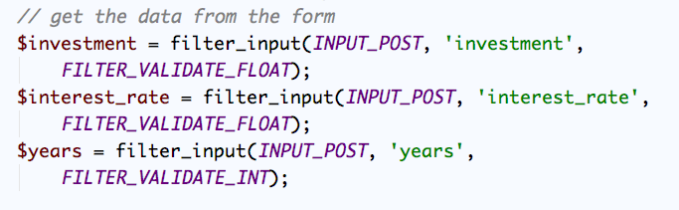
Examples of filter_input()

Slide 12
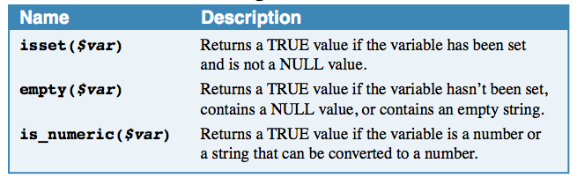
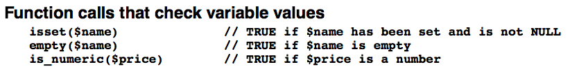
Checking Variables
Three functions for checking variable values isset() – returns true if variable has been set
emtpy() – returns true if a variable does not exist or is empty (“”, 0, null or no value).

Slide 13
Built-in Functions that Pass Control

Slide 16
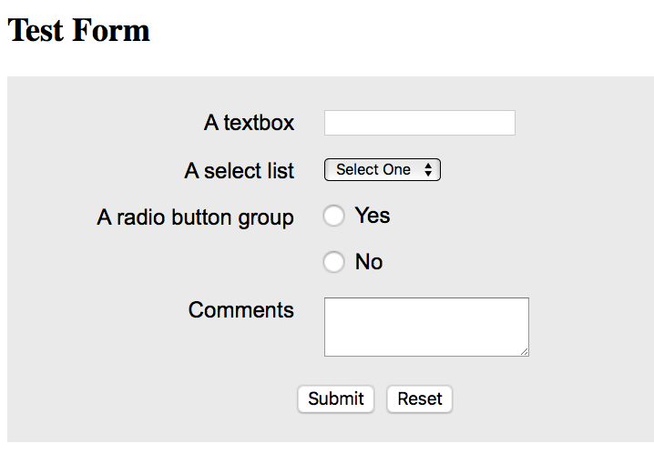
myform.php
http://webbie.org/youtube/stickyform/myform.php

Slide 17
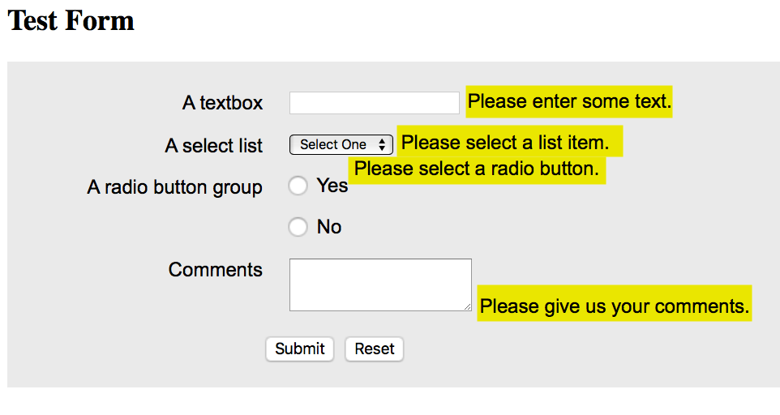
results.php

Slide 18
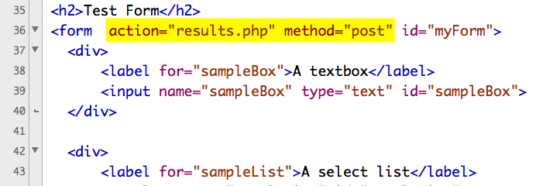
myform.php

Slide 19
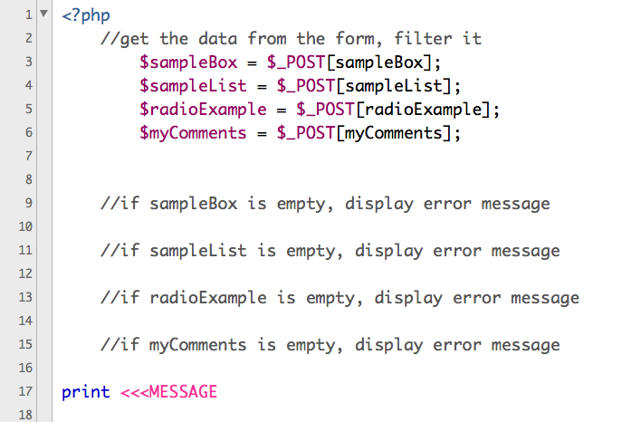
results.php

Slide 20
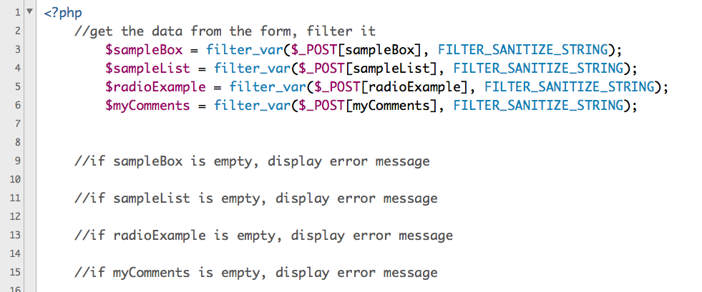
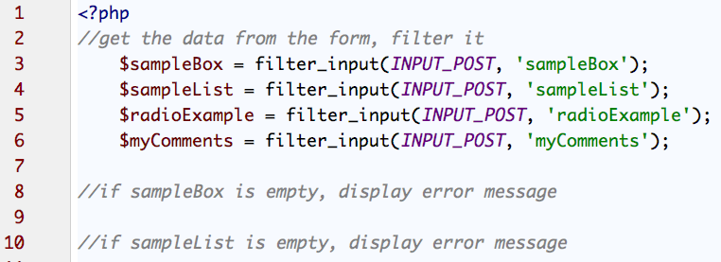
Using filter_var()
https://www.w3schools.com/php/func_filter_var.asp

Slide 21
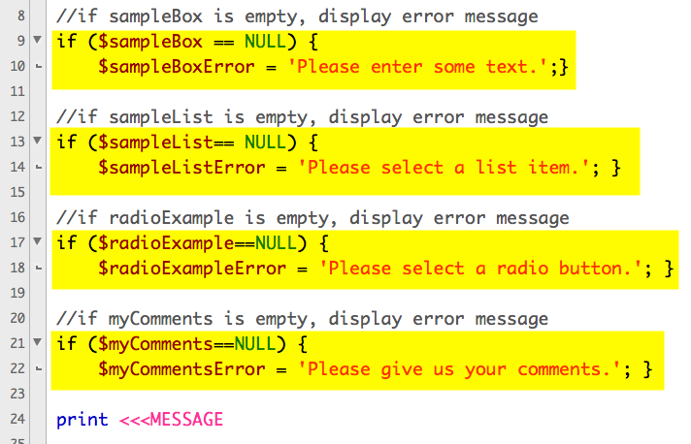

Slide 22
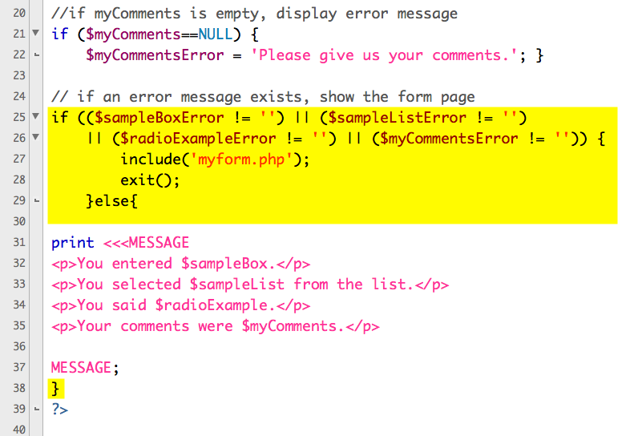

Slide 23
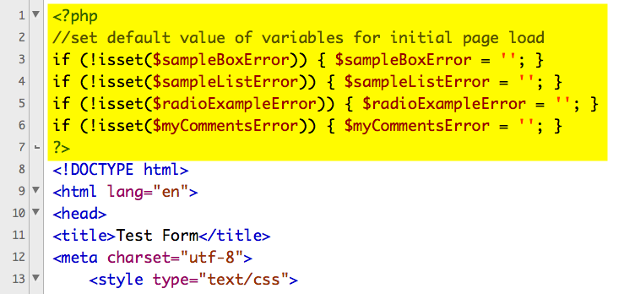
myform.php

Slide 24
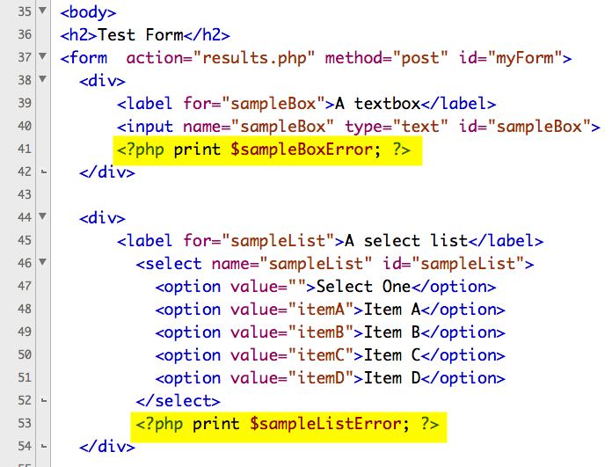

Slide 25
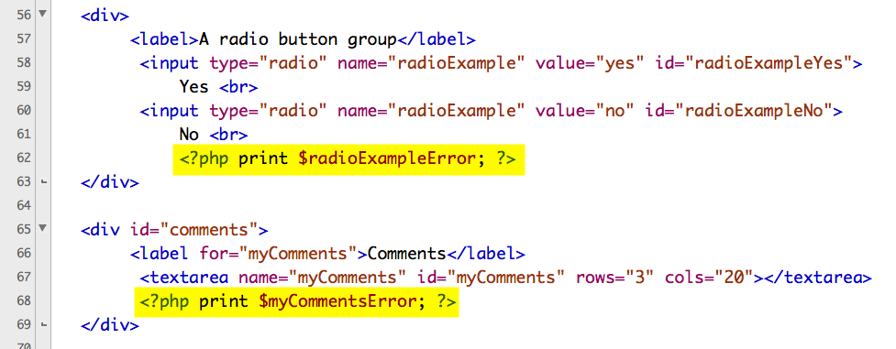
Upload to your server and test.

Slide 26
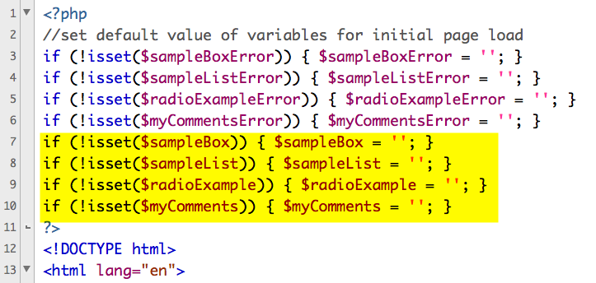
Making it Sticky
myform.php

Slide 27
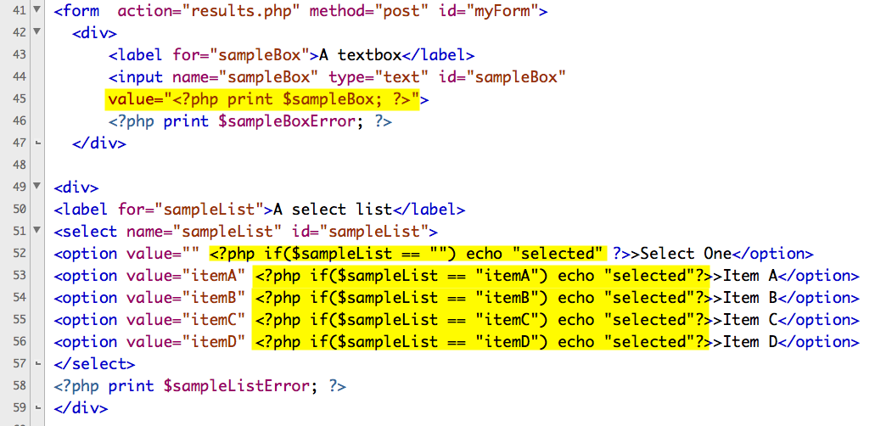
Making it Sticky

Slide 28
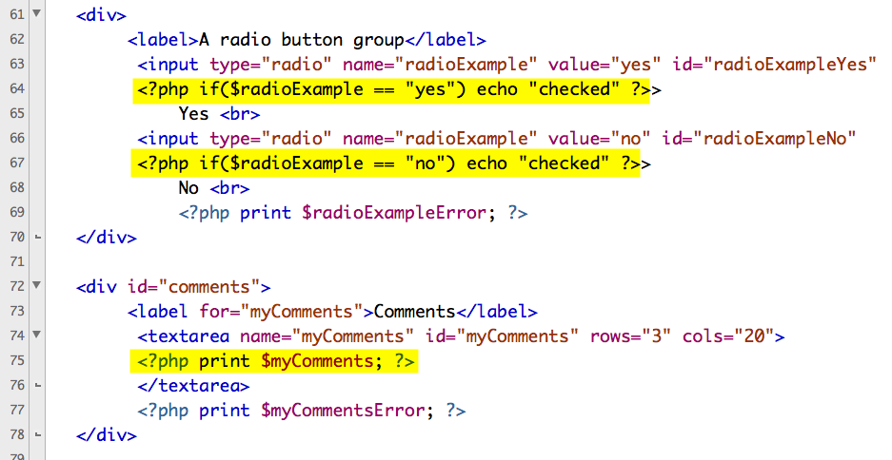
Upload to your server and test.

