Slide 1
Financial Default Prediction
Using machine learning to identify companies at risk of financial collapse — before it happens.
Dataset: 4,256 companies · 51 financial features

Slide 2
SECTION 1
Understanding the Data
Who are the companies in this dataset and how do we spot the ones in trouble?

Slide 3
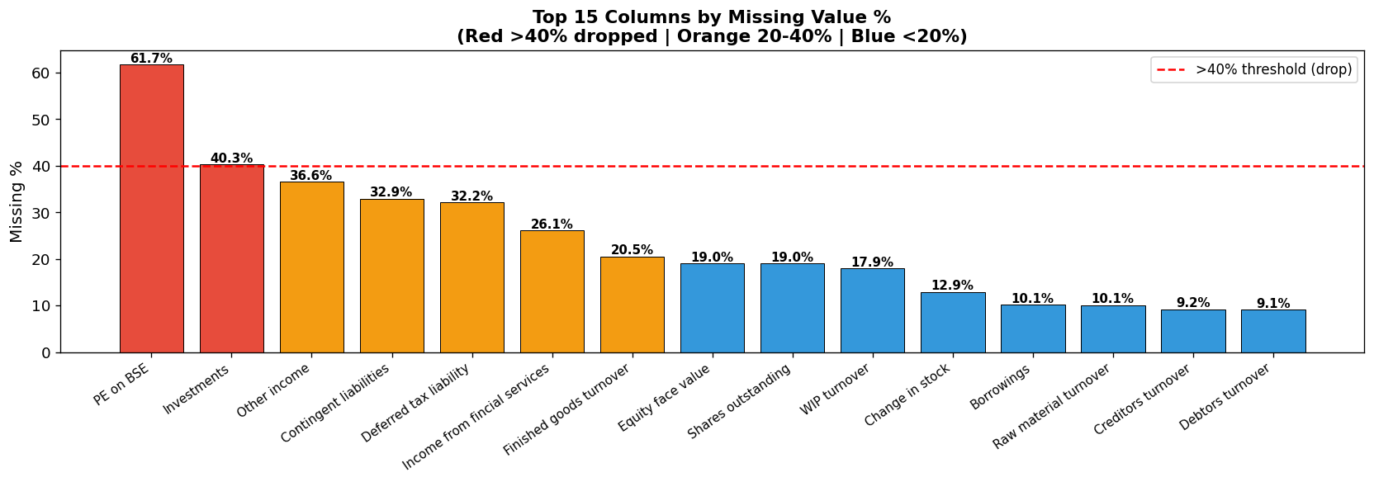
Step 1: Some data was missing — we decided what was safe to keep
Red bars cross the dashed line (over 40% of data missing) — those columns were dropped entirely as too unreliable to use.
Orange & blue columns had smaller gaps — we cleaned those by removing any individual rows still missing values.
After cleaning: 1,042 fully complete company records remained out of the original 4,256.

Slide 4
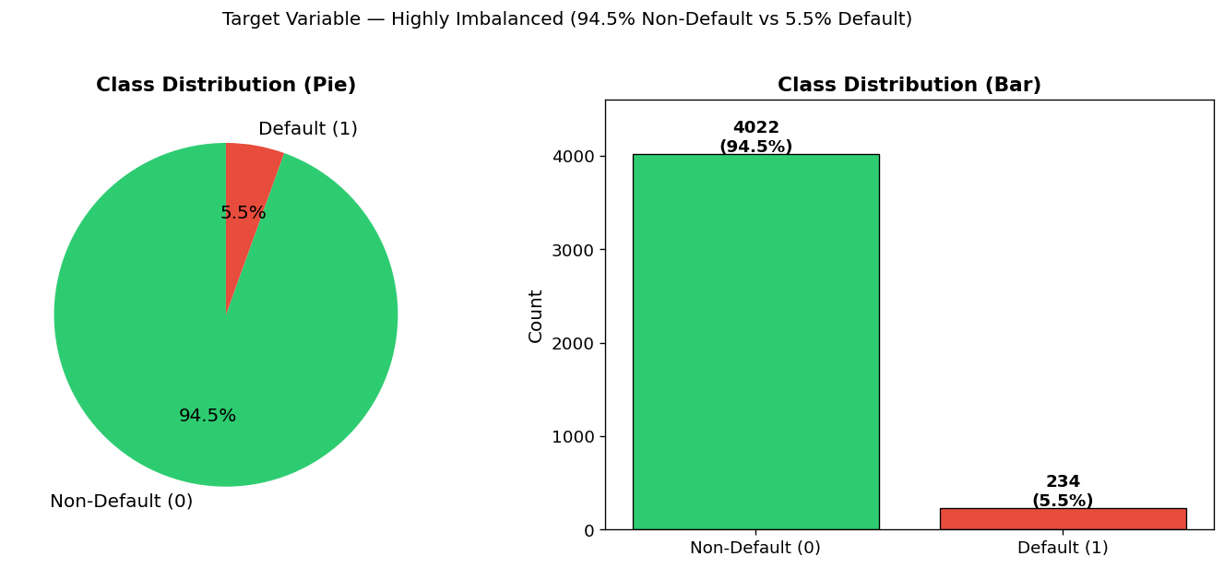
Only 1 in 18 companies ever defaulted — making them rare and hard to detect
The tiny red slice (5.5%) shows companies that went into negative net worth — our definition of 'default'.
A model that simply said 'no one will default' would score 94.5% accuracy — but miss every real case. Accuracy alone is a trap.
Our models were built specifically to hunt down that small red slice without raising endless false alarms.

Slide 5
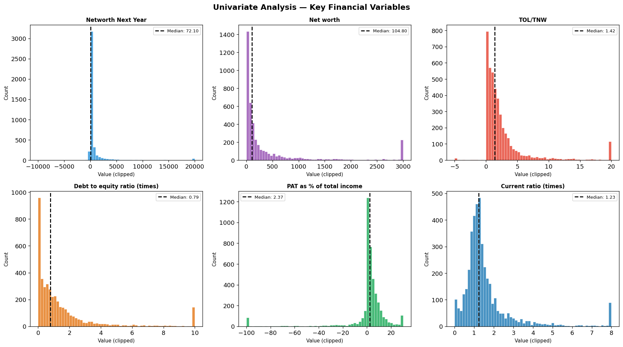
Most companies sit in a normal financial range — a few are extreme outliers
Each panel shows one financial measure. The dashed line is the midpoint. Most companies pile up on the left side of each chart.
The long right tails are a small number of very large or highly distressed companies pulling the average far from typical.
We capped those extremes before training — like removing a broken scale so it doesn't throw off all the measurements.

Slide 6
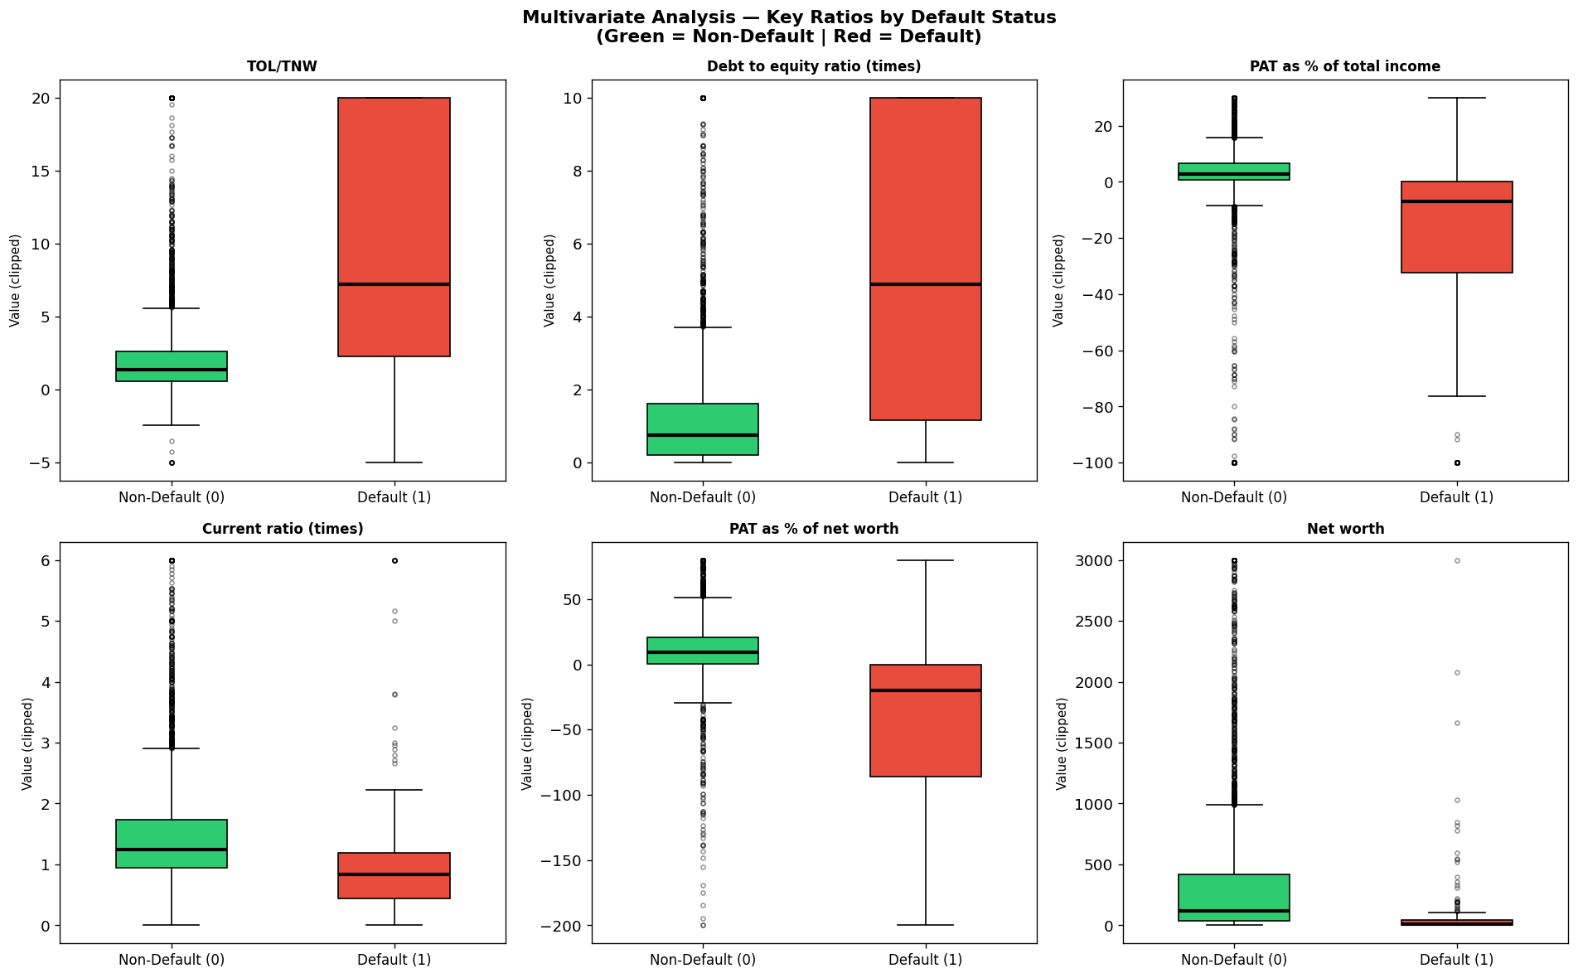
Defaulting companies look dramatically different from healthy ones
Green boxes = healthy companies. Red boxes = defaulters. Where the red box sits much higher or lower, that metric is a warning signal.
Defaulters carry far more debt (top-left & centre panels) and earn far less profit (top-right panel) than their healthy peers.
Defaulters also hold much weaker cash buffers (bottom-left) — less ability to pay their bills when they come due.

Slide 7
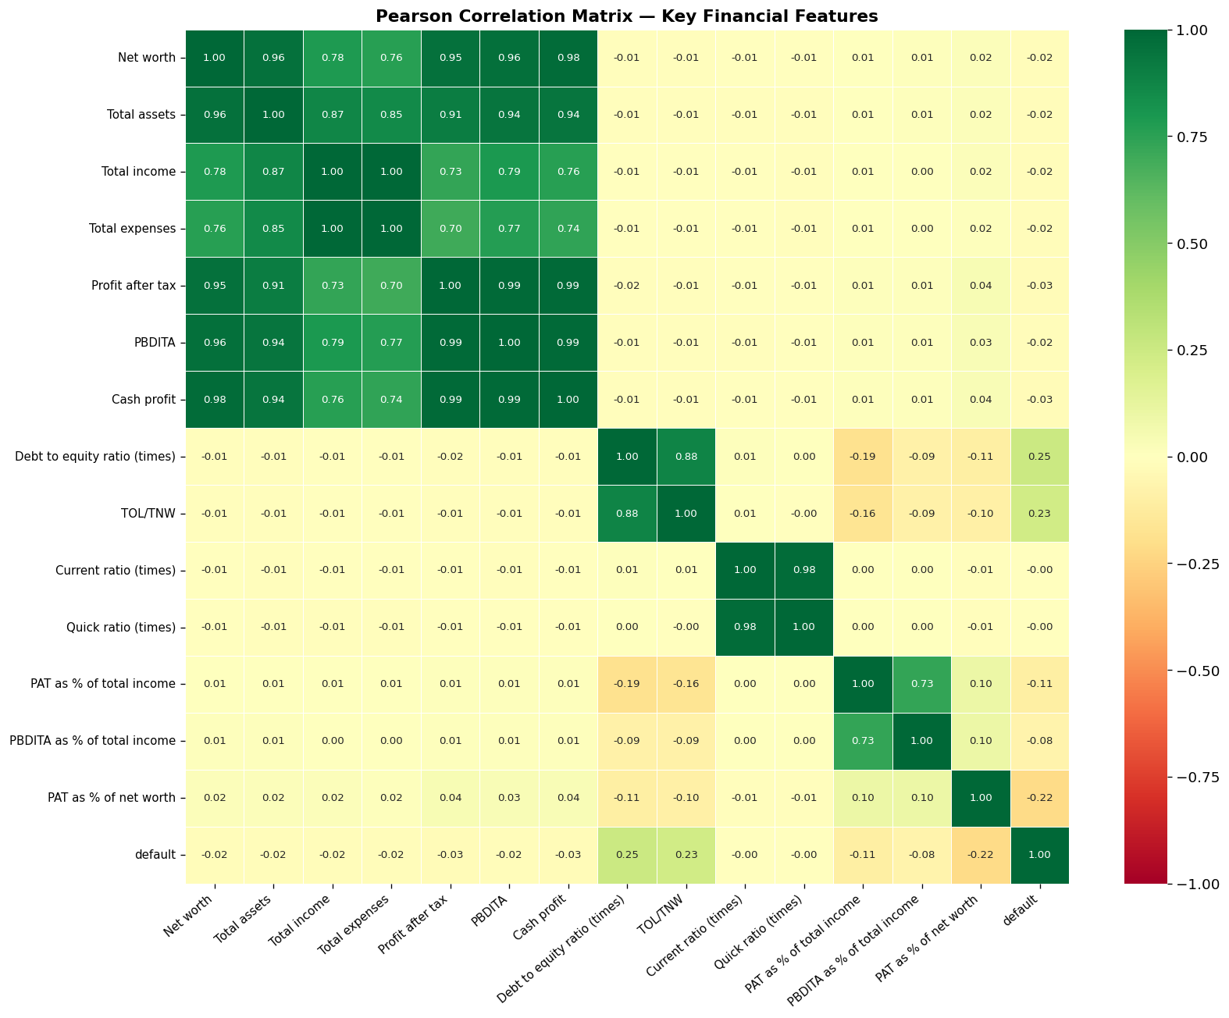
Many financial figures move in lockstep — using duplicates confuses the model
Dark green cells = two measures rise and fall almost perfectly together (e.g. Total Assets and Net Worth tell nearly the same story).
Feeding a model two signals that say the same thing is like calling the same witness twice — it adds noise, not evidence.
We identified all these overlapping pairs and removed the redundant ones before building any models.

Slide 8
SECTION 2
Cleaning the Data & Building the Models
Removing overlapping signals, then training two very different prediction approaches

Slide 9
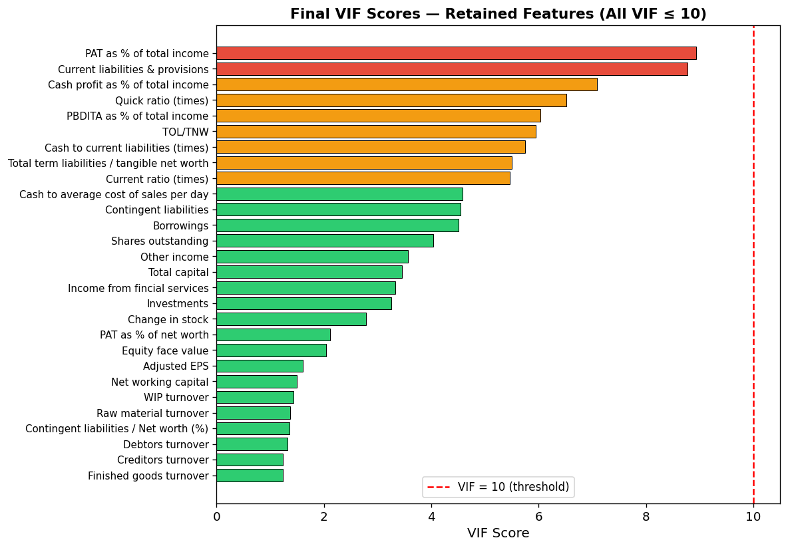
After removing overlapping signals, 28 clean independent measures remained
Every bar here is a financial metric kept in the first model. All bars stay left of the red dashed line — no two signals overlap too much.
Green = highly independent signals (most trustworthy). Orange = moderate overlap. Red = higher but still within safe limits.
This clean-up step only applies to Logistic Regression. The Random Forest handles overlapping signals on its own.

Slide 10
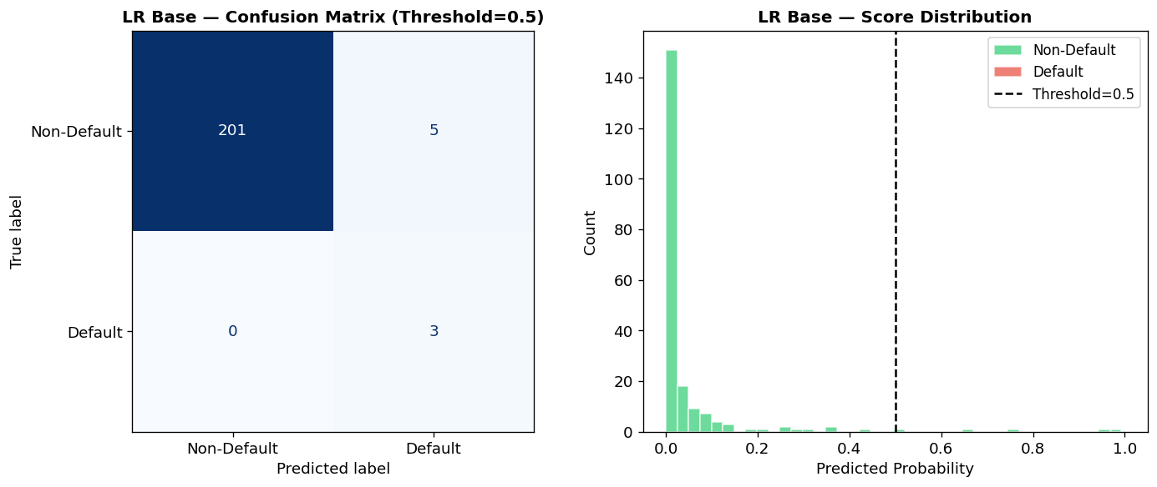
First model, first attempt: caught every defaulter — but raised too many false alarms
This grid is a scoreboard. Bottom-right = real defaulters the model correctly caught. Top-right = healthy companies wrongly flagged.
All 3 real defaulters identified. But 5 healthy companies were also unnecessarily alarmed.
5 false alarms for every 3 real catches is too noisy — it wastes investigation time and damages trust in the system.

Slide 11
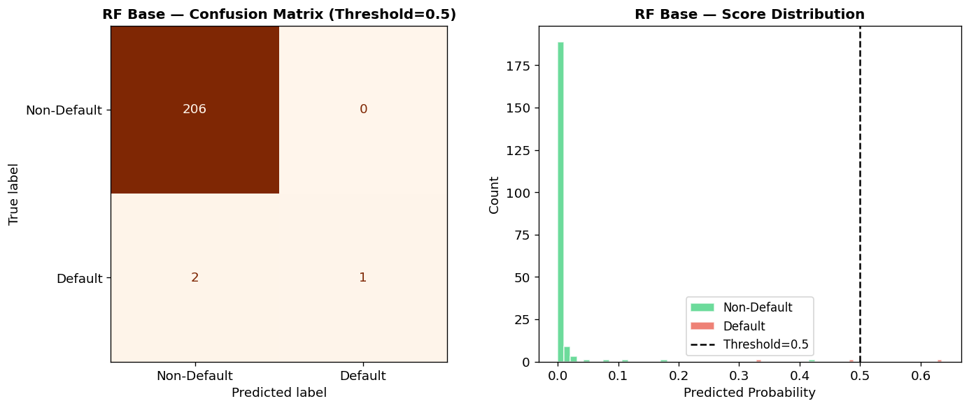
Second model, first attempt: zero false alarms — but missed most real defaulters
This model only raised a flag when it was extremely confident — producing zero false alarms (top-right = 0).
But it only caught 1 of the 3 real defaulters and missed 2 entirely (bottom-left = 2).
Missing 2 in 3 real defaults is dangerous — those are credit losses that slip through unnoticed until it is too late.

Slide 12
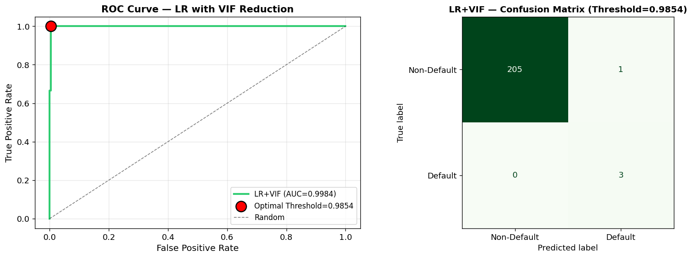
Tuned first model: catches every defaulter AND nearly eliminates false alarms
Left chart: the green line shoots to the top-left corner — near-perfect separation of risky from safe companies.
The red dot marks the optimal decision point: only raise an alert if the model is over 98.5% confident a company will default.
Right grid: all 3 real defaulters caught, just 1 false alarm — a dramatic improvement over the starting point.

Slide 13
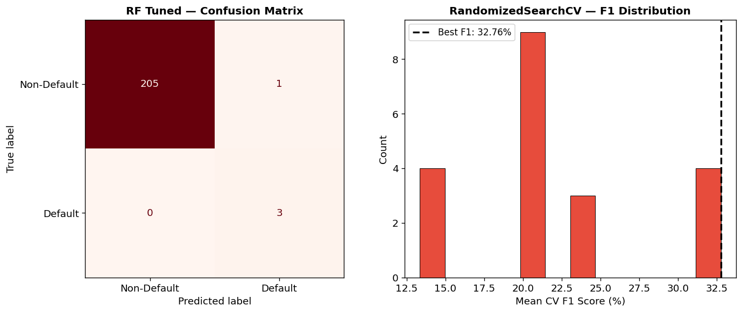
Tuned second model: same excellent result — and a more robust way to get there
Left grid: 3 defaulters caught, 1 false alarm — identical final outcome to the tuned first model.
Right chart: we tested 20 different configurations during training to find the best settings for this dataset.
The Random Forest reaches the same result without requiring manual adjustment of the decision threshold — easier to deploy reliably.

Slide 14
SECTION 3
Comparing All Models & Picking a Winner
Which approach works best — and what does the model actually look at?

Slide 15
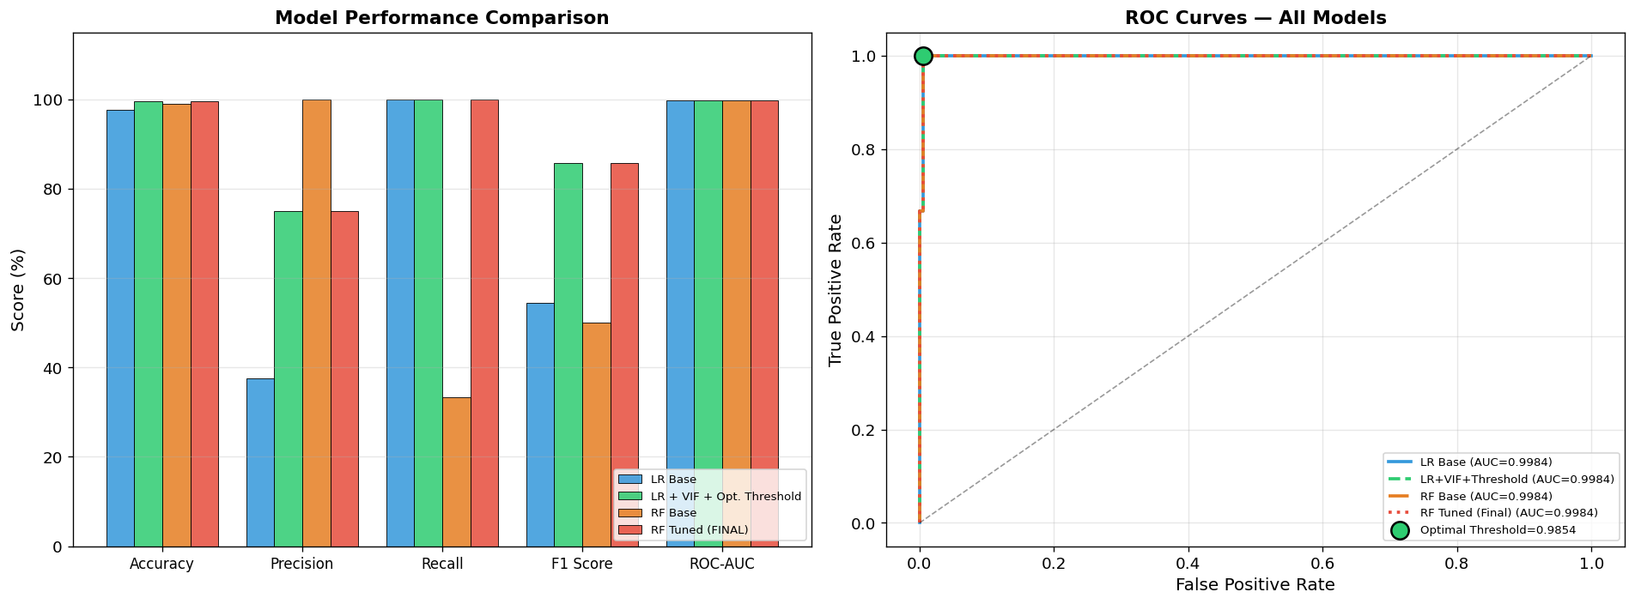
Both tuned models perform equally well — the Random Forest wins on robustness
Left: four models compared side by side. The green and red bars (tuned models) lead on every metric that matters.
'Recall' — did we catch all real defaulters? = 100% for both tuned models. 'F1 Score' (the overall balance) jumped from ~52% to 86%.
Right: all four models hug the top-left corner — near-perfect ability to rank companies from safest to most at-risk.

Slide 16
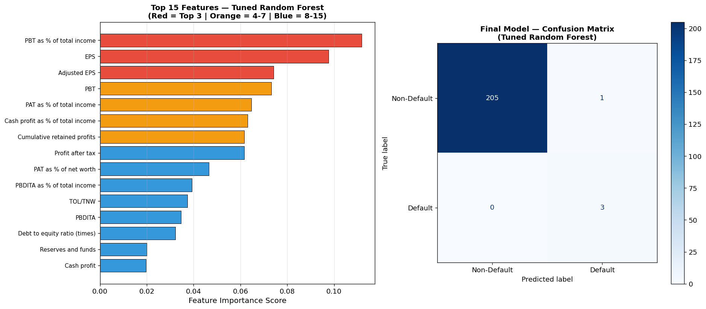
The model's #1 signal: shrinking profit margins — visible months before a default
The longer the bar, the more that financial signal drove the model's decisions. Red bars = the top 3 most powerful.
'Profit Before Tax as % of Income' is the single strongest predictor — when margins start falling, a company is heading for trouble.
Earnings Per Share (EPS) ranks #2 — it is publicly visible and typically drops well before a company formally defaults.

Slide 17
SECTION 4
What Should We Do Now?
Turning the model's output into concrete business decisions and actions

Slide 18
Recommendations: Putting the Model to Work
Deploy & Act
Risk Response Tiers
Use the Tuned Random Forest as the primary credit risk screening tool
Flag any company scoring ≥ 98.5% risk probability for immediate review
Build a monthly dashboard tracking profit margins and EPS per borrower
Retrain the model annually with fresh financial data
Combine model scores with human judgement for final credit decisions
🔴 High risk (≥ 98.5%): freeze credit, trigger full audit immediately
🟡 Medium risk (50–98%): enhanced monitoring, quarterly financial review
🟢 Low risk (< 50%): standard annual review cycle maintained
Alert the team if the model's catch-rate drops below 95% on new data
Watch for: 2+ quarters of declining profit margins as the earliest warning

Slide 19
THANK YOU
Financial Default Prediction

