Slide 1
Dataset Overview
Stock Market Risk Analysis
Period
Mar 2016 – Mar 2024
Observations
418 weekly data points
Weekly Stock Price & Returns Analysis for Five Indian Equities
Stocks
5 Indian Equities
Objective
Risk-Return Profiling

Slide 2
Project Context & Problem Statement
Business Context
Problem Statement
Equity investing in Indian markets requires quantifying risk alongside expected returns. Selecting stocks purely on price appreciation ignores the volatility incurred.
This analysis examines five prominent Indian equities across diverse sectors — FMCG, Telecom, Automotive, Real Estate, and Banking — over an eight-year window (March 2016 to March 2024).
The findings inform portfolio construction decisions for fund managers, retail investors, and risk committees.
Given weekly price data for ITC Limited, Bharti Airtel, Tata Motors, DLF Limited, and Yes Bank:
1. Visualise price trends over time to identify patterns and anomalies.
2. Compute weekly returns and measure their mean and standard deviation.
3. Plot the risk-return profile to compare stocks on a single chart.
4. Deliver actionable portfolio allocation recommendations.
Constraints: Analysis is backward-looking (historical data only). No transaction costs modelled.

Slide 3
Dataset Description
Market_Risk_Data_coded.csv — 418 weekly observations | 28 Mar 2016 to 25 Mar 2024
418
5
8 Yrs
0
Weekly Observations
Stocks Covered
Time Span
Missing Values
Stock
Sector
Price Range (INR)
Mean Price (INR)
CV
ITC Limited
FMCG
156 – 493
279
0.27
Bharti Airtel
Telecom
261 – 1,236
528
0.43
Tata Motors
Automotive
65 – 1,035
369
0.49
DLF Limited
Real Estate
110 – 928
277
0.56
Yes Bank
Banking
11 – 397
124
1.05
CV = Coefficient of Variation (Std Dev / Mean). Higher CV = more volatile relative to price level. Yes Bank CV of 1.05 signals extreme relative volatility.

Slide 4
Stock Price Graph Analysis
Section 1 of 3
Weekly closing prices for ITC Limited, Bharti Airtel, Tata Motors, DLF Limited, and Yes Bank — March 2016 to March 2024.

Slide 5
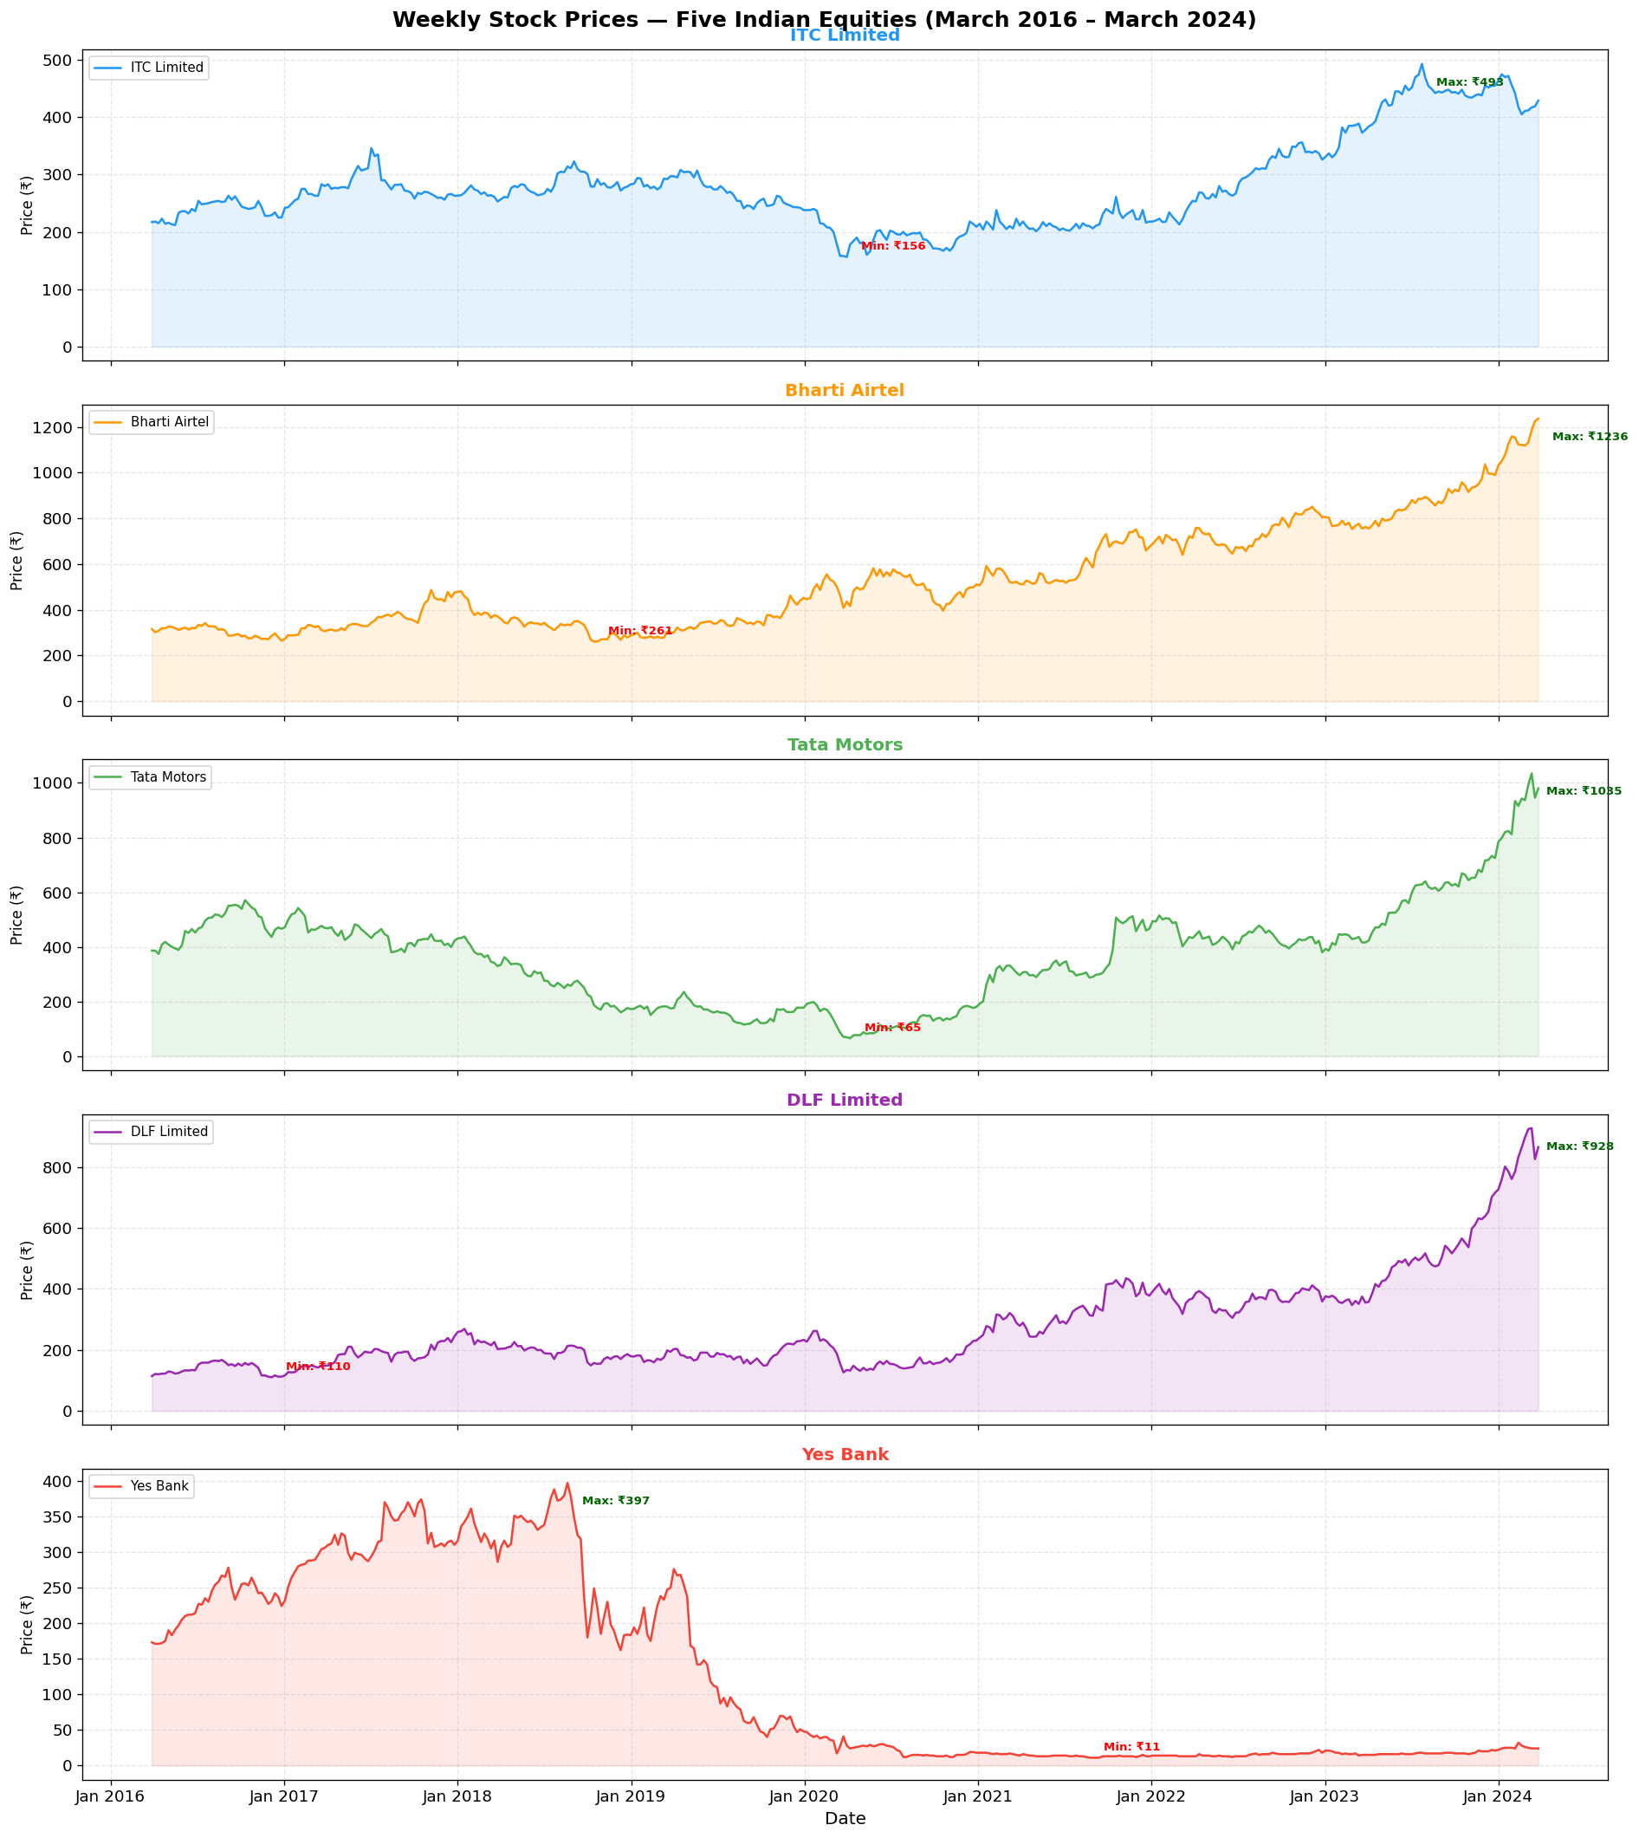
Stock Price Trends — Individual Series (Mar 2016 – Mar 2024)
Key Observations
ITC Limited:
Steady uptrend; strong appreciation from 2022 onward.
Bharti Airtel:
Trough in 2018-20 (Jio disruption), then strong recovery to INR 1,236.
Tata Motors:
Widest price range; COVID crash drove price to INR 65 before full recovery.
DLF Limited:
Extended sideways period, then sharp late-cycle real estate surge (2023-24).
Yes Bank:
Catastrophic collapse from INR 397 to INR 11 during 2020 governance crisis. Value not recovered.

Slide 6
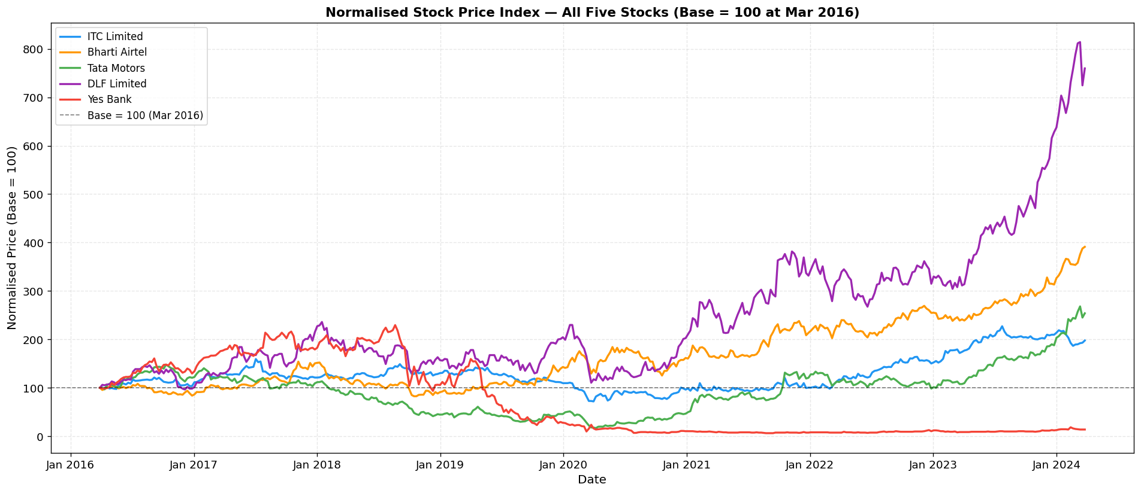
Normalised Price Index — Comparative Total Return (Base = 100, Mar 2016)
Total Return over ~8 years (March 2016 to March 2024)
Stock
Total Return
Interpretation
Interpretation
ITC Limited
+97.7%
Nearly doubled investor capital over the period.
Bharti Airtel
+291.1%
Almost 4x return; post-Jio recovery and 5G growth.
Tata Motors
+153.9%
JLR recovery and EV pivot rewarded patient holders.
DLF Limited
+659.6%
Best total return; driven by late-cycle real estate surge.
Yes Bank
-86.1%
Governance failure and RBI bailout destroyed value.

Slide 7
Returns Calculation & Analysis
Section 2 of 3
Weekly return = (Price(t) - Price(t-1)) / Price(t-1) x 100 417 weekly return observations per stock derived from 418 price points.

Slide 8
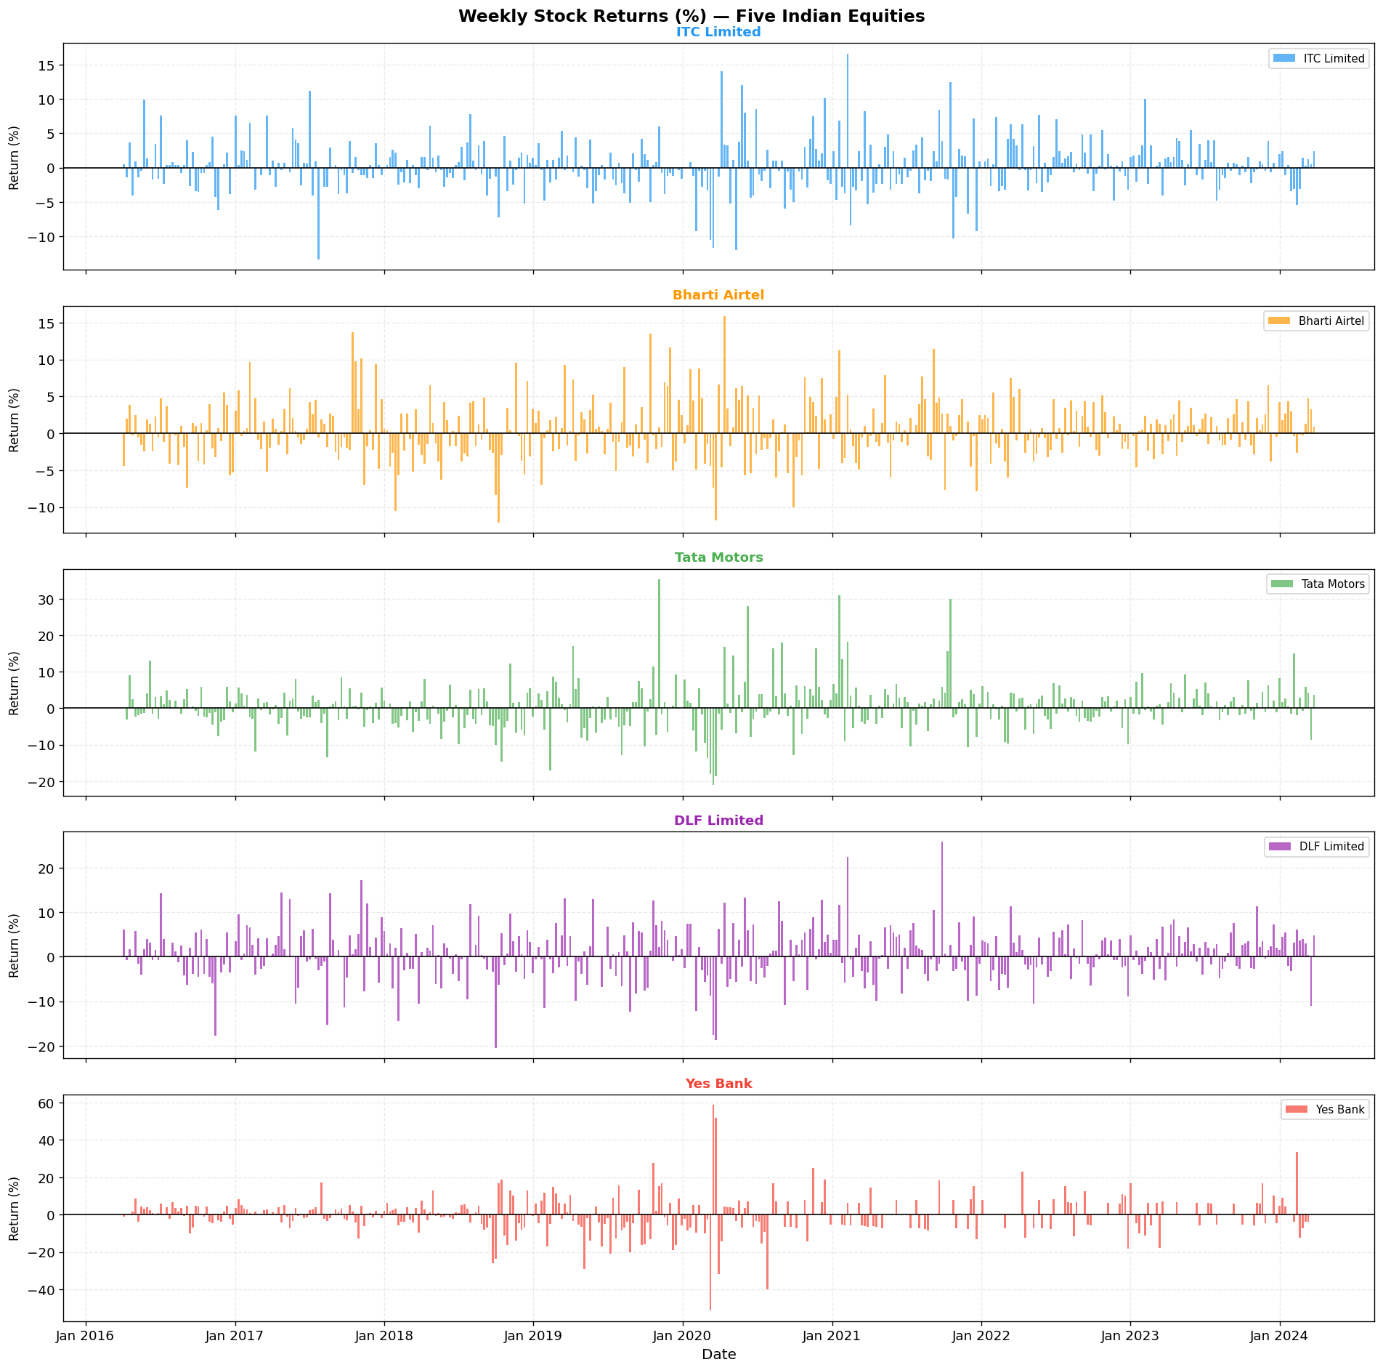
Weekly Stock Returns — Time Series
Key Observations
ITC & Bharti Airtel:
Tight, symmetric return bands; limited extreme events.
Tata Motors:
Notable spike in early 2020 (COVID crash). High-amplitude oscillations throughout.
DLF Limited:
Cyclical return clusters; clear volatility regime shifts.
Yes Bank:
Extreme spikes in both directions around 2020 crisis (range: -51% to +59% in a single week).
General:
Volatility clustering visible across all stocks — periods of calm followed by turbulence.

Slide 9
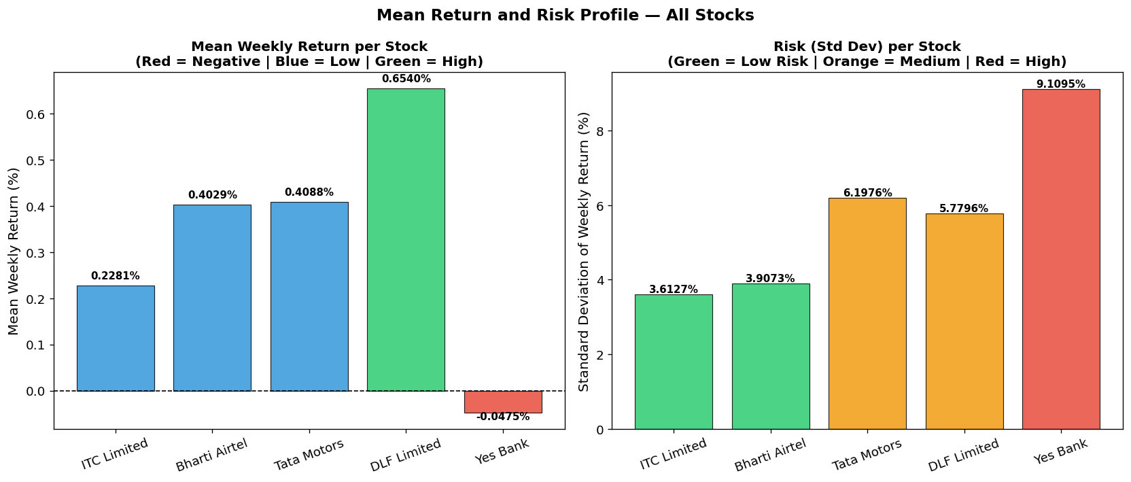
Mean & Standard Deviation of Weekly Returns — All Stocks
Stock
Mean Return (%)
Std Dev (%)
Min Return (%)
Max Return (%)
Sharpe-like Ratio
ITC Limited
+0.2281
3.6127
-13.43
+16.67
0.0631
Bharti Airtel
+0.4029
3.9073
-12.09
+15.87
0.1031
Tata Motors
+0.4088
6.1976
-21.10
+35.43
0.0660
DLF Limited
+0.6540
5.7796
-20.50
+25.84
0.1132
Yes Bank
-0.0475
9.1095
-51.43
+58.82
-0.0052
Sharpe-like Ratio = Mean Return / Std Dev. Highest (best): DLF (0.1132), Bharti Airtel (0.1031). Lowest (worst): Yes Bank (-0.0052).

Slide 10
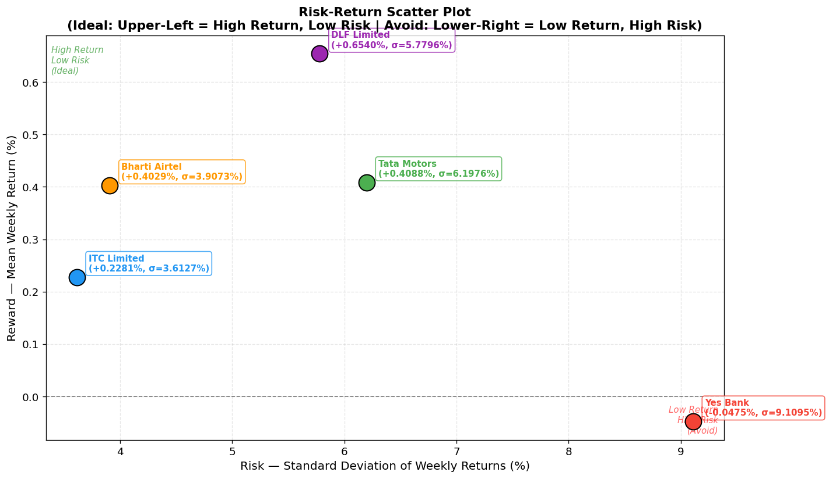
Risk-Return Profile — Mean vs Standard Deviation Scatter Plot
Quadrant Analysis
BEST RISK-ADJUSTED: Bharti Airtel
Mean: +0.40% | Std: 3.91% Moderate risk, solid return. Core holding candidate.
HIGHEST RETURN: DLF Limited
Mean: +0.65% | Std: 5.78% Top performer but real estate cyclicality adds risk.
DEFENSIVE: ITC Limited
Mean: +0.23% | Std: 3.61% Lowest risk. Capital preservation anchor.
CYCLICAL: Tata Motors
Mean: +0.41% | Std: 6.20% Similar return to Airtel at higher risk.
AVOID: Yes Bank
Mean: -0.05% | Std: 9.11% Negative return + highest risk = worst combination.

Slide 11
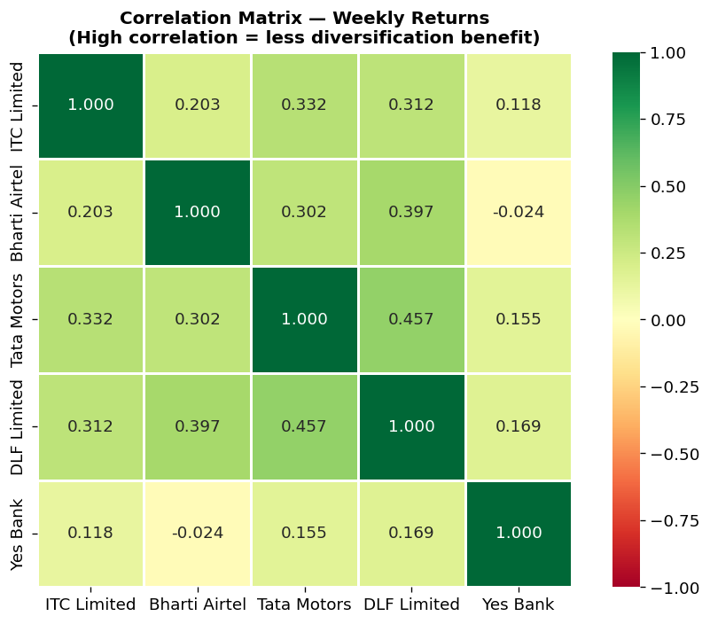
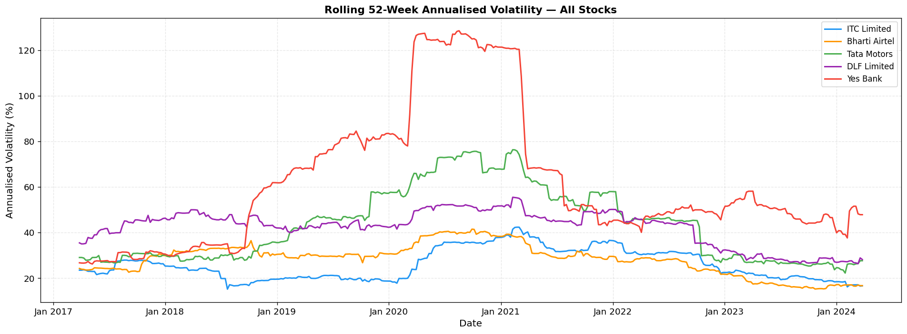
Supporting Analysis — Correlation Matrix & Rolling Volatility
Rolling 52-Week Annualised Volatility
Yes Bank volatility spiked dramatically in 2020. COVID crash (March 2020) elevated all stocks simultaneously. Post-2021, most stocks returned to lower volatility regimes — indicating improving market conditions.
Correlation Matrix — Weekly Returns
Most pairs show moderate positive correlation (0.20-0.46), suggesting partial diversification benefit. Yes Bank shows near-zero or negative correlation with others, providing diversification value — though its negative return profile negates this benefit.

Slide 12
Actionable Insights & Recommendations
Section 3 of 3
Portfolio allocation guidance, risk-parity principles, and strategic recommendations for fund managers and investors based on the risk-return analysis.

Slide 13
Portfolio Assessment Summary
Bharti Airtel
Best risk-adjusted return across the portfolio. Post-Jio disruption recovery is sustained. 5G rollout and ARPU growth support continued momentum. Broadest appeal for all investor types.
Suggested Allocation
CORE HOLDING
30–35%
Mean: +0.40% | Std: 3.91%
ITC Limited
Lowest volatility in the group with positive mean return. Demonstrated resilience during COVID. Diversified conglomerate business (FMCG, Hotels, Agribusiness) provides natural internal diversification.
Suggested Allocation
DEFENSIVE ANCHOR
25–30%
Mean: +0.23% | Std: 3.61%
DLF Limited
Highest mean weekly return driven by real estate recovery cycle. Cyclical sector — performance is sensitive to interest rates and housing demand. Late-cycle momentum may continue but reversal risk exists.
Suggested Allocation
TACTICAL GROWTH
15–20%
Mean: +0.65% | Std: 5.78%
Tata Motors
Similar return to Airtel but at higher risk (6.20% vs 3.91% std dev). JLR exposure adds FX and global demand risk. EV transition provides growth optionality. Size the position smaller relative to its risk.
Suggested Allocation
SELECTIVE EXPOSURE
10–15%
Mean: +0.41% | Std: 6.20%
Yes Bank
Negative mean return combined with the highest risk in the group. Shareholder value permanently impaired post-2020 crisis. Not suitable for a risk-managed portfolio. Any exposure should be under 5% and purely speculative.
Suggested Allocation
AVOID
< 5%
Mean: -0.05% | Std: 9.11%

Slide 14
Actionable Insights & General Portfolio Principles
1
Risk-Parity Sizing
2
Avoid Yes Bank
Allocate inversely proportional to each stock's standard deviation. Lower-risk stocks (ITC, Airtel) receive larger weights. This approach equalises the risk contribution of each position rather than simply distributing capital equally.
Yes Bank is the only stock with a negative mean return (-0.05%/week) combined with the highest risk (std dev 9.11%). The governance crisis of 2020 is a permanent structural event. No recovery to pre-crisis price levels has occurred over four years. Exclude from institutional portfolios.
3
Sector Diversification
4
Annual Review
The five stocks span FMCG, Telecom, Automotive, Real Estate, and Banking. This sector spread reduces concentration risk. Correlations between most pairs range from 0.20 to 0.46 — meaningful but not extreme co-movement, providing partial diversification.
Sectoral dynamics evolve. Real estate (DLF) and automotive (Tata Motors) returns are highly sensitive to interest rate cycles. Review allocations annually and trim positions that have drifted beyond risk tolerance.

Slide 15
THANK YOU
Stock Market Risk Analysis
Data Science & Analytics
Dataset: Market_Risk_Data_coded.csv | Analysis Period: March 2016 – March 2024

