Slide 1
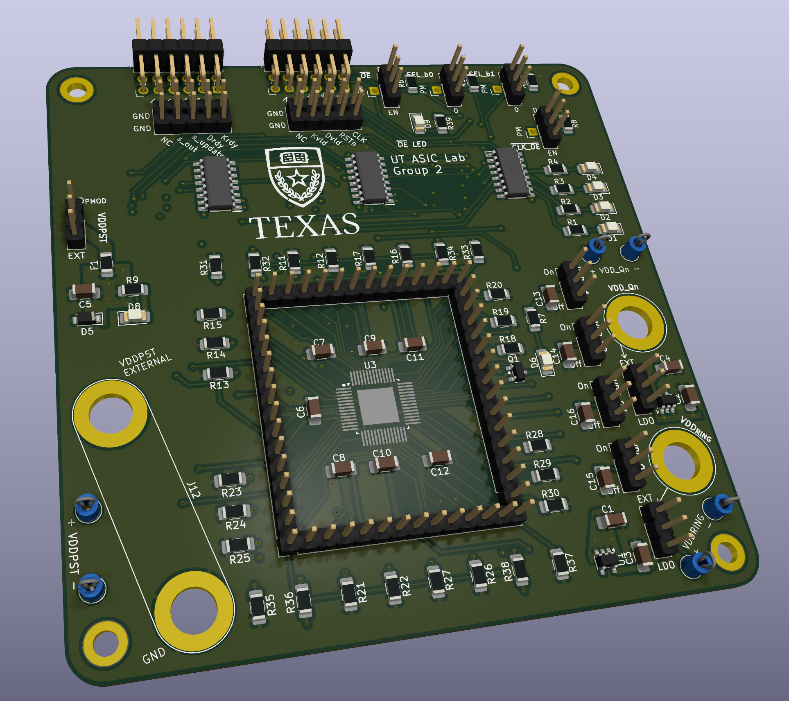
ASIC Design Lab II | PCB Design Summary
UT ASIC Lab Group 2
Morris Lin
Vendor: JLCPCB
Price: $8.00
Dimensions : 100 mm x 100 mm
Area: 9978.517 mm²
Layers: 4
Power Conn.: 2-pin Banana, 2x 1-pin Banana
Data Conn.: 2x PMOD, 2x logic analyzer, QFN breakout pins (for backup use)

Slide 2
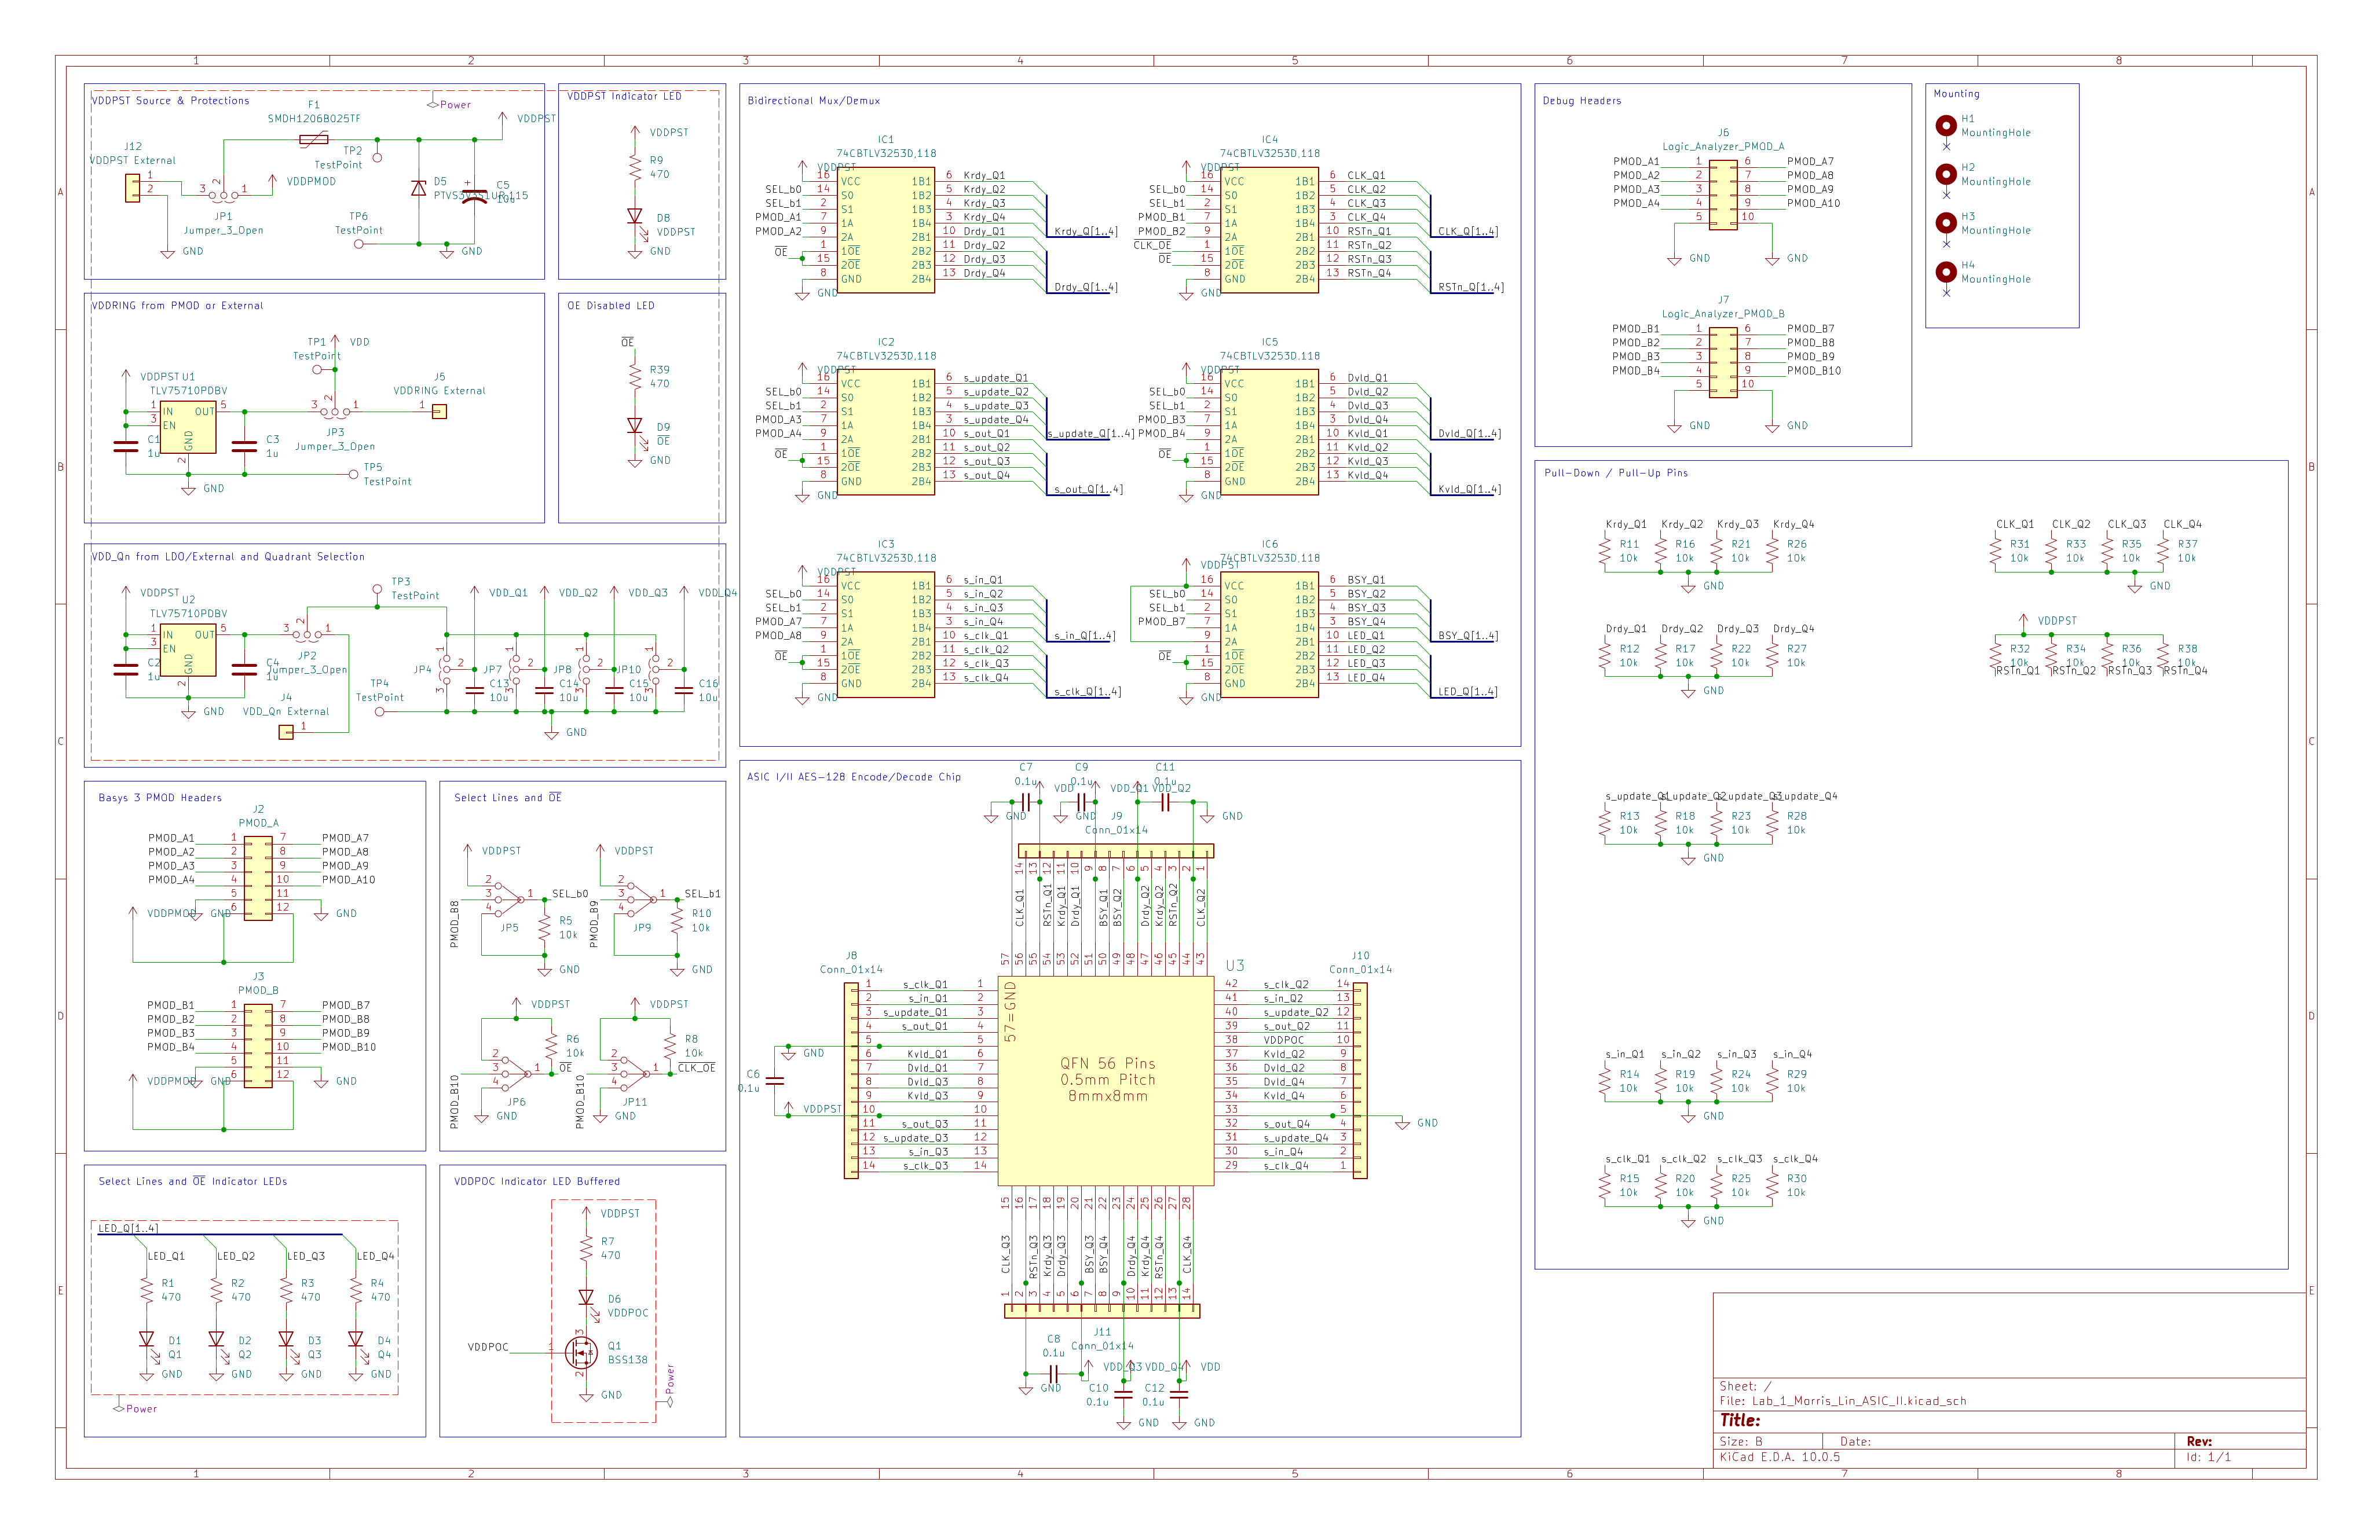
Schematic & Design Choices | Power
Choice of power sources for all rails
  PMOD 3v3
  External via Banana
Generated 1V rails from PMOD via LDOs
  VDDRING
  VDD_Qn
  Separate LDOs
Passives
  Bulk capacitors
  ESD Protection diode
  PTC Resettable fuse

Slide 3
Schematic & Design Choices | Data
Bidirectional Mux/Demux IC
  NMOS + PMOS pass transistor implementation
  Nominal 5 Ω resistance
Quadrant Selection Mechanisms
  Select lines and output enable
  Manually set or from FPGA
  Chip CLK OE independent (allow external clock)

Slide 4
Schematic & Design Choices | Other Features
Square of Backup Headers
  For the case of muxes failing
  Routing breakout (layout)
LED Indicators
  Improve ease of debugging
  Quadrant selection, Mux output enable, Chip power
10k Pull-Down Resistors
  On all input pins on ASIC (not shown here)

Slide 5
Schematic & Design Choices | Full Schematic

Slide 6
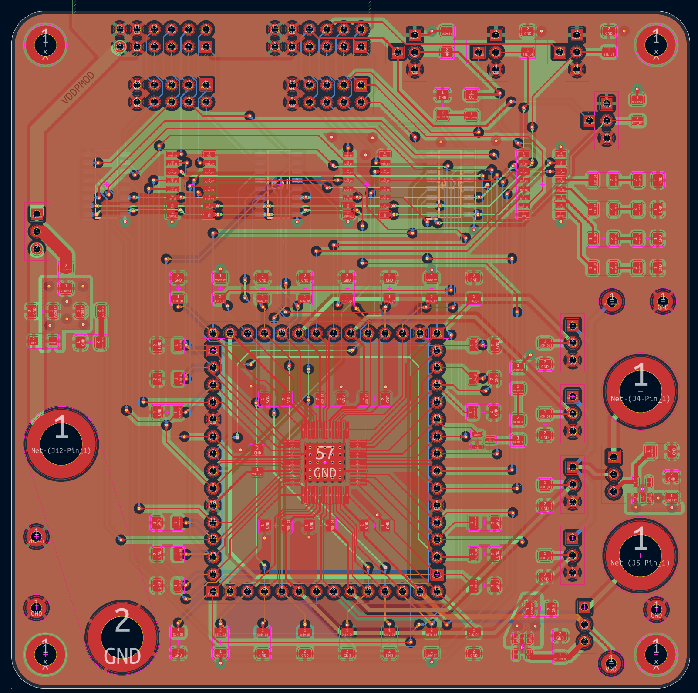
Layout Overview
4-layer Stackup
  Red: Signal
  Green: Power
  Orange: Ground
  Blue: Signal
Cost saving methods
  Limit to 100 mm x 100 mm
  No via-in-pad
  Allows minimum JLCPCB 4-layer cost
SI Routing (Super Intelligence)
  Tried open-source routers, tended to struggle
  All routing done by hand

Slide 7
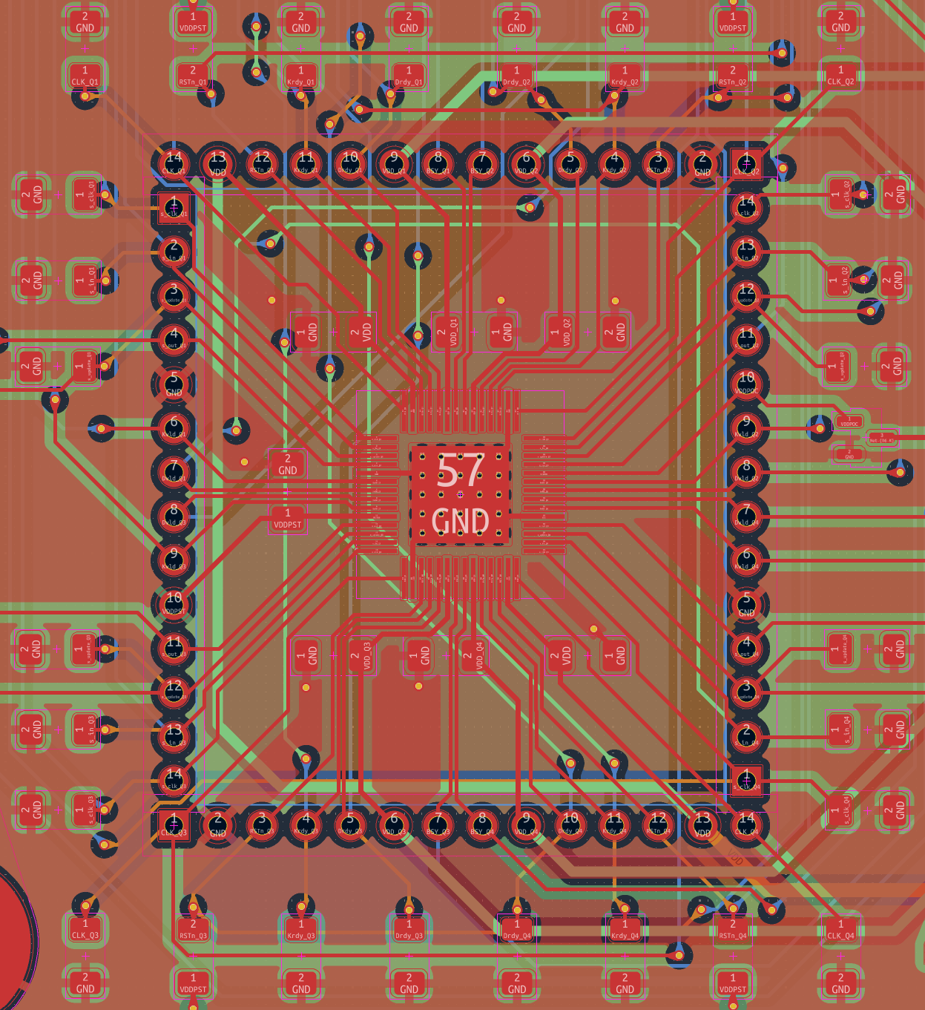
Layout | QFN-56 Package
Backup Header Square
  Headers in matching order to ASIC pinout
  For use if muxes fail
  Also serves as breakout for dense QFN pins
Decoupling Capacitors
  Kept as close as possible to ASIC
  Some standoff for routing space

Slide 8
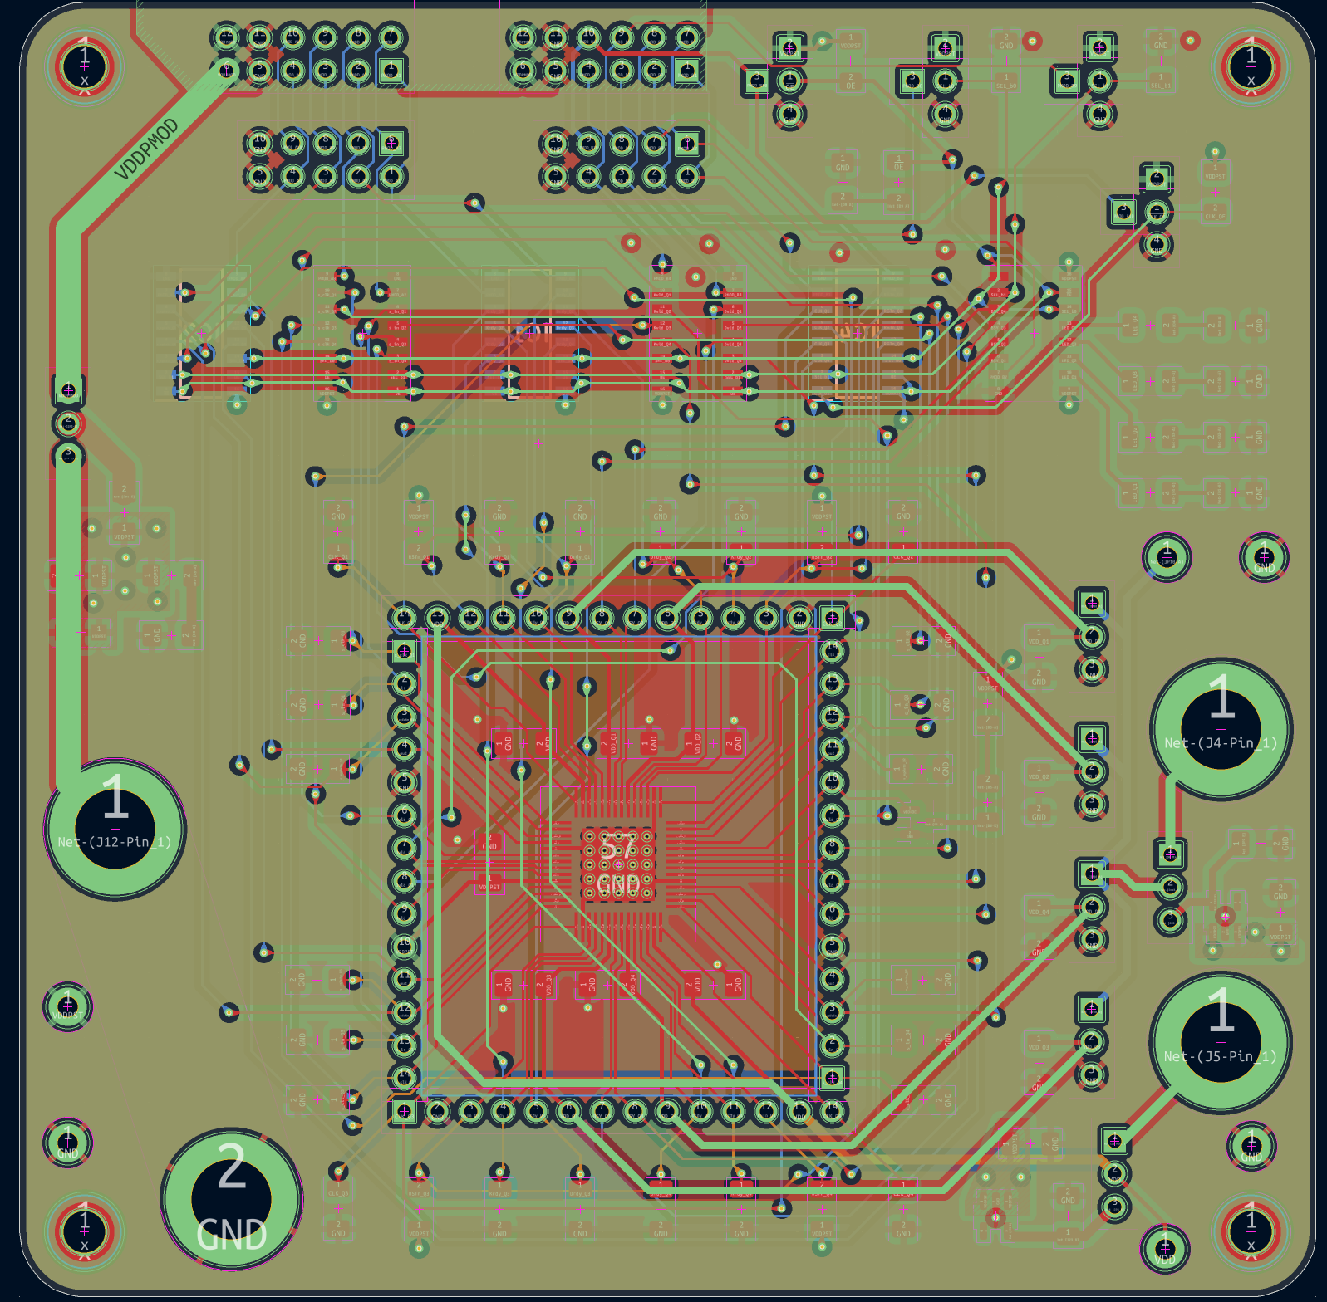
Layout | Power
VDDPST Fill
Routes for other power domains
Additional routing space
  Breakout from Mux ICs use this layer
  Some signals use for reaching pins as well
Speed limitations
  High-speed boards will use signal-gnd-gnd-signal or signal-pwr-gnd-signal stackups, middle planes kept as uninterrupted as possible
  This design is not high-speed, also high routing demand for 4 independent AES-128 Modules

Slide 9
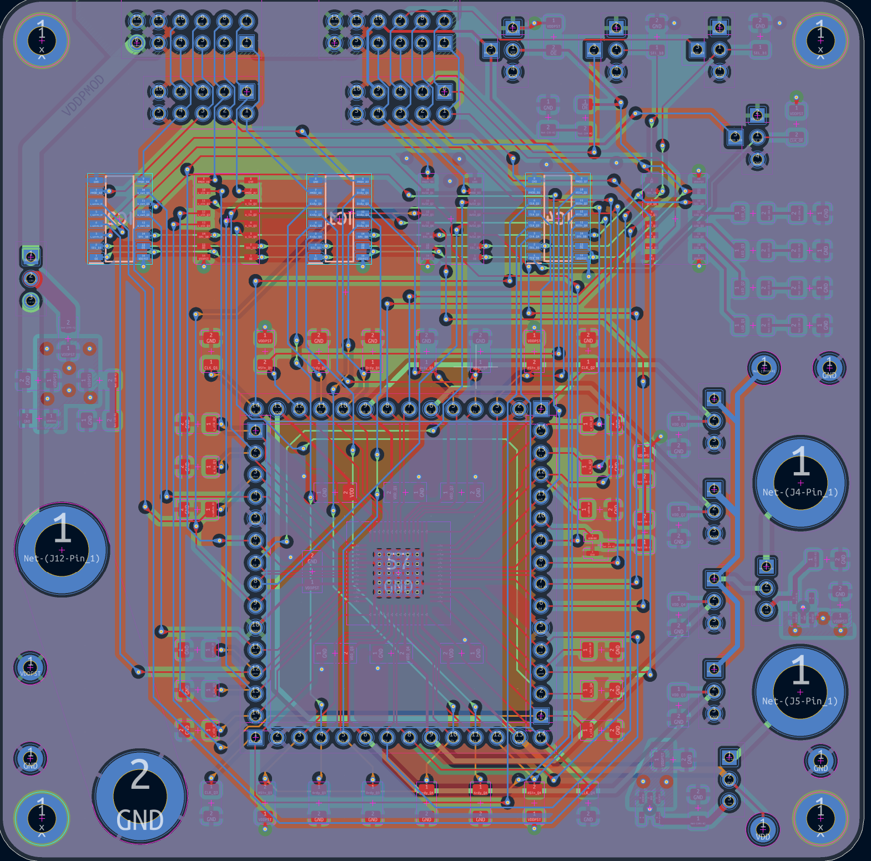
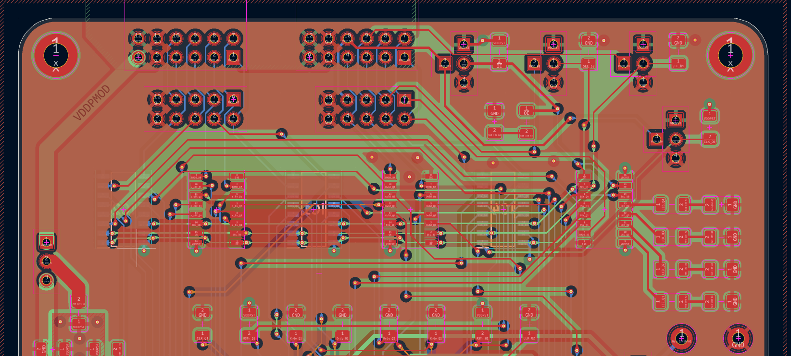
Layout | Data
Horizontal/Vertical Routing method
  Top kept mostly horizontal, bottom kept vertical
  Allows easier positioning of traces
Not impedance matched
  FPGA Board is not impedance matched, no point doing it here

Slide 10

BOM
SHOPPING CART
This is not an invoice
01-Oct-26 18:04:37
 | Mouser # | Mfr. # | Manufacturer | Customer # | Description | RoHS | Lifecycle | Order Qty. | Price (USD) | Ext.: (USD) | Estimated Tariff Price (USD) | Estimated Tariff Ext. (USD)
1 | 187-CL31B105KAHNFNE | CL31B105KAHNFNE | Samsung Electro-Mechanics | C1,C2,C3,C4 | Multilayer Ceramic Capacitors MLCC - SMD/SMT 1uF+/-10% 25V X7R 32 1206 | RoHS Compliant |  | 4 | $0.18 | $0.72 | $0.02 | $0.09
2 | 187-CL31A106KAHNNNF | CL31A106KAHNNNF | Samsung Electro-Mechanics | C5,C13,C14,C15,C16 | Multilayer Ceramic Capacitors MLCC - SMD/SMT 10uF+/-10% 25V X5R 3 1206 | RoHS Compliant |  | 5 | $0.23 | $1.15 | $0.03 | $0.14
3 | 187-CL31B104KBCNFNC | CL31B104KBCNFNC | Samsung Electro-Mechanics | C6,C7,C8,C9,C10,C11,C | Multilayer Ceramic Capacitors MLCC - SMD/SMT 100nF+/-10% 50V X7R 1206 | RoHS Compliant |  | 7 | $0.13 | $0.91 | $0.02 | $0.11
4 | 859-LTST-C230KRKT | LTST-C230KRKT | LITEON | D1 | Single Color LEDs Red Clear 631nm | RoHS Compliant |  | 7 | $0.18 | $1.26 | $0.05 | $0.38
5 | 771-PTVS3V3S1UR115 | PTVS3V3S1UR,115 | Nexperia | D5 | ESD Protection Diodes / TVS Diodes PTVS3V3S1UR/SOD123W/CFP3 | RoHS Compliant By Exemption |  | 1 | $0.58 | $0.58
6 | 603-SMDH1206B025TF | SMDH1206B025TF | YAGEO | F1 | Resettable Fuses - PPTC 1206,16V 0.25A 0.6W SMD AEC-Q200 High Temp | RoHS Compliant | New Product | 1 | $0.10 | $0.10 | $0.03 | $0.03
7 | 771-74CBTLV3253D118 | 74CBTLV3253D,118 | Nexperia | IC1,IC2,IC3,IC4,IC5,I | Encoders, Decoders, Multiplexers & Demultiplexers 74CBTLV3253D/SOT109/SO16 | RoHS Compliant |  | 6 | $0.50 | $3.00 | $0.19 | $1.14
8 | 771-BSS138AK-QR | BSS138AK-QR | Nexperia | Q1 | MOSFETs BSS138AK-Q/SOT23/TO-236AB | RoHS Compliant |  | 1 | $0.18 | $0.18
9 | 603-RC1206FR-13470RL | RC1206FR-13470RL | YAGEO | R1,R2,R3,R4,R7,R9,R39 | Thick Film Resistors - SMD General Purpose Chip Resistor 1206, 470Ohms, 1%, 1/4W | RoHS Compliant By Exemption |  | 7 | $0.10 | $0.70 | $0.01 | $0.06
10 | 603-RC1206JR-0710KP | RC1206JR-0710KP | YAGEO | R5,R6,R8,R10,R11,R12, | Thick Film Resistors - SMD General Purpose Chip Resistor 1206, 10kOhms, 5%, 1/4W | RoHS Compliant |  | 32 | $0.047 | $1.50 | $0.00 | $0.13
11 | 595-TLV75710PDBVR | TLV75710PDBVR | Texas Instruments | U1,U2 | LDO Voltage Regulators 1-A low-IQ high-acc uracy low-dropout (L | RoHS Compliant |  | 2 | $0.34 | $0.68 | $0.13 | $0.26
By submitting your order you agree to these terms and conditions. |  |  |  |  |  |  |  |  |  |  | Merchandise: | $10.78
Prices are reflected at the date and time shown. |  |  |  |  |  |  |  |  |  |  | Shipping Charge: | $8.49
 |  |  |  |  |  |  |  |  |  |  | Backorder Shipping: | $1.99
 |  |  |  |  |  |  |  |  |  |  | Estimated Tariff: | $2.34

Slide 11
Questions?
Thank you for your attention!

