Slide 1


Getting Started
Class 01

Slide 2

WELCOME!
In this course, you’ll be learning the foundational skills of web development and software engineering.

Slide 3
The purpose of this course
To help you form a solid, beginner-level understanding of the core technologies of web development, even if you have little to no experience.
The primary focus of the course will be on the JavaScript programming language.
At the end of this course you will be able to build a functioning web application using HTML, CSS, JavaScript, and third-party APIs (Application Programming Interfaces).

Slide 4
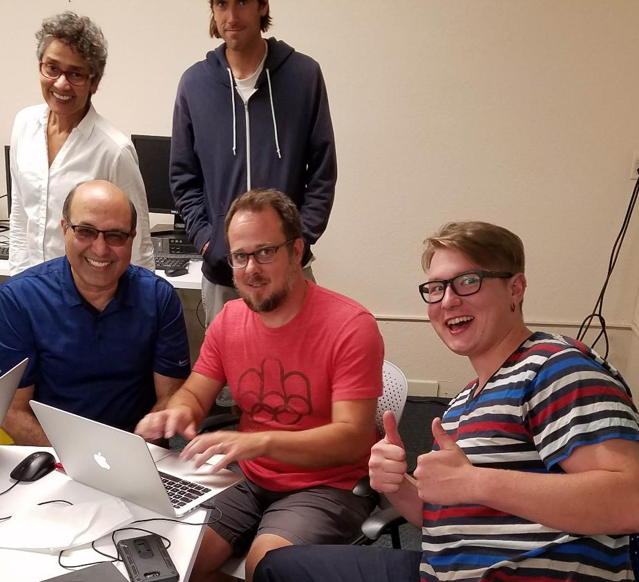
Introductions
Many of the people in this class will be your peers as you advance in your software development career.
Let’s get to know each other a little bit.
Notes:
Introduce yourself and any other instructors or mentors.
Have students introduce themselves to the class.

Slide 5
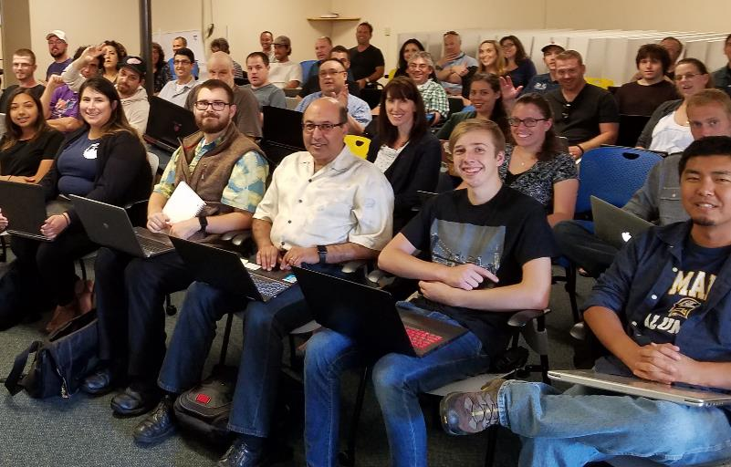
Attendance
We’ll be tracking attendance with the Morro Class Management App.
Let’s check in!
Notes:
Show students around the Morro application. Show them how to check in.

Slide 6
EXPECTATIONS
  Classes will start on time.
  Mentors will conduct themselves as the professionals they are.
  We expect the same conduct from everyone here.
  We have a “no jerk” rule. Treat everyone as you would like to be treated.
  Classes will be challenging. Come ready to work.

Slide 7
Learning to code is hard…
and that’s okay.
  The challenge you’ve accepted is not an easy one.
  You’re going to get stuck. You’re going to feel frustrated.
  Sometimes you’re going to feel like you’re not smart enough to do this.
  These are common feelings. Keep working at it.
  Remember… if coding were easy it wouldn’t pay so well!

Slide 8
Learning to code is…
Fun!
  Even though it can be challenging, learning to code can also be a lot of fun.
  If you enjoy puzzles, building things, or solving problems you’re probably going to enjoy this class.

Slide 9
The genius moments
Sometimes you’ll feel like you’re not smart enough, other times you’ll feel like a genius. The genius part is fleeting but makes the whole thing worth it.
Remember…

Slide 10
IT’s the Will
{ NOT THE SKILL }

Slide 11
Let’s Get Started

Slide 12
HOW THE WEB WORKS
  It all starts with the browser.
  The browser is a program that runs on the client computer.
  The client computer delivers information stored on a web server to the browser.
  Files and data are transferred between the client and server via HTTP or HTTPS.
  Servers deliver HTML, CSS, JavaScript, and data formats such as JSON.

Slide 13
Client and Server,
Front-end and Back-end
The client computer is the one that hosts the web browser. Right now, all of us are sitting in front of client computers. Programming for the client is considered front-end development.
The server is the computer that hosts the HTML, CSS, and JavaScript files. The server also communicates with a database in more complex applications. Programming for the server is called back-end development.
Clients and servers communicate using HTTP.

Slide 14



HTTP REQUEST
INTERNET
CLIENT
SERVER
HTTP RESPONSE

Slide 15
What Web Developers DO
WEB DEVELOPERS PRIMARILY WORK WITH THREE TECHNOLOGIES: HTML, CSS, AND JAVASCRIPT.
HTML defines the content of a web page, such as text and images.
CSS defines the appearance of that content. It’s a styling language.
JavaScript is the programming language of the web. It defines the functionality of a site or application.

Slide 16
HTML
HTML is a markup language.
It was the first web technology invented and it was originally used for creating scientific and engineering papers that could be easily shared over a network. It was developed at CERN.
HTML (Hypertext Markup Language) is easy to learn. We’ll work with it first.

Slide 17
CSS
CSS is the styling language of the web. It is a tool that can give a web page pretty much any appearance.
CSS came later in the history of the web.
CSS is more complex that HTML. We’ll get a chance to work with it soon.

Slide 18
JavaScript
JavaScript is the programming language of the web. It is currently the only language that browsers understand (WebAssembly aside, for those who have heard the rumors).
JavaScript started as a browser-only language, but it has expanded and is now one of the most versatile programming languages in the world.
It can be used for front-end, back-end, mobile, desktop, game development… and more!

Slide 19
More on JavaScript
JavaScript is the most difficult of the three core-technologies to learn, and it is where we’ll spend the most time.

Slide 20
That’s not all
Web developers work with a variety of other technologies.
It’s common to work with JavaScript frameworks and libraries such as Angular or React.
Developers also work with database technologies like SQL and MongoDB.

Slide 21

Web Development and
Software Engineering
  Web developers are a subset of software engineers.
  All software engineers solve problems with code. Web developers do it on the Internet.
  The titles are largely interchangeable.

Slide 22

Learning is an experience. Everything else is just information.
-Albert Einstein
Web development is something you learn by doing.
So let’s get started.

Slide 23
The Development Environment
We’re here to learn to be professional developers, so we need to use professional tools.
Code Editor | Visual Studio Code
Version Control | Git + Github
In-Browser Testing | Chrome + Chrome Dev Tools
Other tools | Live Server, Node.js and Code Runner

Slide 24
INSTALLATIONS

Slide 25
Visual Studio Code
VS Code is the tool we’ll use when creating HTML, CSS, and JavaScript.
VS Code is a text-editor with special features for developers. It was designed by Microsoft and is free to use. It works on Windows, MacOS, and Linux.
Download it right here: https://code.visualstudio.com/
Go ahead and install it. If it prompts you to install Git, don’t do it.

Slide 26
GIT
Git is the most popular version control software in the world and it’s free.
Git files are called repositories or repos.
Git repos are often stored on GitHub, which is another free service.
Git is so common that you may hear the question “What’s your GitHub?” from a potential employer.
You’ll learn the basics of Git later in this course.

Slide 27
Installing Git
Windows or Mac: https://git-scm.com/downloads
Linux: sudo apt-get install git
Open command prompt or VS Code terminal and type:
git --version
You should see something like this:
git version 2.17.1.windows.2
Notes:
Apt-get doesn’t work on all Linux distros. Apt-get and apt install should work on those based on Ubuntu.

Slide 28
Github
Git repos can be stored locally, but more commonly they are stored on a server or with a service like GitHub.
GitHub has millions of users and countless projects stored on it. It is the nexus of the open-source software world.
In this class, we’ll use it for downloading code samples and uploading projects.
You’ll need a GitHub account! Go to https://github.com and create one using the email address you use for class.

Slide 29
The Chrome Browser
Chrome has several extensions that are useful for web developers.
Most importantly, it has the Chrome DevTools, which we will use for troubleshooting our HTML, CSS, and JavaScript.
If you don’t have it already, you’ll need to download and install it. There are versions for Windows, MacOS, and Linux.
https://google.com/chrome

Slide 30
Node.js
Node.js is a powerful technology that allows JavaScript to be executed outside of a web browser.
In class, we will use it to run and test small JavaScript programs.

Slide 31
Installing Node
Windows or MacOS: https://nodejs.org/en/download/
Linux: sudo apt-get install nodejs npm

Slide 32
Testing Node
Open a command prompt / terminal window on your operating system and enter this command:
node -v
You should see something like this in response:
v8.11.3
Don’t know how to open a command prompt or terminal window? Ask us for help. You’ll want to get comfortable with the CLI of your operating system.

Slide 33
Live Server
Live Server is a VS Code extension that allows us to easily open our projects as web pages.

Slide 34
Code Runner
Code Runner is an extension for Visual Studio Code. It leverages Node.js in order to run your JavaScript code right inside your development environment.

Slide 35
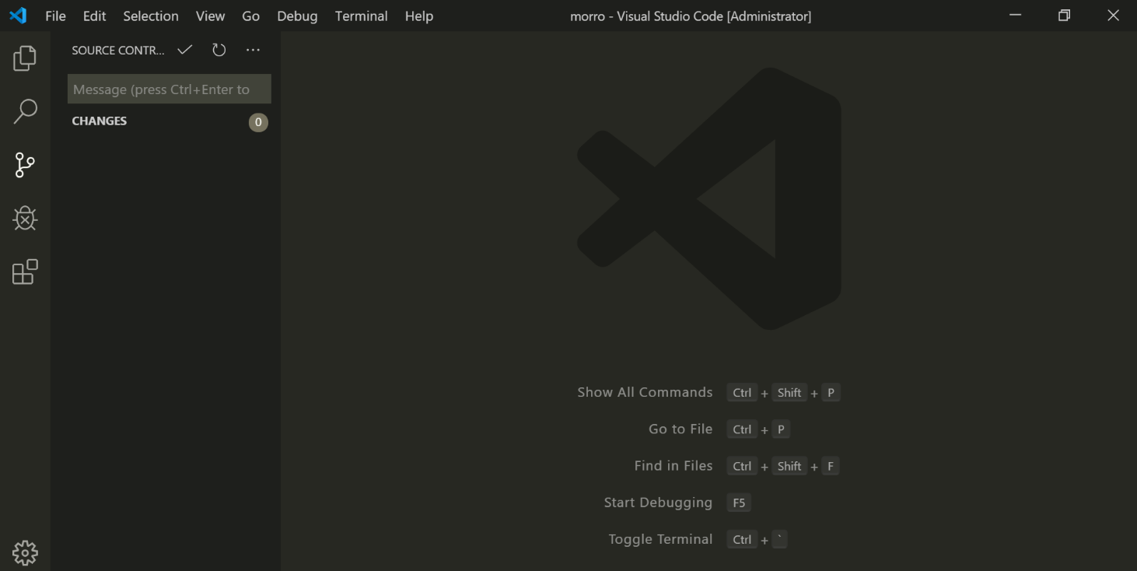
Installing VS Code Extensions
Click the extensions icon

Slide 36
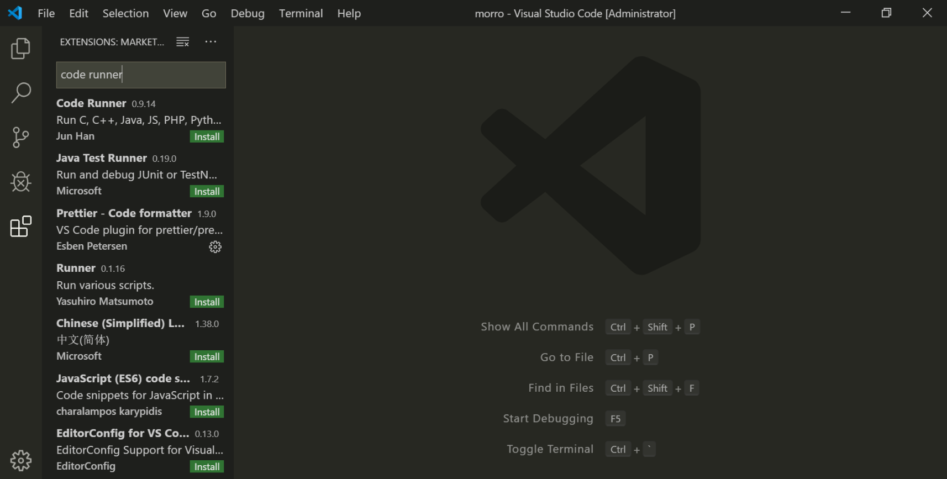
Installing Code Runner
Type code runner here
Click Install under Code Runner

Slide 37
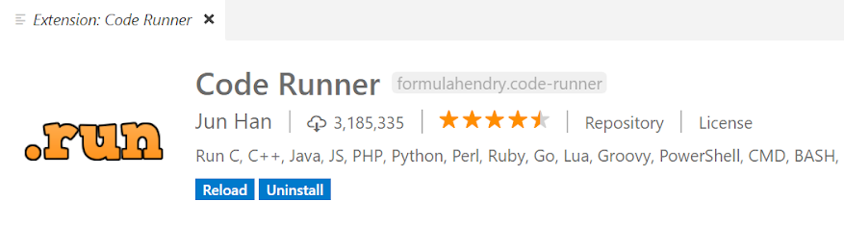
Code runner (More)
After installing an extension like Code Runner in VS Code, look for a Reload or Reload Required button. Sometimes VS Code needs to reload before the extension will work…

Slide 38
Exercise: Testing Everything
Let’s make sure everything on your development environment is set up correctly. Please follow along:
Open Visual Studio Code.
Create hello-world.html.
Open hello-world.html with LiveServer.
Create hello-world.js.
Run hello-world.js using Node and Code Runner.
If it all worked, your dev environment is set-up and configured! If something didn’t work, don’t worry, we’ll get you set up before you leave.
Notes:
First demonstrate making hello-world.html: <h1>Hello World</h1>. Next, demonstrate hello-world.js: console.log(“Hello World”).

Slide 39
REVIEW
Today you took your first steps into software engineering.
You learned that coding is hard, and that it’s the will not the skill that will get you through.
You got connected to the Wi-Fi network, got registered on Morro, and learned how to check-in for class.
You installed, configured, and tested your development environment.

Slide 40
What’s next?
In the next class, we’ll go over working with your computer’s file system, the command line, and the Git version control system.
Later in this course, you’ll learn about HTML and CSS, which define and style content in a static webpage.
After that, you’ll start learning about the JavaScript programming language.

Slide 41
Questions?

Slide 42

This presentation is protected by U.S. and International copyright laws. Reproduction and distribution of the presentation without written permission of CodeSLO LLC is prohibited.
©2019 CodeSLO LLC

