Slide 1
HTML
Class 03

Slide 2
Using
Visual Studio Code

Slide 3
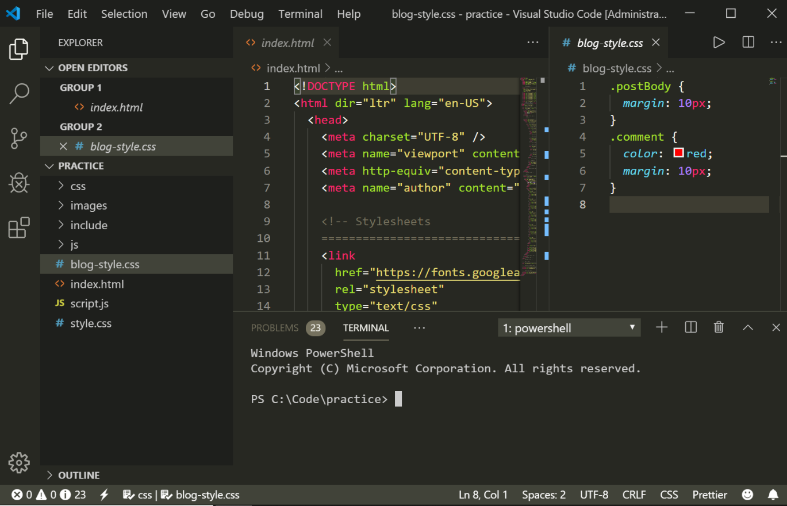
A
B
C
Activity bar
Sidebar
Editor groups
Panel
Status Bar
D
E

Slide 4
The Activity Bar
Let’s look at some of the options available to us on the activity bar.
Notes:
Briefly talk about each icon on the activity bar and what it does. It isn't necessary to go into detail about source control or debugging. Be sure to demonstrate opening and closing the file explorer by clicking on the icon.

Slide 5
The Sidebar
Let’s use the sidebar to create folders and files

Slide 6
The Editor
Let’s enter some basic HTML into the editor so we can see some of its features.
Notes:
Create very simple HTML file show syntax highlighting and auto complete.

Slide 7
The Console
The console is a convenient feature of VS Code.
Notes:
Demo using ctrl + ` to open console. Demo basic navigation in console to show that it is a standard CLI.

Slide 8
Let’s Write Some Code!

Slide 9
HTML
HTML (Hypertext Markup Language) describes content on the web.
HTML isn’t a programming language because it doesn’t provide complex functionality like loops or decision making. It’s a markup language that tells browsers what to display.
HTML doesn’t even tell a browser what style the content should have; just what content is there.
Let’s write some!

Slide 10
Exercise One
Open your Morro folder in VSCode.
Expand your MyCode folder then expand the Module-01 folder.
Create a new file in Module-01 called index.html.
In the editor window make sure you have the index.html tab selected and type the following:
Save your file.
<h1>This is a heading element</h1>
<h2>This is a subheading element</h2>
<p>This is a paragraph element</p>

Slide 11
Opening Tags and Closing Tags
<h1>This is a heading element</h1>
Opening tag
Closing tag
Element content is between the opening and closing tags.

Slide 12

Time to Check In

Slide 13
Exercise Two: Open the File in the Browser
Use the Live Server extension to open your index.html file.
or
In explorer or finder, open the index.html file with the Chrome browser. This method won’t work with all web pages, but it’s good to know how to use.

Slide 14
Exercise Three
Add the code below to index.html:
Save and test your code. Clicking the link should take you to GitHub!
<a href="https://github.com"><p>This is an anchor element, AKA a link</p></a>

Slide 15
href
When you added the anchor link, <a>, you used href= to tell the browser what URL to link to.
Href is short for hypertext reference.
There are many attributes that can be included in an opening HTML tag, href is a common one.

Slide 16
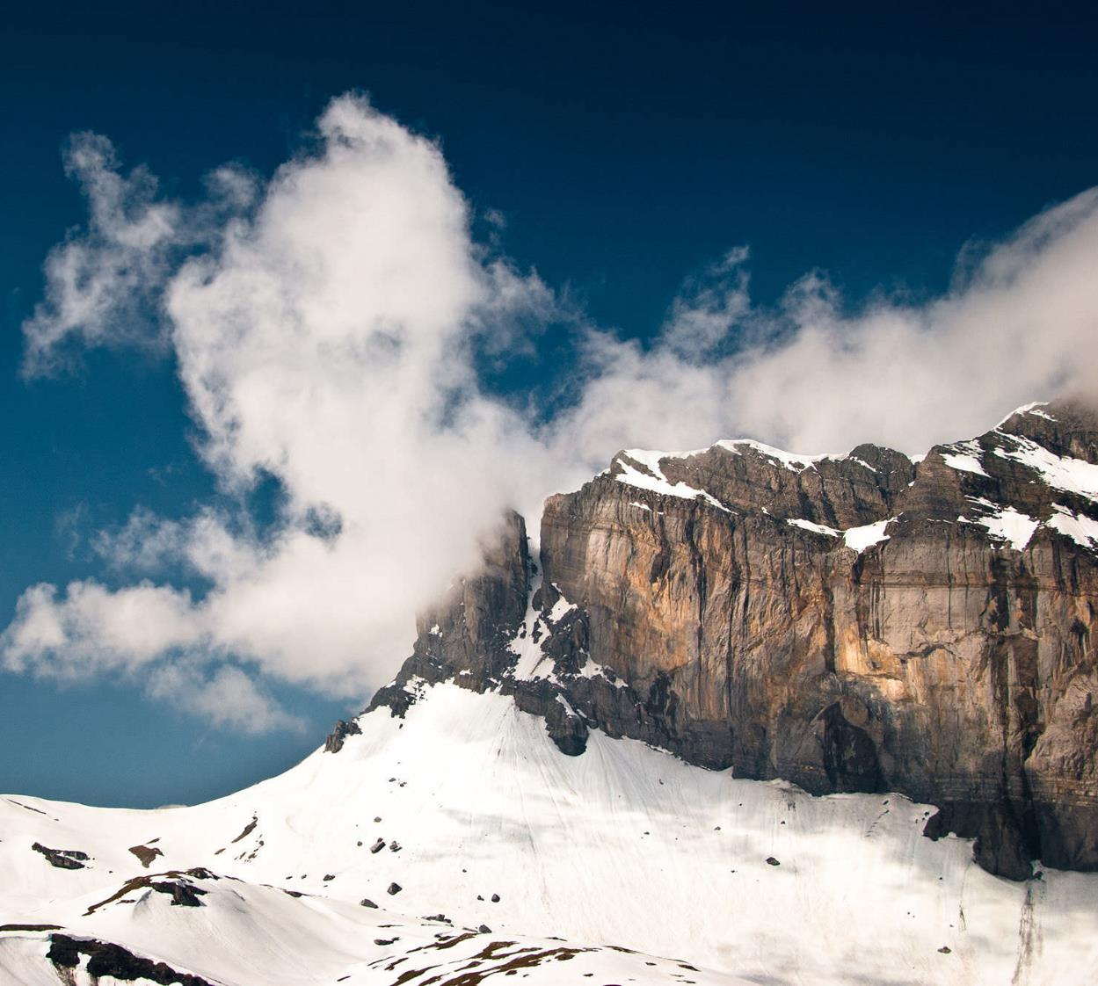
Images
There are two ways to add an image to your page:
The first is to link to an image that is already online via a URL.
The second is to add an image that is stored in the file system of your web server.

Slide 17
Exercise Four
Do a Google search for an image of anything. Kittens, space monkeys, carrots… whatever.
Use an image URL that ends in .jpg or .png.
Copy the URL for your image. Make sure you have the image URL (https://kittens.com/kitten.jpg), not the URL for the search result.
Add the following code to index.html:
<img src="paste your image URL here" />
Notes:
A common problem students have here is finding images with invalid URLs. Their chosen image needs to end with .jpg or .png.

Slide 18
Wait!
My image is too big!
If you found a large image it might display WAY too big on your page. We’ll tame it with a sneak peak of CSS.
Modify your <img> tag to look like this:
<img style="width:300px" src="<your image URL here>" />

Slide 19
<img> tags are different
Image tags use the source property, with src=. It’s like the HREF property and it is used the same way.
Image tags don’t have normal closing tags because there isn’t anything to put between the tags.
Instead, <img> is a self-closing tag, indicated by the /> at the end:
<img src="https://kittens.com/kitten.jpg"/>

Slide 20
Exercise
Five
Choose an image you have on your computer or find one and download it.
Copy the image and paste it into the Module-01 folder.
Rename the image to something simple and descriptive like “space-monkey-pic.jpg” Do not use spaces in your filename.
Change your <img> tag to look like this:
<img style="width:300px" src="space-monkey-pic.jpg” />

Slide 21
Exercise Six:
Your First Webpage!
Your web page will be called “How to Google.”
Create a new file in the Module-01 folder called how-to-google.html
Think about a web page for teaching people how to use Google.
Build the webpage using <h1>, <h2>, <p>, <img>, and <a> tags.
Inside the <p> tags add some paragraphs about how to Google. Try to include at least four paragraphs, it will be important for styling later.

Slide 22
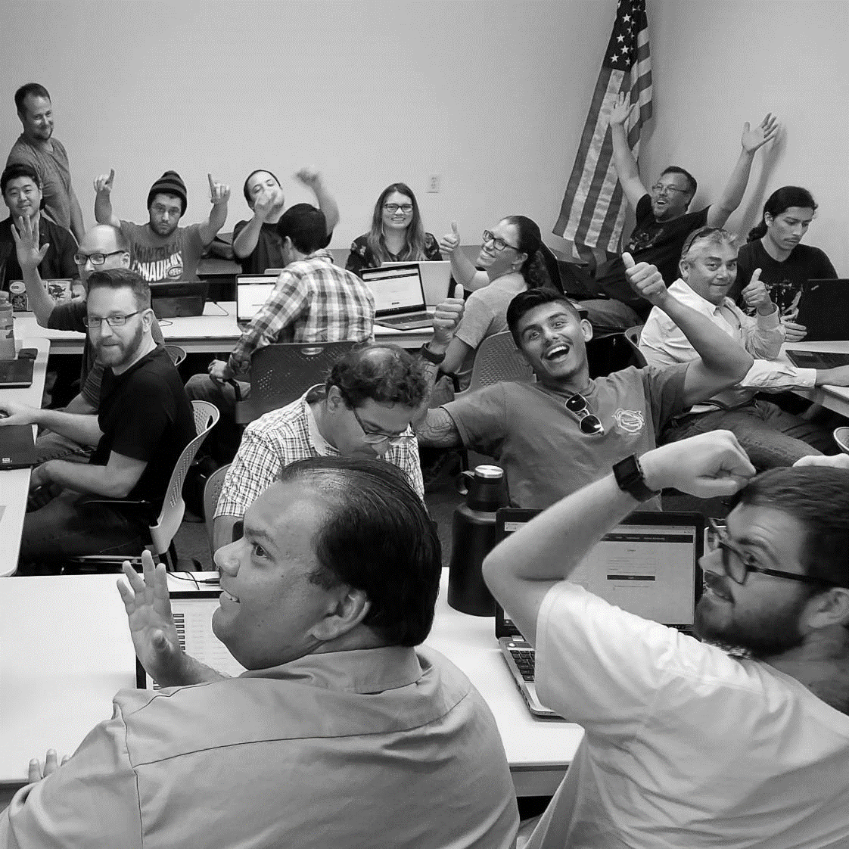
Questions?

Slide 23

Coming Up
Next time we’ll go over more HTML, then we’ll style it using CSS.

Slide 24

This presentation is protected by U.S. and International copyright laws. Reproduction and distribution of the presentation without written permission of CodeSLO LLC is prohibited.
©2019 CodeSLO LLC

