Slide 1

Intro to CSS
Class 04

Slide 2
HTML
In our last class we started working with HTML.
Today we are going to make that HTML more sophisticated.
That’s generally how this course will work. We’ll start with the basics and each class will build on the last.
Notes:
This is a good time to remind students not to miss classes, since each class builds on the last.

Slide 3
Doctype, head, body, and comments
There are many parts of an HTML document that are invisible to the user.
Some of these contain information that tells the browser how to display content.
Others contain information that is useful to the developer (that’s you!).

Slide 4
<!DOCTYPE html>
<head>
<!-- head content is invisible to users but still important -->
</head>
<body>
<!-- Body content can be seen by users unless inside a tag -->
<!-- This is a comment. It cannot be seen by users and is
meant for the developer. Comments are really useful! -->
</body>

Slide 5
Title tag
<head>
<title>My Page Title</title>
<!-- head content is invisible to users but still important -->
</head>
One type of field that goes in the head section of your HTML document is the title.
The title shows up on the tab for a page, in the browser.
It is contained within tags, like other content we’ve seen.

Slide 6
EXERCISE: Add doctype, head and body tags
Open your how-to-google.html file from last class.
Add DOCTYPE, head, and body tags to your document.
Add a title to the head section.
Put all your content from last class between the body tags.

Slide 7
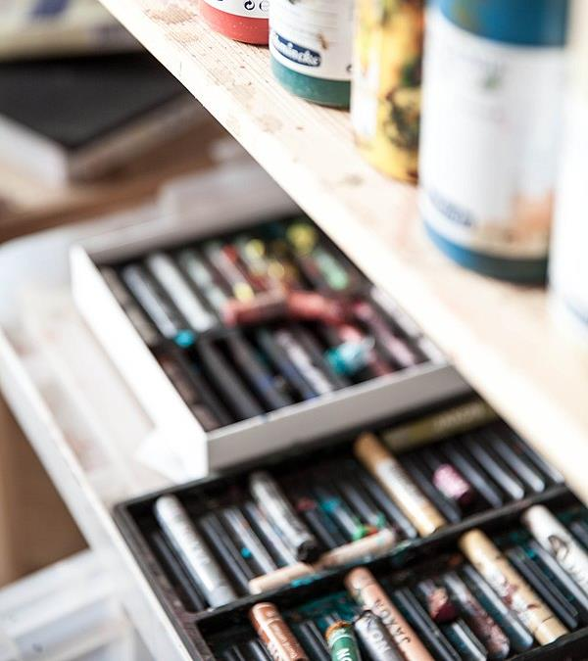
Let’s talk about style
Your “How to Google” page is a little boring isn’t it?
In web development, HTML defines the content of a page.
A technology called CSS (Cascading Style Sheets) defines the presentation of that content.
Take a quick look at a “How to Google” page without CSS.
Notes:
Go to the GitHub repo for Module-01, Class-04. Demo how-to-google-original.html.

Slide 8
Not too inspiring.
Now let’s take the same HTML and add some CSS styling.
Notes:
Go to the GitHub repo for Module-01, Class-04. Demo how-to-google-with-style.html.

Slide 9
Big difference, right?
With CSS, the presentation of every element was changed.
Fonts, text size, background colors, and the spacing of elements were all different. Borders were added and the text layout was styled.
The result is a page that’s not only nicer to look at, it’s also easier to read.
That’s what CSS is for. Presenting your content in a way that will help a user consume it.

Slide 10
CSS
CSS uses selectors to find the elements in an HTML document that you want to style.
Properties called rules tell the browser how to style an element. There are thousands of CSS rules and no one knows all of them.
If you need a CSS rule that you don’t know, refer to your “How to Google” page, and google it!
CSS can be frustrating in the beginning. Like anything, it gets easier the more you use it.

Slide 11
Inline styling
A simple way to add CSS styling is to write a style property right into an element’s HTML tag. Then all you have to do is define a rule or two.
One problem with inline styling is you’d have to add it for every element individually.
<h1 style="color:blue;">This is a Blue Heading</h1>
<h1>This element has no style</h1>

Slide 12
The internal style sheet
A better way to style a page is with a style sheet.
A style sheet contains rules that can be used by multiple elements on a page.

Slide 13
<head>
<style>
h1{
color:blue;
}
</style>
</head>
<body>
<h1>This is a blue heading</h1>
<h1>So is this one</h1>
<h2>This element has no style</h2>
</body>
Internal style sheet

Slide 14
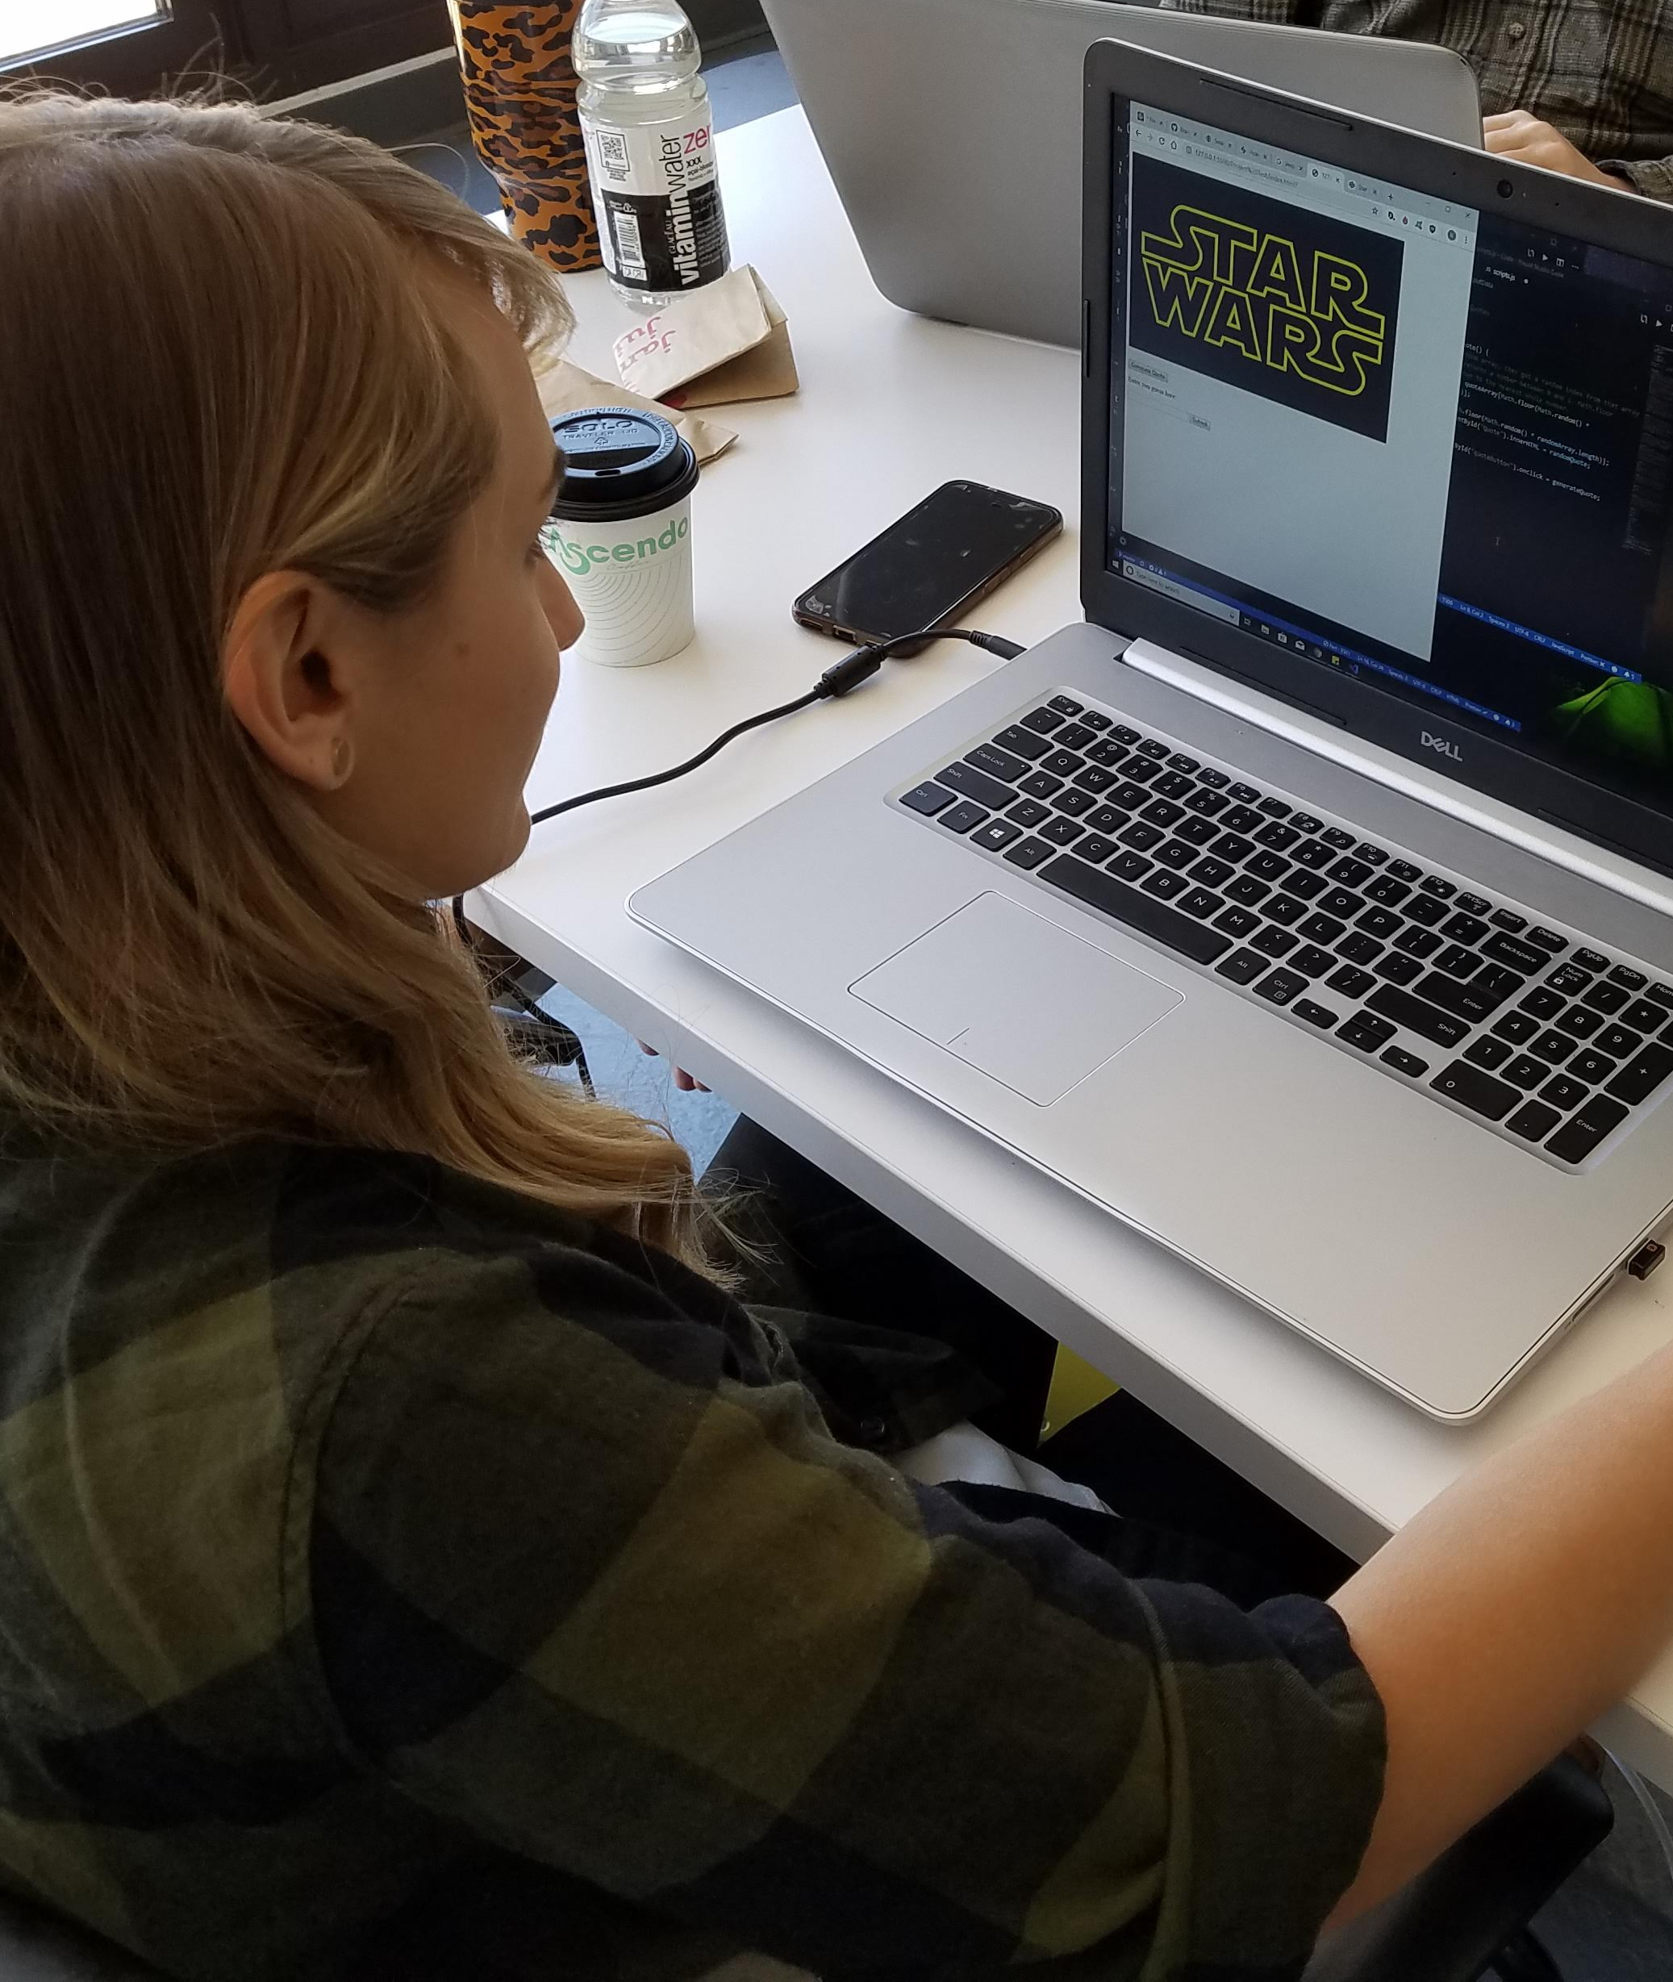
EXERCISE
Now you make a stylesheet.
Make a stylesheet in the head area of your “How to Google” page.
For now, just include a single rule to make sure everything is working.
Don’t forget to save your file!

Slide 15

Time to Check In!

Slide 16
Anatomy of a CSS Rule
h1{
color:blue;
}
SELECTOR
DECLARATION
PROPERTY
VALUE

Slide 17
Color
The color property changes the font color of an element.
It can be set to a variety of english-language settings like “red” or “blue”, or it can be set using a hex value such as #fffff or #37474f.
h1{
color:yellow;
}

Slide 18
Background color
h1{
color:yellow;
background-color:blue;
}
The background-color property changes the, well, background color of an element.
It is set in the same way as the color property.

Slide 19
Classes and IDs
You can assign specific selectors to elements in order to style them.
For example, if you want to change the text in one paragraph to aqua and another to gold, you can assign classes to those elements like this:
<body>
<p class="color-one">This text is aqua</p>
<p class="color-two">This text is gold</p>
</body>
These class names are arbitrary.

Slide 20
The Difference Between Classes and IDs
IDs can be used for styling in the same way that classes can.
The difference is classes are usually used for styling, while IDs are usually used for hooking into a specific element (such as a button), with JavaScript.
IDs should be unique in a page.
Classes can, and often are, shared by many elements.

Slide 21
Styling with classes
  <style>
  .color-one{
  color:aqua;
  }
  .color-two{
  color:gold;
  }
  </style>
A period designates a class in CSS.

Slide 22

EXERCISE
Colorize it!
Assign different classes to elements on your “How to Google” page.
Using CSS and an internal stylesheet, change the color and background color of these elements.

Slide 23
EXERCISE: Big and little
Make a new HTML document called big-and-little.html. Add doctype, head, and body sections to your document.
Add a title and internal stylesheet to your head section.
In the body section, create two sets of paragraph elements.
The content of one <p> element should be “big text” and the content of the other should be “small text”.
Assign separate classes to your <p> elements.
Give one class the CSS rule font-size:24px and the other font-size:8px.
Don’t forget semicolons!

Slide 24
EXERCISE: Borders
Make a new HTML document called box-model.html. Give it doctype, head and body tags with an internal stylesheet in the head.
In <body> create a heading element that reads This is an element.
Give it a class of my-box.
Give .my-box a property of border with a value of 2px solid black;
<style>
.my-box {
border:2px solid black;
}
</style>

Slide 25
EXERCISE: Padding and margins
Give .my-box a property of width with a value of 200px. The text will wrap automatically.
Give .my-box a property of padding with a value of 25px. This pushes the border away from the element because padding adds space inside of the border.
Now, give .my-box a property of margin with a value of 50px. This pushes the element away from the edge of the page. Margins are outside of borders.

Slide 26
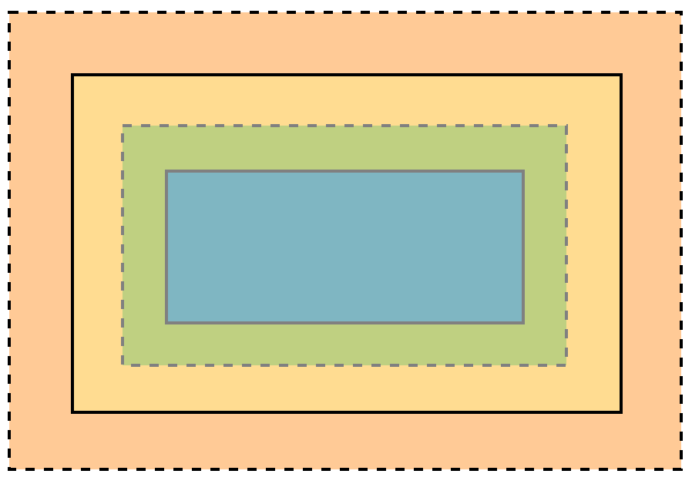
The CSS box model
margin
border
The CSS box model can be thought of as a box that wraps around every HTML element.
It consists of the content itself, padding, borders, and margins.
padding
content
Notes:
Give students a tour of the elements tab in Chrome DevTools, with an emphasis on showing the box model.

Slide 27
EXERCISE: See your own box model
Open your box-model.html page in the Chrome Browser.
Right-click your element and select inspect element.
What you’re seeing now is Chrome DevTools. It is one of the most important tools a web developer can have.
Watch this demonstration to see how you can use the dev tools to view the box model for any element in any web page.
Now try it on your “How to Google” page.
Notes:
Show some of your favorite tricks in Chrome DevTools.

Slide 28

Chrome DevTools
Chrome DevTools can do a LOT more than display the box model.
Check out this demonstration on how to use DevTools to view and change CSS rules for any page.

Slide 29
Coming up
In our next class we’ll learn about an HTML element called a div.
We’ll also learn how to use width, height, and the box model to control the placement of elements on a page.
Then we’ll take what we’ve learned and attempt to give our “How to Google” page some style.

Slide 30

This presentation is protected by U.S. and International copyright laws. Reproduction and distribution of the presentation without written permission of CodeSLO LLC is prohibited.
©2019 CodeSLO LLC

