Slide 1

Tables and Typography
Class 06

Slide 2
HTML tables
Tables can help display many types of data, like:
Contact Lists
Event Schedules
Guest Lists
Inventory
And more!

Slide 3
CREATING TABLES
Tables are enclosed by <table> tags and are divided into rows and columns.
Rows are created in HTML explicitly with the <tr> tag.
Columns are implicit, there is no tag for them.
Each “cell” in a row must be created explicitly with the <td> tag. Typically, the number cells you create in a row determines the number of columns.
The top row of a table is usually defined as a table header with the <th> tag for each cell.

Slide 4
table {
  width:30%;
  margin:auto;
  border:1px solid gray;
  font-size:20px;
}
td {
  border:1px solid gray;
  padding:5px;
}
.table-head {
  color:white;
  background-color:seagreen;
  font-weight:bold;
}
<table>
<tr class="table-head">
<th>Last Name</th>
<th>First Name</th>
<th>Phone Number</th>
</tr>
<tr class="dark">
<td>Daniels</td>
<td>Joe</td>
<td>555.555.2123</td>
</tr>
</table>
Last Name | First Name | Phone Number
Daniels | Joe | 555.555.2123
Johnson | Wendy | 555.555.1987
Steele | Kevin | 555.555.4298

Slide 5
A note on striped tables
In the example today, we used the class “dark” to create alternating light and dark rows. It’s a common way to render tables.
There are better ways to do it! For example, we might use the front-end framework Bootstrap to create striped tables, or we could use JavaScript to assign the appropriate classes dynamically when the page loads.
But that’s all for later. For now, we’ll have to type our classes in manually.

Slide 6

EXERCISE: Event schedule
Create a new file called event-schedule.html.
Add a doctype declaration, head, and body sections.
Add a table for a fictional hackathon that includes the following events and times:
  Welcome: 9am
  Setup: 10am
  Hack Session: 10:30am
  Lunch: 12pm
  Hack Session: 12:30pm
  Presentations: 6pm
  Awards: 8pm

Slide 7
EXERCISE: Style your table
Create header and container divs.
Style the table-head row.
Make your table rows striped for readability.
Center your page content but not the header.

Slide 8
External style sheets

Slide 9
Separation of concerns
Until now, we’ve been styling our pages using internal stylesheets. While that method works for an individual page, internal stylesheets don’t scale well to multi-page sites.
Also, there is an idea in web development called the separation of concerns. Separation of concerns dictates that we keep HTML, CSS, and JavaScript files separate from one another for increased maintainability.
Let’s learn how to use an external stylesheet!
Notes:
New frontend frameworks like React have a different way of defining ‘separation of concerns.’ This is worth bringing up in class.

Slide 10
The link statement
The link statement is how you tell your HTML how to find its stylesheet.
It looks like this:
<link rel='stylesheet' href='table-style.css' />
rel defines the relationship between the linked item and your page. In this case, it’s a stylesheet.
href is a hypertext reference, like we’d use in an anchor. It tells the browser where to look for the CSS file.

Slide 11
EXERCISE
An external stylesheet is a file created with the .css extension.
Create a new file in your module-02 project folder called table-style.css.
Copy/paste your event-schedule CSS into table-style.css.
Delete your style tags. You don’t need them with an external stylesheet.
In the head section of your html page, add the following line:
Save your CSS and HTML files. Open your page in a browser and test.
<link rel='stylesheet' href='table-style.css' />
Notes:
It is a good idea to walk the class through the creation of an external stylesheet.

Slide 12

Did it work?
Let’s make sure everyone can successfully create an external stylesheet.
Note: In the code samples, you’ll notice there is a CSS folder. This structure affects the way the link statement looks because the folder name and file name must be in it.

Slide 13
Typography
In web design, typography is the use of fonts, line width, height, and spacing, to make your content more appealing and consumable.
Typography is a cornerstone of web design, but we aren’t going to cover the topic in-depth in this course.
Instead, you’ll learn some general guidelines. We’ll also go over some helpful resources.

Slide 14
Elements of typography
We’ll talk about seven elements of typography today:
Color Contrast
Font Size
Leading
Kerning
Hierarchy
White Space
Font Choice
Notes:
‘Leading’ is pronounced like lead pencil (led-ing).

Slide 15
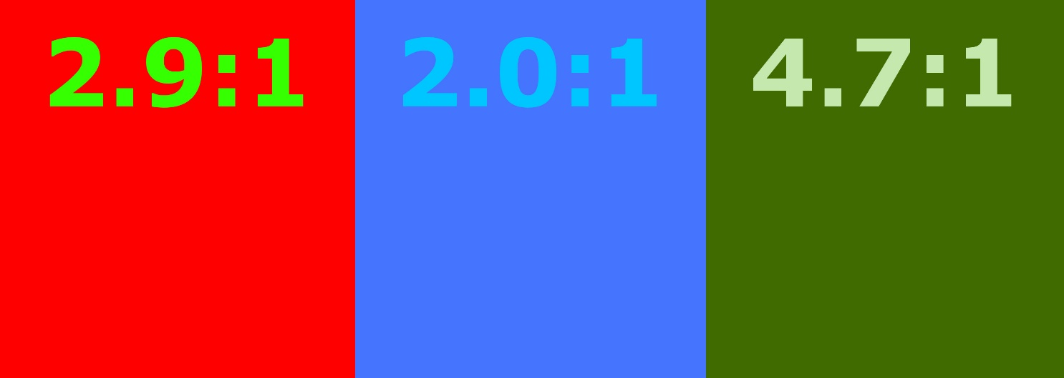


Color Contrast
Color contrast makes text stand out. It can also make your site more accessible to a wide range of people with disabilities.
The World Wide Web Consortium (W3C) developed the Web Content Accessibility Guidelines (WCAG) for making web content more accessible.
Addressing color contrast, the WCAG 2.1 recommends that the visual presentation of most text on a page have a contrast ratio of at least 4.5:1.
Google “contrast ratio” for free tools that check contrast ratios.

Slide 16
But not TOO
much contrast
You also want to avoid too much contrast.
Black on white, for example, is a bit much.
If you look at most professional web pages, you’ll see they use gray text on a white page.
Note. This rule doesn’t apply to black or very dark websites, which are all about high contrast.

Slide 17

FONT SIZE
In general, you should consider 13px to be the minimum font size for a web page.
16px is standard.
18px looks pretty good, too.
Font size can be controlled with the CSS property font-size.

Slide 18
LEADING
KERNING
Leading is the print term for line height.
Generally, line height is set to a percentage of the font size, with 120% being a good guideline.
You can use this rule in CSS like this:
line-height:1.2;
Kerning is the spacing between letters. It usually comes into play in large heading elements.
In CSS, it can be controlled with letter-spacing.
Letter spacing can be given in pixels and even sub-pixel sizes such as .8px or 1.2px, like this:
letter-spacing:1.2px;

Slide 19
HIERARCHY
Hierarchy utilizes font size, font color, or other techniques to draw attention to certain content.
One quick tool web designers use for establishing hierarchy is applying various heading and paragraph tags in HTML, to adjust font size.
It’s possible to get a lot more creative than that though.

Slide 20
HIERARCHY
LETS THE READER KNOW
WHERE TO LOOK FIRST.

Slide 21

TIME TO CHECK IN!

Slide 22
WHITE SPACE
White space is a good design principle in general, not just for typography.
Not enough white space can make your content cluttered.
Poor use of white space
Good use of white space
White space is the area between design elements. It is also the space within individual design elements, including the space between text characters.
White space does not have to be white. It can be any color, texture, pattern, or background image.
White space is the area between design elements. It is also the space within individual design elements, including the space between text characters.
White space does not have to be white. It can be any color, texture, pattern, or background image.

Slide 23
FONT
Fonts can influence a viewer’s feelings about a web page. They can be elegant, classic, casual, friendly, fun, edgy, and many more. Make sure you create the impression you want!
You should avoid using too many fonts on a page. Usually one or two is plenty, and three should be an absolute maximum.
Fonts can be changed in CSS with the font-family property.
There are four basic font families, serif, sans-serif, display, and script.

Slide 24
Serif
Serif fonts have decorative lines attached the ends of their letters. They’re generally thought to look more serious or traditional.
Sans-serif
Sans-serif means “without serif”. The letters don’t have extra lines on the ends of them. They look more modern and streamlined, and tend to be easier to read online.
Display
Display fonts are meant to be attention getting. They can be more unusual than practical and should be used sparingly for a specific effect or purpose.
Script
Script fonts are cursive or handwriting-like fonts and sometimes have connecting letters.

Slide 25

Google Fonts
Google Fonts is a free source for all kinds of fonts to make your webpages pop.
Try googling “font pairs” to get inspiration for your pages. Once you get the hang of it you can create your own pairings.
Google Fonts is easy to use…

Slide 26
How to use google fonts
Google Fonts are brought in like external stylesheets.
Then you set which fonts go to which elements, with CSS.
Look at the google-fonts.html example in today’s source code to see how its done.
Also, see our typography-example.html and typography-dark.html.
Check out this quick demo of how to select fonts on the Google Fonts site…
Notes:
Log on to google fonts, select two to three fonts and show students how to download them.

Slide 27
EXERCISE:
Landing page
Choose between a restaurant, an adventure sports company, or another fictional company.
Create a landing page for this company using what you learned about typography. Include images.
Google around for inspiration but the code should be yours!
The landing page of a website is the first page a viewer sees.

Slide 28

QUESTIONS?

Slide 29
Coming up
Practice creating and styling HTML tables to reinforce what you’ve learned.
Free Code Camp is a great place to supplement what you’re learning in class
Next class, we’ll talk about Responsive Design.

Slide 30

This presentation is protected by U.S. and International copyright laws. Reproduction and distribution of the presentation without written permission of CodeSLO LLC is prohibited.
©2019 CodeSLO LLC

