Slide 1





Regularization, Semi-supervision, and Supervision for a Plausible Attention-Based Explanation
D.H. Nguyen, C. Mallart, G. Gravier, P. Sébillot

Slide 2
Attention-based explanation
Objective
Explain a predictive decision to a non-expert human.
Explanation techniques
Post-hoc: LIME, SHAP, Gradient – based [1]
Intrinsic: Attention rationale extraction [2]
Explanability qualities
Faithfulness [3]
Plausibility [4]
Notes:
Hello everyone,
In deep learning, having a good predictive model is an achievement. However, I believe that it is more crucial to explain someone that is not in our domain how did a decision make.
In XAI, there exists the post-hoc explainers, which consists of having an outside explainers to explain to us how the model works. It is interesting to model developpers and scientists. However, these methods are often computationally expensive, and it is not necessary to explain a non-expert users.
Among intrinsic methods, which means the models are explanable by design. Among different design, we present in this study the use of attention mechanism in order to extract rationale.
Typo: enlève les espaces avant les ':'
Mieux séparer le faithfulness et plausibilité <-

Slide 3

Classification tasks
Task | Dataset | Labels
Natural Language Inference | e-SNLI | Entailment / Contradiction / Neutral
Sentiment classification | YelpHat | Negative / Positive
Hate speech detection | HateXPlain | Hateful / Offensive / Neutral
Fig 1. An example of human annotations in e-SNLI
Notes:
We use 3 different classification datasets in 3 different tasks in to assess this property of attention explanation. In YelpHat, we classify the polarity of sentiment in restaurant reviews. In HateXplain we detect whether the text is hateful,offensive or not. And finally the last dataset, we try to detect whether the premise sentence is entailed, contradict with the hypothesis sentence, or they are completely neutral.
We choose these 3 dataset with human annotations, that help us to qualify the plausibility of the attention map. The idea here is that if the attention map is closed to human rationale to explain the label, then that explanation could help user to understand why there are labels.
Si on a l'annotation , on peut très bien superviser, mais dans plus part on n'en a pas. So we have to think other strategies.
Les mots surlignés explique le label <- à dire dans l'oral

Slide 4
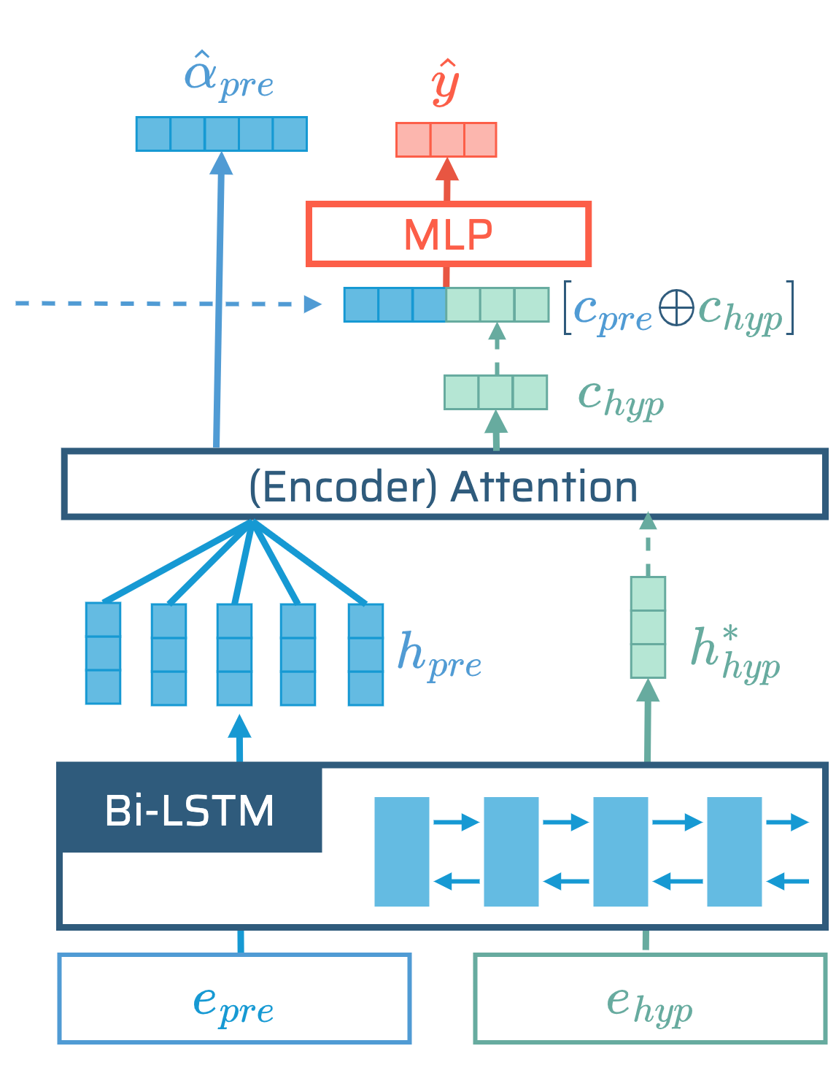
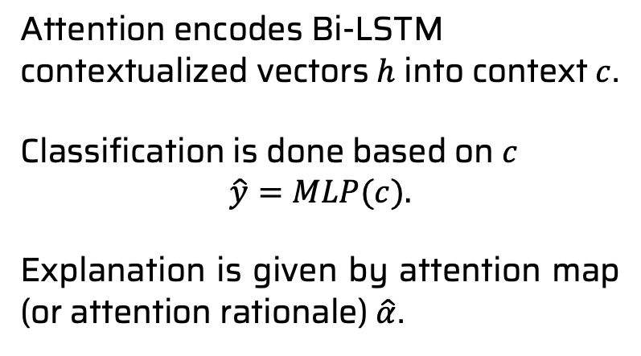
Attention model Bi-LSTM encoders
Attention encodes Bi-LSTM contextualized vectors $h$ into context$c$.
Classification is done based on $c$
$$\hat{y}=MLP(c).$$
Explanation is given by attention map (or attention rationale) $\hat{α}$.
Fig 2. Bi-LSTM based Attention model
Notes:
Speaking of attention rationale, in our study, we employ an Encoder attention, in order to transform the contextualized token vectors output from Bi-LSTM into a single context vector c here. The context vector c is then used to make decition though a multilayer perceptron classifier.
When we extract the explanation from attention mechanim, the rationale is hardly plausible. The problem is that it highlights all words in input text. Therefore, the objective in my study is to improve its plausibility, which means to make it converge close to human annotation.
However, using human annotation to teach attention layer to explain in real world is a challenge : In many NLP dataset, we don’t always have human annotations. In fact, having human explanation is expensive. So we want to find another way to constraint the attention map to come closed to human annotation, without the direct use of the human annotation.
--
Schéma à refaire pour mieux expliquer l'architecture
Un slide pour expliquer le détail du modèle sur les différentes tâches .

Slide 5
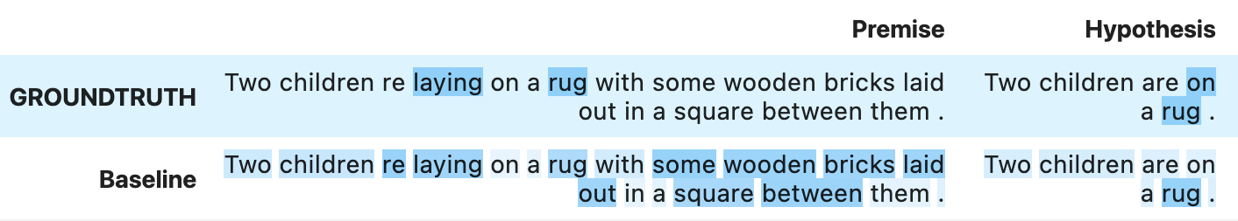
Explanation from baseline attention
Fig 3. GROUNDTRUTH highlighted by human annotator and attention rationale from Baseline model.
Challenges
Attention rationale is spreading.
Human annotation is not always available.
Notes:
Speaking of attention rationale, in our study, we employ an Encoder attention, in order to transform the contextualized token vectors output from Bi-LSTM into a single context vector c here. The context vector c is then used to make decition though a multilayer perceptron classifier.
When we extract the explanation from attention mechanim, the rationale is hardly plausible. The problem is that it highlights all words in input text. Therefore, the objective in my study is to improve its plausibility, which means to make it converge close to human annotation.
However, using human annotation to teach attention layer to explain in real world is a challenge : In many NLP dataset, we don’t always have human annotations. In fact, having human explanation is expensive. So we want to find another way to constraint the attention map to come closed to human annotation, without the direct use of the human annotation.
--
Schéma à refaire pour mieux expliquer l'architecture
Un slide pour expliquer le détail du modèle sur les différentes tâches .

Slide 6

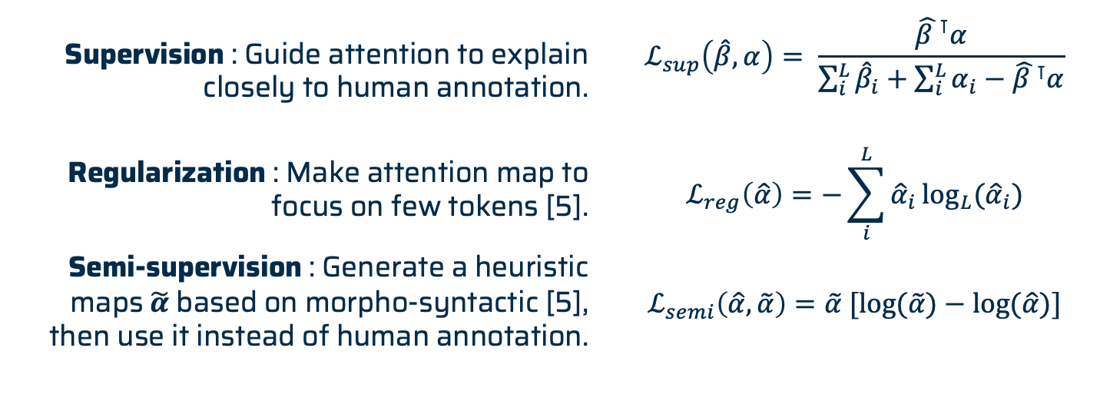
Additional constraint to improve plausibility
$ℒ\left(y, \hat{y},\hat{α}\right)=ℒ_{c}\left(y, \hat{y}\right)+λ{ ℒ}_{α}(\hat{α})$
Supervision : Guide attention to explain closely to human annotation. | $$ℒ_{sup}\left(\hat{β},α\right)= \frac{{\hat{β }}^{⊺}α}{\sum_{i}^{L}{{\hat{β}}_{i}}+\sum_{i}^{L}{α_{i}}−{\hat{β }}^{⊺}α}$$
Regularization : Make attention map to focus on few tokens [5]. | $$ℒ_{reg}\left(\hat{α}\right)=−\sum_{i}^{L}{{\hat{α}}_{i}\log_{L}{({\hat{α}}_{i})}}$$
Semi-supervision : Generate a heuristic maps $\tilde{α}$ based on morpho-syntactic [5], then use it instead of human annotation. | $$ℒ_{semi}\left(\hat{α},\tilde{α}\right)=\tilde{α} [\log{(\tilde{α})}−\log{(\hat{α})}]$$
Notes:
In our pursuit to better align the attention map with the task at hand, we've reimagined its formulation and integrated it directly into the loss function.
Of course, it's crucial for us to maintain the loss term on the predicted label. This way, we ensure the model is still performing its intended task. Simultaneously, we introduce a second term focused on the attention map, alpha hat, controlled and regularized by the lambda parameter. In this study, we propose and analyze three distinct strategies for placing constraints on the attention map.
The first approach leverages real-world human annotations that can guide the model's attention, making it more plausible and relevant.
Our second solution involves regularization by entropy. The objective of this strategy is to make the attention mechanism to concentrate on fewer words and we will see whether the mechanism can converge to the words that have been hand-picked by humans. We employ entropy to quantify the degree to which the attention map is dispersed, or, put differently, how closely it approximates a uniform distribution.
In the third and final approach, we bypass human annotation and simply instruct the model to pay attention to the critical parts of the text - nouns, verbs, and adjectives, which are part of (morphosyntactic).
So we create a heuristic map which we zero those that are not in this category, then rescores those left based on their likelihood of being chosen by a human for the task. This generated map acts as a distribution function, so we modify the loss function to encourage the attention maps to converge toward this heuristic map.
Regularization : C'est parce que l'humain surligne moins
Typo : morpho-syntaxic

Slide 7
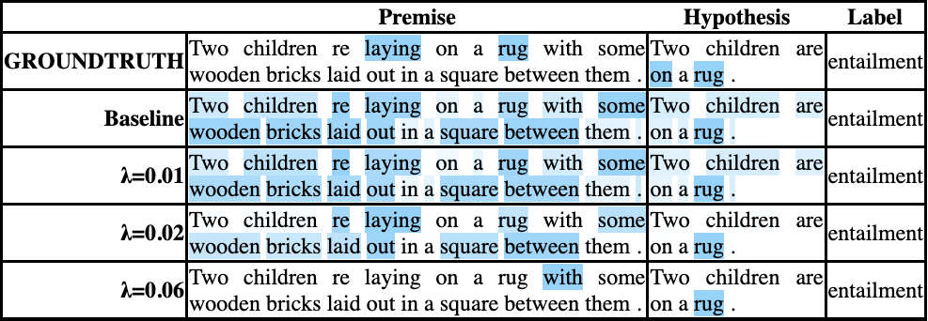
Regularization by entropy
Fig 4. Regularized attention rationale in one e-SNLI example.
Notes:
So what is the effect of the regularization : It is actually deleteing the tokens in the baseline and keeping the the words that are supposed to be plausible.

Slide 8
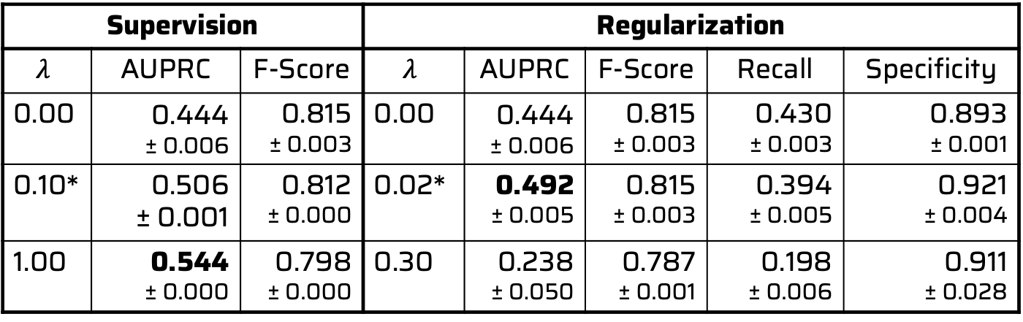
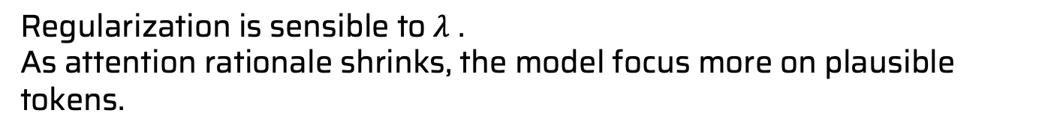
Regularization by entropy
Supervision | Supervision |  | Regularization
$$λ$$ | AUPRC | F-Score | $$λ$$ | AUPRC | F-Score | Recall | Specificity
0.00 | 0.444 ± 0.006 | 0.815 ± 0.003 | 0.00 | 0.444 ± 0.006 | 0.815 ± 0.003 | 0.430 ± 0.003 | 0.893 ± 0.001
0.10* | 0.506 ± 0.001 | 0.812 ± 0.000 | 0.02* | 0.492 ± 0.005 | 0.815 ± 0.003 | 0.394 ± 0.005 | 0.921 ± 0.004
1.00 | 0.544 ± 0.000 | 0.798 ± 0.000 | 0.30 | 0.238 ± 0.050 | 0.787 ± 0.001 | 0.198 ± 0.006 | 0.911 ± 0.028
Regularization is sensible to $λ$ .
As attention rationale shrinks, the model focus more on plausible tokens.
Notes:
In the case of semi-supervision, we use a heuristic that highlight noun, verb, adj and we rescore the words, based on their likelihood to be chosen by annotator.
The model can actually converge to this heuristic map instead of the ground truth.
sensible -> sensitive
focus -> focuses
AUPRC entre l'attention et l'annotation humaine.

Slide 9
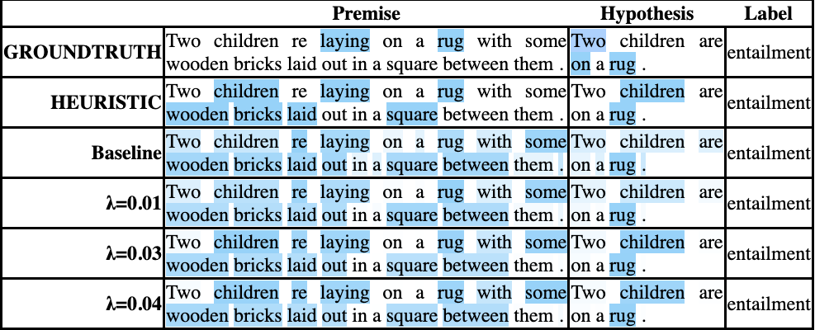
Semi-supervision by a heuristic map
Fig 5. Semi-supervised attention rationale in one e-SNLI example.
Notes:
In the case of semi-supervision, we use a heuristic that highlight noun, verb, adj and we rescore the words, based on their likelihood to be chosen by annotator.
The model can actually converge to this heuristic map instead of the ground truth.
Rappeller c'est quoi l'heuristique : on se focaliser sur certain noms, verbes et adjectifs.

Slide 10
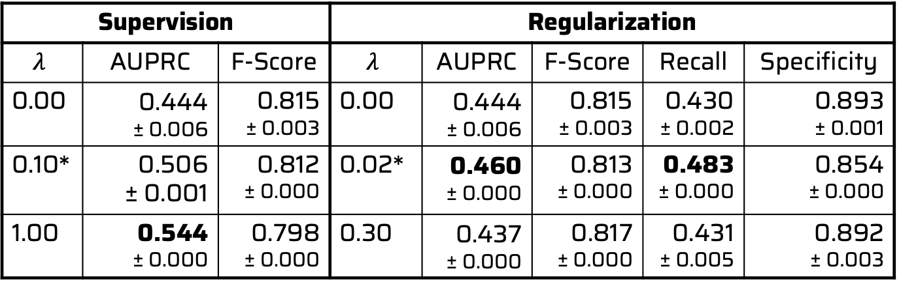
Semi-supervision by a heuristic map
Supervision | Supervision |  | Regularization
$$λ$$ | AUPRC | F-Score | $$λ$$ | AUPRC | F-Score | Recall | Specificity
0.00 | 0.444 ± 0.006 | 0.815 ± 0.003 | 0.00 | 0.444 ± 0.006 | 0.815 ± 0.003 | 0.430 ± 0.002 | 0.893 ± 0.001
0.10* | 0.506 ± 0.001 | 0.812 ± 0.000 | 0.02* | 0.460 ± 0.000 | 0.813 ± 0.000 | 0.483 ± 0.000 | 0.854 ± 0.000
1.00 | 0.544 ± 0.000 | 0.798 ± 0.000 | 0.30 | 0.437 ± 0.000 | 0.817 ± 0.000 | 0.431 ± 0.005 | 0.892 ± 0.003
Semi-supervision is less dependant to $λ$.
Attention rationale is searching for new plausible words.
Notes:
In the case of semi-supervision, we use a heuristic that highlight noun, verb, adj and we rescore the words, based on their likelihood to be chosen by annotator.
The model can actually converge to this heuristic map instead of the ground truth.
Title
Regularization --> Semi-supervision

Slide 11
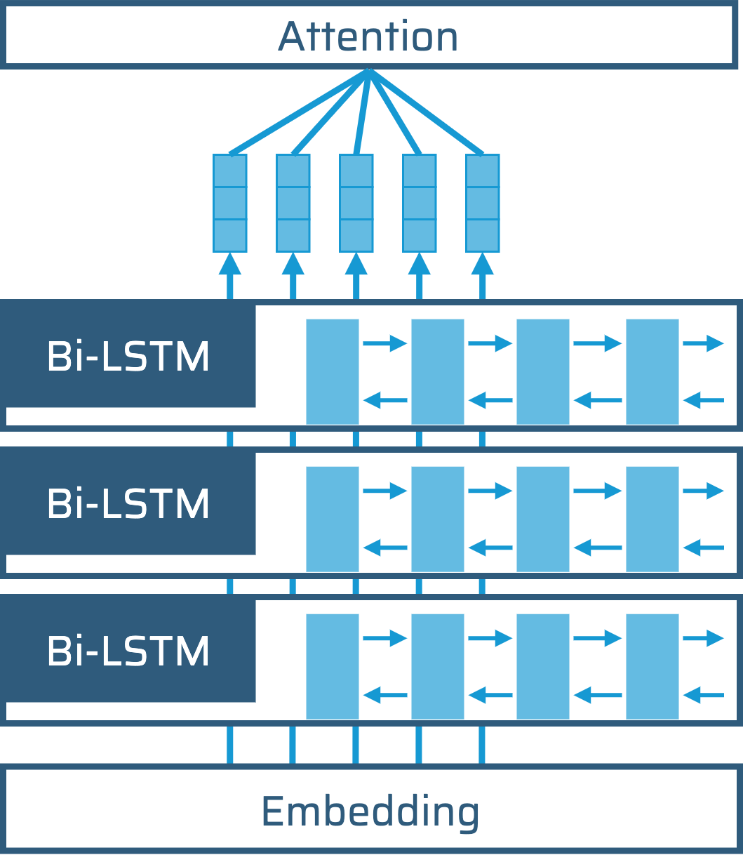
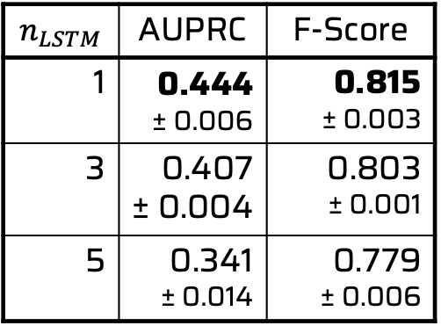

Plausibility in deep contextualized representation
$$n_{LSTM}$$ | AUPRC | F-Score
1 | 0.444 ± 0.006 | 0.815 ± 0.003
3 | 0.407 ± 0.004 | 0.803 ± 0.001
5 | 0.341 ± 0.014 | 0.779 ± 0.006
$$n_{LSTM}$$
The deeper the model, the less plausible it is.
Notes:
+ métrique ???
TYPO: presentation --> represetation
l'orale : à marquer la transition

Slide 12
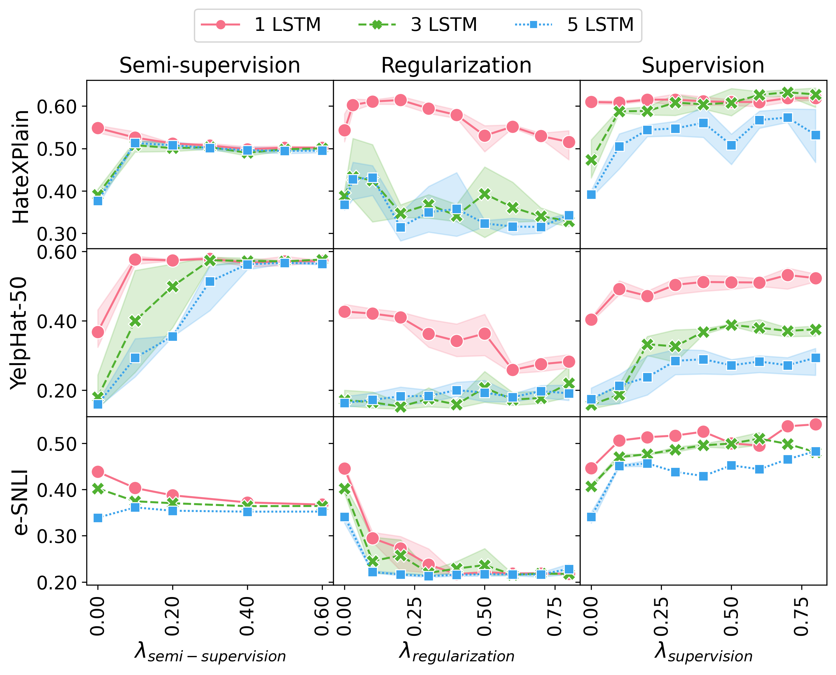
Can regularization improve plausibility in deeper models?
Supervision and regularization cannot alleviate this limitation.
Semi-supervision converges to heuristic rationale regardless to this limitation.
Fig 6. Plausibility (AUPRC) as a function of $λ$

Slide 13
Conclusion
Regularization and semi-supervision can improve attention plausibility without losing performance
Semi-supervision based on morpho-syntax is a more robust technique to improve plausiblity (on the tested tasks)
Deeper contextualization poses a challenge to plausibility improvement
Future works:
Impact of contextualisation on model plausibility
Generalization in different architectures

Slide 14

Our code is available!
duc-hau.nguyen@irisa.fr
cyrielle.mallart@univ-rennes2.fr
pascale.sebillot@irisa.fr
guillaume.gravier@irisa.fr

Slide 15
Bibliography
[1] Bastings, Jasmijn, and Katja Filippova. “The Elephant in the Interpretability Room: Why Use Attention as Explanation When We Have Saliency Methods?” In Proceedings of the Third BlackboxNLP Workshop on Analyzing and Interpreting Neural Networks for NLP. ACL 2020.
[2] Mohankumar, Akash Kumar, Preksha Nema, Sharan Narasimhan, Mitesh M. Khapra, Balaji Vasan Srinivasan, and Balaraman Ravindran. “Towards Transparent and Explainable Attention Models.” In Proceedings of the 58th Annual Meeting of the Association for Computational Linguistics. ACL 2020.
[3] Jacovi, Alon, and Yoav Goldberg. “Towards Faithfully Interpretable NLP Systems: How Should We Define and Evaluate Faithfulness?” In Proceedings of the 58th Annual Meeting of the Association for Computational Linguistics, ACL 2020.
[4] Nguyen, Duc Hau, Guillaume Gravier, and Pascale Sébillot. “A Study of the Plausibility of Attention between RNN Encoders in Natural Language Inference.” ICMLA 2021.
[5] Nguyen, Duc Hau, Guillaume Gravier, and Pascale Sébillot. “Filtrage et Régularisation Pour Améliorer La Plausibilité Des Poids d’attention Dans La Tâche d’inférence En Langue Naturelle.” TALN 2022.
Notes:
roburst -> robust
pose -> poses
Semi-supervision based on morpho-syntax is a more robust technique (on the tested tasks).
pas de point quand on a les items.

