Slide 1


Data Governance @ SneakerPark
Prepared by:
Submitted on:

Slide 2
Background
SneakerPark is an online shoe reseller that allows people to buy and sell used and new shoes. Buyers can bid for shoes or buy them outright, and sellers can set a price or sell to the highest bidder.
Each buyer and seller must have an active account in order to sell, bid, or purchase sneakers using SneakerPark’s website.
SneakerPark authenticates the shoes before shipping them to the buyer, so before listing an item, the seller must ship it to SneakerPark’s warehouse. Upon receipt, SneakerPark assigns an item number to each pair of sneakers and notifies the seller that they are now free to list their item. If the item is not listed within 45 days, SneakerPark returns it to the seller and sends an invoice to the seller for the shipping cost.
If the item is found to be inauthentic or in an unacceptable condition, it is also returned back to the seller in a similar fashion.
When the item sells, the buyer’s account is credited with the purchase price minus the SneakerPark service fee and shipping fees to deliver the item to the buyer.
Currently, SneakerPark only supports sales within the United States.

Slide 3
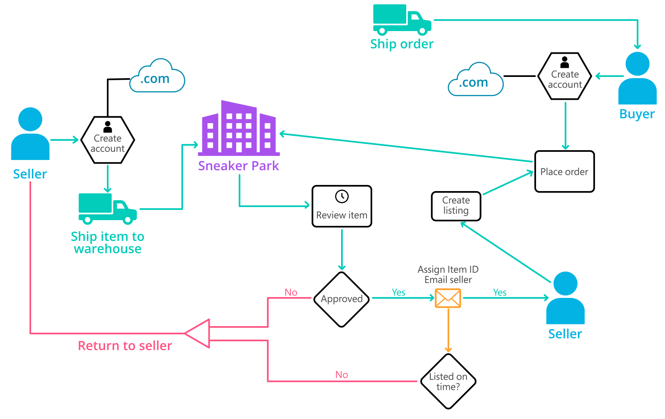
Background (cont’d)
Below you can see a diagram that will hopefully help you visualize some of SneakerPark's business processes. Keep in mind that it does not capture ALL processes and every nuance, but simply serves as another artifact to use in your project.

Slide 4
Step 1
Enterprise Data Catalog Part 1: Enterprise Data Model

Slide 5
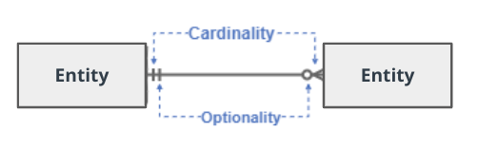
Create a conceptual data model that will provide SneakerPark with a holistic view of its data systems and help you grasp the organization's important entities and relationships, which will be instrumental as you move further in the project. You can use Lucidchart or any other diagramming tool of your choice, but please use the Crow’s Foot/IE Notation and please be sure to indicate both cardinality (the type of a relationship such as 1:N or N:N) and optionality (whether the relationship is optional or mandatory).

Slide 6
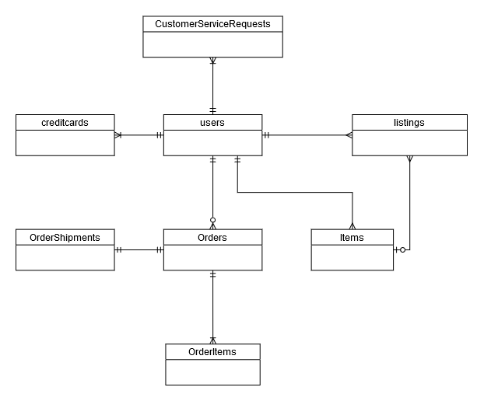
Replace the example below with your own solutions (obviously feel free to take more space):

Slide 7
Step 2
Enterprise Data Catalog Part 2: Metadata

Slide 8
Create the first version of the Metadata Catalog by documenting the metadata from all systems in the "Data Dictionary" and the “Enterprise Data Catalog” tabs of the provided Sheets template.
Please note that you are required to fill out all fields in both tabs.

Slide 9
Step 3
Data Quality
Part 1: Profiling and Cleansing

Slide 10
Profile the data to identify at least 3 data quality issues you see in the data. Also provide at least 1 data quality issue that you haven’t yet seen in the data, but can foresee occurring in the future. Based on the issues you’ve identified, come up with the data quality rule for each data quality issue, including for the one that you foresee.
Make sure you fill out all columns in the "Data Quality Issues" tab with your answers in the provided Sheets template.

Slide 11
Step 4
Data Quality
Part 2: Monitoring

Slide 12
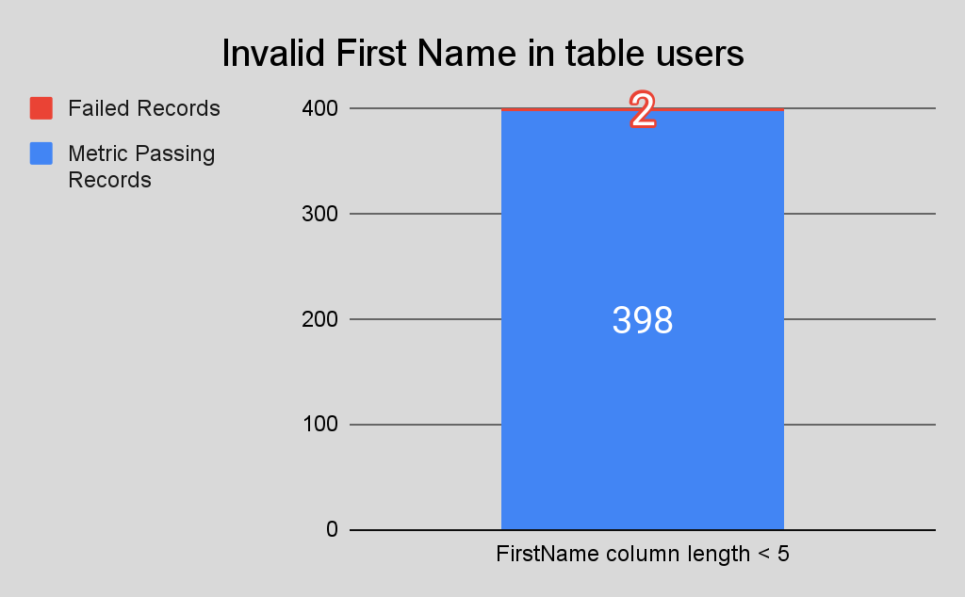
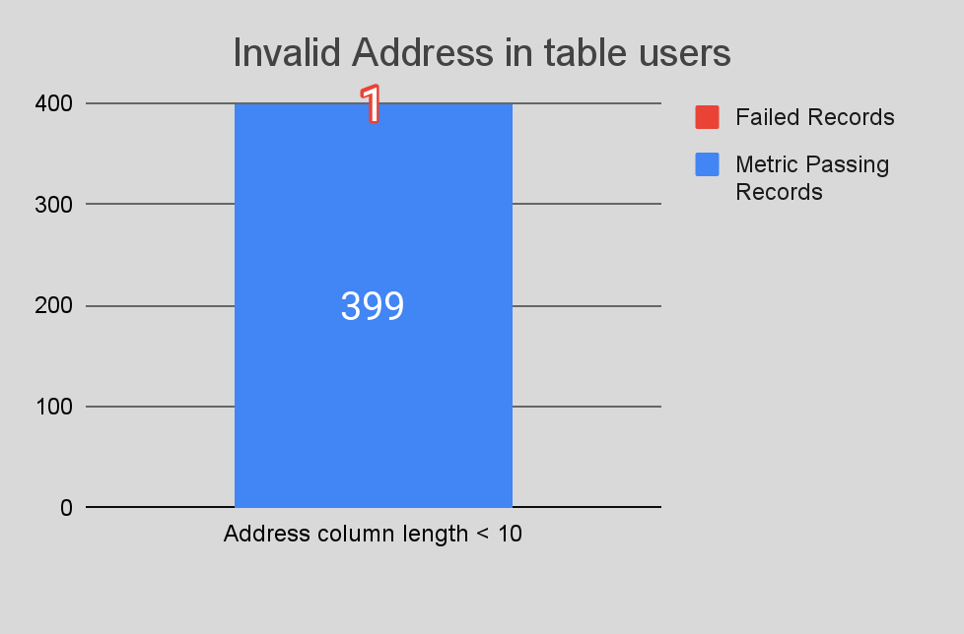
Using the metrics you've created in the last step, please create a mock-up of a data quality monitoring dashboard that will be used to monitor the data to ensure compliance with your data quality rules.
Please make sure to label your metrics clearly on your mock-up.
Replace the example dashboard below with your own. (obviously feel free to take more space).

Slide 13
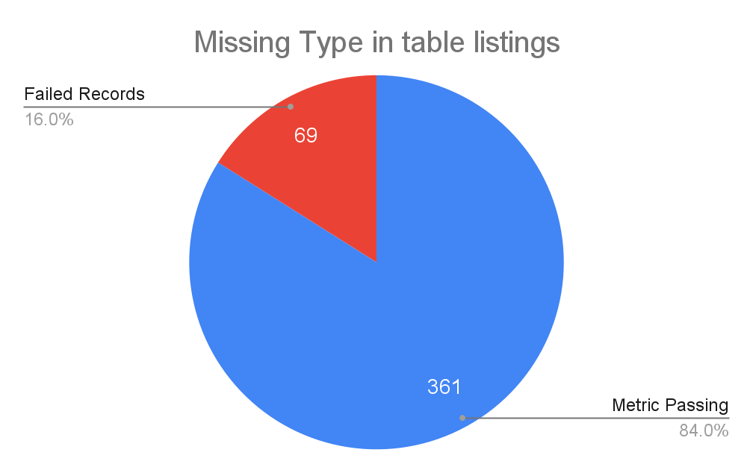
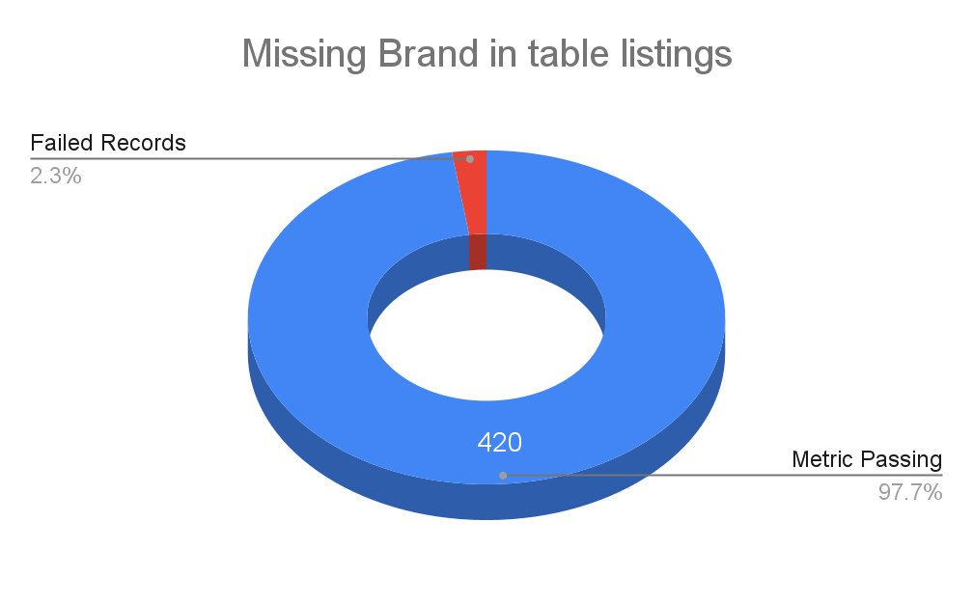
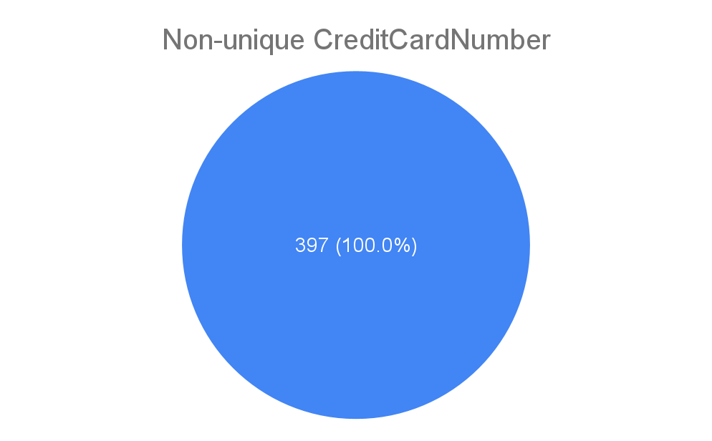

Slide 14
Step 5
Master Data Management
Part 1: MDM Architecture

Slide 15
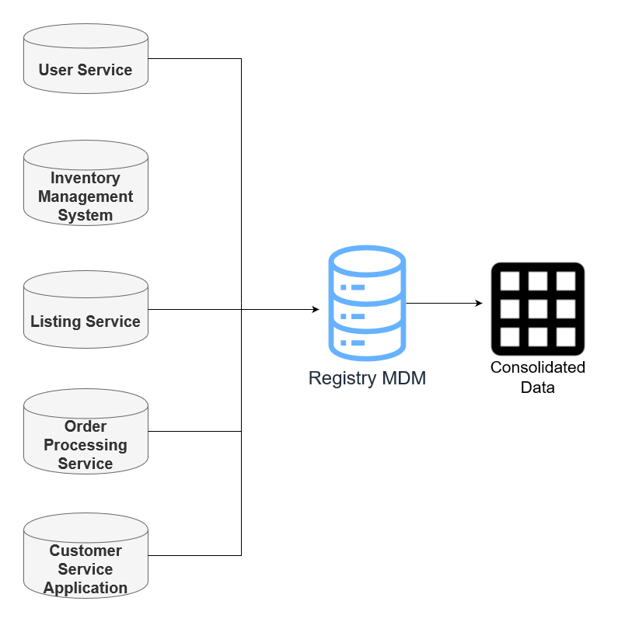
MDM Architecture - Registry MDM

Slide 16
Registry MDM Structure
Key | Attributes | Source System | Identifiers
UserID | FirstName, LastName, Email, Address, ZipCode | User Service | FirstName + LastName, Email
CreditCardID | CreditCardNumber, CreditCardExpirationDate, UserID | User Service | CreditCardNumber
ListingID | SellerID, ProductID, ShoeType, Brand, Color, Gender, Size, Condition, ListingPrice, ListingType, ListingCreateDate, ListingEndDate | Listing Service | SellerID, ProductID
OrderID | BuyerID, CrediCardID, ShippingCost, TaxRatePercent, TotalAmount, Shipping Address, ShippingZipCode, OrderDate, Status | Order Processing Service | BuyerID, CreditCardID
ShipmentID | OrderID, Carrier, TrackingNumber, OrderShipDate | Order Processing Service | TrackingNumber
ItemID | ItemName, SellerID, Type, BrandName, Color, Size, Sex, Condition, ItemStatus, ArrivalDate | Inventory Management System | ItemName + BrandName + Type, SellerID
ID | UserID, FirstName, LastName, ContactReason, Email, Phone, OrderID, Resolution, ContactMethod | Customer Service Application | UserID, FirstName + LastName

Slide 17
Explanation:
Registry MDM is a suitable architectural choice for Sneakerpark. Sneakerpark has no existing existing implementation of an Enterprise data warehouse, and is just starting out on their MDM journey. The application of a Registry MDM will serve as a proof of concept of an MDM and demonstrate the feasibility and benefits of a full-fledged MDM if implemented properly in the future.
A Registry MDM is also a low-cost pursuit, that will require minimal intrusion in Sneakerpark’s existing application systems. A Registry MDM will also be easier to implement than other architectures, with a single source of master data as the truth.

Slide 18
Step 6
Master Data Management
Part 2: Master Record

Slide 19
In this step, you will define a set of matching rules that will be used by the SneakerPark's MDM Hub to match item and customer entities between the company's different systems.
Please come up with 4 rules - 2 for Items and 2 for Customers and list them below.
1 – Item Primary match rule: match Item data on ItemID, corresponds with matching ProductID in Listing data. Same ItemID -> Same Item.
2 – Item: Secondary match rule: match using combination of BrandName, ItemName, and Type, SellerID. Confidence threshold of 70% with this rule. In Listing data, BrandName matches with Brand, and ShoeType with Type.
3 - Customer: Primary match rule: match Customer data on userID, corresponds with SellerID in Listings and Items. Same userID -> Same Customer.
4 - Customer: Secondary match rule: match Customer data on combination of FirstName and LastName, Email. Confidence threshold of 80% with this rule.

Slide 20
Step 7
Data Governance:
Roles and Responsibilities

Slide 21
Write 1-2 paragraphs discussing what data governance roles and responsibilities will be necessary to oversee this new Data Management initiative. Please be sure to discuss the responsibilities in the context of at least 3 different aspects of Data Governance (such as Data Quality Management, Metadata Management, MDM, etc). Based on what you know, do SneakerPark's current employees have the necessary skills for these roles or should the company make new hires?
By introducing a Data Management Initiative, Sneakerpark will have to add or skill existing employees to sustain the data governance involved in the project.
Data Stewards as well as Technical Architects may be required, with the increased responsibilities.
Data profiling, identification of data quality issues, data quality remediation, and monitoring via dashboards are some of the tasks involved in the upkeep of Data Management.
The role of Data Stewards and SMEs is particularly in the process of Master Data Management, in particular:
The process of defining match results, and reviewing and overriding match results
Approving or rejecting golden records
Reviewing golden records and manually creating them where required
Both Jake and Jane will need to be reskilled to handle new responsibilities as Data Stewards.
Jake, as IT support can take on the role of Data Steward for the less crucial systems of Sneakerpark.
Jane, as an SME can take on the role of advanced Data Steward tasks and manage the more business-critical systems of Sneakerpark including User Service and Order Management System.
Additional personnel will be required to take on the role of Data Stewards and Technical Architects and Developers, after Jake and Jane establish a baseline, especially if Sneakerpark decide to move to a Consolidated MDM.

