Slide 1
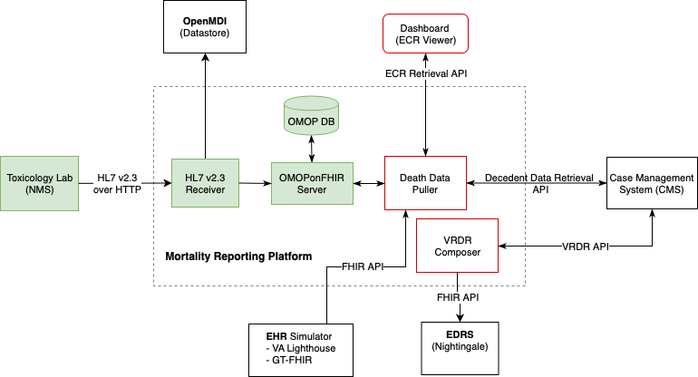


Data Flow
HL7v2 Message Conversion to OMOP using OMOPonFHIR
PRESENTER: Jon Duke
INTRODUCTION:
HL7 version 2 (HL7v2) is a standard messaging protocol used between labs and health providers (or systems)
OMOP CDM is used for data analytics
FHIR is a standard for health interoperability
HL7v2 → OMOP using OMOPonFHIR allows observation/measurement data in the lab reports to be stored into OMOP CDM in real-time.
METHODS
HL7v2 Parsing for Context
Conversion to FHIR Message
Submitting to OMOPonFHIR for Mapping to OMOP CDM
Storing to OMOP CDM Database
RESULTS
ELR Receiver developed for FHIR Conversion from HL7v2
OMOPonFHIR upgraded to lab measurement mapping
This approach used in Mortality Report Project funded by CDC
Mapping Electronic Lab Reports in HL7 v2 to OMOP CDM.
HL7 v2 is converted to FHIR, then submitted to OMOPonFHIR to be mapped to OMOP CDM.
Result: HL7v2 → FHIR
HL7v2 to FHIR Mapping
FHIR Observation Method
to OMOP Mapping
Take a picture to download related documents
Myung Choi, Michael Riley,
Jon Duke, Marla Gorges

