Slide 1
Background color codes for different OHDSI poster categories
Data standards and management
Open-source analytics development
Methodological research
Clinical applications

Slide 2
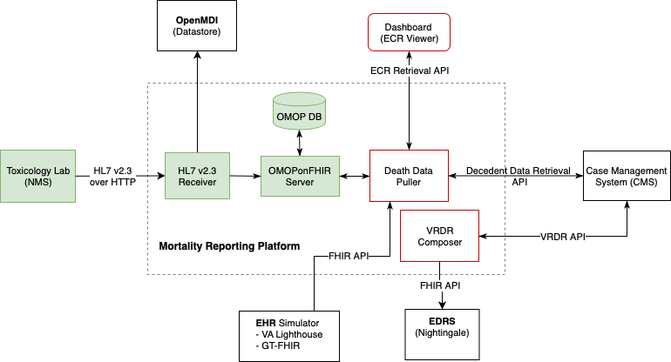


Data Flow
HL7v2 Message Conversion to OMOP using OMOPonFHIR
PRESENTER: Jon Duke
INTRODUCTION:
HL7 version 2 is a standard messaging protocol used between labs and health providers (or systems)
OMOP CDM is used for data analytics
FHIR is a standard for interoperability
HL7v2 → OMOP using OMOPonFHIR allows observation/measurement data to be stored into OMOP CDM (even in real-time).
METHODS
HL7v2 Parsing for Context
Conversion to FHIR Message
Submitting to OMOPonFHIR for Mapping
Mapping and Storing to OMOP CDM
RESULTS
ELR Receiver developed for FHIR Conversion
OMOPonFHIR upgraded to some measurement mapping
This approach used in Mortality Report Project funded by CDC
Mapping Electronic Lab Report in HL7 v2 to OMOP CDM.
HL7 v2 is converted to FHIR message. Then, the message is submitted to OMOPonFHIR to be mapped to OMOP CDM.
HL7v2 to FHIR Mapping
FHIR Method
to OMOP Mapping
Take a picture to download the full paper
Myung Choi, Michael Riley,
Jon Duke, Marla Gorges

Slide 3

Title: Subtitle
AMMO BAR
Delete this and replace it with your…
Extra Graphs
Extra Correlation tables
Extra Figures
Extra nuance that you’re worried about leaving out.
Keep it messy! This section is just for you.
PRESENTER: Leeroy Jenkins
INTRO:
Who cares? Explain why your study matters in the fastest, most brutal way possible (feel free to add graphics!).
METHODS
How did you find this?
Collected [what] from [population]
How you tested it.
Illustrate your methods if you can!
RESULTS
Graph/table with essential results only.
All the other correlations in the ammo bar.
Main finding goes here, translated into plain English. Emphasize the important words.
Take a picture to download the full paper
Leeroy Jenkins, author2, author3, author4, author5, author6, author7, author42

Slide 4
Title: Subtitle
AMMO BAR
Delete this and replace it with your…
Extra Graphs
Extra Correlation tables
Extra Figures
Extra nuance that you’re worried about leaving out.
Keep it messy! This section is just for you.
PRESENTER: Leeroy Jenkins
INTRO:
Who cares? Explain why your study matters in the fastest, most brutal way possible (feel free to add graphics!).
METHODS
How did you find this?
Collected [what] from [population]
How you tested it.
Illustrate your methods if you can!
RESULTS
Graph/table with essential results only.
All the other correlations in the ammo bar.
Main finding goes here, translated into plain English. Emphasize the important words.
Take a picture to download the full paper
Leeroy Jenkins, author2, author3, author4, author5, author6, author7, author42

Slide 5
Title: Subtitle
AMMO BAR
Delete this and replace it with your…
Extra Graphs
Extra Correlation tables
Extra Figures
Extra nuance that you’re worried about leaving out.
Keep it messy! This section is just for you.
PRESENTER: Leeroy Jenkins
INTRO:
Who cares? Explain why your study matters in the fastest, most brutal way possible (feel free to add graphics!).
METHODS
How did you find this?
Collected [what] from [population]
How you tested it.
Illustrate your methods if you can!
RESULTS
Graph/table with essential results only.
All the other correlations in the ammo bar.
Main finding goes here, translated into plain English. Emphasize the important words.
Take a picture to download the full paper
Leeroy Jenkins, author2, author3, author4, author5, author6, author7, author42

