Slide 1
TSDuck
An extensible toolbox for MPEG transport streams
Version 3.29

Slide 2
Topics
TSDuck overview
Transport stream processor
PSI/SI table manipulation using XML or JSON
Extending TSDuck
TSDuck as an MPEG/DVB C++ library
Using TSDuck from Java and Python

Slide 3
TSDuck overview
Process ISO/IEC 13818-1 transport streams
Set of low-level utilities
extensible through plugins
« Batch & Bash » oriented
command-line only, no fancy GUI
one utility or plugin = one elementary function
can be combined in any order
Written in C++
reusable and extensible code
Java and Python bindings
Available on Linux, Windows and macOS

Slide 4
What TSDuck is / is not
TSDuck is a general-purpose toolbox for digital TV engineers
➔ lab, demo, test, integration, debug, end-to-end testing ⬅
TSDuck is not an off-the-shelf ready-to-use specialized application for production and operations

Slide 5
Sample usages (1/2)
TS acquisition (IP, HTTP, HLS, SRT, RIST, DVB, ATSC, ISDB, ASI)
TS analysis
Transmodulation
Analysis, edition, injection of PSI/SI
using and editing PSI/SI in XML or JSON format
Service manipulation
extract, remove, rename, etc.
SCTE 35 splicing injection, extraction and monitoring
MPE injection and extraction (Multi-Protocol Encapsulation)

Slide 6
Sample usages (2/2)
Route, merge, fork TS between applications
Test bed for CAS or STB
injection of test cases
DVB or ATIS Scrambling with DVB SimulCrypt support
Extraction of specific streams
T2-MI (DVB-T2 Modulator Interface)
PLP’s (Physical Layer Pipe)
Teletext subtitles
Any combination of the above and more…

Slide 7
Availability
Web site
https://tsduck.io/
Open-source code
https://github.com/tsduck/tsduck
BSD license
liberal, no GPL-like contamination
can be used in all applications

Slide 8
Delivery
Installation
pre-built binary installers for Windows and Linux
Fedora, CentOS, Ubuntu, Debian, Raspbian
user’s contribution: Arch Linux (AUR)
through Homebrew on macOS
user’s contribution: MacPorts
Documentation
user’s guide
PDF, 500+ pages of references and examples
programmer’s guide
doxygen-generated, online on tsduck.io
for C++, Java and Python developers

Slide 9
tsp
the transport stream processor

Slide 10
tsp overview
Transport stream processing framework
Combination of elementary processing using plugins
One input plugin
receive a TS from various sources
Any number of packet processing plugins
perform transformations on TS packets
may remove packets
may NOT add packets
One output plugin
send the resulting TS to various destinations

Slide 11
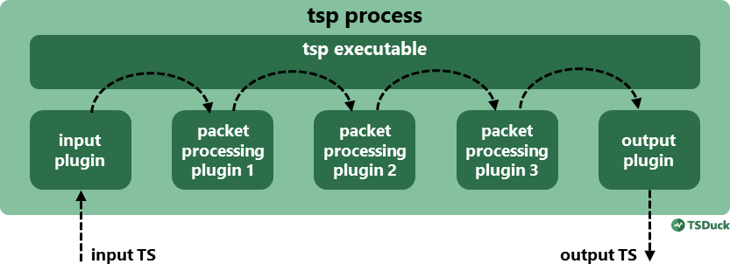
tsp plugin chain

Slide 12
tsp plugins
Each tsp plugin is a shareable library
.so (Linux), .dylib (macOS), .dll (Windows)
plus some embedded plugins, not seen as shareable libraries
File naming
plugin named foo in file tsplugin_foo.so (or .dylib or .dll)
General command line syntax
tsp [tsp-options] -I input-name [input-options] -P processor-name [processor-options]
... -O output-name [output-options]

Slide 13
tsp basic syntax
TS acquisition
tsp –I dvb –-uhf 21 -P until –-seconds 20 -O file capture.ts
Display the PMT of a selected service
tsp –I dvb –-uhf 35 -P zap france2 -P sifilter –-pmt -P tables –-max 1 -O drop
capture DVB stream from UHF channel 21
pass packets during 20 seconds, then stop
save packets to file capture.ts
extract service « France 2 », rebuild SPTS
extract PID containing the PMT
display one table, then stop
drop output packets

Slide 14
Simple examples
Transmodulation of a service over IP multicast
tsp –I dvb –-uhf 35 -P zap france2 –-audio fra -O ip 224.10.11.12:1000
On-the-fly replacement of a PSI / SI table
tsp -I dvb --uhf 24 -P inject nit.xml --pid 16 --replace –-stuffing -O dektec --uhf 24 --convolution 2/3 --guard 1/3
extract service « France 2 », keeping only one audio track
broadcast resulting SPTS to multicast IP address:port
replace content of PID 16 with table from an XML file (a NIT)
send modified TS to a Dektec modulator on same frequency

Slide 15
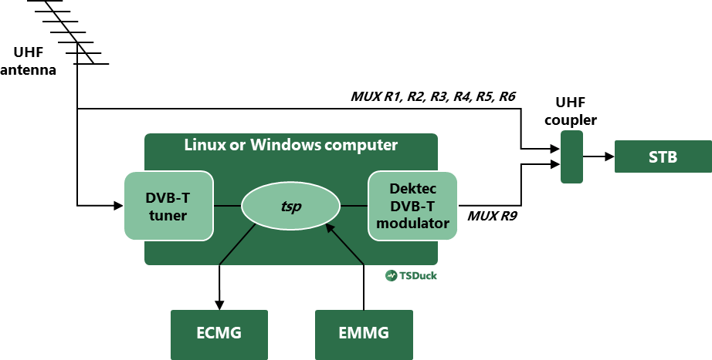
Sample CAS test bed (1/2)
example using French DVB-T network:
duplicate and rename a TS, scramble one service

Slide 16
Sample CAS test bed (2/2)
tsp -I dvb -u $UHF_INPUT
-P tsrename -t 9 -a
-P svrename direct8 -i 0x0901 -l 41 -n "Direct 8 Test"
-P svrename bfmtv -i 0x0903 -l 42 -n "BFM TV Test"
-P svrename 'i>tele' -i 0x0904 -l 43 -n "i>TELE Test"
-P svrename virgin17 -i 0x0905 -l 44 -n "Virgin 17 Test"
-P svrename gulli -i 0x0906 -l 45 -n "Gulli Test"
-P svrename france4 -i 0x0907 -l 46 -n "France 4 Test"
-P svrename 0x02FF -i 0x09FF
-P scrambler GulliTest -e $ECMG -s $SUPER_CAS_ID
-p $PMT_CADESC_PRIVATE -a $AC
-b $ECM_BITRATE --pid $ECM_PID
-P cat -c -a $CAS_ID/$EMM_PID/$CAT_CADESC_PRIVATE
-P datainject -r -s $MUX_SERVER_PORT
-b $EMM_MAX_BITRATE -p $EMM_PID
-O dektec -u $UHF_OUTPUT --convolution 2/3 --guard 1/32
rename the TS, rename all services in the TS
(service name, service id, LCN)
scramble one service, connect to a real ECM Generator, update PMT, insert ECM’s
accept connection from a real EMM Generator, update the CAT, insert EMM’s

Slide 17
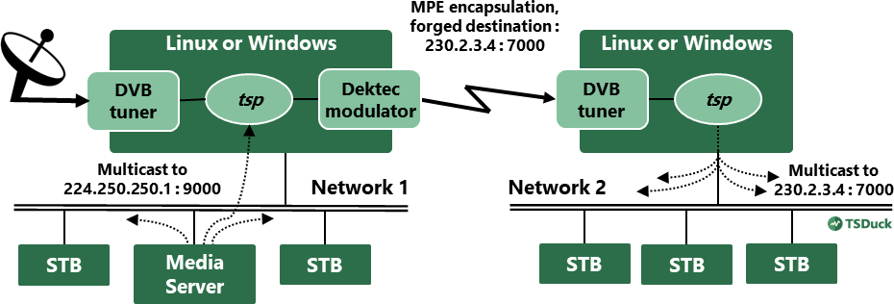
Sample MPE injection and extraction

Slide 18
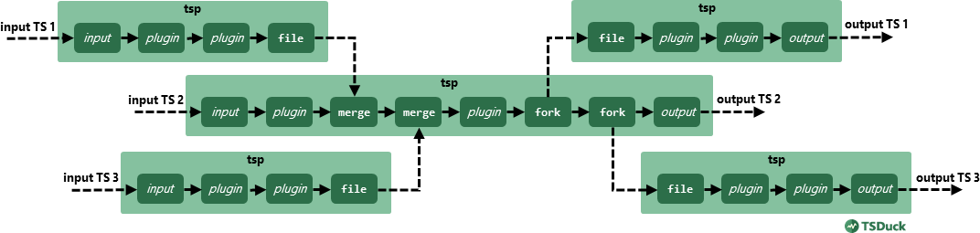
Multiple tsp instances
fork : duplicate the TS to another application
merge : merge with a TS coming from another application
merge service references (PAT, CAT, etc.)

Slide 19
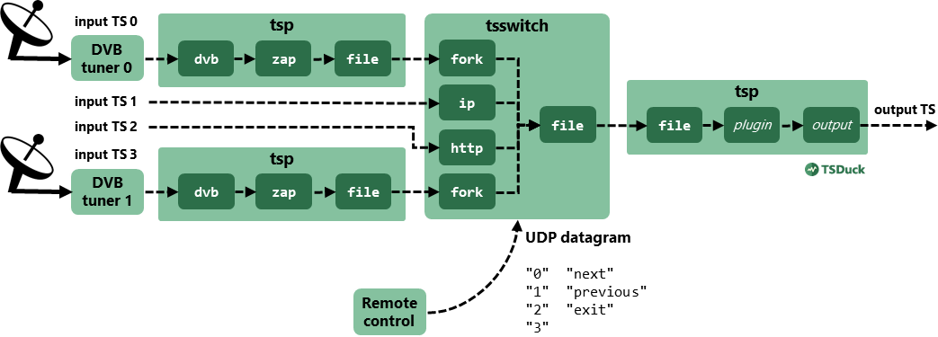
Switching between multiple inputs
tsswitch command
same plugins as tsp
various switching strategies
remote control using UDP

Slide 20
Input and output plugins
Input plugins
Files: TS, M2TS, PCAP
Network: multicast IP, HLS, HTTP, SRT, RIST
Hardware: tuners (DVB, ATSC, ISDB), Dektec (ASI, demodulators)
Application: fork, memory, craft, null
Output plugins
Files: TS, M2TS
Network: multicast IP, HLS, SRT, RIST
Hardware: Dektec (ASI, modulators), HiDes (modulators)
Application: fork, memory, drop, media player

Slide 21
Packet processing plugins
TS transformations
PID or packet filtering, PSI/SI transformation or injection, service extraction or modification, etc.
TS regulation
time regulation, time shifting, scheduled recording, etc.
TS analysis and monitoring
TS analysis, PSI/SI extraction, PID, bitrate monitoring, ECM or EMM monitoring, etc.
TS scrambling & descrambling
DVB SimulCrypt support for ECM / EMM injection
Data injection of extraction
SCTE 35, T2-MI, MPE, Teletext
Any other processing you wish to develop…
75 packet processing plugins available (version 3.29)

Slide 22
PSI/SI tables manipulation
binary, XML or JSON

Slide 23
MPEG tables and sections
Extraction from TS, injection into TS
Data formats
binary
raw sections
XML
fully documented in user’s guide
easy to manually edit or process in applications
JSON
through automated XML-to-JSON conversion
easy to process in applications, especially in Python
All formats are uniformly used
TS extraction, modification, injection
file manipulation

Slide 24
Sample XML file
<?xml version="1.0" encoding="UTF-8"?>
<tsduck>
<PAT version="8" transport_stream_id="0x0012" network_PID="0x0010">
<service service_id="0x0001" program_map_PID="0x1234"/>
<service service_id="0x0002" program_map_PID="0x0678"/>
</PAT>
<PMT version="4" service_id="0x0456" PCR_PID="0x1234">
<CA_descriptor CA_system_id="0x0777" CA_PID="0x0251"/>
<component elementary_PID="0x0567" stream_type="0x12">
<ISO_639_language_descriptor>
<language code="fre" audio_type="0x45"/>
<language code="deu" audio_type="0x78"/>
</ISO_639_language_descriptor>
</component>
</PMT>
</tsduck>

Slide 25
Multiple ways to update tables in a TS
Specialized plugins with predefined options
BAT, CAT, NIT, PAT, PMT, SDT
Manual XML handling
Extract the table as an XML file
Edit the file
Reinject the file
Automated XML modification
Using « XML patch files »
Flexible XML templates to update tables on the fly
Similar to XSLT in principle, but much simpler

Slide 26
Extending TSDuck
C++ transport stream programming

Slide 27
Extending TSDuck
TSDuck is extensible
Source code provided
git clone https://github.com/tsduck/tsduck.git
Common API for Linux, Windows and macOS
DVB tuners, Dektec and HiDes devices are not supported on macOS
Programmer’s guide
doxygen-generated, see https://tsduck.io/
You can modify it yourself !

Slide 28
Why extending TSDuck?
Identify your needs
Try to find a solution using existing TSDuck plugins
review utilities and plugins
Try to extend an existing utility or plugin
add new options
add features, don’t modify existing behavior
remain upward compatible
Develop your own plugin
it is quite simple, really
Send your code back using a pull request
so that everyone can benefit from it

Slide 29
Coding hints
Don’t write a plugin from scratch
use an existing one as code base
choose one which is technically similar
input? output? PSI/SI transformation? packet filtering?
Implement simple & elementary features
preserve TSDuck philosophy
develop several elementary plugins if necessary
not a single big plugin implementing several features
Read the « TSDuck coding guidelines » document
a recommended reading, although not required
RTFM
(as usual)

Slide 30
Proprietary extensions
Reason: manipulation of confidential data
private PSI/SI signalization
conditional access system implementation
Completely independent source code and binary packages
additional plugins
additional commands
dynamically merging inside TSDuck proprietary implementations of tables, descriptors, CAS data structures, naming, etc.
Compatible with TSDuck BSD license
Sample code in source code tree
sample/sample-extension

Slide 31
Using the TSDuck library
to develop third-party applications in C++, Java or Python

Slide 32
TSDuck library
All TSDuck common code is in one large library
libtsduck.so / libtsduck.dylib / tsduck.dll
Contains generic and reusable C++ code
basic operating system independent features
system, multi-treading, synchronization, networking, cryptography, etc.
MPEG/DVB features
TS packets, PSI/SI tables, sections and descriptors, demultiplexing, packetization, encapsulation, DVB tuners, etc.
Can be used in your application
even if not part of TSDuck

Slide 33
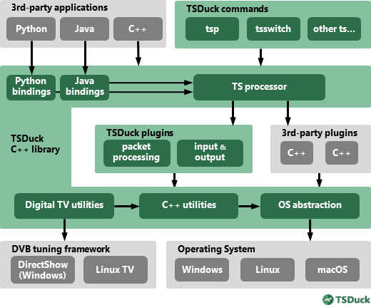
Software architecture
C++ applications
all TSDuck features
Java or Python applications
high-level features only
interactions using JSON or XML
memory buffers for input/output
Custom plugins
C++ only

Slide 34
Programmer’s guide
Online, see https://tsduck.io/doxy/
automatically updated every night
Tutorials
building TSDuck and applications using its library
developing TSDuck plugins and extensions
C++ library tutorial
Java and Python bindings
Reference
all C++, Java and Python classes

Slide 35
Thank you
Any question?

