Slide 1
Privacy Engineering
Additive Secret Sharing-based Distributed Average Consensus
Morten Munk Andersen
2026 SW9
20212638

Slide 2
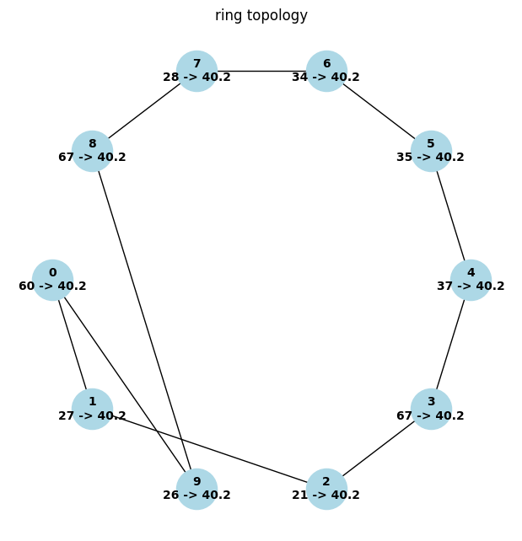
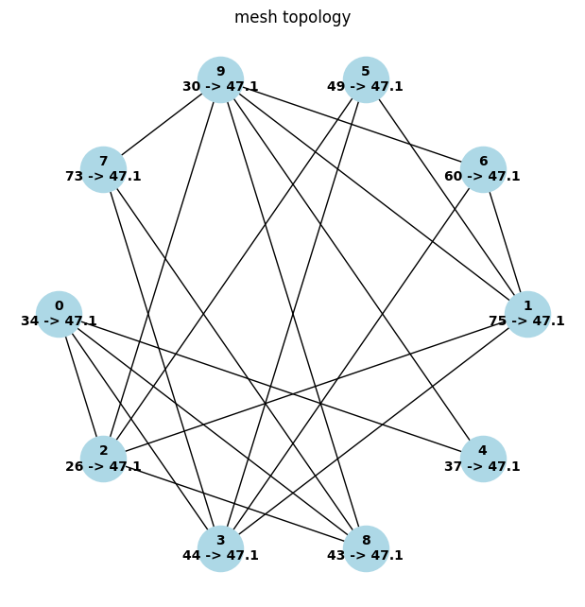
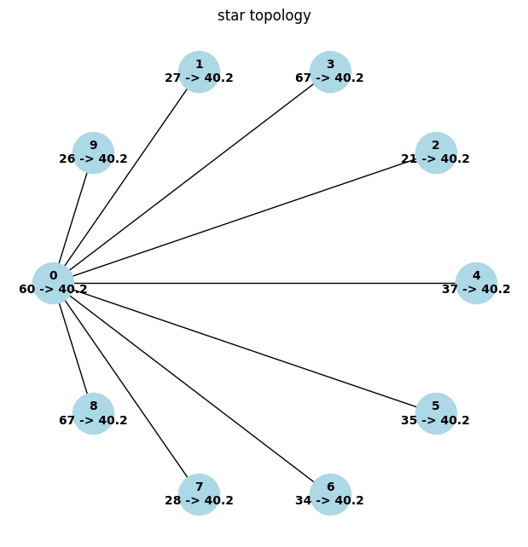
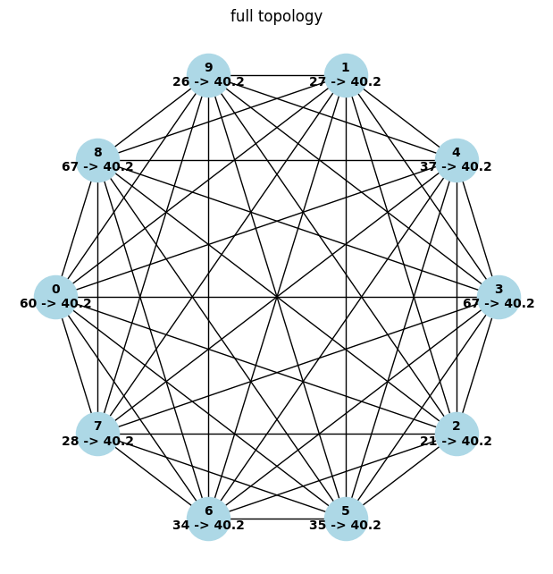
Introduction
Goal
  Compute average age of all nodes
  Don’t reveal individual values

Slide 3
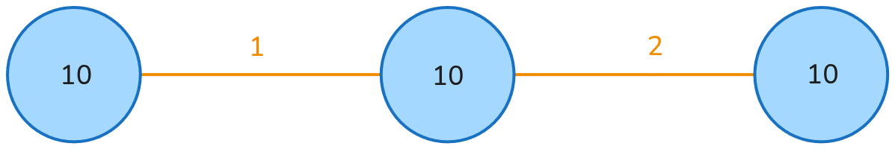
How does it work?
Traditional consensus:
  Neighbors can spy!

Slide 4
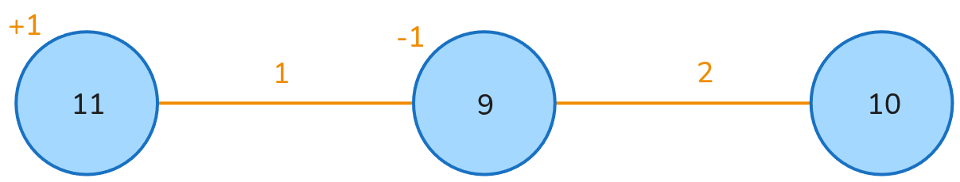
How does it work?

Slide 5
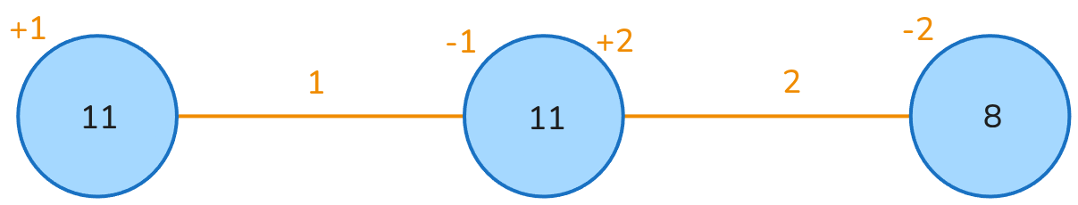
How does it work?
Zero sum mask!

Slide 6
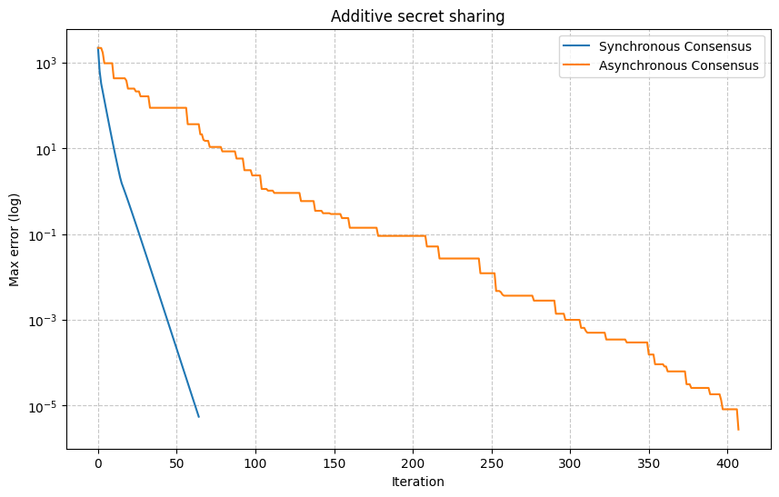
Sync
  Global discrete time updates
  Laplacian weight matrix
Async:
  two nodes at a time

Slide 7
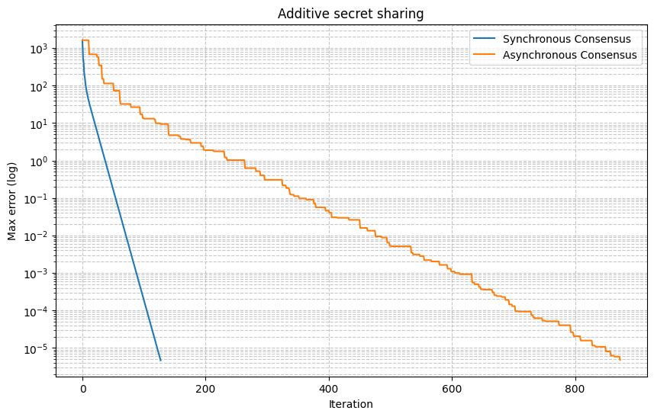
Ring topology
Potential for wasted iterations in async
  e.g. two nodes with similar values

Slide 8
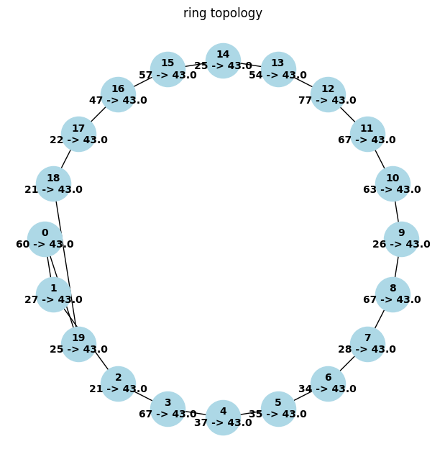
Ring topology
What about more nodes? (10 vs 20)

Slide 9
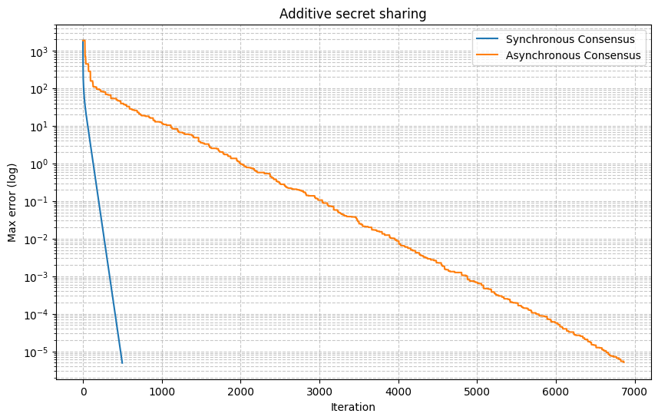
Ring topology
What about more nodes? (10 vs 20)
  Async iterations explode (~900 vs ~7000 iterations)

Slide 10
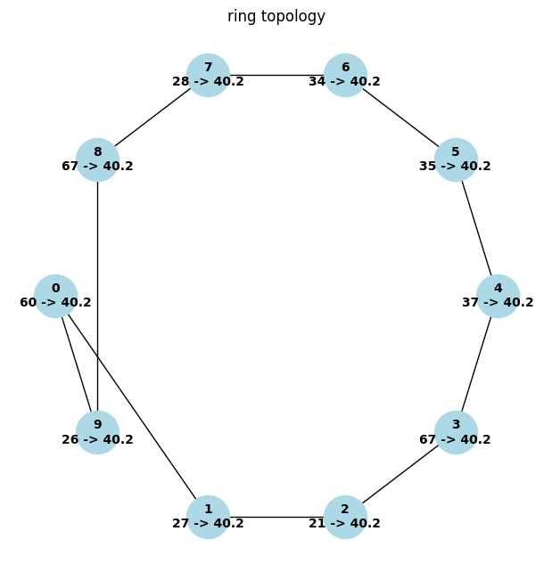
Ring topology
What about higher random number range? (60 to 100k)
  Async iterations explode (~900 vs ~1300 iterations)
  Max error starts higher (~10³ vs ~10⁵)

Slide 11
Ring topology
What about higher random number range? (60 to 100k)
  Async iterations explode (~900 vs ~1300 iterations)
  Max error likely starts higher (hard to see with log scale)

Slide 12
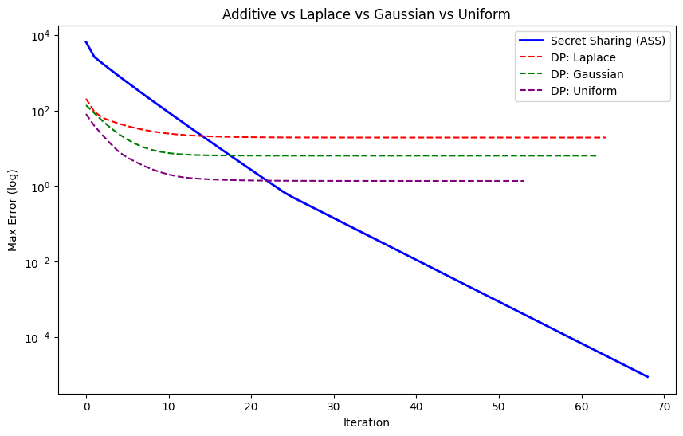
Differential Privacy
Example with mesh (50 nodes)
  Additive: zero sum mask
  DP: permanent noise

Slide 13
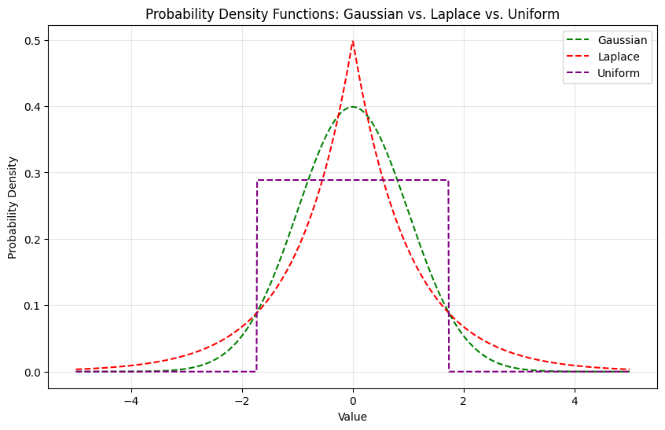
Differential Privacy
ε: The privacy budget (privacy vs accuracy)
δ: Probability of privacy failure

Slide 14
Summary
Additive Secret Sharing:
  Neighbors cant peak at shared values!
Differential Privacy
  Combat statistical attacks on final result

Slide 15
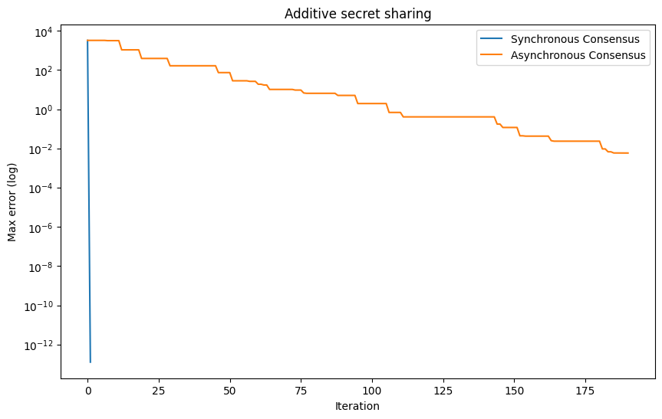
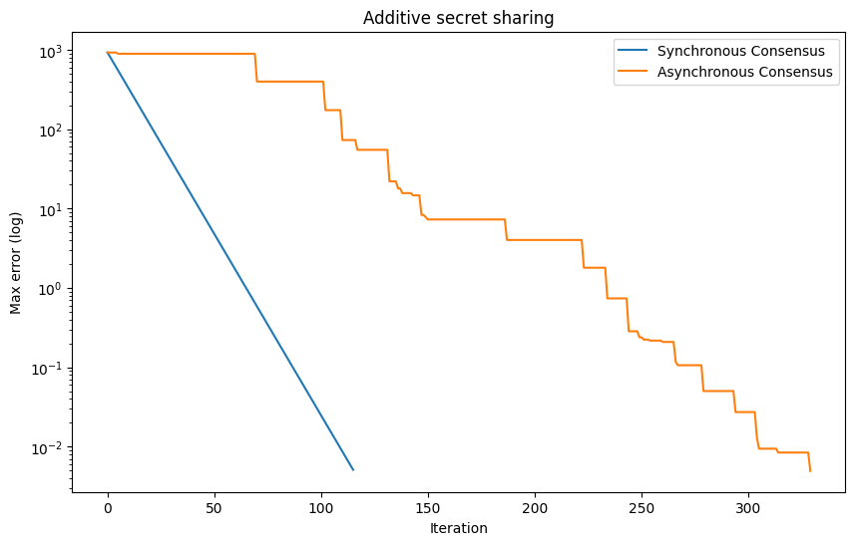
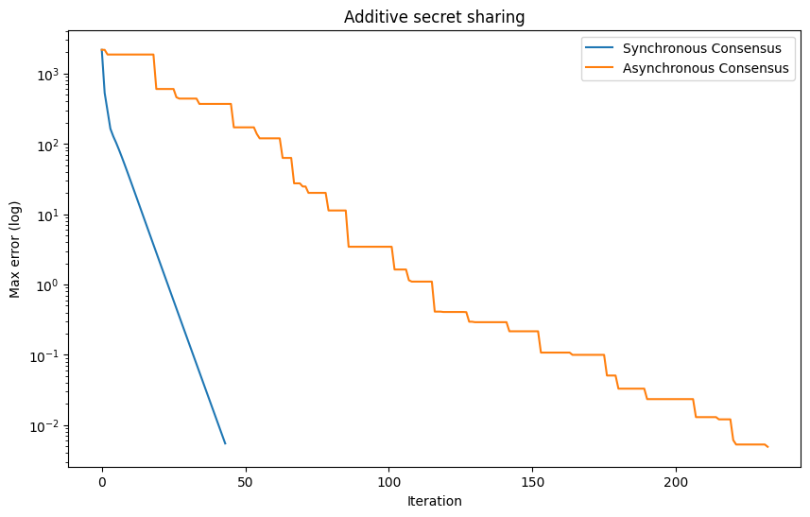
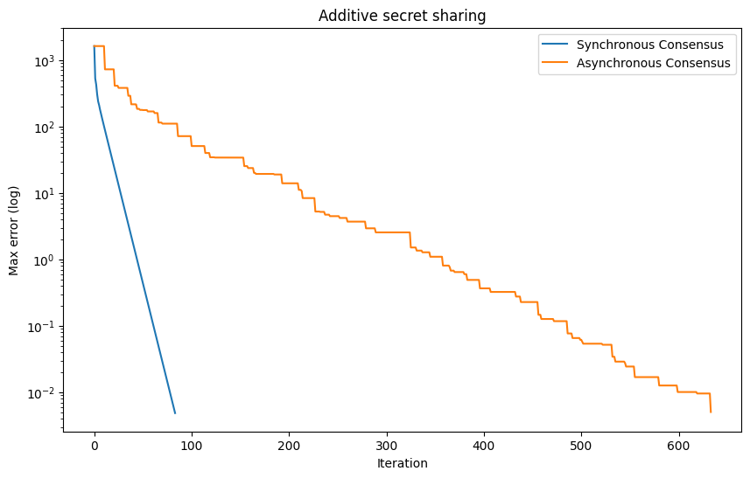
Full
Star
Mesh
Ring

