Slide 1
Privacy Engineering
Morten Munk Andersen
2026 SW9
20212638

Slide 2
Additive Secret Sharing

Slide 3
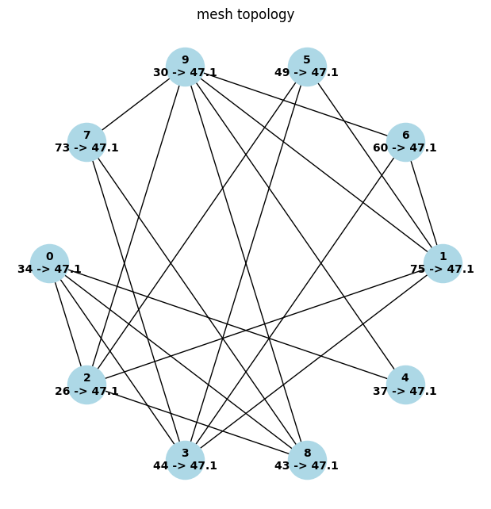
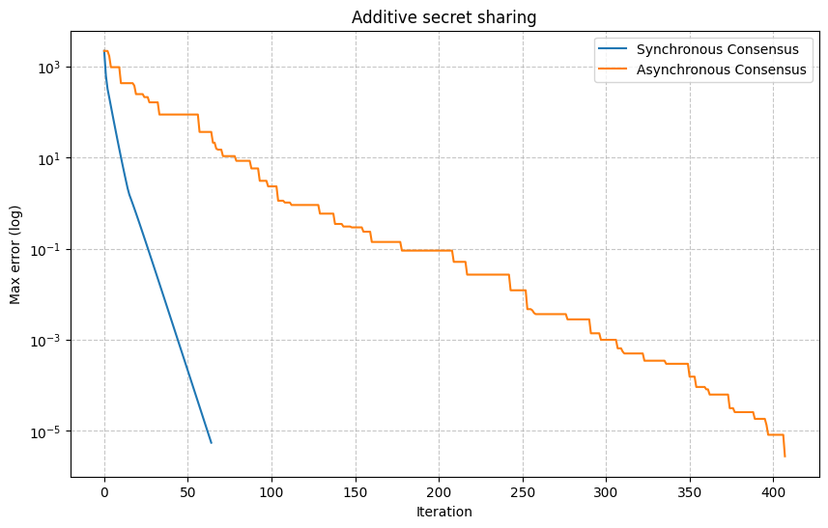
Mesh topology
Sync: global discrete time updates
Async: two nodes at a time

Slide 4
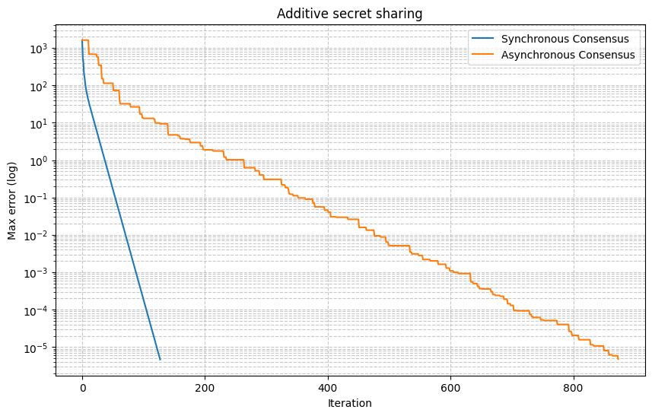
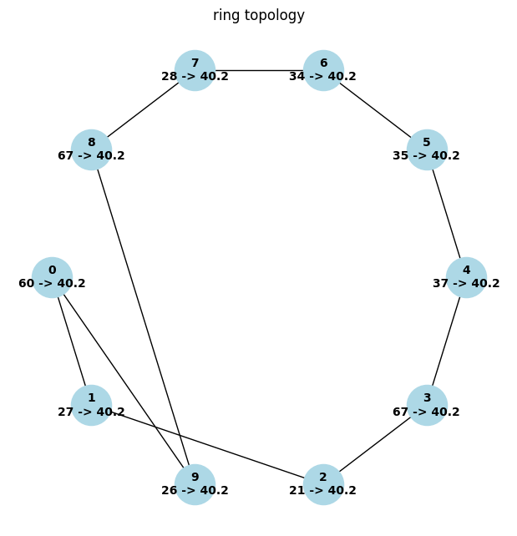
Ring topology
Potential for wasted iterations in async
  e.g. two nodes with similar values

Slide 5
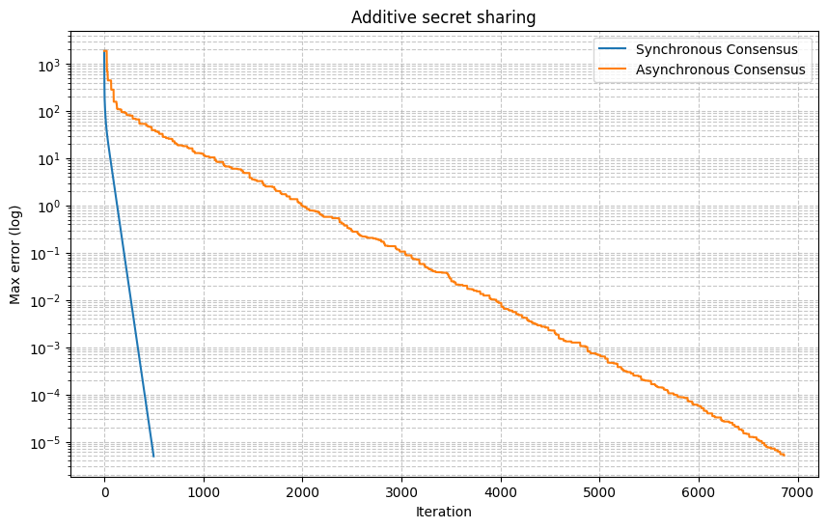
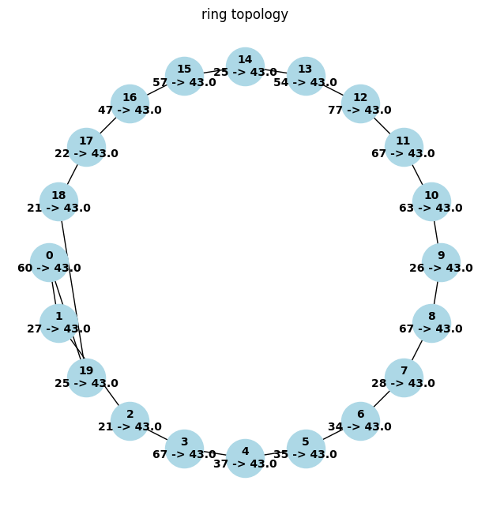
Ring topology
What about more nodes? (10 vs 20)
  Async iterations explode (~900 vs ~7000 iterations)

Slide 6
Ring topology
What about more nodes? (10 vs 20)
  Async iterations explode (~900 vs ~7000 iterations)

Slide 7
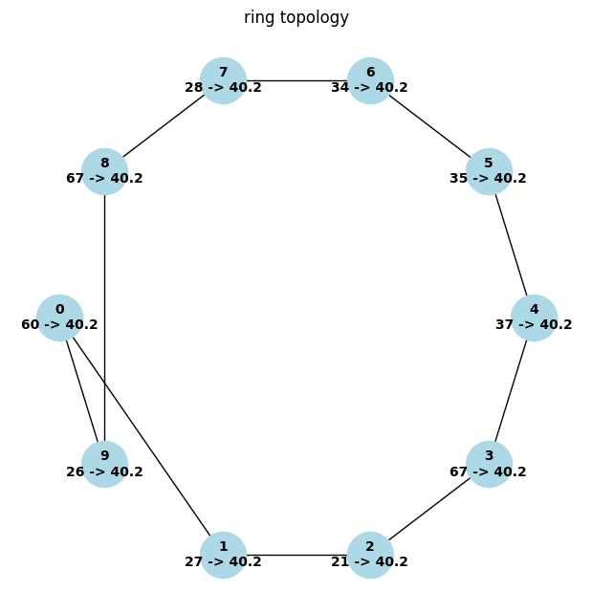
Ring topology
What about higher random number range? (60 to 100k)
  Async iterations explode (~900 vs ~1300 iterations)
  Max error starts higher (~10³ vs ~10⁵)

Slide 8
Ring topology
What about higher random number range? (60 to 100k)
  Async iterations explode (~900 vs ~1300 iterations)
  Max error likely starts higher (hard to see with log scale)

Slide 9
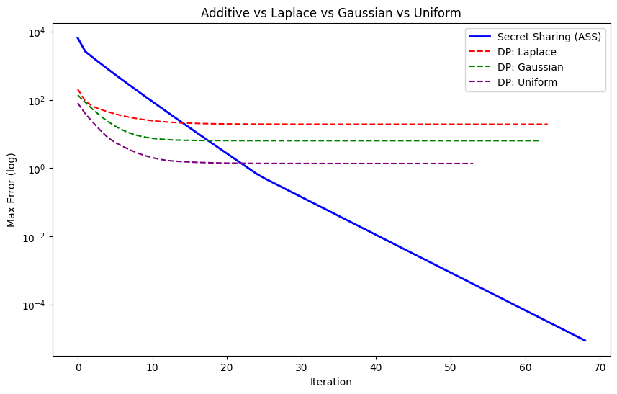
Differential Privacy
Example with mesh (50 nodes)
  Additive: zero sum mask
  DP: permanent noise

Slide 10
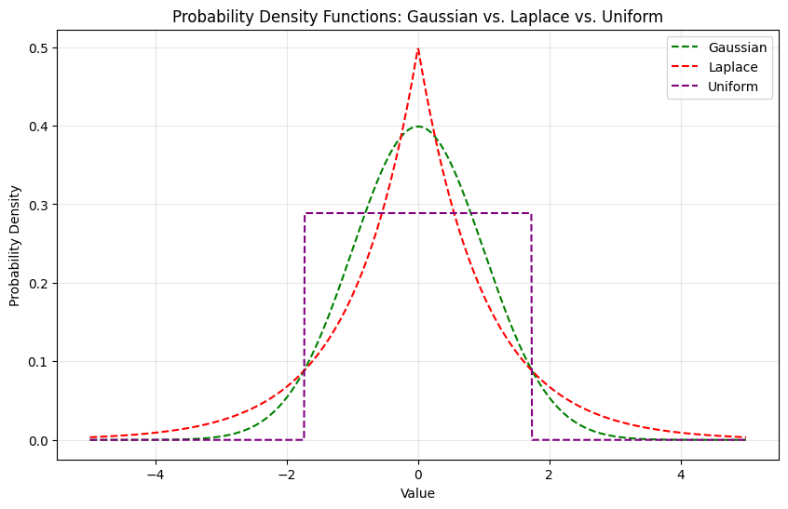
Differential Privacy
ε: The privacy budget (privacy vs accuracy)
δ: Probability of privacy failure

Slide 11
Topology Comparisons
a

