Slide 1
Kaggle Competetion
Dear Professor : Mr.Manthouri
Produced By : Ghasemi,morteza
https://github.com/Morteza-Ghasemi
January 2021

Slide 2

Kaggle Competetion Toxic Comment Classification Challenge
https://www.kaggle.com/c/jigsaw-toxic-comment-classification-challenge/overview

Slide 3
Kaggle Competetion Overview
Discussing things you care about can be difficult. The threat of abuse and harassment online means that many people stop expressing themselves and give up on seeking different opinions. Platforms struggle to effectively facilitate conversations, leading many communities to limit or completely shut down user comments.

Slide 4
Kaggle Competetion Overview
The Conversation AI team, a research initiative founded by Jigsaw and Google (both a part of Alphabet) are working on tools to help improve online conversation. One area of focus is the study of negative online behaviors, like toxic comments (i.e. comments that are rude, disrespectful or otherwise likely to make someone leave a discussion). So far they’ve built a range of publicly available models served through the Perspective API, including toxicity. But the current models still make errors, and they don’t allow users to select which types of toxicity they’re interested in finding (e.g. some platforms may be fine with profanity, but not with other types of toxic content).

Slide 5
Kaggle Competetion Overview
In this competition, you’re challenged to build a multi-headed model that’s capable of detecting different types of of toxicity like threats, obscenity, insults, and identity-based hate better than Perspective’s current models. You’ll be using a dataset of comments from Wikipedia’s talk page edits. Improvements to the current model will hopefully help online discussion become more productive and respectful.
Disclaimer: the dataset for this competition contains text that may be considered profane, vulgar, or offensive.

Slide 6

Kaggle Competetion
Implementing Kaggle Competetion with Scikit-Learn
Importing libraries

Slide 7
Kaggle Competetion
Implementing Kaggle Competetion with Scikit-Learn
Data Preprocessing
Dividing the data into attributes and labels
dividing the data into training and testing sets
replace(r'^\s*$', np.NaN, regex=True)
dropna(axis = 0, how ='any')
reset_index(drop=True)

Slide 8
Kaggle Competetion
Implementing Kaggle Competetion with Scikit-Learn
Exploratory Data Analysis
To get a feel of how our dataset actually looks, execute the following command: bankdata.head()
You can see that all of the attributes in the dataset are numeric. The label is also numeric i.e. 0 and 1.

Slide 9
Kaggle Competetion
Implementing Kaggle Competetion with Scikit-Learn
Evaluating the Algorithm
Confusion matrix, precision, recall, and F1 measures are the most commonly used metrics for classification tasks.
from sklearn.metrics import classification_report, confusion_matrix
print(confusion_matrix(y_test,y_pred))
print(classification_report(y_test,y_pred))

Slide 10
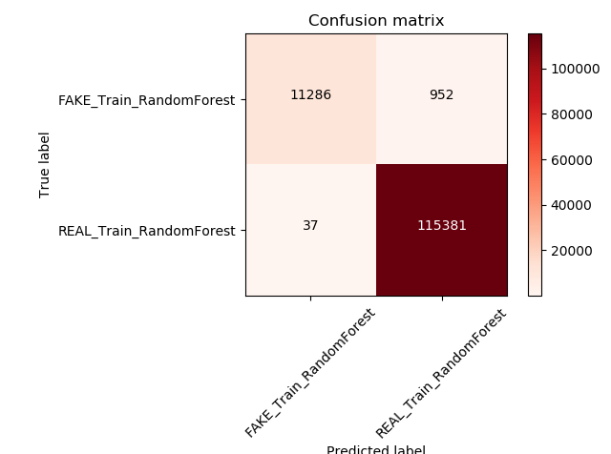
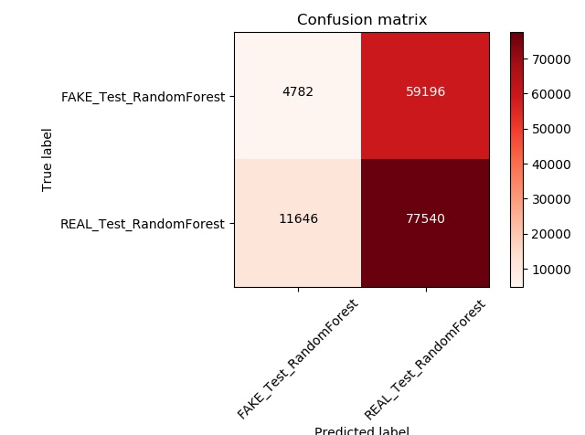
Kaggle Competetion Random Forest
The output of the Random Forest looks like this:

Slide 11
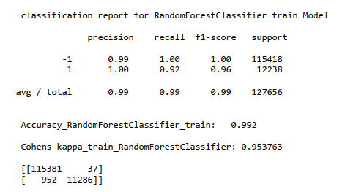
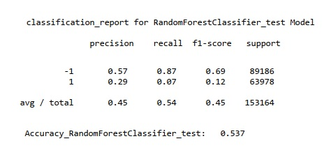
Kaggle Competetion Random Forest
The output of the Random Forest looks like this:

Slide 12
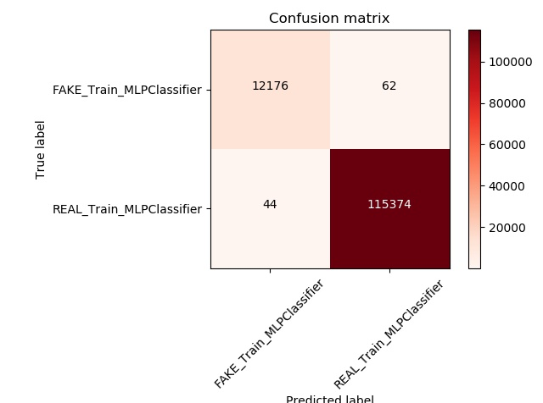
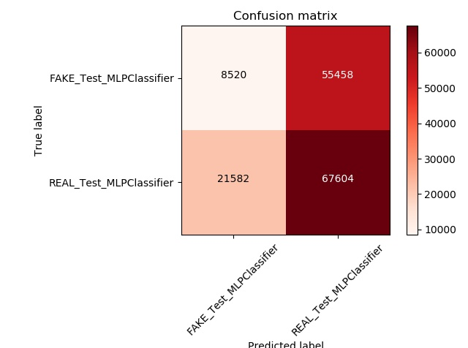
Kaggle Competetion MLP
The output of the MLP looks like this:

Slide 13
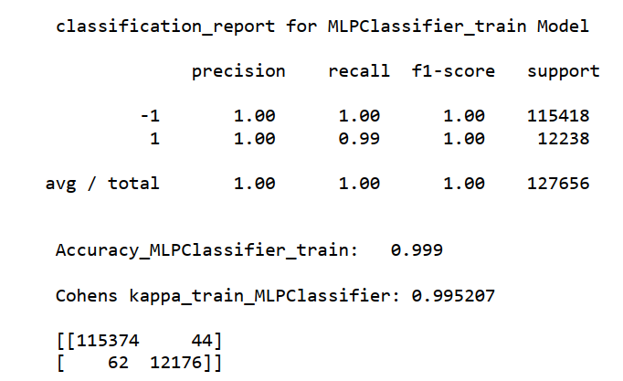
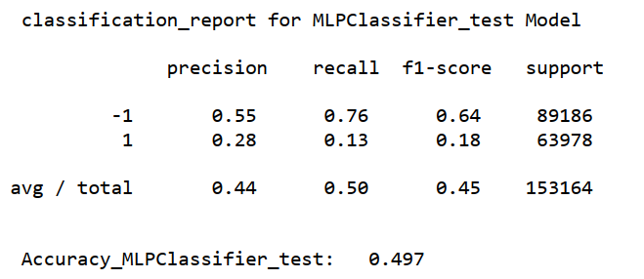
Kaggle Competetion MLP
The output of the MLP looks like this:

Slide 14
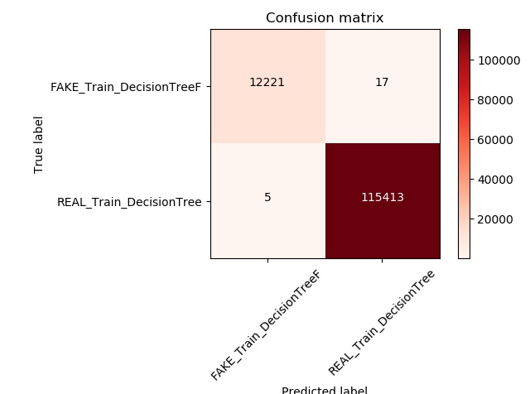

Kaggle Competetion DecisionTree
The output of the DecisionTree looks like this:

Slide 15
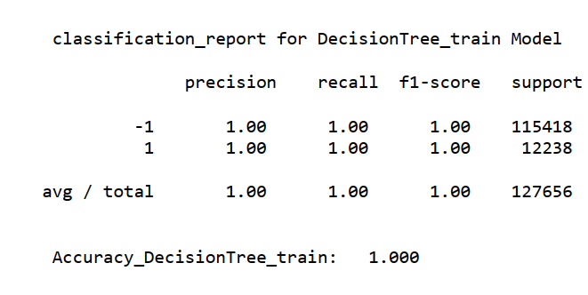
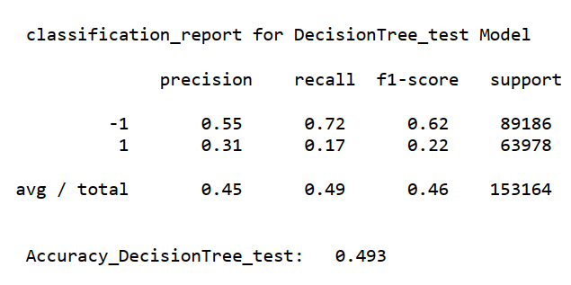
Kaggle Competetion DecisionTree
The output of the DecisionTree looks like this:

Slide 16
The End

