Slide 1
Linear Regression
Dear Professor : Mr.Manthouri
Produced By : Ghasemi,morteza
https://github.com/Morteza-Ghasemi
January 2021

Slide 2
Linear Regression

Slide 3
Linear Regression
There are two types of supervised machine learning algorithms: Regression and classification.
The term "linearity" in algebra refers to a linear relationship between two or more variables.
If we draw this relationship in a two dimensional space (between two variables), we get a straight line.

Slide 4
Simple Linear Regression
We know that the equation of a straight line is basically:
y = mx + b
b is the intercept and m is the slope of the line
The linear regression algorithm gives us the most optimal value for the intercept and the slope
The values that we can control are the intercept and slope
Basically what the linear regression algorithm does is it fits multiple lines on the data points and returns the line that results in the least error.

Slide 5
Multiple Linear Regression
The same concept can be extended to the cases where there are more than two variables. This is called multiple linear regression.
A regression model involving multiple variables can be represented as:
y = b₀ + m₁b₁ + m₂b₂ + m₃b₃ + ... ... M_{n}b_{n}
This is the equation of a hyper plane.
a linear regression model in two dimensions is a straight line; in three dimensions it is a plane, and in more than three dimensions, a hyper plane.

Slide 6
Linear Regression
Implementing Linear Regression with Scikit-Learn
Importing libraries
import numpy as np
import matplotlib.pyplot as plt
import pandas as pd
import seaborn as sns
%matplotlib inline

Slide 7
Linear Regression
Implementing Linear Regression with Scikit-Learn
Importing the Dataset
from sklearn.datasets import load_boston
boston_dataset = load_boston()

Slide 8
Linear Regression
Implementing Linear Regression with Scikit-Learn
Dataset
We print the value of the boston_dataset to understand what it contains.
print(boston_dataset.keys())

Slide 9
Linear Regression
Implementing Linear Regression with Scikit-Learn
Dataset
data: contains the information for various houses
target: prices of the house
feature_names: names of the features
DESCR: describes the dataset

Slide 10
Linear Regression
Implementing Linear Regression with Scikit-Learn
Dataset
CRIM: Per capita crime rate by town ZN: Proportion of residential land zoned for lots over 25,000 sq. ft INDUS: Proportion of non-retail business acres per town CHAS: Charles River dummy variable (= 1 if tract bounds river; 0 otherwise) NOX: Nitric oxide concentration (parts per 10 million) RM: Average number of rooms per dwelling AGE: Proportion of owner-occupied units built prior to 1940 DIS: Weighted distances to five Boston employment centers RAD: Index of accessibility to radial highways TAX: Full-value property tax rate per $10,000 PTRATIO: Pupil-teacher ratio by town B: 1000(Bk — 0.63)², where Bk is the proportion of [people of African American descent] by town LSTAT: Percentage of lower status of the population MEDV: Median value of owner-occupied homes in $1000s

Slide 11
Linear Regression
Implementing Linear Regression with Scikit-Learn
Dataset
We will now load the data into a pandas dataframe using pd.DataFrame.
boston = pd.DataFrame(boston_dataset.data, columns=boston_dataset.feature_names)
boston.head()
boston['MEDV'] = boston_dataset.target

Slide 12
Linear Regression
Implementing Linear Regression with Scikit-Learn
Data preprocessing
After loading the data, it’s a good practice to see if there are any missing values in the data. We count the number of missing values for each feature using :
boston.isnull().sum()

Slide 13
Linear Regression
Implementing Linear Regression with Scikit-Learn
Exploratory Data Analysis
After loading the data, it’s a good practice to see if there are any missing values in the data. We count the number of missing values for each feature using :
boston.isnull().sum()

Slide 14
Linear Regression
Implementing Linear Regression with Scikit-Learn
Exploratory Data Analysis
first plot the distribution of the target variable
sns.set(rc={'figure.figsize':(11.7,8.27)})
sns.distplot(boston['MEDV'], bins=30)
plt.show()

Slide 15
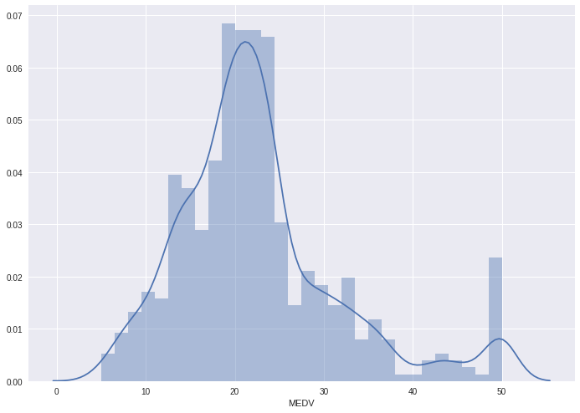
Linear Regression
Implementing Linear Regression with Scikit-Learn
Exploratory Data Analysis
We see that the values of MEDV
are distributed normally with
few outliers.

Slide 16
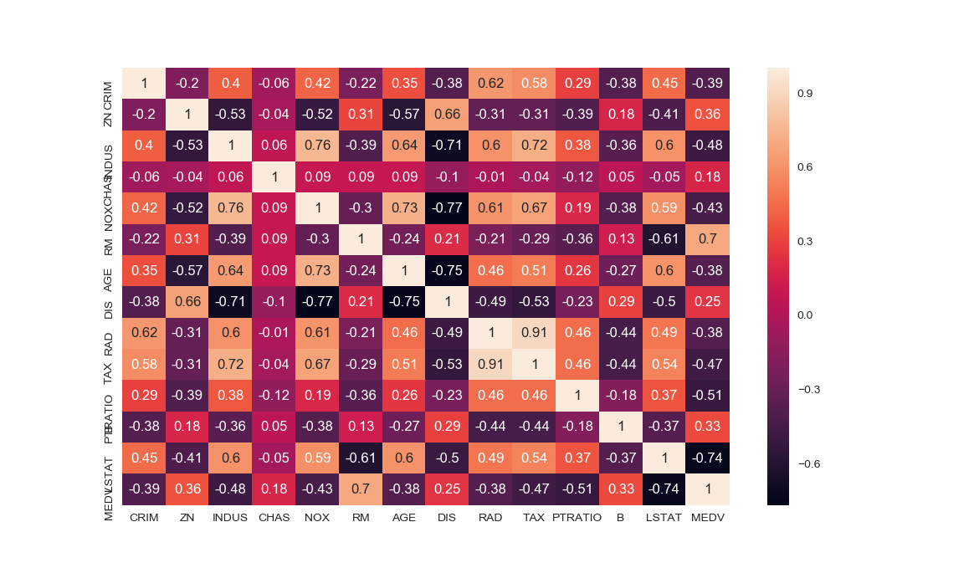
Linear Regression
Implementing Linear Regression with Scikit-Learn
Exploratory Data Analysis
create a correlation matrix that measures the linear
relationships between the variables.
correlation_matrix = boston.corr().round(2)
sns.heatmap(data=correlation_matrix, annot=True)

Slide 17
Linear Regression
Implementing Linear Regression with Scikit-Learn
Exploratory Data Analysis
The correlation coefficient ranges from -1 to 1.
If the value is close to 1, it means that there is a
strong positive correlation between the two variables.
When it is close to -1, the variables have a strong
negative correlation.

Slide 18
Linear Regression
Implementing Linear Regression with Scikit-Learn
Observations :
To fit a linear regression model, we select those
features which have a high correlation with our
target variable MEDV
we can see that RM has a strong positive correlation
with MEDV(0.7).
LSTAT has a high negative correlation with MEDV(-0.7)

Slide 19
Linear Regression
Implementing Linear Regression with Scikit-Learn
Observations :
An important point in selecting features for a linear
regression model is to check for multi-co-linearity.
The features RAD and TAX have a correlation of 0.91.
These feature pairs are strongly correlated to each
other. We should not select both these features
together for training the model.
Same goes for the features DIS and AGE which have a correlation
of -0.75.

Slide 20
Linear Regression
Implementing Linear Regression with Scikit-Learn
Observations :
Based on the above observations we will RM and
LSTAT s our features.
Using a scatter plot let’s see how these features vary
with MEDV

Slide 21
Linear Regression
Implementing Linear Regression with Scikit-Learn
plt.figure(figsize=(20, 5))
features = ['LSTAT', 'RM']
target = boston['MEDV']
for i, col in enumerate(features):
plt.subplot(1, len(features) , i+1)
x = boston[col]
y = target
plt.scatter(x, y, marker='o')
plt.title(col)
plt.xlabel(col)
plt.ylabel('MEDV')

Slide 22
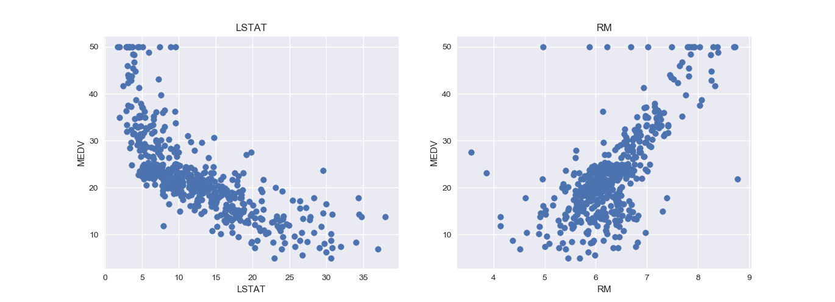
Linear Regression
Implementing Linear Regression with Scikit-Learn
Observations :
Using a scatter plot let’s see how these features vary with MEDV

Slide 23
Linear Regression
Implementing Linear Regression with Scikit-Learn
Observations :
The prices increase as the value of RM increases linearly. There are few outliers and the data seems to be capped at 50.
The prices tend to decrease with an increase in LSTAT. Though it doesn’t look to be following exactly a linear line.

Slide 24
Linear Regression
Implementing Linear Regression with Scikit-Learn
Preparing the data for training the model :
We concatenate the LSTAT and RM columns using np.c_ provided by the numpy library.
X = pd.DataFrame(np.c_[boston['LSTAT'], boston['RM']], columns = ['LSTAT','RM'])
Y = boston['MEDV']

Slide 25
Linear Regression
Implementing Linear Regression with Scikit-Learn
Splitting the data into training and testing sets:
from sklearn.model_selection import train_test_split
X_train, X_test, Y_train, Y_test = train_test_split(X, Y, test_size = 0.2, random_state=5)

Slide 26
Linear Regression
Implementing Linear Regression with Scikit-Learn
Training and testing the model :
from sklearn.linear_model import LinearRegression
from sklearn.metrics import mean_squared_error
lin_model = LinearRegression()
lin_model.fit(X_train, Y_train)

Slide 27
Linear Regression
Implementing Linear Regression with Scikit-Learn
Model evaluation :
We will evaluate our model using RMSE and R2-score.
y_train_predict = lin_model.predict(X_train)
rmse = (np.sqrt(mean_squared_error(Y_train, y_train_predict)))
r2 = r2_score(Y_train, y_train_predict)

Slide 28



Linear Regression
Implementing Linear Regression with Scikit-Learn
Model evaluation :
Mean Absolute Error (MAE) is the mean of the absolute value of the errors. It is calculated as:
Mean Squared Error (MSE) is the mean of the squared errors and is calculated as:
Root Mean Squared Error (RMSE) is the square root of the mean of the squared errors:

Slide 29
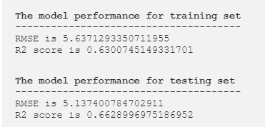
Linear Regression
Implementing Linear Regression with Scikit-Learn
Model evaluation :

Slide 30
Linear Regression
Implementing Linear Regression with Scikit-Learn
Model evaluation :
There are many factors that may have contributed to this inaccuracy, a few of which are listed here:
Need more data: Only one year worth of data isn't that much, whereas having multiple years worth could have helped us improve the accuracy quite a bit.
Bad assumptions: We made the assumption that this data has a linear relationship, but that might not be the case. Visualizing the data may help you determine that.
Poor features: The features we used may not have had a high enough correlation to the values we were trying to predict.

Slide 31
The End

