Slide 1
Logistic Regression (L1,L2 applied)
Dear Professor : Mr.Manthouri
Produced By : Ghasemi,morteza
https://github.com/Morteza-Ghasemi
January 2021

Slide 2
Logistic Regression
Classification is a large domain in the field of statistics and machine learning. Generally, classification can be broken down into two areas
Binary classification, where we wish to group an outcome into one of two groups.
Multi-class classification, where we wish to group an outcome into one of multiple (more than two) groups.

Slide 3
Logistic Regression
Logistic Regression is a type of Generalized Linear Model (GLM).
uses a logistic function to model a binary variable based on any kind of independent variables.
LR = LogisticRegression()
LR. fit(X, y)

Slide 4
Logistic Regression
Implementing Logistic Regression with Scikit-Learn
The task is to predict whether a bank currency note is authentic or not based upon four attributes of the note i.e. skewness of the wavelet transformed image, variance of the image, entropy of the image, and curtosis of the image.
This is a binary classification problem and then will use Logistic Regression algorithm to solve this problem.

Slide 5

Logistic Regression
Implementing Logistic Regression with Scikit-Learn
Importing libraries

Slide 6
Logistic Regression
Implementing Logistic Regression with Scikit-Learn
Importing the Dataset
The data is available for download at the following link: https://drive.google.com/file/d/13nw-uRXPY8XIZQxKRNZ3yYlho-CYm_Qt/view
The detailed information about the data is available at the following link: https://archive.ics.uci.edu/ml/datasets/banknote+authentication

Slide 7
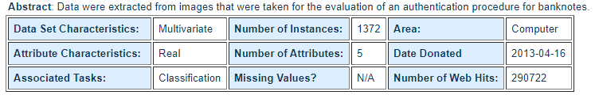
Logistic Regression
Hints :
the dataset is banknote authentication

Slide 8
Logistic Regression
Implementing Logistic Regression with Scikit-Learn
Exploratory Data Analysis
The following code reads bank currency note data into pandas dataframe:
bankdata = pd.read_csv(r"D:\...\bill_authentication.csv")
To see the rows and columns and of the data, execute the following command:
bankdata.shape

Slide 9
Logistic Regression
Implementing Logistic Regression with Scikit-Learn
Exploratory Data Analysis
To get a feel of how our dataset actually looks, execute the following command: bankdata.head()
You can see that all of the attributes in the dataset are numeric. The label is also numeric i.e. 0 and 1.

Slide 10
Logistic Regression
Implementing Logistic Regression with Scikit-Learn
Data Preprocessing
Dividing the data into attributes and labels :
X = bankdata.drop('Class', axis=1)
y = bankdata['Class']
dividing the data into training and testing sets:
from sklearn.model_selection import train_test_split
X_train, X_test, y_train, y_test = train_test_split(X, y, test_size = 0.20)

Slide 11
Logistic Regression
Implementing Logistic Regression with Scikit-Learn
Training the Algorithm
The fit method of Logistic Regression class is called to train the algorithm on the training data, which is passed as a parameter to the fit method.
from sklearn.linear_model import LogisticRegression
logreg = LogisticRegression()
logreg.fit(X_train, y_train)

Slide 12
Logistic Regression
Implementing Logistic Regression with Scikit-Learn
Making Predictions
To make predictions, the predict method of the Logistic Regression class is used.
y_pred = logreg.predict(X_test)

Slide 13
Logistic Regression
Implementing Logistic Regression with Scikit-Learn
Evaluating the Algorithm
Confusion matrix, precision, recall, and F1 measures are the most commonly used metrics for classification tasks.
from sklearn.metrics import classification_report, confusion_matrix
print(confusion_matrix(y_test,y_pred))
print(classification_report(y_test,y_pred))

Slide 14
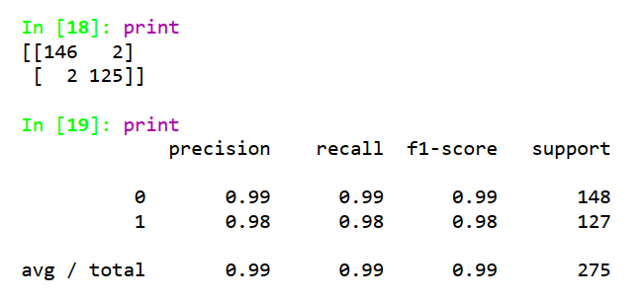
Logistic Regression
Implementing Logistic Regression with Scikit-Learn
Evaluating the Algorithm(Penalty = None)
The output of the Logistic Regression(penalty='none', solver='saga') looks like this:

Slide 15
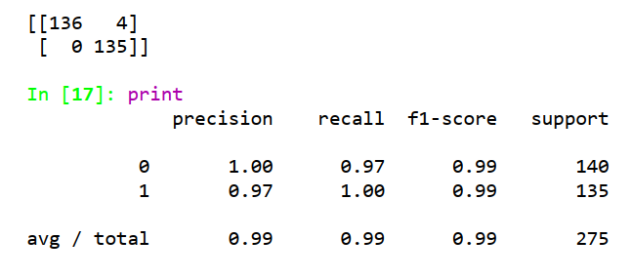
Logistic Regression
Implementing Logistic Regression with Scikit-Learn
Evaluating the Algorithm (Penalty = L1)
The output of the Logistic Regression(penalty='l1', solver='liblinear') looks like this:

Slide 16
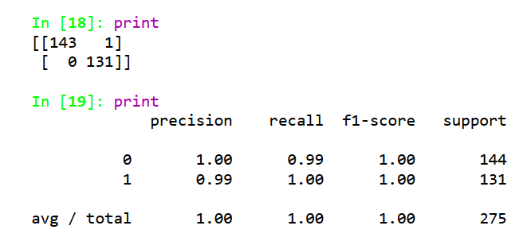
Logistic Regression
Implementing Logistic Regression with Scikit-Learn
Evaluating the Algorithm (Penalty = L2)
The output of the Logistic Regression(penalty='l2', solver='liblinear') looks like this:

Slide 17
The End

