Slide 1
SVM(Kernels - Simple) & PCA
Dear Professor : Mr.Manthouri
Produced By : Ghasemi,morteza
https://github.com/Morteza-Ghasemi/SVM-PCA
January 2021

Slide 2
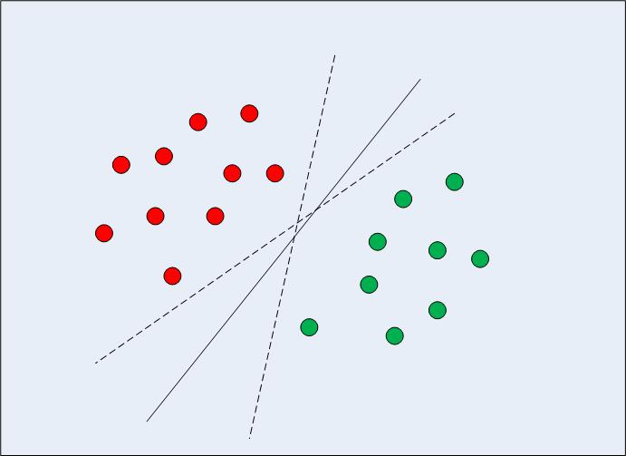
SVM(Kernels - Simple)
In case of linearly separable data in two dimensions
SVM differs from the other classification algorithms in the way that it chooses the decision boundary that maximizes the distance from the nearest data points of all the classes.

Slide 3
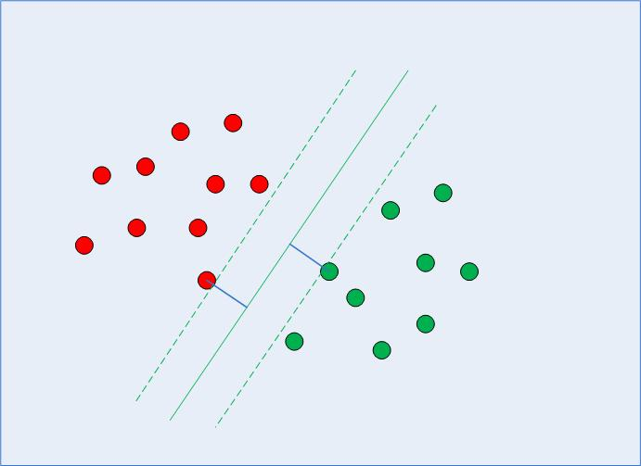
SVM(Kernels - Simple)
An SVM doesn't merely find a decision boundary; it finds the most optimal decision boundary.
The most optimal decision boundary is
the one which has maximum margin from
the nearest points of all the classes.

Slide 4
SVM(Kernels - Simple)
he nearest points from the decision boundary that maximize the distance
between the decision boundary and the
points are called support vectors.
The decision boundary in case of support vector
machines is called the maximum margin classifier,
or the maximum margin hyper plane.

Slide 5
SVM(Kernels - Simple)
There is complex mathematics involved behind finding the support vectors,
calculating the margin between decision boundary
and the support vectors and maximizing
this margin.

Slide 6
SVM(Kernels - Simple)
Implementing SVM with Scikit-Learn
The task is to predict whether a bank currency note is authentic or not based upon four attributes of the note i.e. skewness of the wavelet transformed image, variance of the image, entropy of the image, and curtosis of the image.
This is a binary classification problem and then will use SVM algorithm to solve this problem.

Slide 7

SVM(Kernels - Simple)
Implementing SVM with Scikit-Learn
Importing libraries

Slide 8
SVM(Kernels - Simple)
Implementing SVM with Scikit-Learn
Importing the Dataset
The data is available for download at the following link: https://drive.google.com/file/d/13nw-uRXPY8XIZQxKRNZ3yYlho-CYm_Qt/view
The detailed information about the data is available at the following link: https://archive.ics.uci.edu/ml/datasets/banknote+authentication

Slide 9
SVM(Kernels - Simple)
Implementing SVM with Scikit-Learn
Exploratory Data Analysis
The following code reads bank currency note data into pandas dataframe:
bankdata = pd.read_csv(r"D:\...\bill_authentication.csv")
To see the rows and columns and of the data, execute the following command:
bankdata.shape

Slide 10
SVM(Kernels - Simple)
Implementing SVM with Scikit-Learn
Exploratory Data Analysis
To get a feel of how our dataset actually looks, execute the following command: bankdata.head()
You can see that all of the attributes in the dataset are numeric. The label is also numeric i.e. 0 and 1.

Slide 11
SVM(Kernels - Simple)
Implementing SVM with Scikit-Learn
Data Preprocessing
Dividing the data into attributes and labels :
X = bankdata.drop('Class', axis=1)
y = bankdata['Class']
dividing the data into training and testing sets:
from sklearn.model_selection import train_test_split
X_train, X_test, y_train, y_test = train_test_split(X, y, test_size = 0.20)

Slide 12
SVM(Kernels - Simple)
Implementing SVM with Scikit-Learn
Training the Algorithm
we will use the support vector classifier class, which is written as SVC in the Scikit-Learn's svm library.
This class takes one parameter, which is the kernel type.
This is very important. In the case of a simple SVM we simply set this parameter as "linear" since simple SVMs can only classify linearly separable data.

Slide 13
SVM(Kernels - Simple)
Implementing SVM with Scikit-Learn
Training the Algorithm
The fit method of SVC class is called to train the algorithm on the training data, which is passed as a parameter to the fit method.
from sklearn.svm import SVC
svclassifier = SVC(kernel='linear')
svclassifier.fit(X_train, y_train)

Slide 14
SVM(Kernels - Simple)
Implementing SVM with Scikit-Learn
Making Predictions
To make predictions, the predict method of the SVC class is used.
y_pred = svclassifier.predict(X_test)

Slide 15
SVM(Kernels - Simple)
Implementing SVM with Scikit-Learn
Evaluating the Algorithm
Confusion matrix, precision, recall, and F1 measures are the most commonly used metrics for classification tasks.
from sklearn.metrics import classification_report, confusion_matrix
print(confusion_matrix(y_test,y_pred))
print(classification_report(y_test,y_pred))

Slide 16
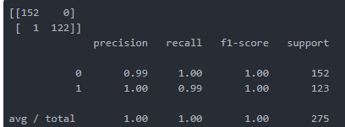
SVM(Kernels - Simple)
Implementing SVM with Scikit-Learn
Evaluating the Algorithm
The output of the SVM with linear kernel looks like this:

Slide 17
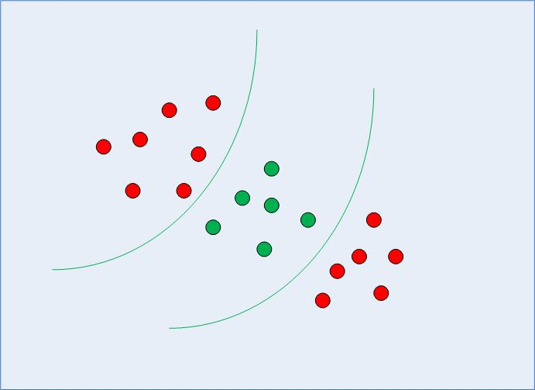
SVM(Kernels - Simple)
Implementing Kernel SVM with Scikit-Learn
in the case of non-linearly separable data, a straight line cannot be used as a
decision boundary. Rather, a modified version
of SVM, called Kernel SVM, is used.

Slide 18
SVM(Kernels - Simple)
Implementing Kernel SVM with Scikit-Learn
Basically, the kernel SVM projects the non-linearly separable data lower
dimensions to linearly separable data in higher
dimensions in such a way that data points
belonging to different classes are allocated to
different dimensions.

Slide 19
SVM(Kernels - Simple)
Implementing Kernel SVM with Scikit-Learn
Importing libraries

Slide 20
SVM(Kernels - Simple)
Implementing Kernel SVM with Scikit-Learn
Importing the Dataset
url = https://archive.ics.uci.edu/ml/machine-learning-databases/iris/iris.data
colnames = ['sepal-length', 'sepal-width', 'petal-length', 'petal-width', 'Class']
irisdata = pd.read_csv(url, names=colnames)

Slide 21
SVM(Kernels - Simple)
Implementing Kernel SVM with Scikit-Learn
Preprocessing
X = irisdata.drop('Class', axis=1)
y = irisdata['Class']

Slide 22
SVM(Kernels - Simple)
Implementing Kernel SVM with Scikit-Learn
Train Test Split
from sklearn.model_selection import train_test_split
X_train, X_test, y_train, y_test = train_test_split(X, y, test_size = 0.20)

Slide 23
SVM(Kernels - Simple)
Implementing Kernel SVM with Scikit-Learn
Training the Algorithm
In the case of the simple SVM we used "linear" as the value for the kernel parameter. However, for kernel SVM you can use Gaussian, polynomial, sigmoid, or computable kernel.
We will implement polynomial, Gaussian, and sigmoid kernels to see which one works better for our problem.

Slide 24
SVM(Kernels - Simple)
Implementing Kernel SVM with Scikit-Learn
Polynomial Kernel
In the case of polynomial kernel, you also have to pass a value for the degree parameter of the SVC class. This basically is the degree of the polynomial.
from sklearn.svm import SVC
svclassifier = SVC(kernel='poly', degree=8)
svclassifier.fit(X_train, y_train)

Slide 25
SVM(Kernels - Simple)
Implementing Kernel SVM with Scikit-Learn
Making Predictions
Now once we have trained the algorithm, the next step is to make predictions on the test data
y_pred = svclassifier.predict(X_test)

Slide 26
SVM(Kernels - Simple)
Implementing Kernel SVM with Scikit-Learn
Evaluating the Algorithm
As usual, the final step of any machine learning algorithm is to make evaluations for polynomial kernel.
from sklearn.metrics import classification_report, confusion_matrix
print(confusion_matrix(y_test, y_pred))
print(classification_report(y_test, y_pred))

Slide 27
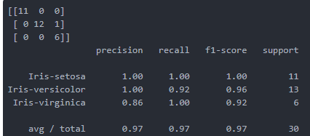
SVM(Kernels - Simple)
Implementing Kernel SVM with Scikit-Learn
Evaluating the Algorithm
The output for the kernel SVM using polynomial kernel looks like this:

Slide 28
SVM(Kernels - Simple)
Implementing Kernel SVM with Scikit-Learn
Gaussian Kernel
To use Gaussian kernel, you have to specify 'rbf' as value for the Kernel parameter of the SVC class.
svclassifier = SVC(kernel='rbf')

Slide 29
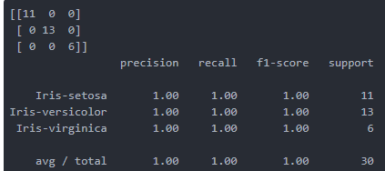
SVM(Kernels - Simple)
Implementing Kernel SVM with Scikit-Learn
Evaluating the Algorithm
The output of the Kernel SVM with Gaussian kernel looks like this:

Slide 30
SVM(Kernels - Simple)
Implementing Kernel SVM with Scikit-Learn
Sigmoid Kernel
To use sigmoid kernel, you have to specify ' sigmoid ' as value for the Kernel parameter of the SVC class.
svclassifier = SVC(kernel='sigmoid')

Slide 31
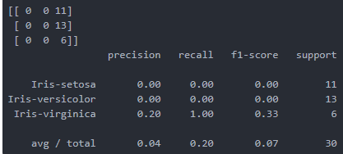
SVM(Kernels - Simple)
Implementing Kernel SVM with Scikit-Learn
Evaluating the Algorithm
The output of the Kernel SVM with Sigmoid kernel looks like this:

Slide 32
SVM(Kernels - Simple)
Implementing Kernel SVM with Scikit-Learn
Comparison of Kernel Performance
If we compare the performance of the different types of kernels we can clearly see that the sigmoid kernel performs the worst. This is due to the reason that sigmoid function returns two values, 0 and 1, therefore it is more suitable for binary classification problems. However, in our case we had three output classes.

Slide 33
SVM(Kernels - Simple)
Implementing Kernel SVM with Scikit-Learn
Comparison of Kernel Performance
Amongst the Gaussian kernel and polynomial kernel, we can see that Gaussian kernel achieved a perfect 100% prediction rate while polynomial kernel misclassified one instance. Therefore the Gaussian kernel performed slightly better. However, there is no hard and fast rule as to which kernel performs best in every scenario. It is all about testing all the kernels and selecting the one with the best results on your test dataset.

Slide 34
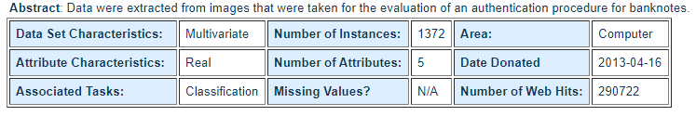
SVM(Kernels - Simple)- Results Comparison of Kernels Performance
Hints :
the dataset is banknote authentication
Kernels : Linear, Gaussian(Rbf), Polynomial, Sigmoid

Slide 35
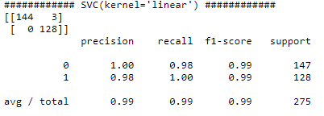
SVM(Kernels - Simple)- Results Comparison of Kernels Performance

Slide 36
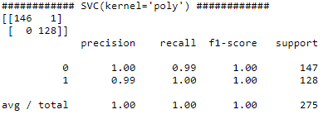
SVM(Kernels - Simple)- Results Comparison of Kernels Performance

Slide 37
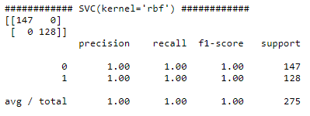
SVM(Kernels - Simple)- Results Comparison of Kernels Performance

Slide 38
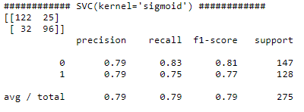
SVM(Kernels - Simple)- Results Comparison of Kernels Performance

Slide 39
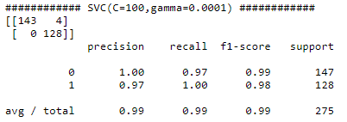
Comparison of RBF Performance with & without PCA
Without PCA

Slide 40
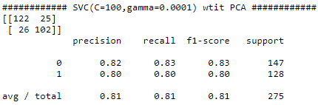
Comparison of RBF Performance with & without PCA
With PCA
4 features reduced to 2

Slide 41
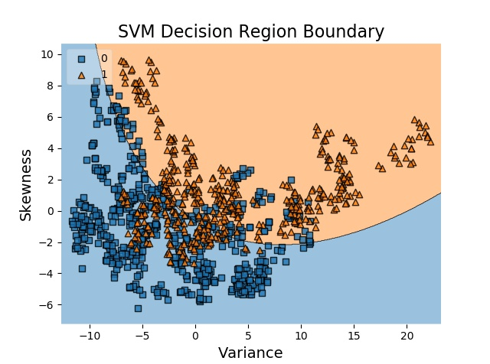
Decision Region Boundary

Slide 42
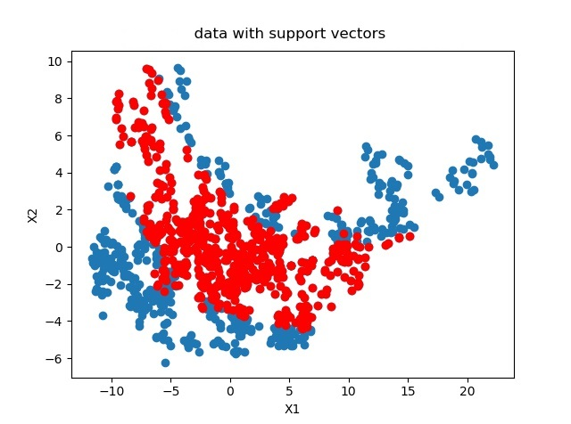
Data With Support Vectors

Slide 43
The End

