Slide 1
Softmax
Dear Professor : Mr.Manthouri
Produced By : Ghasemi,morteza
https://github.com/Morteza-Ghasemi
January 2021

Slide 2
Softmax Regression
Classification is a large domain in the field of statistics and machine learning. Generally, classification can be broken down into two areas
Binary classification, where we wish to group an outcome into one of two groups.
Multi-class classification, where we wish to group an outcome into one of multiple (more than two) groups.

Slide 3
Softmax Regression
Softmax Regression (synonyms: Multinomial Logistic, Maximum Entropy Classifier, or just Multi-class Logistic Regression) is a generalization of logistic regression that we can use for multi-class classification (under the assumption that the classes are mutually exclusive).
In contrast, we use the (standard) Logistic Regression model in binary classification tasks.
Softmax classifiers give you probabilities for each class label.

Slide 4
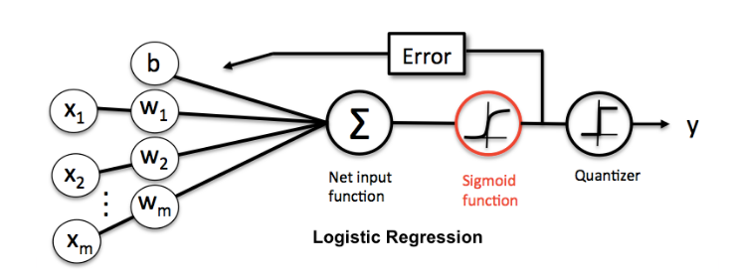
Softmax Regression

Slide 5
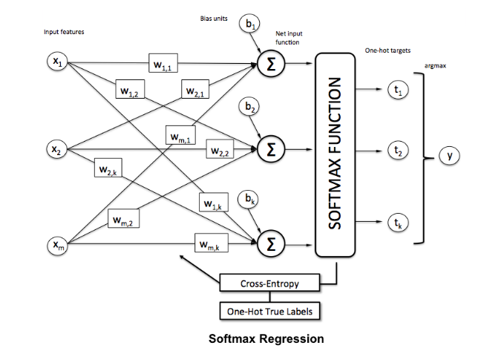
Softmax Regression

Slide 6

Softmax Regression
Implementing Softmax Regression with Scikit-Learn
Importing libraries

Slide 7
Softmax Regression
Implementing Softmax Regression with Scikit-Learn
Importing iris dataset :
from sklearn import datasets
iris = datasets.load_iris()
X = iris.data
y = iris.target

Slide 8
Softmax Regression
Implementing Softmax Regression with Scikit-Learn
Training the Algorithm
The fit method of Softmax Regression class is called to train the algorithm on the training data, which is passed as a parameter to the fit method.
from mlxtend.classifier import SoftmaxRegression
soft_regressor = SoftmaxRegression()
soft_regressor.fit(X_train, y_train)

Slide 9
Softmax Regression
Implementing Softmax Regression with Scikit-Learn
Making Predictions
To make predictions, the predict method of the Softmax Regression class is used.
y_pred = soft_regressor.predict(X_test)

Slide 10
Softmax Regression
Implementing Softmax Regression with Scikit-Learn
Evaluating the Algorithm
Confusion matrix, precision, recall, and F1 measures are the most commonly used metrics for classification tasks.
from sklearn.metrics import classification_report, confusion_matrix
print(confusion_matrix(y_test,y_pred))
print(classification_report(y_test,y_pred))

Slide 11
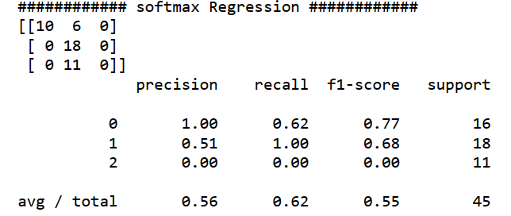
Softmax Regression
Implementing Softmax Regression with Scikit-Learn
Evaluating the Algorithm
The output of the Softmax Regression looks like this:

Slide 12
The End

