Slide 1
Table of contents:
Analysis of metrics changes in time
Conversion rate
Bounce Rate
Error Rate
Basket-Starts/Visit
Conclusion

Slide 2
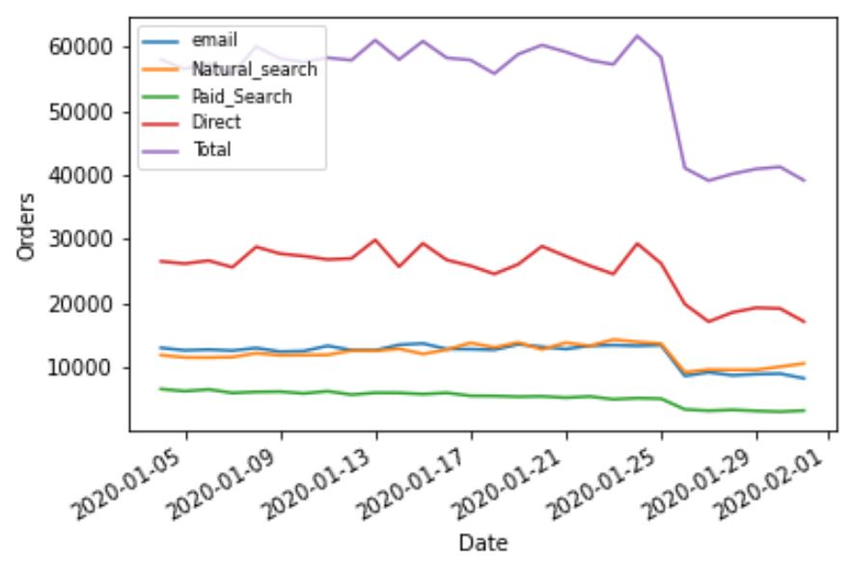
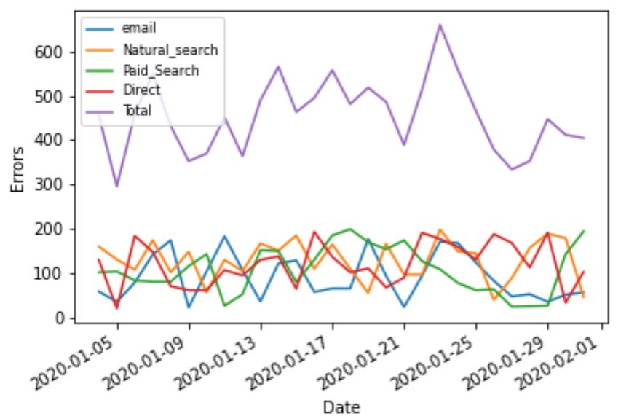
Analysis of metrics changes in time
Orders changes in time chart demonstrates a sudden decrease around the date 2020-01-24 for all metrics.
This decline is sharper for direct channel and it is less extreme for the other metrics .
Errors changes in time chart demonstrates a sudden growth around the date 2020-01-23 for all metrics except paid search.

Slide 3
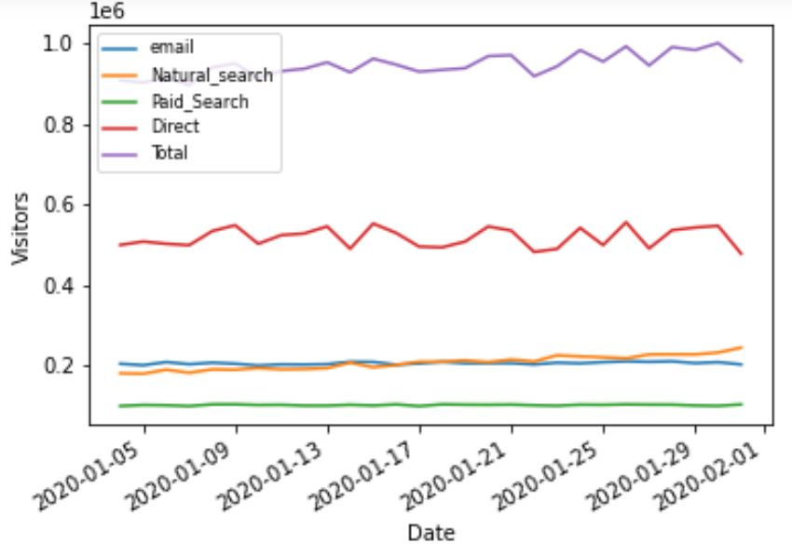
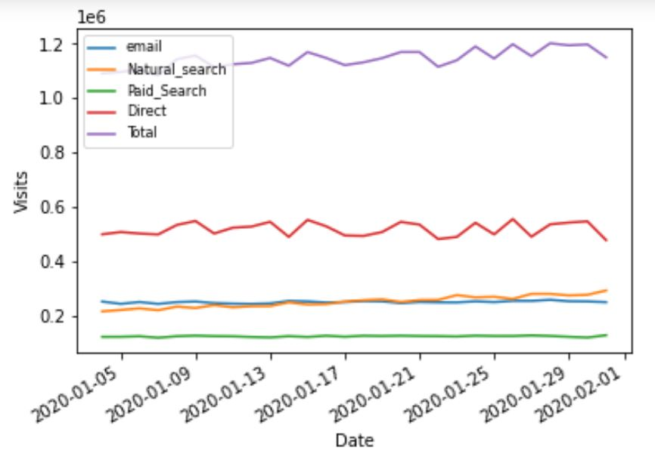
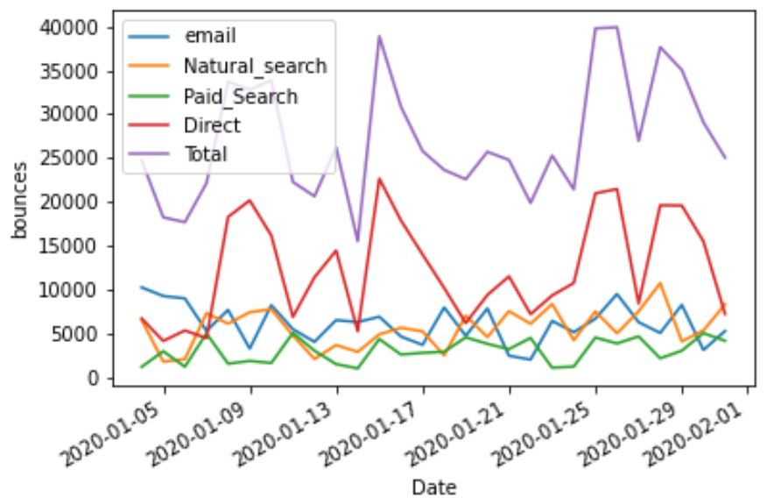
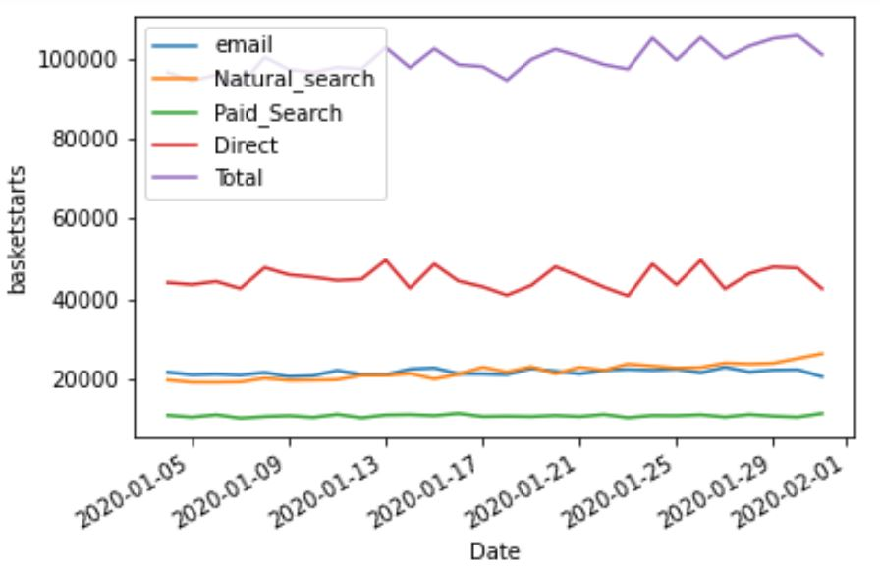
The following charts represent the changes of three factors, visitors, visits , basket-starts in time.
These charts don’t display any sudden decrease or increase.
Bounces changes around the date 2020-01-24 don’t show any abnormal variation as similar changes are seen in previous days.

Slide 4
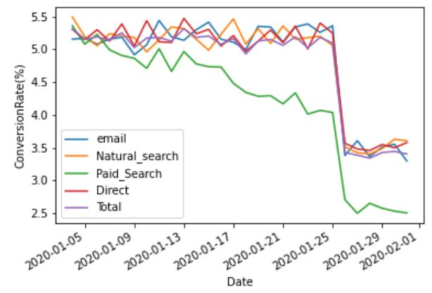
Conversion Rate:
The conversion rate is the percentage of visits that leads to orders. It is calculated by dividing the number of orders by visits.
The conversion rate for paid search has been descending.
It shows a sudden decline around the date 2020-01-26 for all metrics.

Slide 5
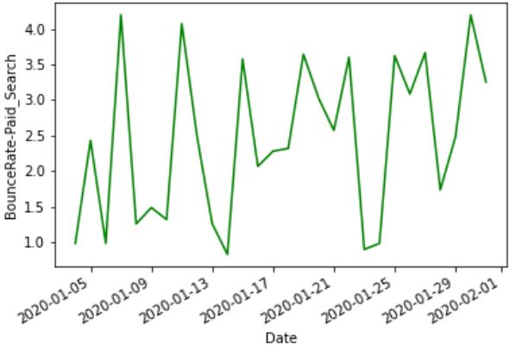
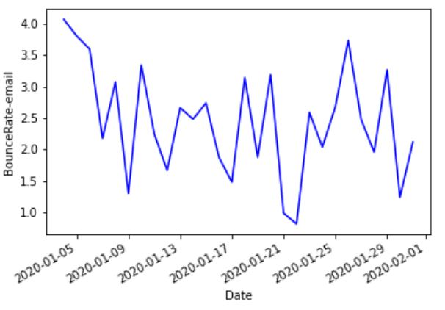
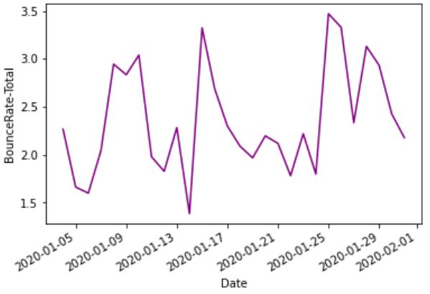
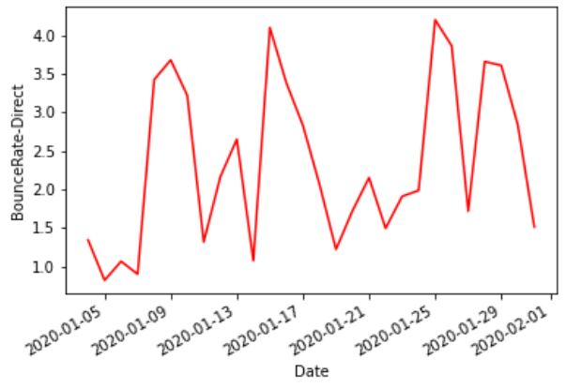
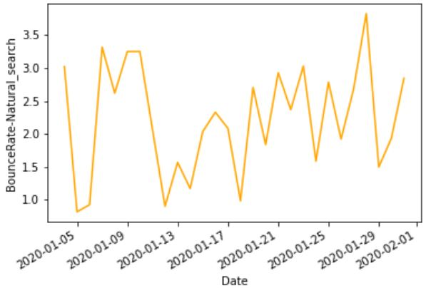
Bounce Rate:
The bounce rate represents the percentage of visitors who entering the site and then leaving rather than continuing to view other pages within the same site. It is calculated by dividing the number of bounces by visits.
High bounce rates typically indicate that the website doesn’t succeed in attracting the continued interest of visitors. In this page the bounce rate for all metrics is shown.

Slide 6
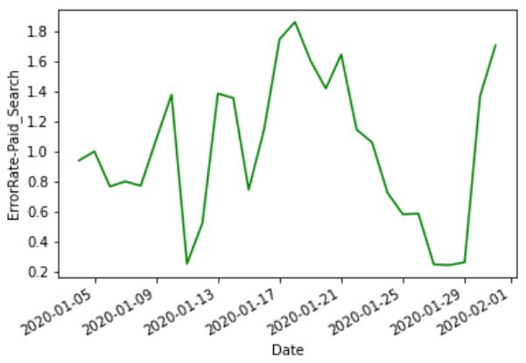
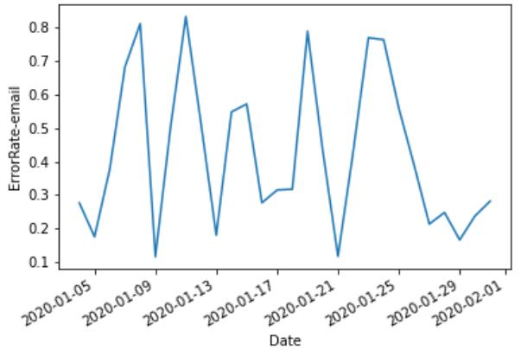
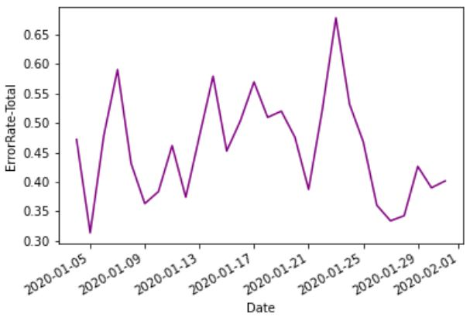
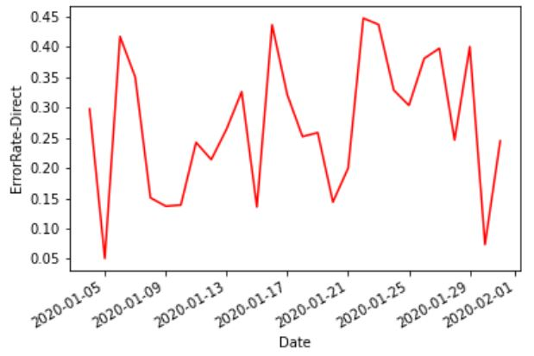
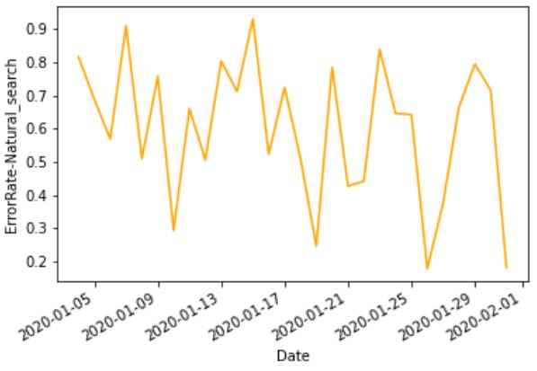
Error Rate:
Error rate is calculated by dividing the number of errors in the payment process by times a visitor has clicked "Buy" and started the payment process.
By tracking this metric the times when more errors occur are recognized. In this page the Error rate for all metrics is demonstrated.

Slide 7
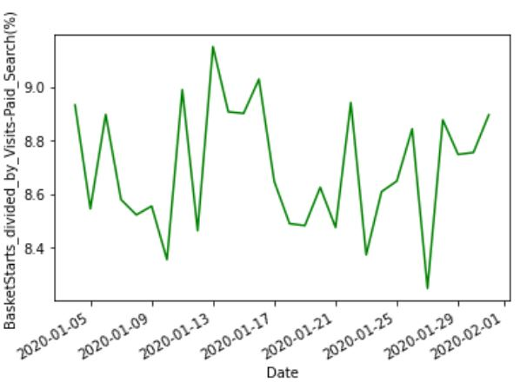
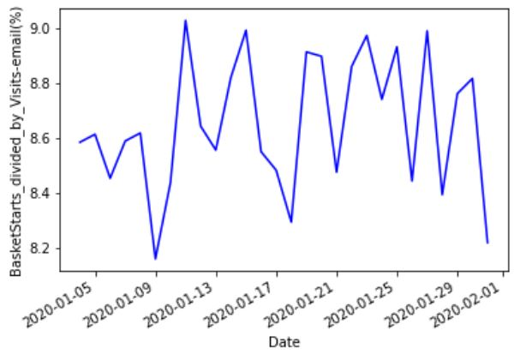
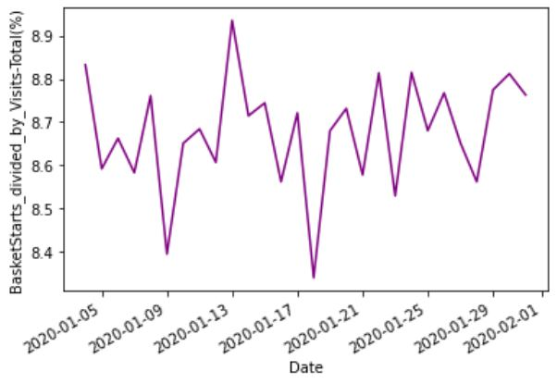
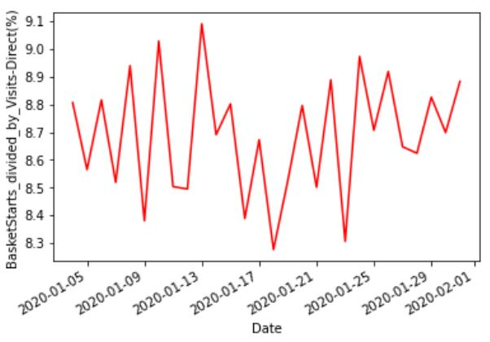
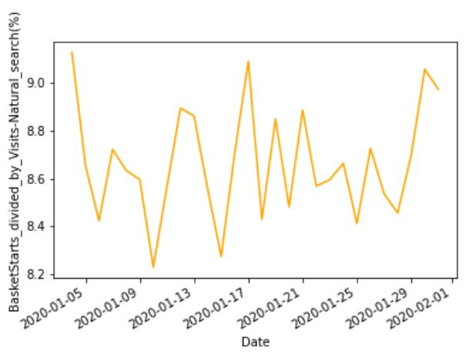
Basket-Starts/Visits:
This metric shows the percentage of visits that leads to the payment process. It’s calculated by dividing the number of basket-starts by visits.

Slide 8
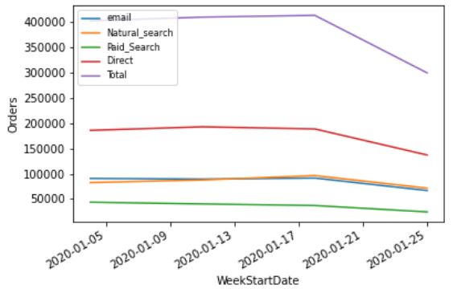
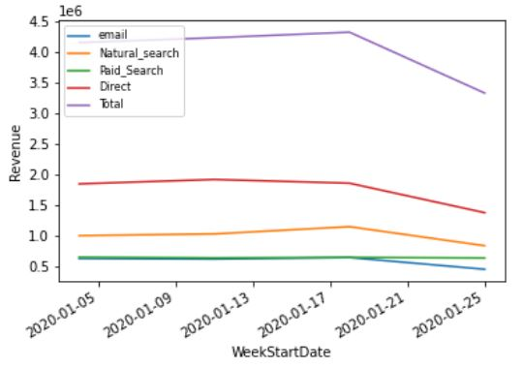
Orders and Revenue weekly changes demonstrates a sudden decrease around the date 2020-01-18 for all metrics. The date 2020-01-18 is the start day of week 4.

Slide 9
Conclusion:
The errors chart shows that the number of errors ascended the day before the number of orders started
to decline. It can be due to a malfunction in payment system of the company or service disconnection.
According to the orders chart, the total number of orders did not recover after the sharp increase in errors,
it indicates that the website lost it’s credibility for the customers.
The conversion-rate chart is descending for paid-search channel. It shows that this channel is not attracting
the potential customers and better sources for advertising should be chosen.
The average bounce rate for total channels is around 2.5%, but lower is always better.
It is recommended to focus on target market segments with the highest conversion and lowest bounce rate to help maximize the marketing spend.

