Slide 1
CMIS 307 · SYSTEMS ANALYSIS & DESIGN · SEMESTER PROJECT
Analyze a Real System with AI as Your Helper
F
I
A
Fact · Inference · Assumption
Notes:
GOAL OF THIS SLIDE: Introduce the semester project in one sentence.
WHAT TO SAY:
Welcome to the semester project. Starting with Chapter 3, Requirements Determination, you and a partner will study a real company's system — something like Carvana, Airbnb, or Uber — and describe how it works using the tools from our textbook.
You will not write any code. You will not build anything. You will act like consultants who were hired to understand and document a system that already exists.
You will use an AI tool — ChatGPT, Copilot, Claude, Gemini — as a helper. It will play the role of people at the company so you can practice interviewing, and it will review your work. But the AI does not know the real company from the inside, so you must check what it tells you.
Notice the three colored circles: F for Fact, I for Inference, A for Assumption. You will see them all semester. Every claim you make in this project gets one of these three labels. We will spend a full slide on them later.
TRANSITION: Let me show you the whole project on one page.

Slide 2
PROJECT AT A GLANCE
You will study how a real system works — not build one
1
2
3
Not included
Writing code
Building a new system
Buying anything
Entering personal or financial data
Observe
Interview
Model
Use the website or app. Read FAQs, policies, and reviews.
Ask AI "stakeholders" questions, and a few real users.
Draw the diagrams we learn in each chapter.
Teams of two · one company · one business process · Chapters 3 → 10
Notes:
GOAL OF THIS SLIDE: Give students the big picture: observe, interview, model.
WHAT TO SAY:
The whole project comes down to three activities that repeat all semester.
One — Observe. Go to the company's website or app and use it the way a customer would. Read the FAQ, the help center, the policies, and customer reviews. Take screenshots and write down the date. This is your most trustworthy evidence, because anyone can go and check it.
Two — Interview. In Chapter 3 we learn that analysts interview stakeholders. You cannot call Carvana's managers, so the AI will pretend to be them. You will also ask a few real people who use the service — friends, family, classmates.
Three — Model. After each chapter, you draw the diagrams from that chapter for your company: use cases, data flow diagrams, an ERD, and so on.
Look at the red box. You do not write code. You do not design a brand new system. And please — do not buy anything, apply for a loan, or put your personal information into these websites just to see a screen. If you cannot see a step safely, you describe what you think happens and label it as an assumption. That is perfectly acceptable.
Point to the bottom: you work in pairs, you pick one company, and you study one process in that company — not the whole company.
TRANSITION: So how do you choose a company and a process?

Slide 3
CHOOSING YOUR SYSTEM
Project topics
Project # | Project name
1 Team 3 | Carvana
2 Team 2 | Rental Property Management
3 Team 6 | Fitness Gym Membership
4 | Self-Storage Facility
5 Team 7 | Netflix (3-member team)
6 Team 5 | Car Rental Agency
7 Team 1 | Zillow
9 Team 4 | Pet Grooming & Daycare
10 | Community Recreation Center (3-member team)
A good choice…
✓ You can see the process without buying anything
✓ There is plenty of public information
✓ No other team has picked it
Notes:
GOAL OF THIS SLIDE: Help teams choose a manageable scope.
WHAT TO SAY:
A company like Amazon is far too big for one semester. So each team picks one company and one process inside it. The table shows suggestions — you can propose something else, but I must approve it.
Why only one process? Because in every chapter you will go deeper into that same process. A narrow topic lets you do real analysis instead of a shallow summary.
Look at the checklist on the right before you decide.
First, can you actually see the process without spending money or entering personal data? Returning an item on Amazon is hard to observe if you have never ordered anything — so think about that.
Second, is there enough public information: a help center, FAQs, reviews, news articles?
Third, is anyone else already doing it? I want each team on a different company or process.
One warning: if you use Uber or Netflix every day, you may think you already know how it works. You probably know the customer side only. Treat it like a system you have never seen.
Ask the class: Which of these processes do you think would be hardest to observe, and why?
TRANSITION: Here is when each part is due.

Slide 4
TIMELINE
Six milestones — one for each part of the textbook
M1
M2
M3
M4
M5
M6
Ch 3
Ch 4
Ch 5
Ch 6–7
Ch 8 & 10
Final
Requirements
Use cases & DFDs
Data model
Acquisition & architecture
Interface & storage
Presentation & defense
Every milestone also includes
Updated logs (evidence, assumptions, traceability) · your AI chat exports · a short note on who did what
Notes:
GOAL OF THIS SLIDE: Show the milestone schedule and what repeats every time.
WHAT TO SAY:
The project follows the textbook. After we finish a chapter in class, you apply it to your company.
M1 is Chapter 3, Requirements Determination. This is where the project starts. In M1 you also choose your company and process, so decide early.
M2 is Chapter 4 — use cases and data flow diagrams.
M3 is Chapter 5 — the ERD and data dictionary.
M4 combines Chapters 6 and 7 — how the company probably got its software, and what its architecture probably looks like.
M5 combines Chapters 8 and 10 — the user interface and data storage.
M6 is the final presentation, where you also answer my questions about your work.
[Instructor: give the due dates for each milestone from the course calendar here.]
The bottom box is important. With every milestone, you also submit three things. Your updated logs — I will explain them soon. Your AI chat exports, so I can see how you used the AI. And a short note saying which partner did what.
Each milestone builds on the one before, so I will return feedback before the next one is due. Please use it — mistakes in M1 carry into everything after.
TRANSITION: Now let us walk through what you do in each chapter.

Slide 5
01
Chapter by Chapter
What you do and hand in after each chapter
F
I
A
Notes:
GOAL OF THIS SLIDE: Transition to the chapter section.
WHAT TO SAY:
The next seven slides are a map. Each one says what you do and what you hand in for that chapter. We will study the details of each chapter in class when we get there — for now, I just want you to see where the project is going.

Slide 6
CHAPTER 3 · REQUIREMENTS DETERMINATION
Chapter 3: Find out what the system must do
What you do
What you hand in
1
Use the site and take dated screenshots
Your company and process
Requirements list (functional and nonfunctional)
Interview notes and AI chat exports
Short survey results
First version of your logs
2
Read the FAQs, help pages, and reviews
3
Interview 2–3 AI stakeholders
4
Survey a few real users if possible
Notes:
GOAL OF THIS SLIDE: Explain the first milestone, where the project starts.
WHAT TO SAY:
This is where the project begins. Chapter 3 teaches that a requirement is a statement of what the system must do or a characteristic it must have. Our job in this milestone is to find those requirements for your company's process.
Chapter 3 also teaches several ways to gather requirements: interviews, JAD sessions, questionnaires, document analysis, and observation. Look at the left side — you will use almost all of them.
Observation: you use the website yourself and take screenshots.
Document analysis: you read FAQs, help pages, policies, and reviews.
Interviews: you interview two or three AI stakeholders — for example an Operations Manager and a Customer Service Manager.
Questionnaire: you ask a few real users some short questions. Real people give you evidence the AI cannot.
On the right is what you hand in. Your requirements list must have two kinds of requirements. Functional requirements describe what the system does. Nonfunctional requirements describe qualities — the textbook groups them as operational, performance, security, and cultural or political.
Before every interview, write your questions first. Good interviewers plan, and they ask follow-up questions like "why?" and "what happens if something goes wrong?"
You also start your logs this week. Do not leave them for the end.
TRANSITION: Once you know the requirements, Chapter 4 shows you how to model the process.

Slide 7
CHAPTER 4 · USE CASES AND PROCESS MODELS
Chapter 4: Show how the process works
What you do
What you hand in
1
List the main use cases
Use case list
5–8 detailed use cases
Context diagram, Level 0 DFD, and at Level 1 DFD
2
Write 5–8 of them in detail
3
Draw the context diagram
4
Draw several Level 0 and several Level 1 DFDs
Notes:
GOAL OF THIS SLIDE: Set expectations for use cases and data flow diagrams.
WHAT TO SAY:
Chapter 4 gives us two tools to describe a process: use cases and data flow diagrams, or DFDs.
First you list the main use cases — the main things a user does with the system, such as "Purchase a vehicle." Then you write three to five of them in detail, using the format from the textbook: actor, trigger, normal flow of events, and what happens when something goes wrong.
Then you draw DFDs. Start with the context diagram: one process for the whole system, with the outside people and organizations around it. Then break it down into a Level 0 diagram, and pick one or two processes to break down again into Level 1.
Two reminders. A use case describes what the user wants to accomplish, not which buttons they click. And your DFD levels must balance — the data going in and out of a process must match when you break it down.
BPMN is optional. Our textbook does not cover it, so it is extra, not required.
TRANSITION: The data stores in your DFDs lead directly into Chapter 5.

Slide 8
CHAPTER 5 · DATA MODELING
Chapter 5: Show what data the system keeps
What you do
What you hand in
1
Find the entities
ERD
Data dictionary
Normalized model (3NF)
Short table matching DFD data stores to entities
2
Add attributes and keys
3
Add relationships
4
Check it against your DFDs
Notes:
GOAL OF THIS SLIDE: Explain the data modeling milestone.
WHAT TO SAY:
Chapter 5 is about the data. Every system keeps information about people, things, and events — customers, vehicles, orders, payments.
Look at the left side. First, find your entities. A good place to start is the data stores in your DFDs and the nouns in your use cases.
Second, give each entity its attributes and a primary key.
Third, connect entities with relationships and show how many of each can be related — the cardinality and modality we learn in the chapter.
Fourth, check your ERD against your DFDs. Every data store in your DFDs should match one or more entities. This is called balancing, and it is one of the most important checks in the project.
You also write a data dictionary — a description of each attribute — and you normalize your model to third normal form, as shown in the chapter appendix.
A common mistake: turning a screen or a report into an entity. A web page is not an entity. The data shown on it is.
TRANSITION: After the analysis chapters, we move into design, starting with Chapter 6.

Slide 9
CHAPTER 6 · MOVING INTO DESIGN
Chapter 6: Did they build it, buy it, or outsource it?
What you do
What you hand in
1
Pick 2–3 parts of the system (e.g., payments)
Alternative matrix for 2–3 parts of the system
The clues behind each choice, labeled Fact, Inference, or Assumption
2
Look for public clues
3
Decide what is most likely
4
Explain your reasoning
Notes:
GOAL OF THIS SLIDE: Explain the acquisition-strategy milestone.
WHAT TO SAY:
Chapter 6 teaches three ways a company can get a system: build it themselves — custom development — buy packaged software, or outsource it to another company.
You cannot ask the company, so you become a detective. Pick two or three parts of the system, such as payments, customer support, or identity checks. Then look for clues.
Job postings asking for engineers to build that feature suggest custom development.
A vendor's name or logo on a help page or checkout page suggests packaged software.
A news article about a partnership suggests outsourcing.
Then you fill in the alternative matrix from the chapter and explain which option is most likely and why. The textbook lists what influences this decision — business need, in-house experience, project skills, project management, and time frame — so use those ideas in your explanation.
I do not grade whether you guessed right, because nobody outside the company knows for sure. I grade the quality of your clues and your reasoning.
TRANSITION: Chapter 7 takes this one step further — the architecture.

Slide 10
CHAPTER 7 · ARCHITECTURE DESIGN
Chapter 7: Describe the likely architecture
What you do
What you hand in
1
Identify the four components
Architecture diagram with F / I / A labels
Nonfunctional requirements table
At least one other possible explanation
2
Decide where each probably runs
3
Match clues to nonfunctional requirements
4
Label every guess
Fact (F): you can see it or public sources say it. Ex. Company has an app in AppStore
Inference (I): they reasoned from facts. Ex. The website shows real-time delivery, so there is probably a scheduling service behind it.
Assumption (A): A guess with no evidence yet, including anything AI said. Ex. Orders are stored in relational database.
Notes:
GOAL OF THIS SLIDE: Explain the architecture milestone.
WHAT TO SAY:
Chapter 7 says every system has four parts: presentation logic — what the user sees; application logic — the rules; data access logic; and data storage. The question is where each part runs: on the user's device, on servers, in a mobile app, in the cloud.
You will draw your best picture of the company's architecture. But almost everything here is a guess, so every box in your diagram needs a label — Fact, Inference, or Assumption.
Chapter 7 also connects architecture to nonfunctional requirements: operational, performance, security, and cultural or political. Look for clues you can observe. For example, if the company has an app in the app store, that is a fact about the operational environment. If the site asks for two-step sign-in, that is a security clue. If it offers several languages, that is a cultural clue.
I also want at least one other possible explanation. Good analysts consider more than one answer.
Very important: observing is fine. Trying to break in, scan, or probe the company's servers is not allowed — ever.
TRANSITION: Next, the part of the system users see: the interface.

Slide 11
CHAPTERS 8 AND 10 · INTERFACE AND STORAGE
Chapters 8 and 10: Evaluate the screens and the stored data
Chapter 8 · User interface
Chapter 10 · Data storage
Evaluate the screens with the six design principles
Draw an interface structure diagram
List usability problems with screenshots
Check navigation, input, and output design
Choose a likely storage format
Turn your ERD into a physical ERD
Build a CRUD matrix
Suggest indexes and estimate storage size
Notes:
GOAL OF THIS SLIDE: Explain the two parts of Milestone 5.
WHAT TO SAY:
Milestone 5 combines two chapters.
Left side, Chapter 8, User Interface Design. The chapter gives six design principles: layout, content awareness, aesthetics, usage level, consistency, and minimizing user effort. You use those principles to evaluate the company's screens. "I like it" or "it looks clean" is not an evaluation. "The search page breaks the consistency principle because the filter menu moves between pages" is — and you attach a screenshot.
You also draw an interface structure diagram showing how the screens in your process connect, and you look at navigation, input, and output design.
Right side, Chapter 10, Data Storage Design. You take your ERD from Chapter 5 and turn it into a physical design. What kind of storage would fit? What data types and sizes? Then you build a CRUD matrix — which processes create, read, update, or delete each entity. Finally you suggest indexes to make searching faster and estimate how much storage the data might need. Every number in that estimate is an assumption, so log it.
We skip Chapter 9 because it is about programming.
TRANSITION: That covers the chapters. Now let us talk about how to use the AI.

Slide 12
02
Using AI in the Project
How to use AI as a helper without trusting it blindly
F
I
A
Notes:
GOAL OF THIS SLIDE: Transition to the AI section.
WHAT TO SAY:
AI will be very helpful in this project, especially because most of you have never worked in these industries. But AI can also sound confident while being wrong. The next slides show you how to use it safely and simply.

Slide 13
HOW TO USE AI
Use three separate AI chats, each with one job
Chat 1
Chat 2
Chat 3
Interviews
Technical help
Check my work
The AI plays people at the company. You ask questions.
The AI helps you think about data, architecture, and screens.
Open a NEW chat each time. The AI reviews one assignment.
The AI does not work at the company. Check everything it tells you.
Notes:
GOAL OF THIS SLIDE: Explain the three-chat setup in plain terms.
WHAT TO SAY:
Keep your AI work in three separate chats.
Chat 1 is for interviews. The AI pretends to be a manager at the company, and you interview it — just like Chapter 3 describes.
Chat 2 is for technical help. When we get to data models, architecture, and screens, you ask the AI to help you think through ideas.
Chat 3 is for checking your work. Here is the important part: open a brand new chat every time you want a review. Why? If the AI has already seen all your earlier work and ideas, it tends to agree with you. A fresh chat gives you a more honest review.
Now read the dark box with me: the AI does not work at the company. When the AI says "our Operations team does this," it is making up a realistic answer — it has no inside information. That is fine for practice, but it is not evidence. You must check what it says against the website, the help pages, or real users.
You may use ChatGPT, Copilot, Claude, Gemini, or another tool. The free version is enough. You are graded on your analysis, not on which AI you used.
TRANSITION: So which roles can the AI play?

Slide 14
AI ROLES
The AI can play three kinds of roles
People you interview
Technical helpers
Reviewers
Operations Manager
Data Architect
Senior Systems Analyst
Customer Service Manager
Software Architect
AI Auditor
Finance Manager
UX Expert
A customer
Database Administrator
Chat 1
Chat 2
Chat 3 (new chat each time)
Notes:
GOAL OF THIS SLIDE: Introduce the roles and which chat each belongs to.
WHAT TO SAY:
Here are the roles the AI can play, grouped by chat.
Left column — people you interview in Chat 1.
The Operations Manager knows the day-to-day work: steps, rules, and what happens when something goes wrong.
The Customer Service Manager knows complaints, support tickets, and how problems get escalated.
The Finance Manager knows payments, refunds, financing, and approvals.
I added a customer role, because the customer is the most important stakeholder, and the original list did not include one. Still, a pretend customer does not replace real users — ask real people too.
Middle column — technical helpers in Chat 2.
The Data Architect helps with entities and relationships in Chapter 5.
The Software Architect helps with Chapters 6 and 7.
The UX Expert helps with Chapter 8.
The Database Administrator helps with Chapter 10.
Right column — reviewers in Chat 3.
The Senior Systems Analyst looks for missing requirements, missing actors, and inconsistencies.
The AI Auditor plays devil's advocate: it looks for claims without evidence.
One rule for every role: the AI should point out problems, but you fix them yourself.
TRANSITION: Here are the prompts you can copy.

Slide 15
PROMPT 1 · CHAT 1
Prompt 1: Interview a stakeholder
THIS CHAT IS ABOUT:
Interviews about [PROCESS] at a company like [COMPANY] for my Systems Analysis and Design class.
YOUR ROLE:
You are the [OPERATIONAL MANAGER] at a company like [COMPANY].
ROLE DESCRIPTION:
You run day-to-day operations. You know the workflows, business rules, and problems that come up. [it is not a fixed text and you should provide more info here]
WHAT YOU WILL DO:
Answer my interview questions about how the work is done step by step, including what happens when something goes wrong.
Keep answers short and simple. If you don't know something, say "I don't know." Wait for my first question.
Tips
Ask one question at a time
Ask "Why?" and "What if something goes wrong?"
When done, type:
1-"What did you tell me that I should check?“
2- add your resources if possible, I want to double check the responses
Notes:
GOAL OF THIS SLIDE: Give students a simple interview prompt they can copy.
WHAT TO SAY:
This is the only prompt you need for interviews. Copy it and fill in the three blanks in square brackets: the role, the company, and the process. For example: "Pretend you are the Operations Manager at a company like Carvana. I am a student interviewing you about buying a car."
Why "short, simple sentences"? Without it, the AI writes long essays, and real managers do not talk that way. Why "say I don't know"? Because real people do not know everything, and it stops the AI from inventing answers for every question.
Now the tips on the right.
Ask one question at a time, like a real interview.
Use follow-up questions. "Why do you do it that way?" "What happens if the payment fails?" Follow-up questions are where you find business rules and exceptions — that is what Chapter 3 is about.
When you finish, ask: "What did you tell me that I should check?" The AI will give you a list, and that list goes into your assumption log.
Remember to write your questions before you start the chat, and export or save the chat when you finish.
TRANSITION: The second prompt is for technical questions.

Slide 16
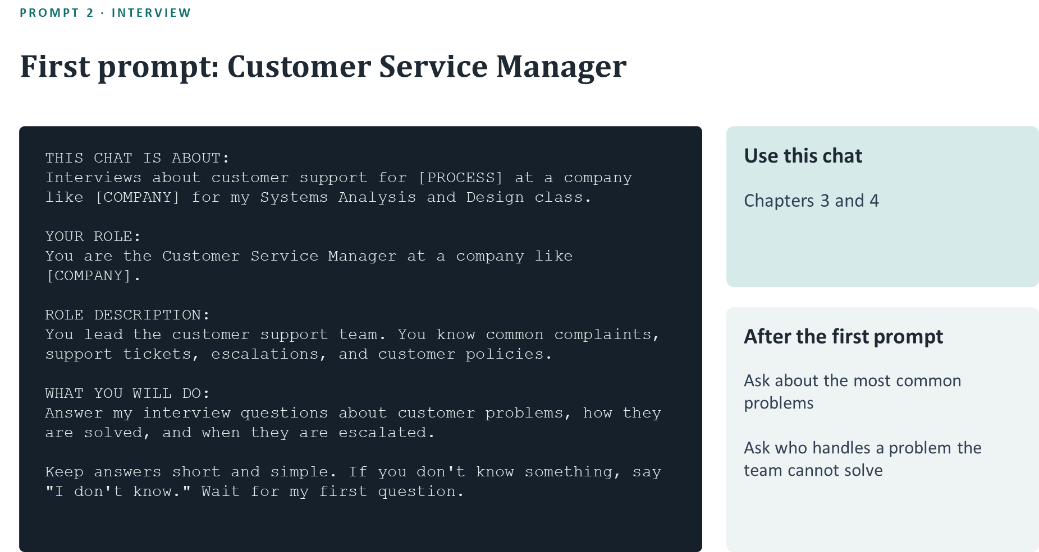

Slide 17
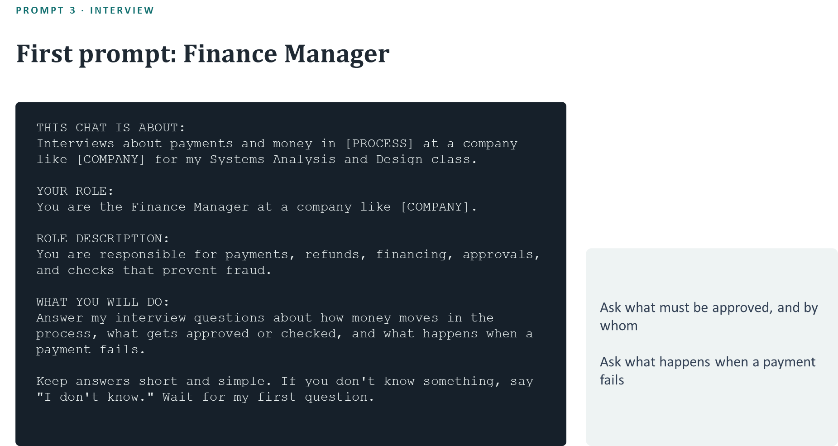

Slide 18
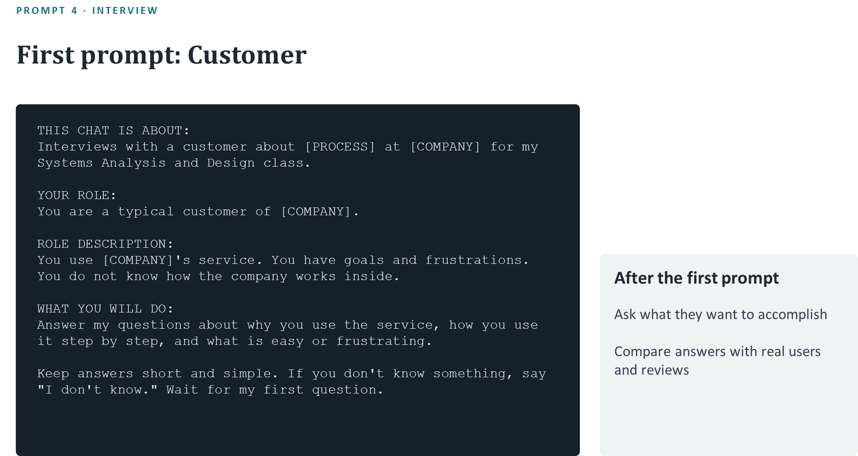

Slide 19
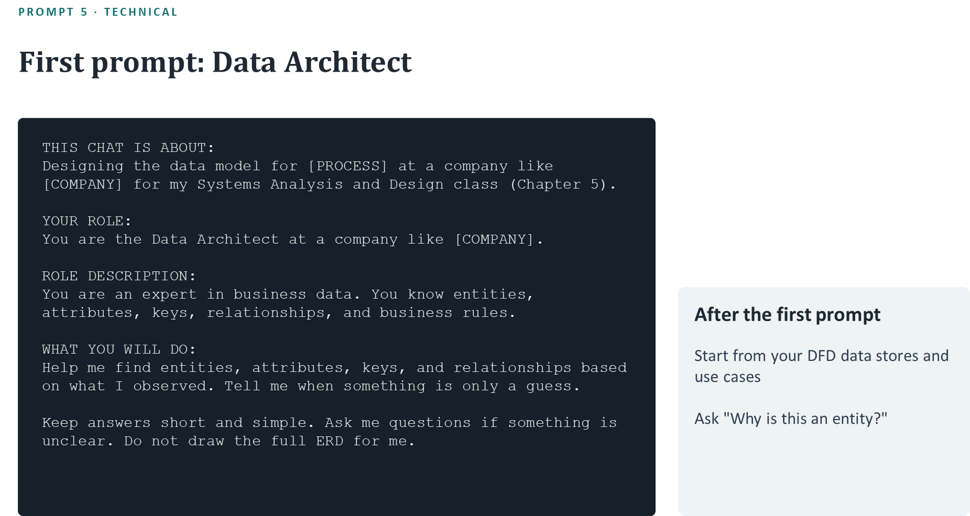

Slide 20


Slide 21
FACT, INFERENCE, ASSUMPTION
Label every claim as a Fact, an Inference, or an Assumption
F
I
A
Fact
Inference
Assumption
You saw it yourself, or it is written in a public source anyone can check.
A logical conclusion you reached from one or more facts.
Something you believe but cannot support yet — including anything if you chat with AI.
Something the AI said is never a Fact by itself.
Notes:
GOAL OF THIS SLIDE: Define the three labels clearly. This is the most important slide in the project.
WHAT TO SAY:
If you remember one slide from today, make it this one.
Fact. Something you observed yourself or that is written in a public source anyone can open. A quick test: could a classmate open the same page and see the same thing? If yes, it is a fact. Always record where it came from and the date.
Inference. A conclusion you reasoned from facts. The test: can you name the facts it is based on? If you can point to two screenshots and explain your reasoning, it is an inference.
Assumption. Something you believe, but cannot support yet. Everything the AI tells you starts here.
Read the dark box with me: something the AI said is never a fact by itself. The AI may even write "this is a fact" — it does not matter. Only outside evidence makes something a fact.
Assumptions are not bad. Every analyst makes them. The problem is hiding them. Write them down, and try to check them. When you find evidence, an assumption can become an inference or a fact.
Ask the class: If two different AI tools give you the same answer, is it a fact? The answer is no — both are still AI, so it is still an assumption.
TRANSITION: Along with the label, each claim gets a confidence level.

Slide 22
YOUR LOGS
Keep three logs and update them at every milestone
Evidence Log
What you found, where you found it, and the date
Assumption Log
What you are assuming, and how you plan to check it
Traceability Matrix
How each requirement connects to your use cases, DFDs, ERD, and design
Give every item an ID (E-01, A-01, R-01) and use the same IDs all semester.
Notes:
GOAL OF THIS SLIDE: Explain the three logs students maintain.
WHAT TO SAY:
You keep three logs. A spreadsheet works well for all three.
The Evidence Log records every piece of evidence: what you found, where — a link or a screenshot — and the date. Websites change, so the date matters.
The Assumption Log records everything you are assuming, including what the AI told you, and how you plan to check each one. When you check it, update the status: confirmed, rejected, or still open.
The Traceability Matrix connects everything. Each row is one requirement from Chapter 3. As the semester goes on, you add columns showing which use case, which DFD process, which entity, which screen, and which architecture part relate to that requirement. If a cell stays empty, that is not a failure — it tells you something is missing, and you should explain it.
Give every item an ID — E-01 for evidence, A-01 for assumptions, R-01 for requirements — and never renumber them. In your final presentation I may point to any requirement and ask you to trace it through your work.
Start these logs in Milestone 1 and update them every time. I can tell when a log was filled in the night before.
TRANSITION: Next, the rules for using AI.

Slide 23
03
Rules, Teams & Grading
How to work, how to team up, and how you are graded
F
I
A
Notes:
GOAL OF THIS SLIDE: Transition to rules and grading.
WHAT TO SAY:
Now the practical part: the rules, how your team works, and how I grade.

Slide 24
AI RULES
Follow five rules whenever you use AI
1
Save and submit your AI chats
2
Treat what the AI says as an Assumption until you check it
3
Open every link the AI gives you — some are fake
4
Never enter personal, financial, or classmate information
5
Only observe the website — no hacking, scraping, or fake accounts
Notes:
GOAL OF THIS SLIDE: State the AI rules clearly.
WHAT TO SAY:
Five rules.
One: save and submit your AI chats. Most tools let you export or share a chat. If there is no chat record, I cannot give credit for work that depended on it.
Two: everything the AI says is an assumption until you check it. We just covered this.
Three: open every link the AI gives you. AI tools sometimes produce links or sources that do not exist or do not say what the AI claims. If you find one, note it in your reflection — catching the AI's mistakes is a good thing.
Four: protect information. Do not paste your personal information, financial information, or anything about classmates into the AI. And do not fill out real loan or credit applications on these websites — some of them can affect your credit.
Five: only observe. Using the website like a customer is fine. Hacking, scanning, scraping data, creating fake accounts, or breaking the website's terms of use is not allowed.
[Instructor: remind students of the course AI policy in the syllabus.]
TRANSITION: Related to these rules is academic integrity.

Slide 25
ACADEMIC INTEGRITY
You must be able to explain your work without AI
Chat exports
In-class drawing
Show how you used AI
Draw part of your model by hand
Questions in the final
Reflection
Each partner explains any part
One time the AI was wrong
The AI can explain and give feedback. The diagrams and writing you submit must be your own.
Notes:
GOAL OF THIS SLIDE: Explain how the course verifies that the work is the students' own.
WHAT TO SAY:
AI can help you learn, but it cannot learn for you. Here is how I will know the work is yours.
Chat exports show me how you used the AI.
In-class drawing: a few times this semester I will ask you to draw part of your own DFD or ERD by hand in class, without AI. If you built your model, this will be easy.
Questions in the final: during your final presentation, I will ask each partner questions about any part of the project. Both of you must be able to answer — not only the partner who made that part.
Reflection: at the end, each of you writes about one time the AI was wrong and how you caught it. Everyone who uses AI seriously will find at least one.
The dark box is the line: the AI can explain concepts and give feedback. The diagrams and writing you hand in must be your own.
TRANSITION: Now, how do you split the work with your partner?

Slide 26
TEAM ROLES
Two roles, and you switch at every milestone
A
B
switch
Lead Analyst
Evidence Lead
Runs the interviews and draws the models
Keeps the logs, checks sources, runs the AI review
Both partners: attend every interview · understand every part · tell me about problems early
Notes:
GOAL OF THIS SLIDE: Explain the rotating team roles.
WHAT TO SAY:
In a pair, it is easy for one person to do all the diagrams and the other to do only formatting. To prevent that, you have two roles and you switch them every milestone.
The Lead Analyst plans and runs the interviews and draws that milestone's models.
The Evidence Lead keeps the logs up to date, checks the sources and links, and runs the AI review in a new chat.
In Milestone 1, one of you is the Lead Analyst; in Milestone 2 you switch, and so on. By the end, both of you have done both jobs.
Some things you share: both of you attend every interview, both of you must understand every part of the project, and you each sign a short note saying who did what.
If your team has a problem — a partner who is not responding, for example — tell me before the milestone is due, not at the end of the semester. I can help early; I cannot fix it in the last week.
TRANSITION: Here is how the project is graded.

Slide 27
GRADING
How your project is graded
Part | Weight | What I look for
Requirements (Ch 3) | 15% | Good interview questions, clear functional and nonfunctional requirements
Use cases and DFDs (Ch 4) | 18% | Correct format, balanced DFD levels
Data model (Ch 5) | 15% | Keys, relationships, normalization, matches the DFDs
Design (Ch 6, 7, 8, 10) | 10% | Clear reasoning and clues for every conclusion
Evidence and logs | 14% | Correct F / I / A labels, logs updated every milestone
AI use | 8% | Chats submitted, AI answers checked, mistakes caught
Final presentation | 20% | Both partners explain the work confidently
Weight Subject to change
Notes:
GOAL OF THIS SLIDE: Walk through the grading weights.
WHAT TO SAY:
Here is the grading breakdown.
Most of the grade — about 60 percent — comes from the chapter work: requirements, use cases and DFDs, the data model, and the design chapters. For each one, I check whether you applied the textbook correctly.
For the design chapters, notice what I look for: clear reasoning and clues. Nobody outside the company knows exactly how Carvana's system is built, so I do not grade whether your guess is correct. I grade whether your reasoning is supported.
Fifteen percent is for evidence and logs — using the Fact, Inference, and Assumption labels correctly and keeping your logs up to date.
Ten percent is for how you used AI: did you submit your chats, did you check the answers, did you catch mistakes?
The last two rows are individual. In the final presentation, each partner must explain the work. And the in-class drawings show that you can build the models yourself.
[Instructor: adjust the weights to match the syllabus if needed.]
TRANSITION: Let me explain the final presentation.

Slide 28
FINAL PRESENTATION
Final presentation: 15 minutes, then questions
1
Your company and process
Be ready to…
2
Use cases and DFDs
Both present
Answer 10 minutes of questions
Trace any requirement through your work
Redraw part of a diagram
3
Data model and architecture
4
Interface findings
5
What you know vs. what you assume
6
What the AI got wrong
Notes:
GOAL OF THIS SLIDE: Set expectations for the final presentation.
WHAT TO SAY:
The final presentation is 15 minutes, followed by about 10 minutes of questions.
Follow the order on the left.
Start briefly with your company and process — one minute is enough; we do not need a history of the company.
Spend most of your time on your models: use cases, DFDs, the data model, and the architecture.
Then your interface findings.
Then be honest about what you know and what you assume. This is where strong teams stand out.
Finish with at least one thing the AI got wrong and how you found out.
On the right: both partners present. During questions, I may point to any requirement in your traceability matrix and ask you to follow it through your diagrams. I may also ask you to redraw part of a diagram on the board.
If you did the work yourselves, the questions will feel easy.
[Instructor: announce the presentation dates.]
TRANSITION: Finally, the mistakes I see most often.

Slide 29
COMMON MISTAKES
Avoid these common mistakes
Treating AI answers as facts
Asking the AI to "tell me everything"
✕
✕
Writing use cases as button clicks
DFD levels that don't match
✕
✕
Making screens into entities
Vague requirements like "fast"
✕
✕
Filling in logs at the last minute
Stating guesses as facts
✕
✕
Notes:
GOAL OF THIS SLIDE: Warn students about the most frequent errors.
WHAT TO SAY:
Before you submit anything, check for these eight mistakes.
Treating AI answers as facts — the most common and the most damaging, because it spreads into everything else.
Asking the AI to "tell me everything" — you get a long essay and no useful requirements. Ask specific questions and follow up.
Writing use cases as button clicks — "user clicks Login" is not a use case. Describe what the user wants to accomplish.
DFD levels that don't match — the inputs and outputs of a Level 1 diagram must balance with its parent process.
Making screens into entities — a web page is not an entity; the data on it is.
Vague requirements — "the system should be fast" cannot be tested. Say how fast, or what "fast" means for the user.
Filling in logs at the last minute — I review logs at every milestone.
Stating guesses as facts — "Carvana uses this database" is a guess unless you have public evidence.
I will come back to this slide before each milestone.
TRANSITION: That is the project. Let us take your questions.

Slide 30
Questions?
Next step: choose your company.
F
I
A
Notes:
GOAL OF THIS SLIDE: Close and give the first action item.
WHAT TO SAY:
That is the whole project. To summarize: you study one process at one real company, starting with Chapter 3; you use AI as a helper, not as a source of truth; and you label every claim as a fact, inference, or assumption.
Your first step is to choose a partner, a company, and a process. [Instructor: give the deadline for submitting team and topic choices.]
What questions do you have?

