Slide 1
Holland and Barrett interview
Title: Leveraging Data Science to Reduce Incomplete Online Orders
Presented by: Morteza Layegh
Email: layeghmorteza@gmail.com

Slide 2
Executive Summary for the Director
Problem Statement: Incomplete online transactions are impacting sales at Holland and Barrett.
Goal: Develop a predictive model to identify incomplete transactions and prevent revenue loss.
Approach: We analyzed 5000 digital transactions from January to March 2020 along with customer information to build a predictive model.
Outcome: Our model predicts most of the incomplete transactions (almost 70%), offering insights to improve digital sales strategy.
Impact: By reducing incomplete orders, we aim to enhance digital sales revenue.

Slide 3
Methodology
Data Collection: Gathered transaction data and customer information from January to March 2020.
Data Preparation: Merged transaction and customer data, created new features, and handled outliers.
Exploratory Data Analysis (EDA): Explored relationships between variables to understand patterns and insights.
Data Preprocessing: Split data, imputed missing values, scale data, and balanced training dataset.
Model Development: Tested multiple ML algorithms and built a predictive model to predict transaction completeness.
Model Evaluation: Assessed the model's performance using appropriate metrics and cross-validation techniques.

Slide 4
Metrics for Unbalanced Data
Approach: Given dataset imbalance, precision, recall, and F1 score are prioritized over accuracy for assessing model performance.
Accuracy: Measures the overall correctness of the model's predictions.
Precision: Indicates the proportion of correctly predicted incomplete transactions among all predicted incomplete transactions.
Recall: Measures the proportion of correctly predicted incomplete transactions among all actual incomplete transactions.
F1 Score: Harmonic mean of precision and recall, providing a balance between the two metrics.
Importance of Recall:
Recall is of particular significance as it determines our model's ability to capture incomplete transactions, crucial for prevention.

Slide 5
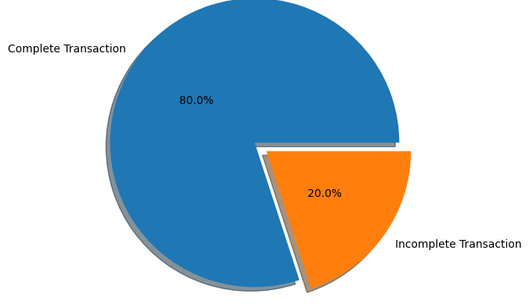
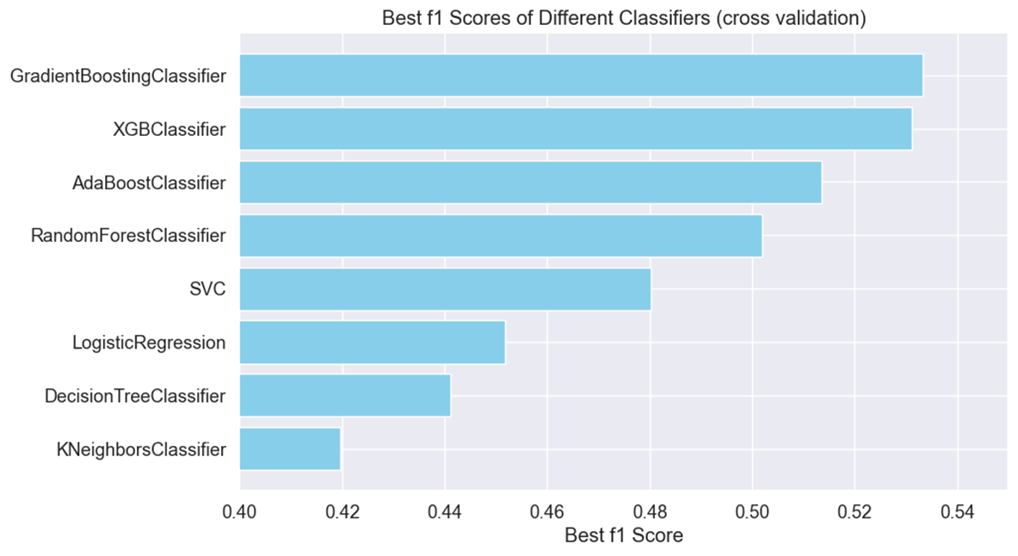
Output of the Model
Predictive Model: Our model predicts transaction completeness based on customer and transaction attributes.
Given that only 20% of the data comprises incomplete transactions, achieving a recall greater than this baseline would already signify improvement.
Results:
Precision: 0.53
Recall: 0.68
F1 Score: 0.57
Accuracy: 0.77

Slide 6
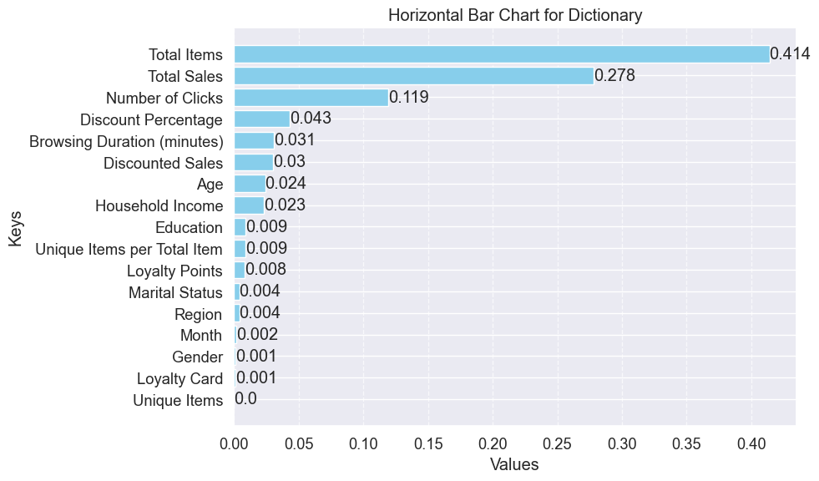
Key Features
Key Features: Identified important features influencing transaction completeness, such total items, total sales, number of clicks, discount percentages.

Slide 7

Limitation of the Model
Low precision (53%) may lead to incorrectly informing customers of incomplete transactions.
Risks customer dissatisfaction and loss of trust.
Recommend internal use for incentive strategies, avoiding direct customer notification.

Slide 8

Influence on Digital Sales Strategy and Business Actions
Proactive Measures to Prevent Incomplete Transactions:
Dynamic Offers: Provide targeted discounts or promotions based on browsing behavior and previous interactions to encourage conversion.
Enhanced Customer Support: Implement live chat support or dedicated customer service channels to assist customers facing difficulties during checkout.
Optimized Resource Allocation:
Focus Marketing Efforts: Direct marketing campaigns towards segments identified as more likely to abandon transactions, maximizing ROI.
Optimize incentives to encourage completed transactions without overspending.
Operational Efficiency: Streamline operational processes to handle incomplete transactions efficiently, minimizing delays and customer frustration.

Slide 9
Additional Data for Enhanced Analysis
Challenge :Data imbalance and similarity in distributions pose challenges.
Potential Solution: Obtaining more instances of incomplete transactions can enhance learning.
Potential Solution: Exploring additional features may provide more information for better predictions.

Slide 10
Caveats and Additional Research
Additional Research: Explore Advanced Techniques (e.g., feature engineering ,more ML algorithms, more balancing techniques, more experiments with hyperparameters)
- Customer History Analysis
External Factors: Like any prediction tool our predictor is limited to the training data. In situations where an unexpected change happens the accuracy of the model can drop (e.g., seasonal change)

