Slide 1
Holland and Barrett interview
Title: Leveraging Data Science to Reduce Incomplete Online Orders
Presented by: Morteza Layegh
Email: layeghmorteza@gmail.com

Slide 2
Executive Summary
Problem Statement: Incomplete online transactions are impacting sales at Holland and Barrett.
Goal: Develop a predictive model to identify incomplete transactions and prevent revenue loss.
Approach: We analyzed 5000 digital transactions from January to March 2020 along with customer information to build a predictive model.
Outcome: Our model predicts most of the incomplete transactions (almost 70%), offering insights to improve digital sales strategy.
Impact: By reducing incomplete orders, we aim to enhance digital sales revenue.

Slide 3
Methodology
Data Collection: Gathered transaction data and customer information from January to March 2020.
Data Preparation: Merged transaction and customer data, created new features and dropped useless data.
Exploratory Data Analysis (EDA): Explored relationships between variables to understand patterns and insights.
Data Preprocessing: Split data, imputed missing values, scale data, and balanced training dataset.
Model Development: Tested multiple ML algorithms and built a predictive model to predict transaction completeness.
Model Evaluation: Assessed the model's performance using appropriate metrics and cross-validation techniques.

Slide 4
Metrics for Unbalanced Data
Approach: Given dataset imbalance, precision, recall, and F1 score are prioritized over accuracy for assessing model performance.
Accuracy: Measures the overall correctness of the model's predictions.
Precision: Indicates the proportion of correctly predicted incomplete transactions among all predicted incomplete transactions.
Recall: Measures the proportion of correctly predicted incomplete transactions among all actual incomplete transactions.
F1 Score: Harmonic mean of precision and recall, providing a balance between the two metrics.
Importance of Recall:
Recall is of particular significance as it determines our model's ability to capture incomplete transactions, crucial for prevention.

Slide 5
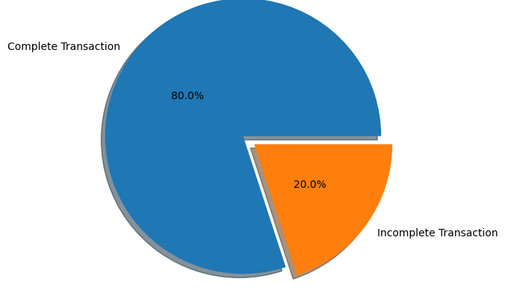
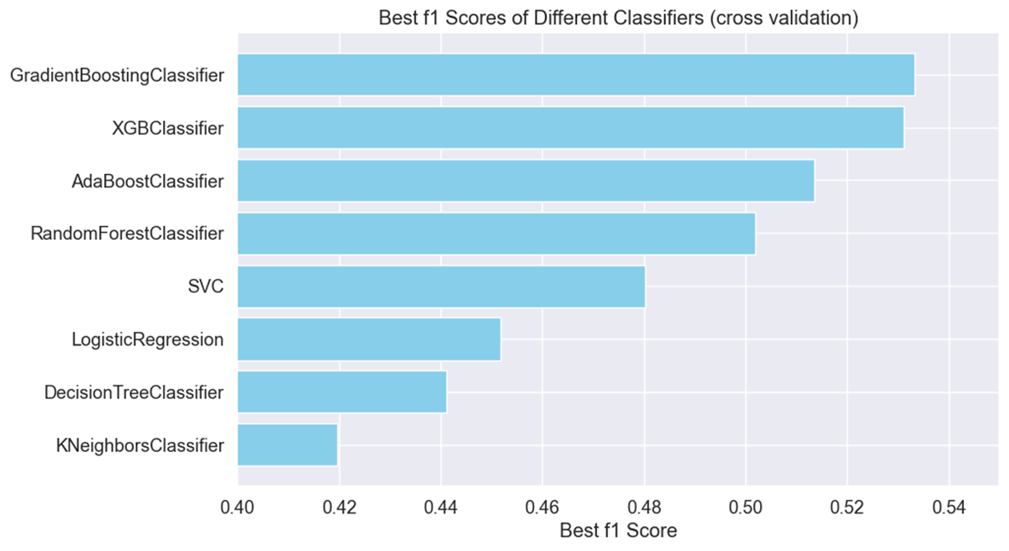
Output of the Model
Predictive Model: Our model predicts transaction completeness based on customer and transaction attributes.
Given that only 20% of the data comprises incomplete transactions, achieving a recall greater than this baseline would already signify improvement.
Results:
Precision: 0.53
Recall: 0.68
F1 Score: 0.57
Accuracy: 0.77

Slide 6
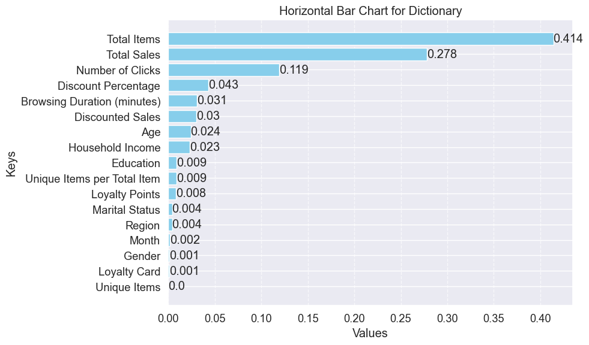
Key Features
Key Features: Identified important features influencing transaction completeness, such total items, total sales, number of clicks, discount percentages.

Slide 7

Limitation of the Model
Low precision (53%) may lead to incorrectly flagging complete transactions as incomplete (high false positives).
Could lead to unnecessary interventions or additional verification steps for complete transactions.
Recommend internal use for incentive strategies, avoiding direct customer notification.

Slide 8

Influence on Digital Sales Strategy and Business Actions
Proactive Measures to Prevent Incomplete Transactions:
Dynamic Offers: Provide targeted discounts or promotions to encourage conversion.
Enhanced Customer Support: Implement live chat support or dedicated customer service channels to assist customers facing difficulties during checkout.
Optimized Resource Allocation:
Focus Marketing Efforts: Direct marketing campaigns towards segments identified as more likely to abandon transactions, maximizing ROI.
Optimize incentives to encourage completed transactions without overspending.
Operational Efficiency: Streamline operational processes to handle incomplete transactions efficiently, minimizing delays and customer frustration.

Slide 9
Additional Data for Enhanced Analysis
Challenge :Data imbalance and similarity in distributions pose challenges.
Potential Solution: Obtaining more instances of incomplete transactions can enhance learning.
Potential Solution: Exploring additional features may provide more information for better predictions. E.g. Customer History Analysis.

Slide 10
Caveats and Additional Research
Additional Research: Explore Advanced Techniques (e.g., feature engineering ,more ML algorithms, more balancing techniques, more experiments with hyperparameters)
External Factors: Like any prediction tool our predictor is limited to the training data. In situations where an unexpected change happens the accuracy of the model can drop (e.g., seasonal change)

